Slide 1


Maintaining a Commitment to Diversity, Equity & Inclusion
March 14, 2025
Presented by:
Jachan Watkis
Director of Diversity, Equity & Inclusion

Slide 2
Goals
Review norms for engaging stakeholders in conversations regarding diversity, equity and inclusion.
Maintain awareness of the federal guidance regarding diversity, equity and inclusion
Explore legal and expert recommendations for moving forward
Discuss curricular decisions and protections

Slide 3


Setting the Stage

Slide 4

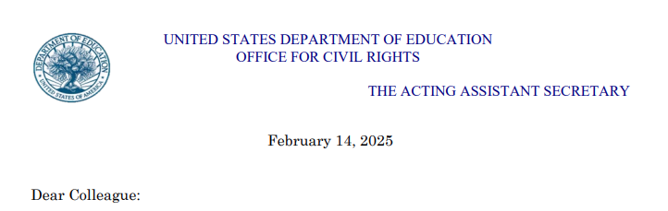





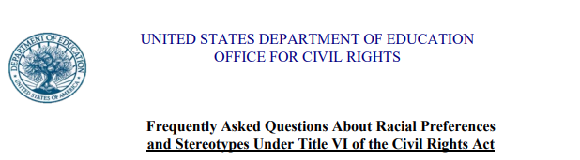
Remain Current

Slide 5

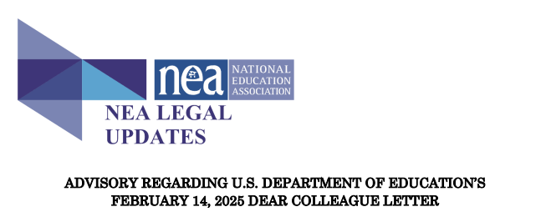
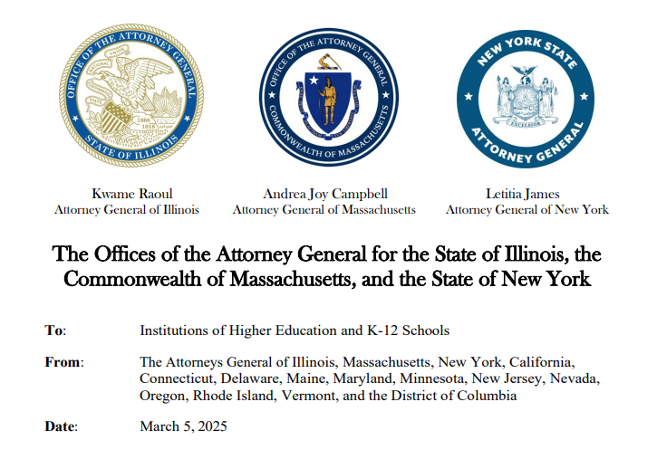
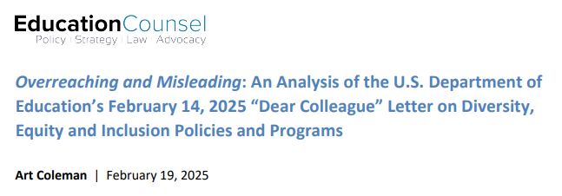
Seek Expert Advice

Slide 6
Take the advice of your legal council
Volz & Vigliotta, PLLC
“The Department’s letter does not have the force and effect of law and does not establish new legal standards. Educational institutions that fail to comply with federal civil rights law may, however, face investigation and risk losing federal funding in accordance with applicable law…While on its face, the State and Federal guidance appears to conflict with each other, they are not inherently incompatible. As such, we encourage school districts and BOCES to review their DEI policies and procedures to ensure that efforts to educate students in the areas of diversity, equity and inclusion are not implemented in such a way which provides preference to any racial groups or seeks to portray some racial groups as bearing “unique moral burdens that others do not.” Rather, in order to avoid conflict with the Department’s guidance, we recommend school districts and BOCES ensure such DEI policies and procedures promote diversity without suggesting or resulting in favoritism.”
Guercio & Guercio, LLP
“Based upon the above referenced documents, should a school district maintain a DEI or DEIA policy or program there is the potential for an investigation, a finding of a violation of the law, and penalties imposed by OCR based upon the language of the policy or the way such policy or program is implemented. Such determinations may be challenged in court. Given NYSED and the Board of Regents’ expectations of school districts and BOCES regarding the establishment of a DEI policy, we believe the board of education and its individual members would be entitled to defense and indemnification during such a challenge. However, you may wish to review and revise any policies or practices to remove any language or practices which may be found to violate the guidance issued by OCR.”

Slide 7
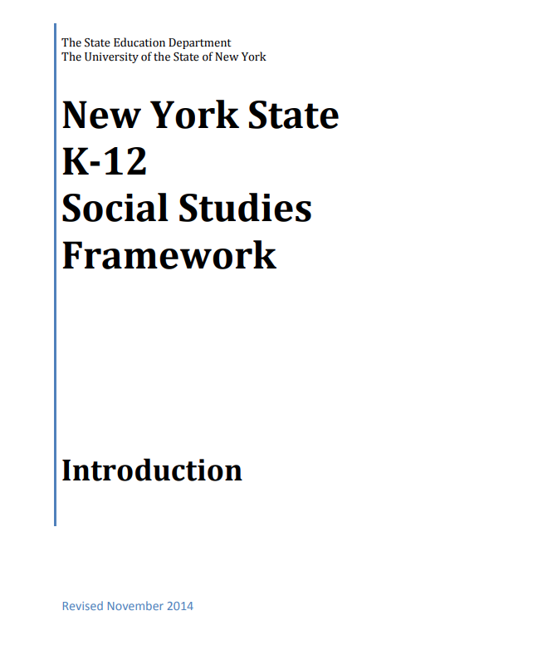

Is my curriculum a problem?
NEA Legal Update
“...the federal government has no authority to intrude upon the decisions of universities, colleges and school districts regarding what is taught, how it is taught, and what educational programming will be provided. Not only do federal education laws prohibit such interference but federal civil rights laws permit such decisions. Curriculum, instruction and programming choices that recognize, celebrate and explore the rich diversity of our country are lawful, valid and necessary to provide educational opportunity and access to all students.”
The 3 domains and 6 values of the school library program encourage and support explorations of diversity, equity and inclusion..
The ten Unifying Themes contain many elements which encourage explorations of diversity and social justice.

Slide 8


Contact
ESBOCESDEI@ESBOCES.ORG
Jachan Watkis
Director of DEI
ESBOCES Office of DEI

