Slide 1


Sachem CSD: A Journey Through our First Year of Seal of Biliteracy Implementation
Presented by:
Marie O’Doherty - Administrator for Instructional Support & Assessment - HUMANITIES
ES BOCES Curriculum Council - March 2025

Slide 2
What is the Seal of Biliteracy?
“The Seal of Biliteracy is an award that recognizes students who have attained a high level of proficiency in two or more world languages (one of which must be English) by high school
Graduation.”
The intent of the NYSSB is to:
• affirm the value of diversity in a multilingual society;
• encourage the study of languages;
• identify high school graduates with multilingualism and multiliteracy skills for employers;
• provide universities with additional information about applicants seeking admission;
• prepare students with twenty-first century skills; and
• recognize the value of world and home language instruction in schools.

Slide 3
Why should districts consider implementing the NYSSB Program??
“The NYSSB acknowledges the importance of being bilingual in today’s global society. It highlights the hard work and achievement of students, and encourages them to pursue language study while in school. The recognition of attaining biliteracy becomes part of the high school transcript and diploma for these students and is a statement of accomplishment for future employers and for college admission. The NYSSB promotes and strengthens robust English and World Language programs. In addition, the NYSSB positively contributes to the school's “College, Career, and Civic Readiness (CCCR)” score in the same way as Advanced Placement (AP) and International Baccalaureate (IB) courses and the Regents Diploma with Advanced Designation.”
Source: NYS Seal of Biliteracy website

Slide 4
What is the intent behind the NYSSB?
“ The intent of the NYSSB is to:
affirm the value of diversity in a multilingual society;
encourage the study of languages;
identify high school graduates with language and biliteracy skills for employers;
provide universities with additional information about applicants seeking admission;
prepare students with twenty-first century skills; and
recognize the value of world and home language instruction.
These goals are consistent with the Regents Reform Agenda of ensuring that all New York State students graduate college-, career-, and civic-ready.
Source: NYS Seal of Biliteracy website

Slide 5
If the SED is eliminating the Regents Diploma with Advanced Designation, will high-achieving students still be able to demonstrate their achievements?
“ Yes. While the Department intends to move to one New York State High School Diploma, districts will still be able to officially recognize students’ achievements through additional seals or endorsements on a student’s diploma.
Source: NYS Blue Ribbon Commission website

Slide 6
What is the College, Career, and Civic Readiness (CCCR) level score?
“ According to Understanding the New York State Accountability System under the Every Student Succeeds Acts (ESSA), “The College, Career, and Civic Readiness indicator uses diplomas, credentials, advanced course credits and enrollment, Career and Technical Education (CTE) certifications, and indicators such as a Seal of Biliteracy or participation in a Smart Scholars program to determine how a school is preparing its students to be ready for college, a career, and civic engagement once the students leave the school. For each accountability subgroup, a CCCR Index, which ranges from 0 to 200, is calculated by awarding extra credit for students who demonstrate higher levels of readiness as well as partial credit for students who complete a High School Equivalency certificate. The formula for computing the CCCR Index is as follows:
Denominator: The number of students in the 4-year cohort as of June 30th of the reporting year + the number of ELL students not in the 4-year cohort who earned a Regents diploma with a Seal of Biliteracy in the current reporting year.
Numerator: The sum of the number of students in the denominator demonstrating success on each of the specific readiness measures multiplied by the weighting assigned to each of these measures in accordance with the table below. Note that students receiving a High School Equivalency (HSE) diploma in the reporting year are included in the numerator but not the denominator.
Source: NYS Blue Ribbon Commission website

Slide 7
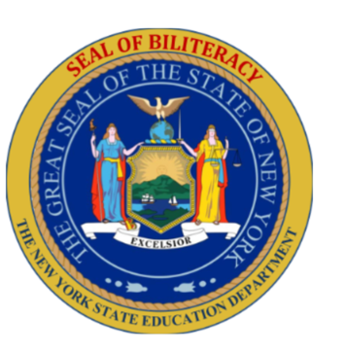

A Look at Sachem’s Timeline
2021-2022
2022-2023
2025-2026
2017
NYS Introduces Seal of Biliteracy
Sachem graduates first Seal of Civic Readiness students
Sachem hopes to graduate our first Seal of Biliteracy student cohort
NYS introduces Seal of Civic Readiness Pilot districts

Slide 8
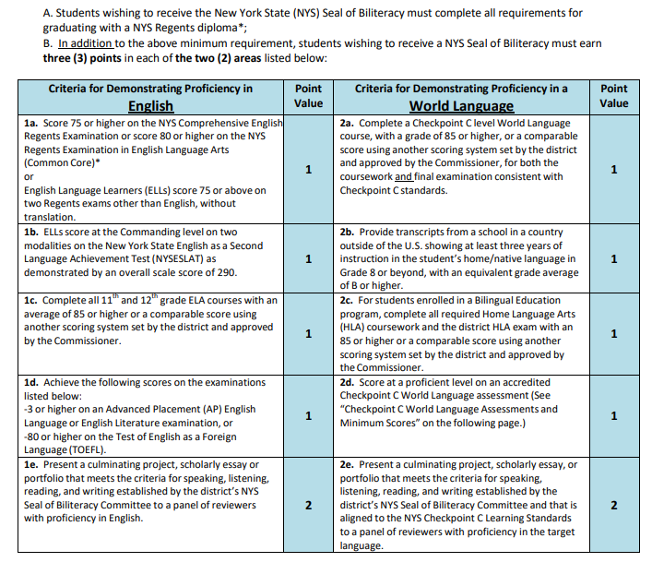
What is Required to Earn the NYS Seal of Biliteracy?
Students need 3 points in both categories!

Slide 9
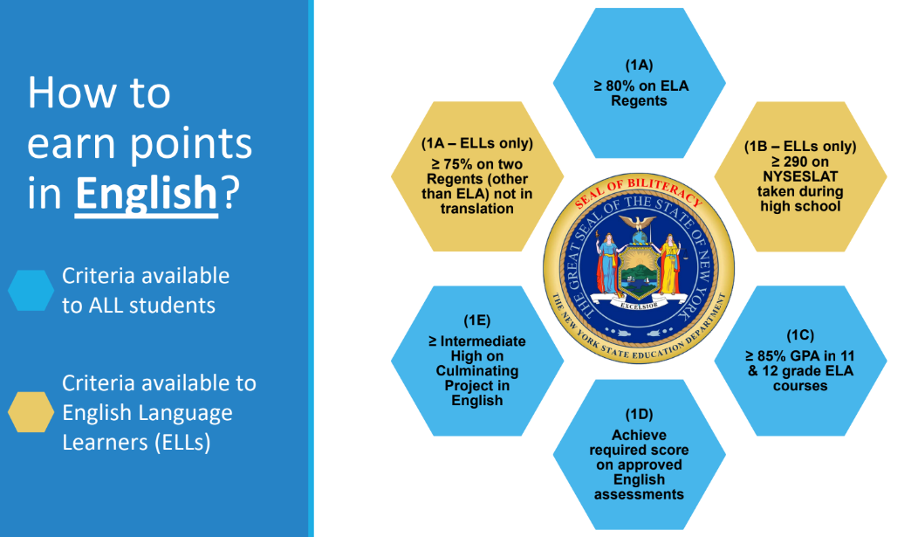
How to Earn Points in English

Slide 10
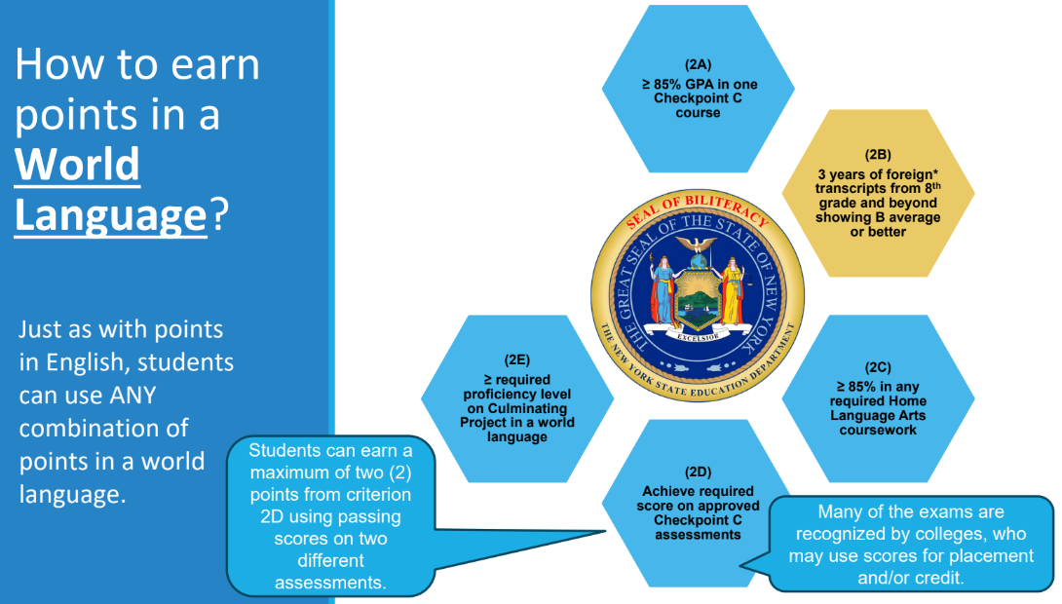
How to Earn Points in WORLD LANGUAGE

Slide 11
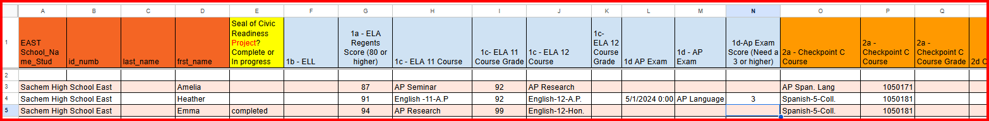
Steps We Took in Sachem…
Step #1 - Submit the Application and Establish Your Committee
Step #2 – Using SMS, run Excel spreadsheet identifying current seniors from both high schools…
ELA Regents Exam score (80 higher)
ELA 11 Course and Grade
ELL status
ELA 12 Course & Grade
Any previous AP Lang exams 7 scores (3 plus)
PLUS…
1) Checkpoint C courses
2) Checkpoint C grades & scores
THEN…
Seal of Civic Readiness Project complete or AP Research?

Slide 12
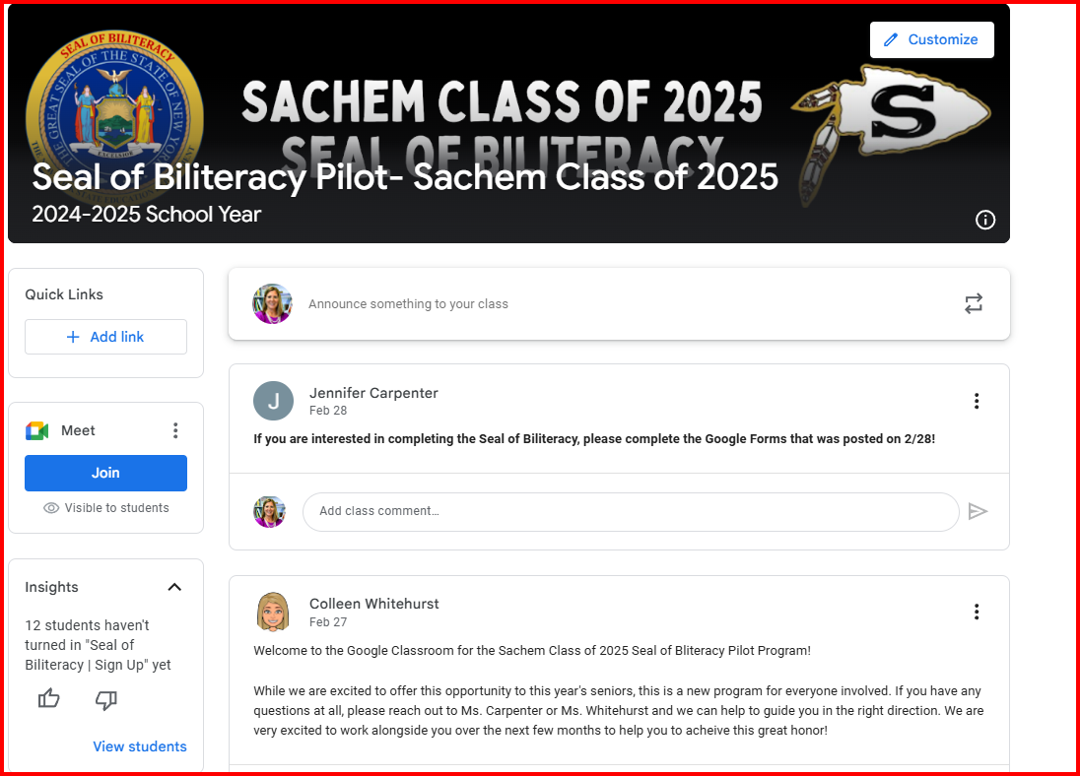
Steps We Took in Sachem…
Step #3 - Find Great School Administration Interns!
Step #4 - Set up informational Google Classrooms for Students and Parents

Slide 13
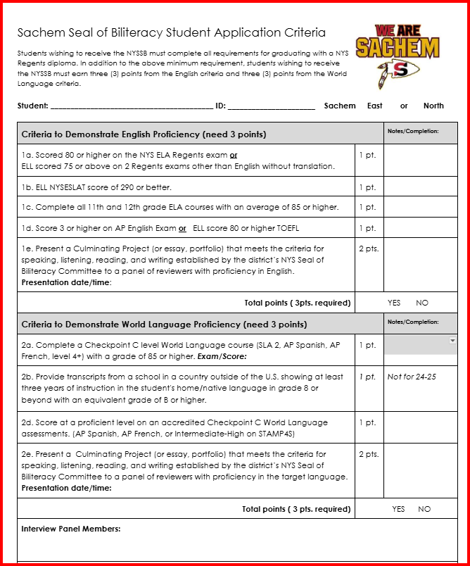
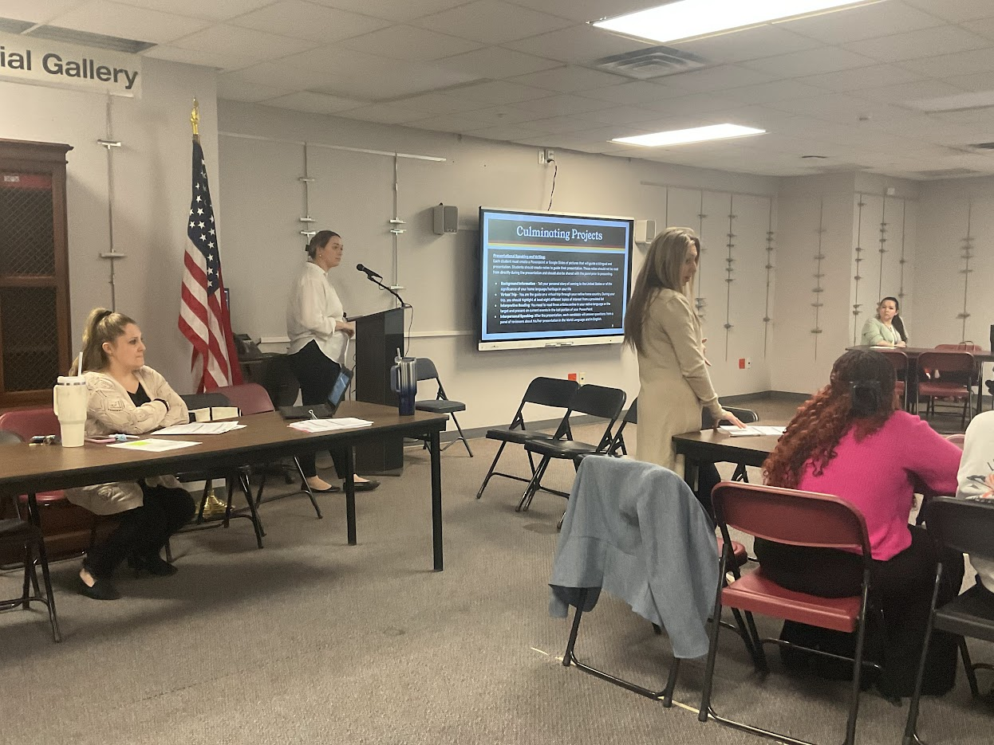
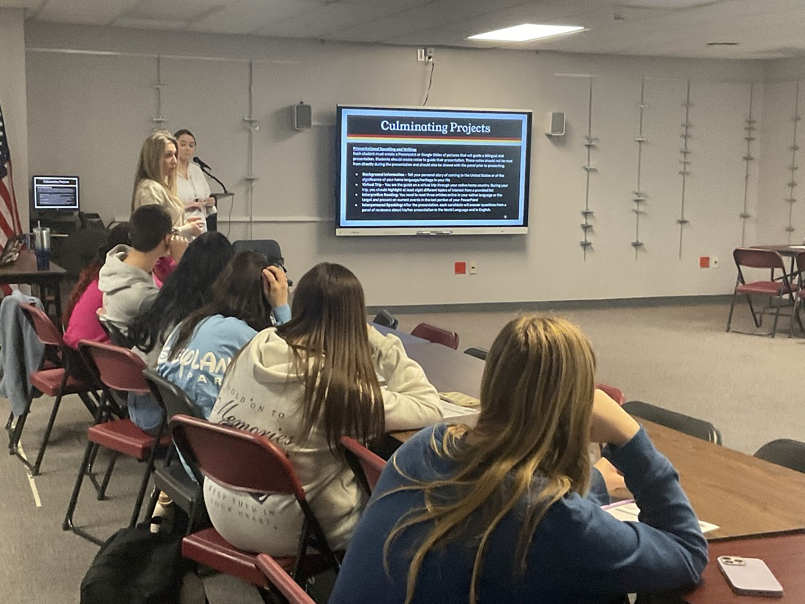
Steps We Took in Sachem…
Step #5 - Host Student Information Sessions at Both High Schools

Slide 14
Steps We Took in Sachem…
Step #5 - From Those Seniors That are Prepared to Move Forward, Set Up Panel Interviews and Provide Support
Next Steps~
~Meet with Department Chairs raise awareness and also to embed more projects, portfolios and essays into the curriculum for 25-26
~Raise awareness for the SBL & Blue Ribbon Commission for both students and families earlier (Curriculum Nights, Guidance Handbook, Curriculum Guides, BOE presentations, website. etc.)
~Develop a multi-faceted plan to include more ELL students (transcripts, embedded projects, advisory meeting, Parent Zooms with translators, etc.

