Slide 1

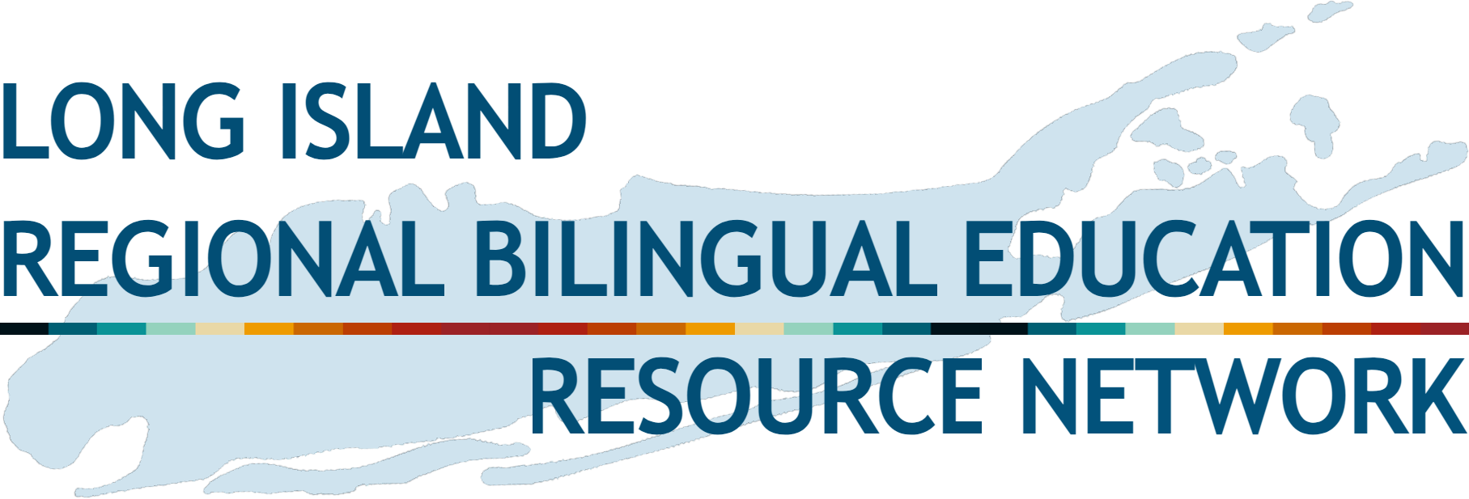
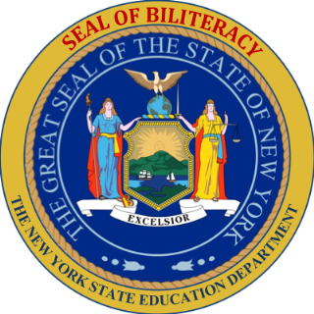

NYS Seal of Biliteracy on Long Island and Support
Dr. Jordan González
Administrative Coordinator
Long Island RBERN, ENL & Bilingual Programs

Slide 2
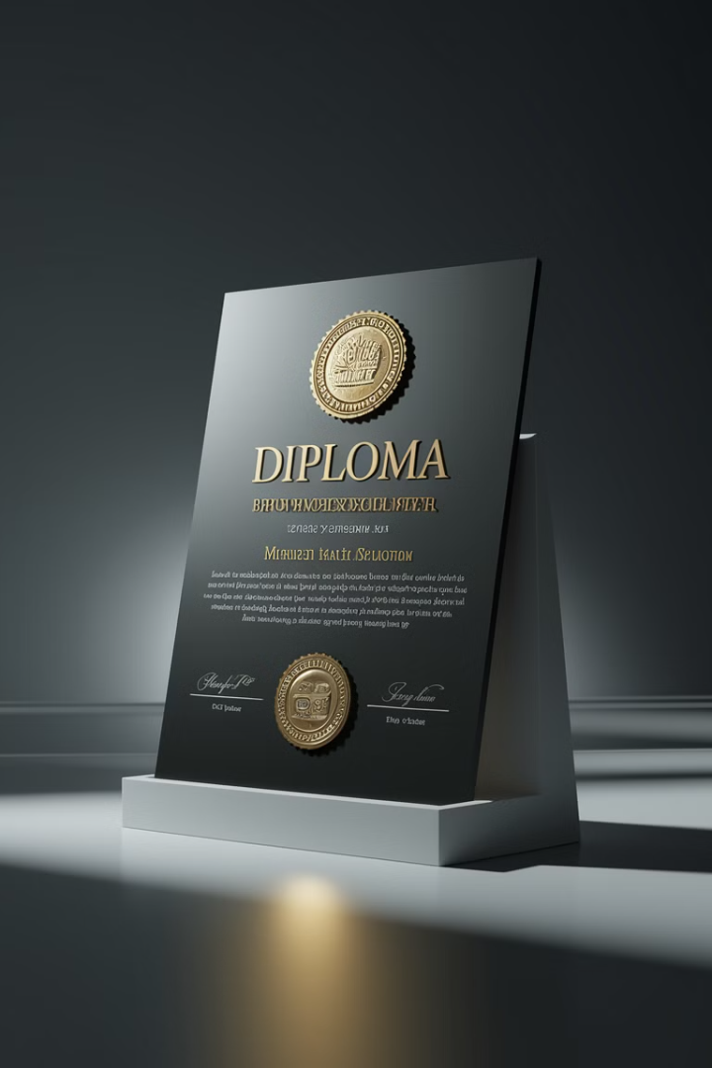
What is the NYSSB?
1
Recognition
2
Eligibility
Acknowledges multilingualism and multiliteracy skills in today's global society.
Available to students from public, charter, and private schools.
3
Requirements
Proficiency in two or more languages, one being English.
Notes:
The New York State Seal of Biliteracy recognizes students who have attained a high level of proficiency in two or more world languages by high school graduation.

Slide 3





Intent of the NYSSB
Affirm Diversity
Recognize the value of diversity in a multilingual society.
Value Language Instruction
Recognize the value of world and home language instruction in schools.
Identify Skills
Highlight graduates with multilingual abilities for employers
and universities
Prepare for Future
Equip students with twenty-first century skills.

Slide 4
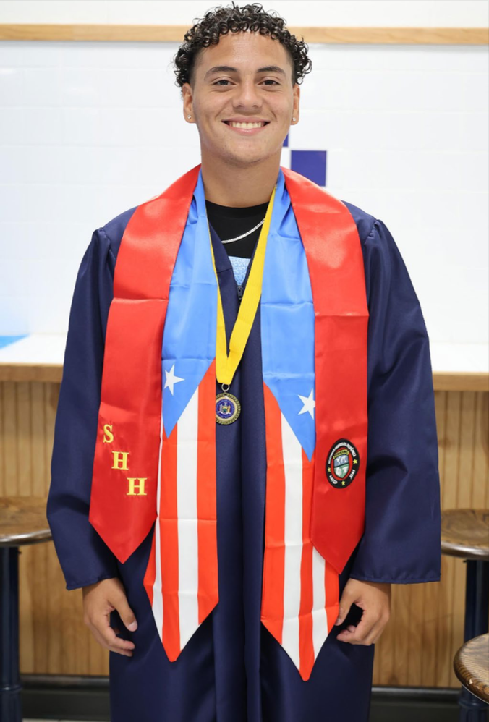
Let’s start with the “why”...
A multilingual and multiliterate population has the
potential to:
enhance academic achievement;
advantage intercultural competences;
boost economic competitiveness;
improve intergroup relations; and
leverage inequities in societies.

Slide 5
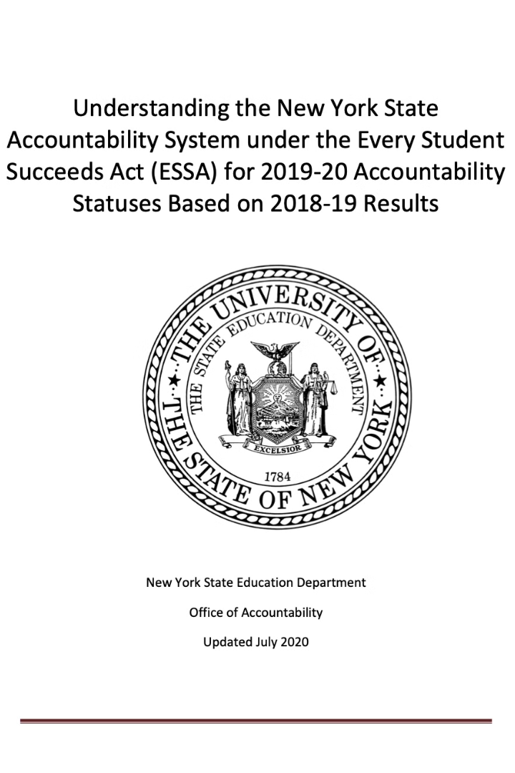
Academic Value
Highest Weight
Equivalent Value
Carries the highest weight on a school's "Readiness Measures."
On par with Regents Diploma with Advanced Designation.
Additional Recognition
Equal to Advanced Placement (AP) & International Baccalaureate IB

Slide 6
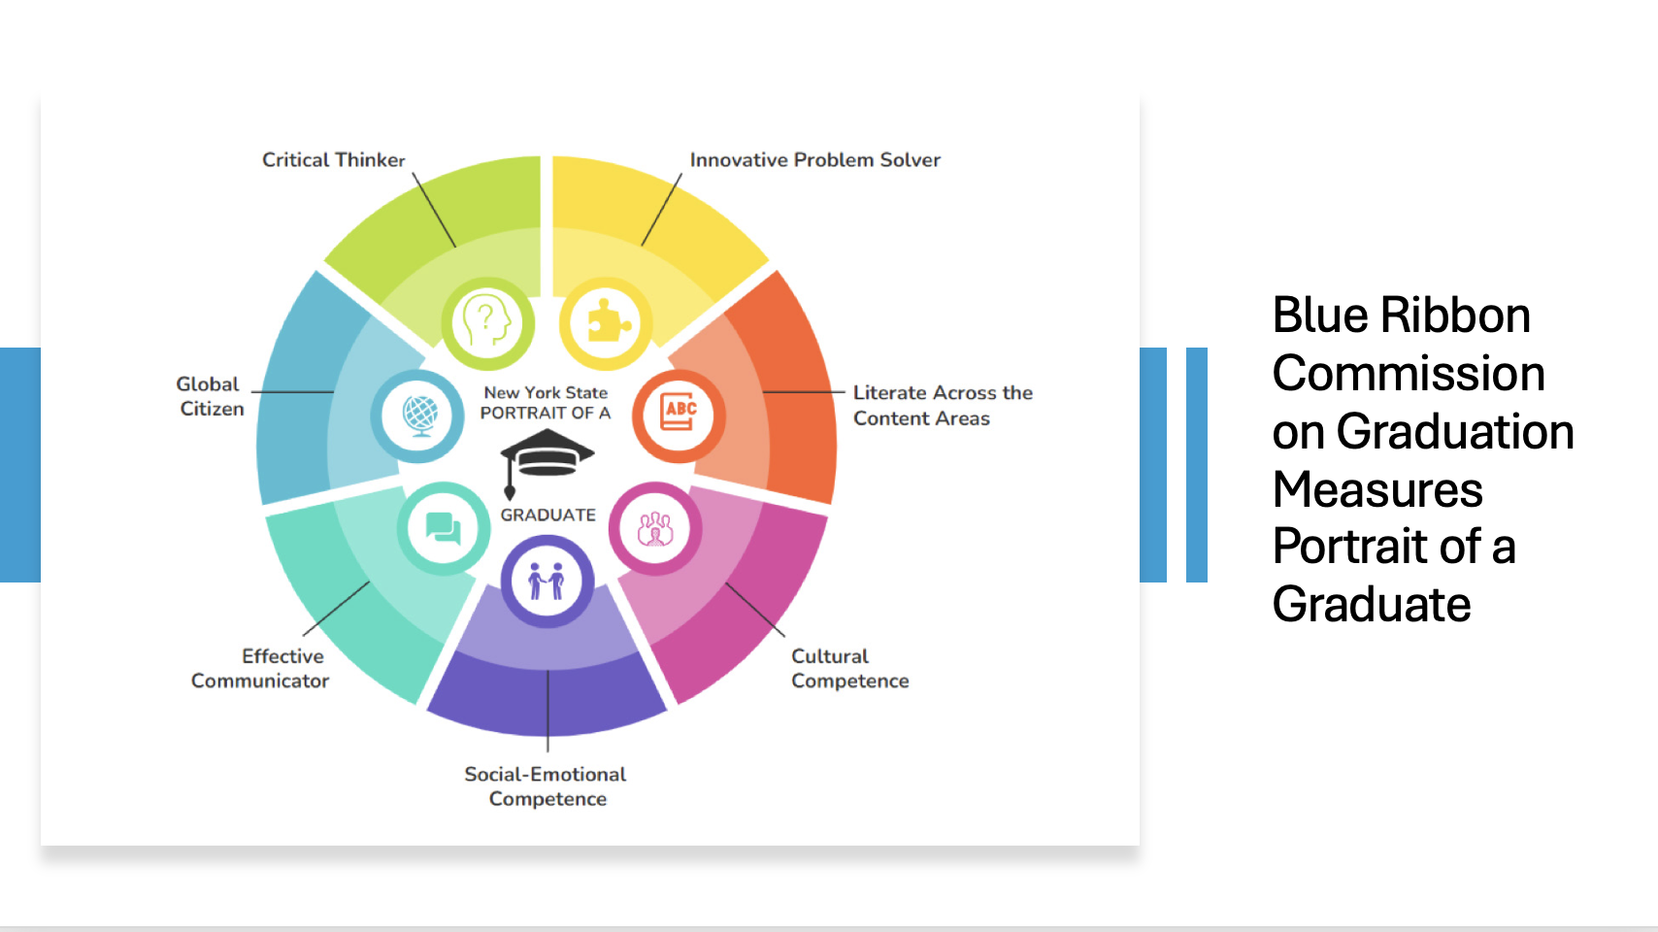

Slide 7
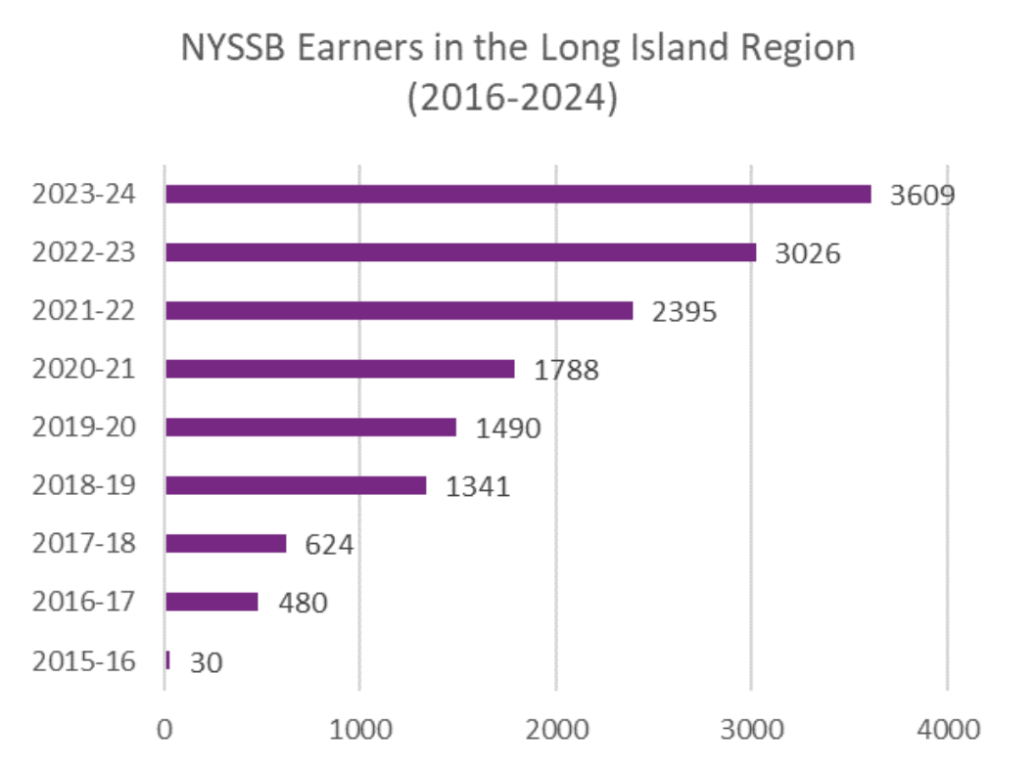
Long Island Students with the Seal of Biliteracy

Slide 8
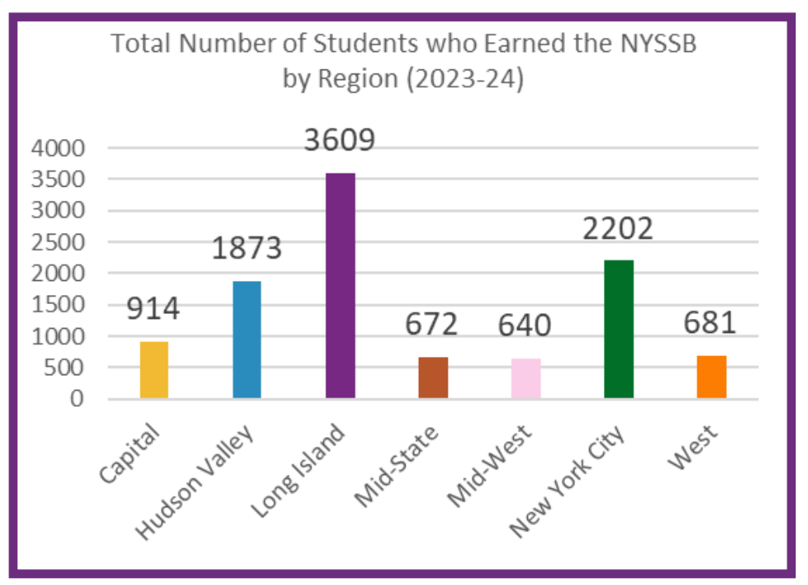
Long Island Leads the State

Slide 9
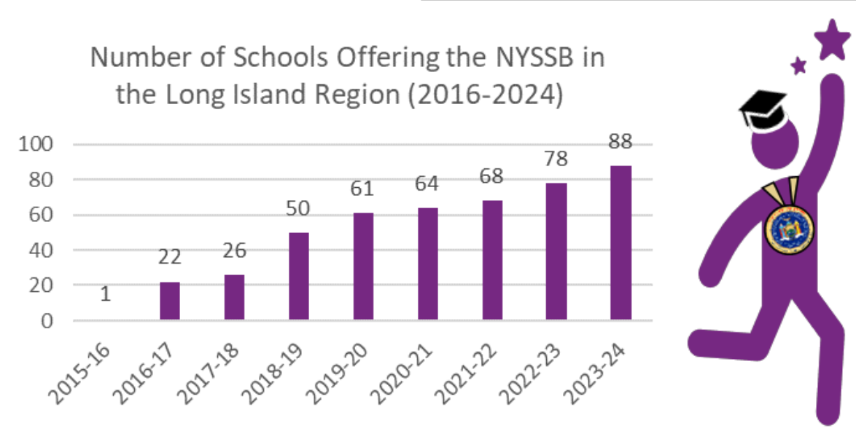
Long Island Schools Participating

Slide 10
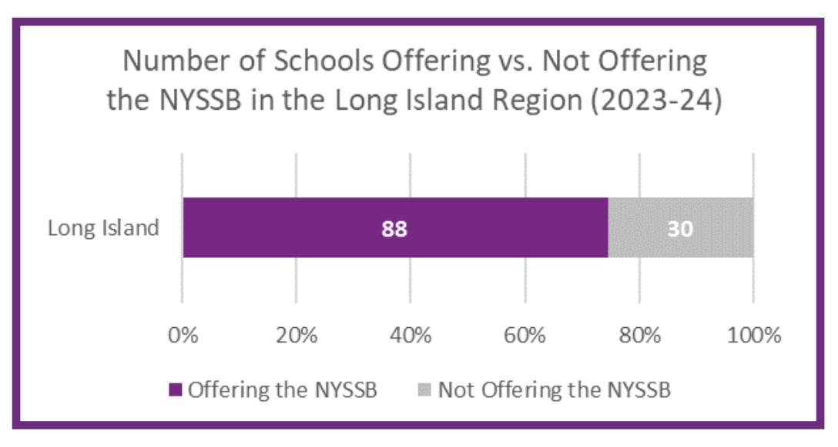
Majority of Long Island High Schools have the Seal of Biliteracy

Slide 11
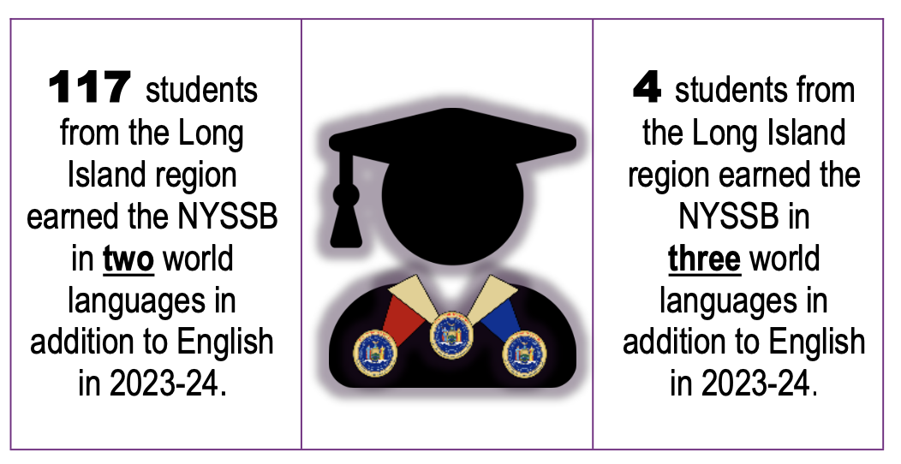
Long Island Achieves Multilingual Seals

Slide 12
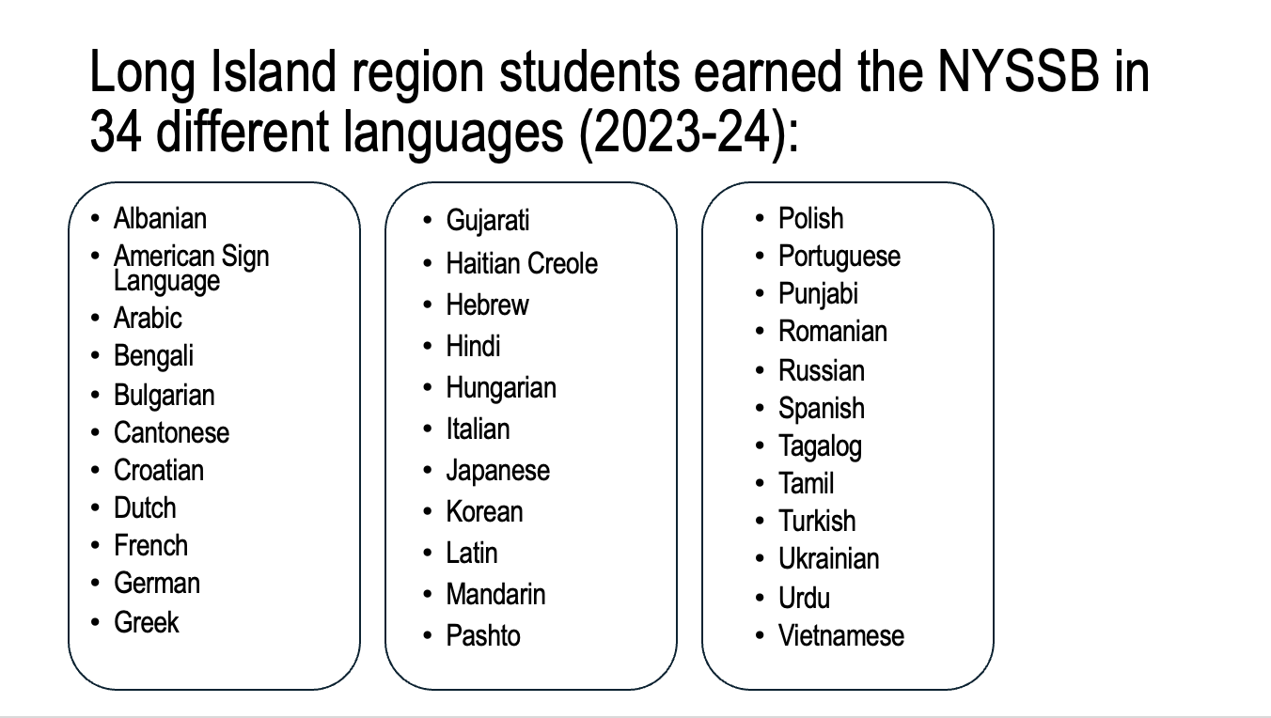



34 Languages Represented
Asian Languages
Mandarin, Cantonese, Japanese, Korean, Vietnamese, Bengali, Hindi, Urdu, and more.
2
European Languages
French, German, Italian, Spanish, Portuguese, Polish, Russian, Ukrainian, and more.
1
3
Other Languages
Arabic, Hebrew, Haitian Creole, American Sign Language, and more.

Slide 13
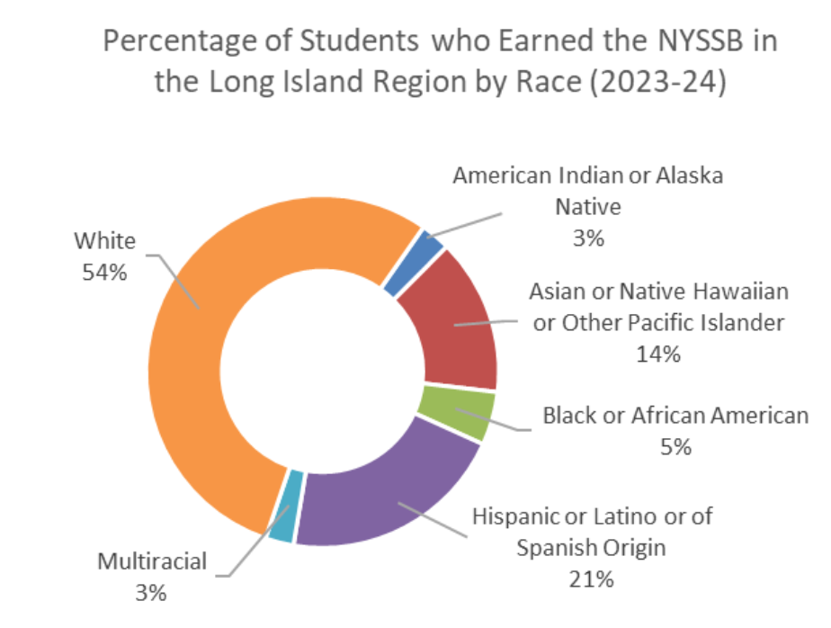
Long Island Seals of Biliteracy by Race & Ethnicity

Slide 14
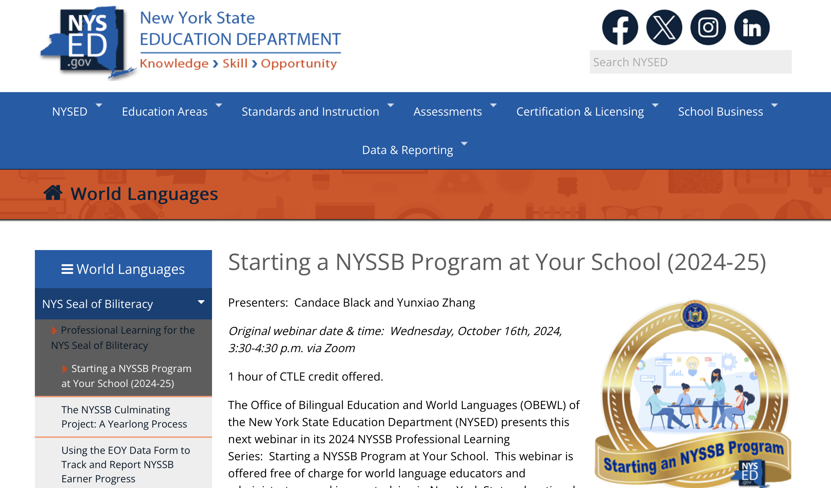

Slide 15
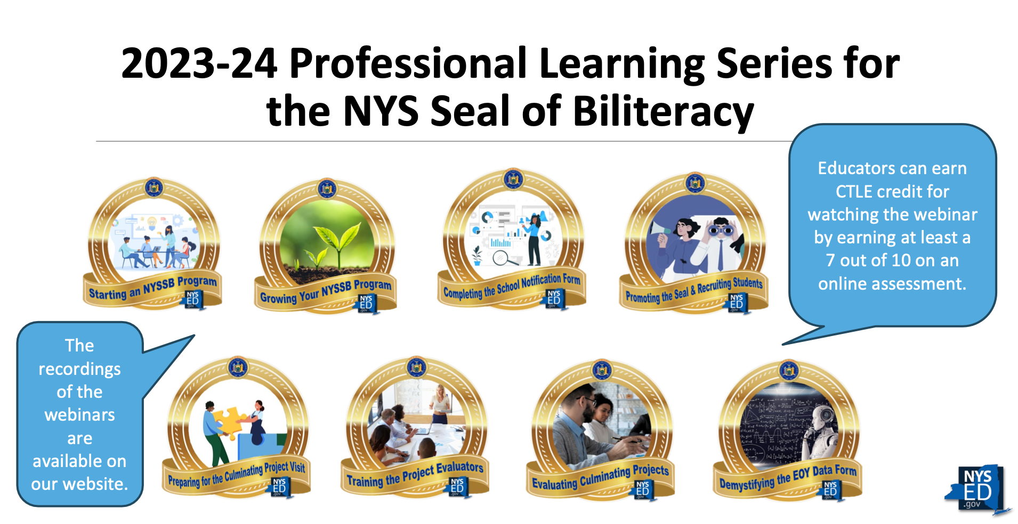

Slide 16
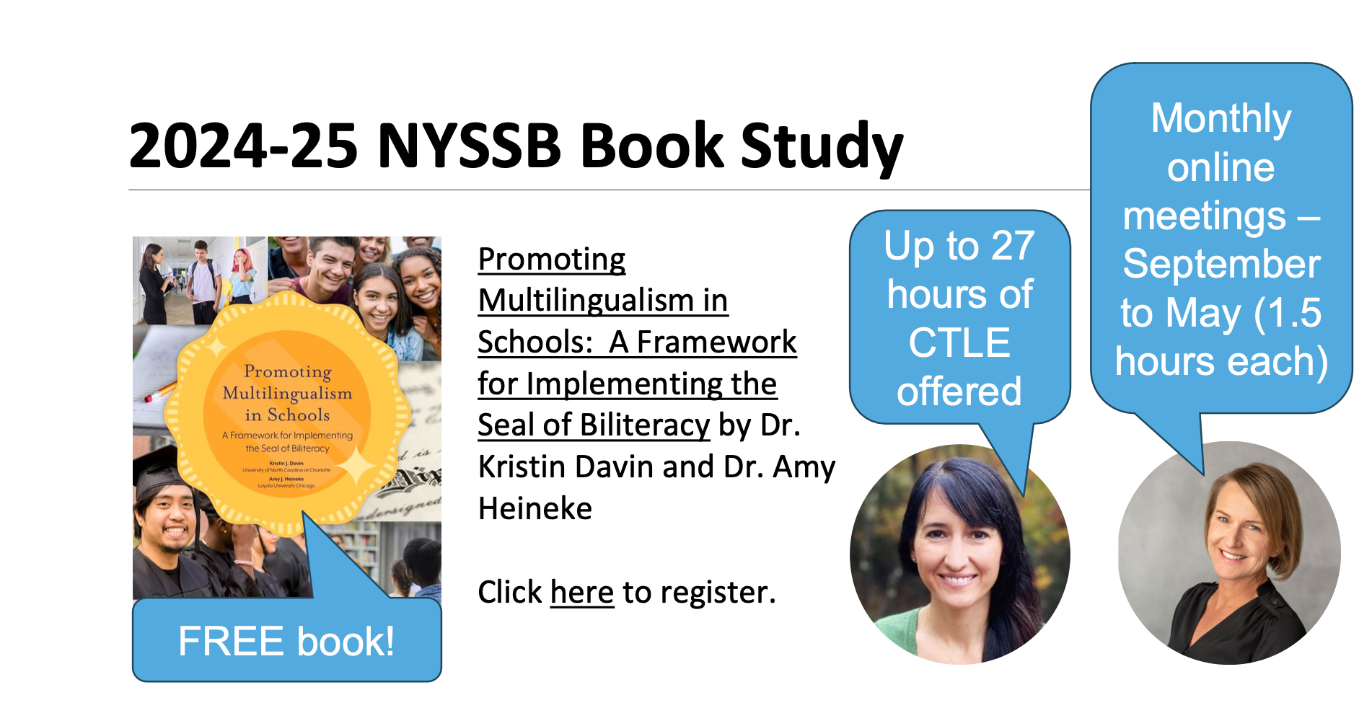

Slide 17
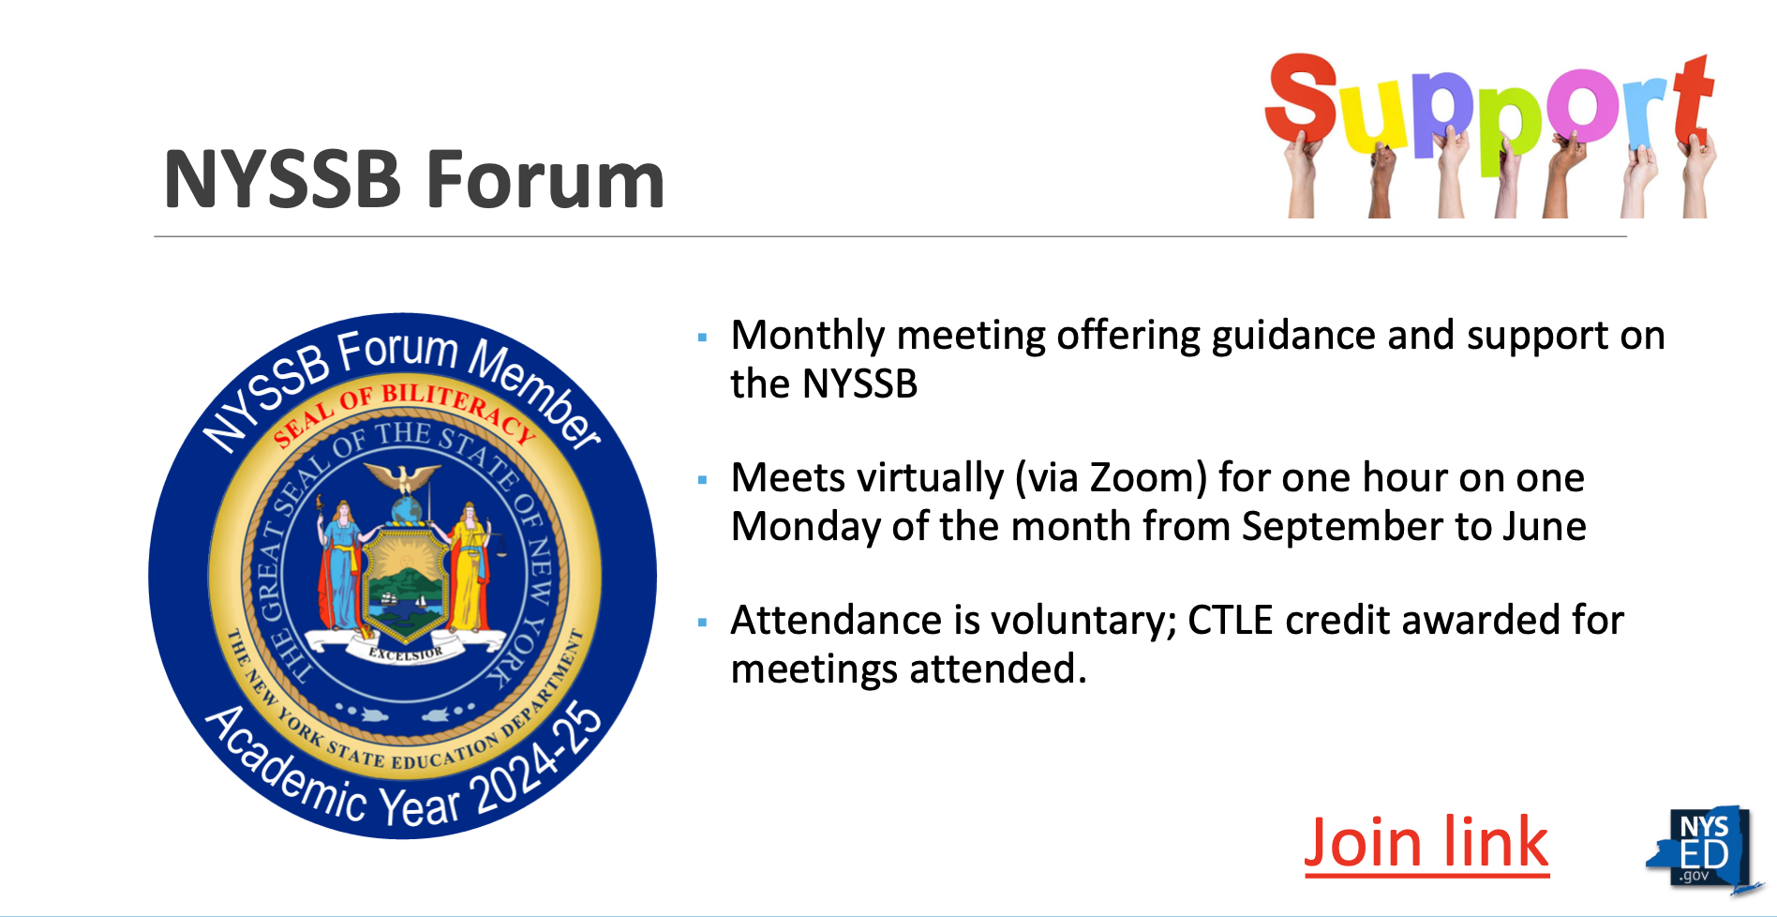

Slide 18
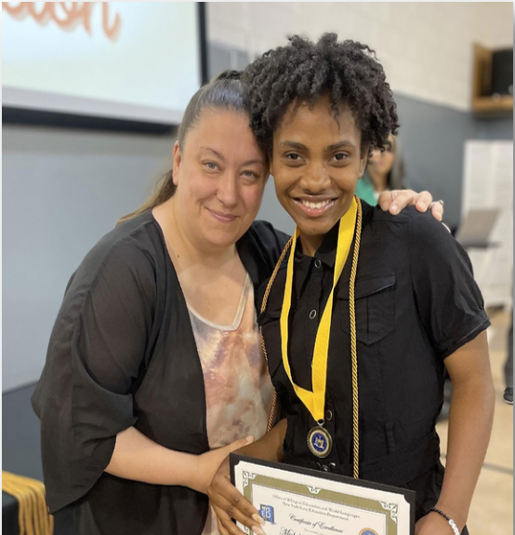
For those considering starting the NYSSB
You already have qualified candidates:
English Language Learners (ELLs) and Heritage language speakers
Students in your upper-level (e.g., 4, 5, AP/IB) courses
Your students most likely have already earned points toward the NYSSB:
80% or better on the ELA Regents
85% or better in 11th-12th grade ELA courses / 85% or better in a Checkpoint C world language course
3 or better on AP English exams
Do your students complete projects in their English and World Language classes?

Slide 19
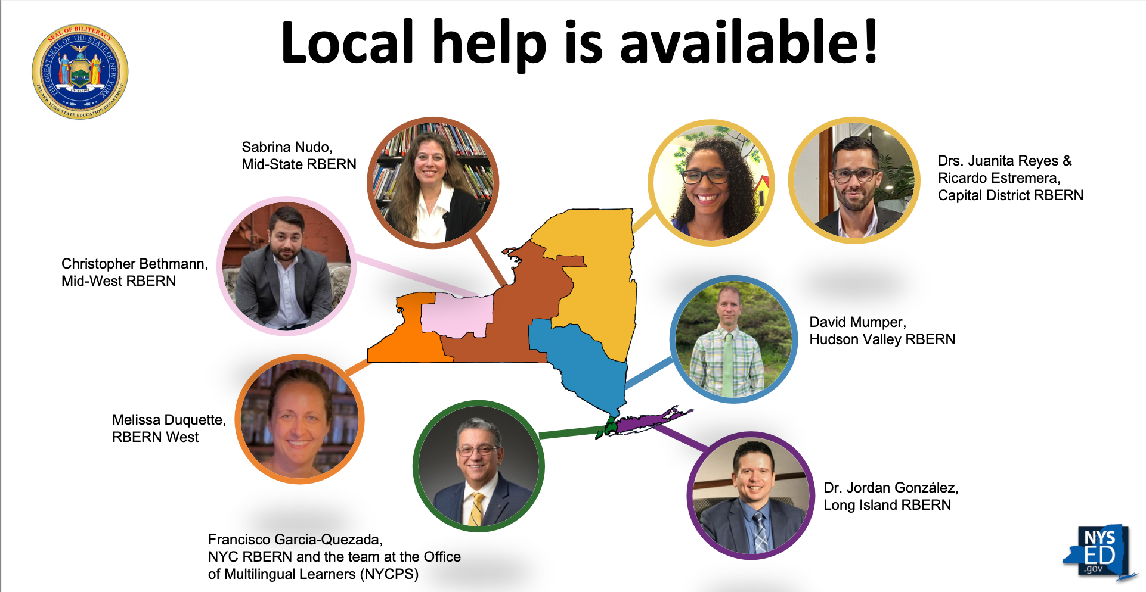

Slide 20
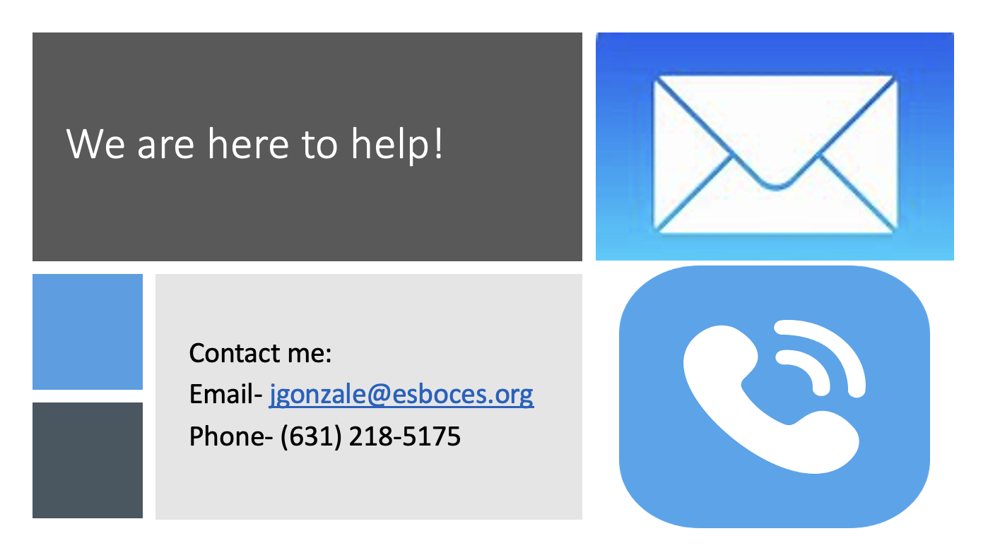


Thank you!
Contact me:
Twitter- @iJordanGonzalez
Email- jgonzale@esboces.org

