Slide 1
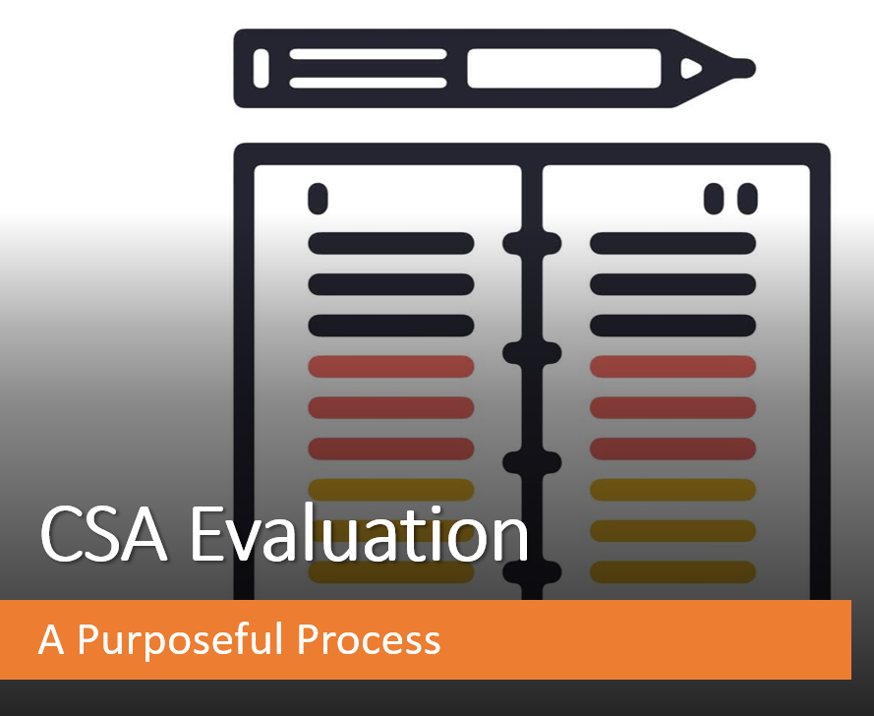
Presented by NJSBA Field Services

Slide 2

Purpose of Annual Evaluation
N.J.A.C. 6A:10-8.1(b)
Purpose of the Annual CSA Evaluation:
Promote professional excellence and improve the skills of the CSA.
Improve the quality of education received by the students we serve.
Provide a basis for the review of the CSA’s performance.

Slide 3
Evaluation Process Checklist
Evaluation calendar
Member Training on the Process
Goal Setting as part of the Evaluation
Evidence/Documentation
Preparation of the Evaluation Document
Evaluation Conference with Board & CSA
Evaluation Tool

Slide 4
Legal Guidelines
N.J.S.A. 18A:17-20.3a
Board shall evaluate performance of superintendent at least once a year.
Evaluation shall be in writing.
Board and superintendent shall meet to discuss findings.
Evaluation will be based on goals and objectives of district, responsibilities of superintendent and other such criteria prescribed by State Board of Education.
N.J.A.C. 6A:10-8.1
Annual performance report shall be prepared by July 1 by majority of Board’s total membership and shall include:
Areas of strength
Areas needing improvement
Recommendations for professional growth
Indicators of student progress and growth
Summary conference meeting shall include a majority of the total Board membership.

Slide 5

School Ethics Commission Guidance
A board member who has a relative employed in the district would be prohibited from participating in any and all issues related to the superintendent, including evaluation of performance.
A24-17

Slide 6
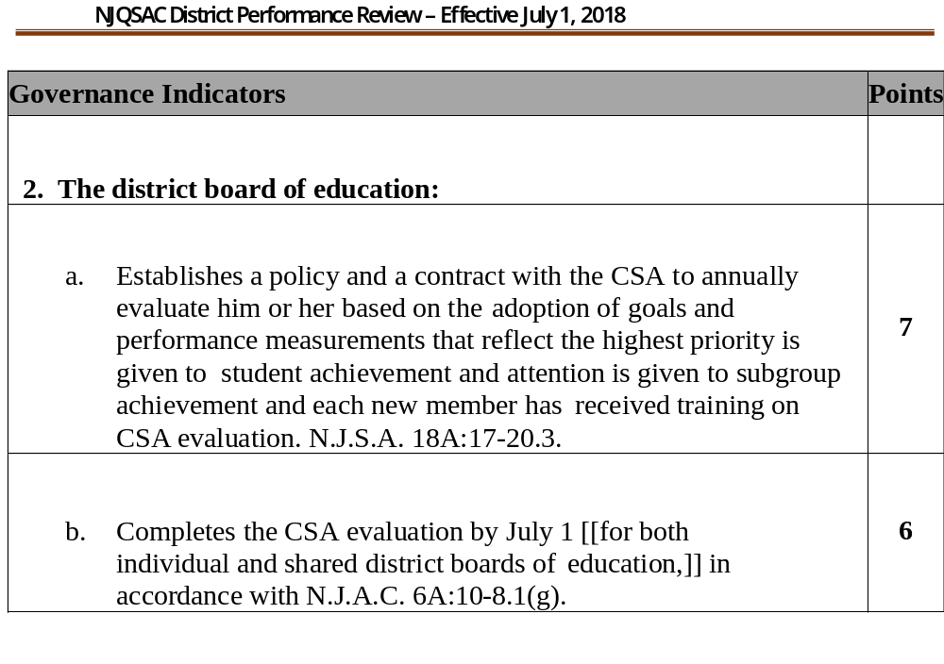
NJQSAC Requirements
Evidence of training: Governance 1
July 1 evidence – dated and signed copy of evaluation, meeting minutes

Slide 7

Evaluation Calendar
Legally Required:
  The evaluation procedure shall be completed by July 1.
NJSBA’s Supports:
  Evaluation tool opens in February.
  Email to all CSAs in state with link to tool.
  Sample evaluation calendar.
  Board president has electronic access to compiled document upon completion by the Board members.
  Members can track completion.

Slide 8
Evaluation Process
District Goal Setting and Action Plans
District Goals
Progress Updates
Superintendent
Evaluation Pre-Conference
BOE
Non-conflicted Board Members Meet to Review Compiled Superintendent Evaluation Results and Develop Majority Opinion Annual Performance Report
BOE
Completes Individual superintendent Evaluations
Superintendent
Completes District Goals
Self-Assessment and Evidence
for Leadership Standards
Annual Summary Conference
Non-Conflicted Board Members Meet with Superintendent to Discuss Annual Performance Report
Board President and Superintendent
Sign and Date the Annual
Performance Report

Slide 9

Goals as Part of Evaluation
Legally required:
The evaluation shall be based upon the goals & objectives of the district …
The conference shall include progress of the CSA in achieving and/or implementing the school district’s goals, …
NJSBA Support
Field rep can work with Board and CSA to set district goals.
Evaluation tool includes progress on achieving/ implementing district goals.

Slide 10

Evaluation Preconference
An Evaluation Preconference is an optional step to ensure all board members feel prepared to begin the evaluation.
Considering that members have different committee assignments, length of time of the Board, etc. a sit-down discussion can help all the Board members have the knowledge needed to write a meaningful evaluation. This evaluative conversation would be based on outcomes and expectations.

Slide 11
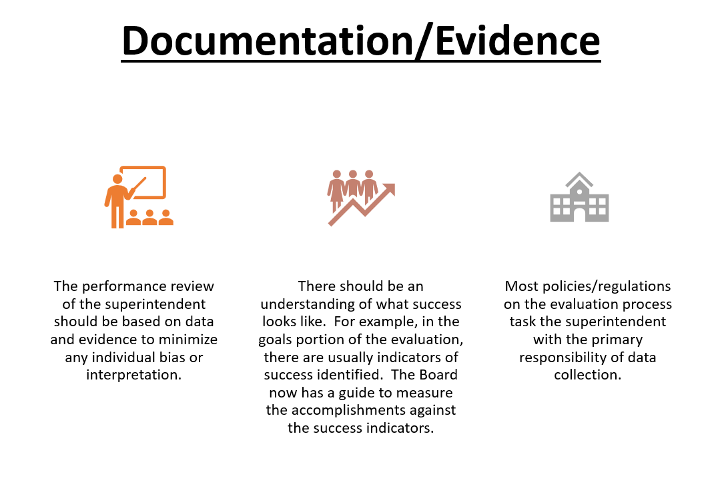

Slide 12
Evaluation Tool Progressions
Online
Tool
Compilation Report
Annual Performance
Report
Captures individual input of superintendent and each board member.
1
NJSBA compiles individual responses into one anonymous document that reflects all opinions.
2
The superintendent’s actual evaluation that reflects the majority opinion of the Board as identified in the Compilation Report and Board discussion.
3

Slide 13


Slide 14





Access to the Evaluation Tool
NJSBA User-Name &
Password
User-name = email
address in Census
Members receive
email from NJSBA
with link 48 hours
after CSA submits their portion.
CSA must complete their portion of evaluation tool before board has access.
Ensure NJSBA
Census is
current –
all members
listed.
Board president
identified in
Leadership portion.
Link to Evaluation page on NJSBA’s website:
https://www.njsba.org/services/field-services/online-evaluations/

Slide 15
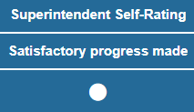

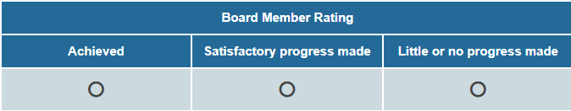

1. Goals Portion of Online Evaluation Tool
Board members will consider for each district goal input by the CSA, the CSA’s self-assessment and evidence: comments/links.
Each board member will provide their rating for each goal and comments
to their fellow board members to support their rating.

Slide 16

1. Standards Portion of Online Evaluation Tool
Mission, Vision, & Core Values
Governance, Ethics, & Professional Norms
Rating Scale
Exemplary
Proficient
Area for Growth
Unsatisfactory
Not Observed*
Operations Management
Curriculum, Instruction, Assessment, and School Improvement
*Not Observed allows new board members to participate where they feel comfortable and select a rating that is neither positive or negative where they have insufficient personal experience.
Community of Care, Equity, and Family Engagement
Professional Capacity/ Community of School District Personnel

Slide 17
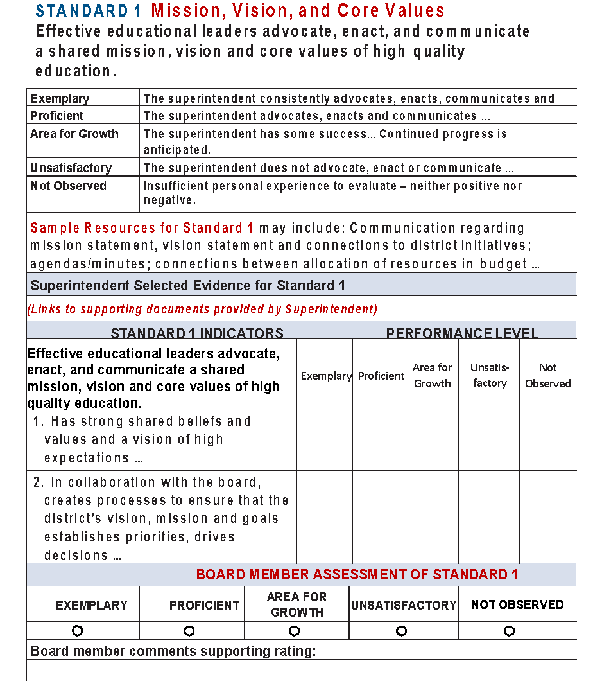
Standard 1 Example
Standard
Rating scale definition specifically for this standard
Resources to
Consider
Evidence links provided
by School Leader
Indicator ratings
help determine
overall standard
rating
Indicators
X
X
Overall rating of performance
on the standard
Board member
comments

Slide 18
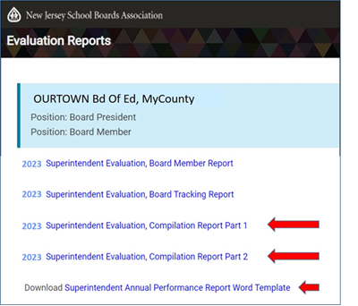
Compilation Report
NJSBA automatically compiles reports of the individual input. When the last member is done, the reports are ready.
Access to the reports is
available to the Board
President. The FSR
will send an email with
access instructions.
The Board will use these
2 reports to complete the
Annual Performance Report template – the CSA’s Evaluation.
Goals compilation
+
Standards compilation
=

Slide 19
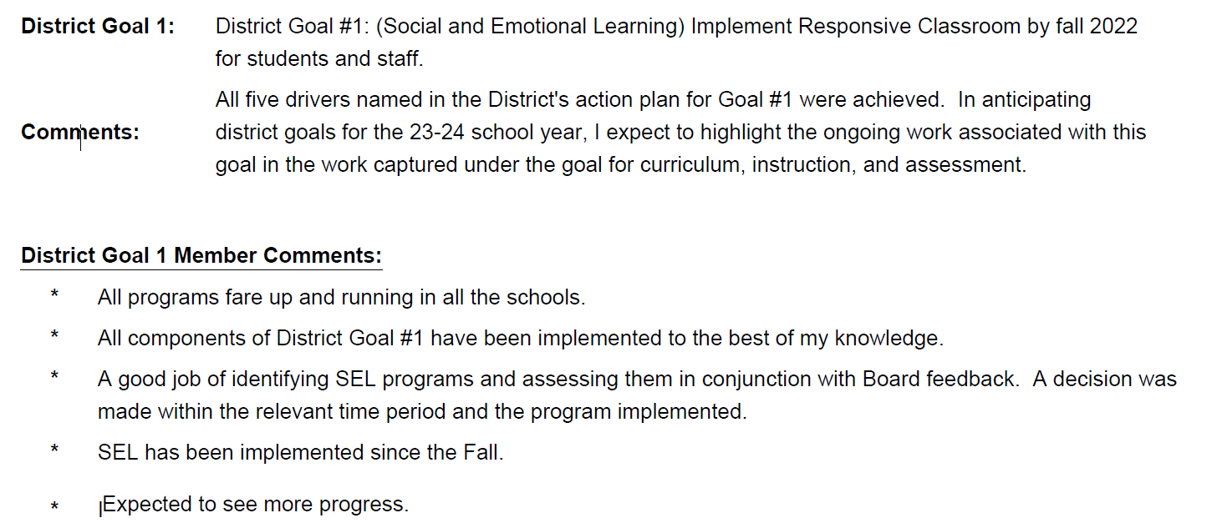
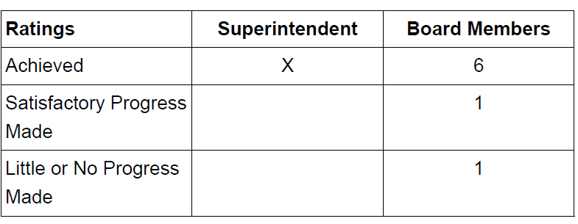
Compilation Report – Goal Example

Slide 20
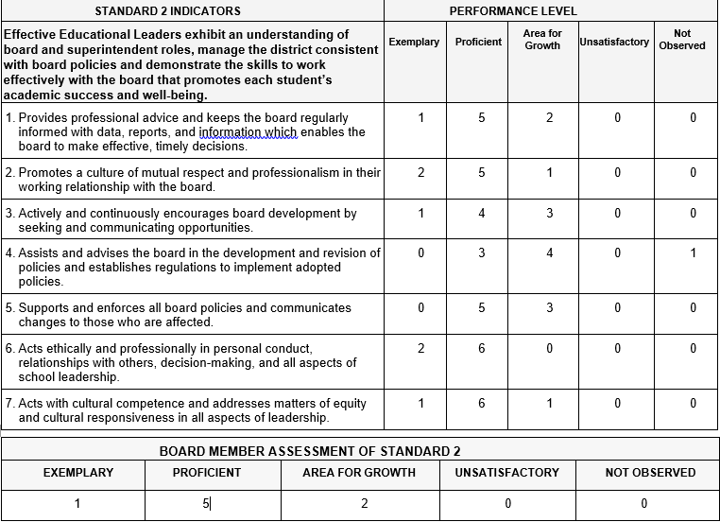
Compilation Report – Standard Example
Board members comments also displayed.

Slide 21
Annual Performance Report
Compilation Report
Downloaded by Board president
Board meets in Executive Session to identify majority opinion
Board reviews Compilation Report and through discussion identifies majority opinion.
Annual Performance Report
Superintendent’s Evaluation written by Board president or designee using direction from Board majority.
Board president or designee may prepare a draft of the Annual Performance Report to guide the conversation.

Slide 22
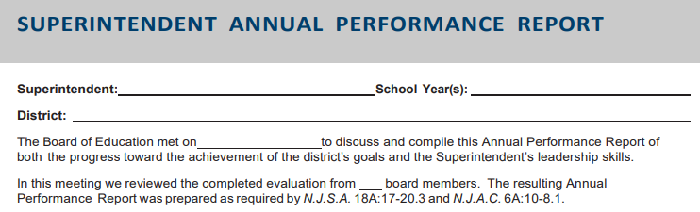
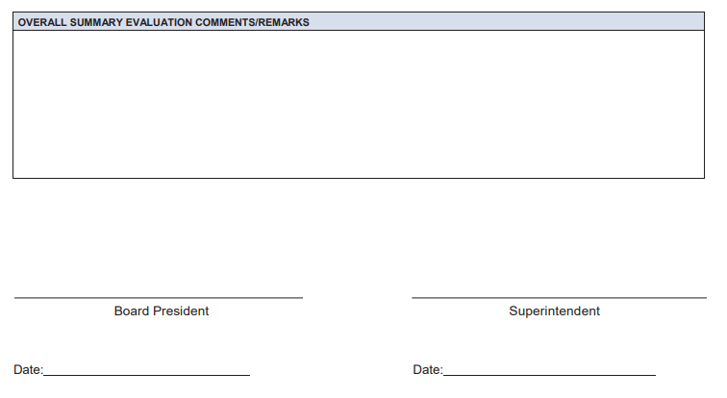
NJSBA Annual Performance Report Template
The Annual Performance Report is a blank template provided by NJSBA to capture the majority opinion and serve as the CSA’s actual evaluation.
Signed by the Board president and CSA for NJQSAC proof.
This template is one of the reports
available to the Board president.

Slide 23
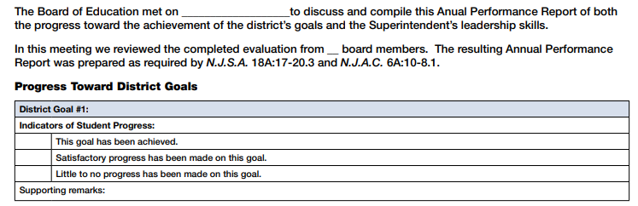

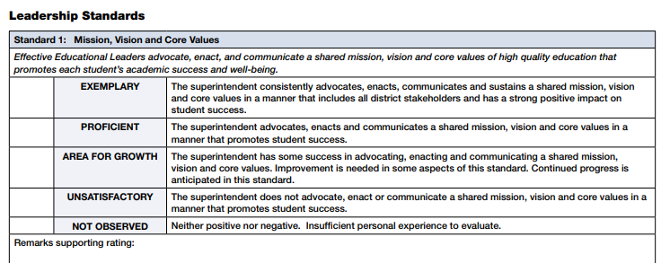

Annual Performance Report Template
Based on
majority
opinion.

Slide 24
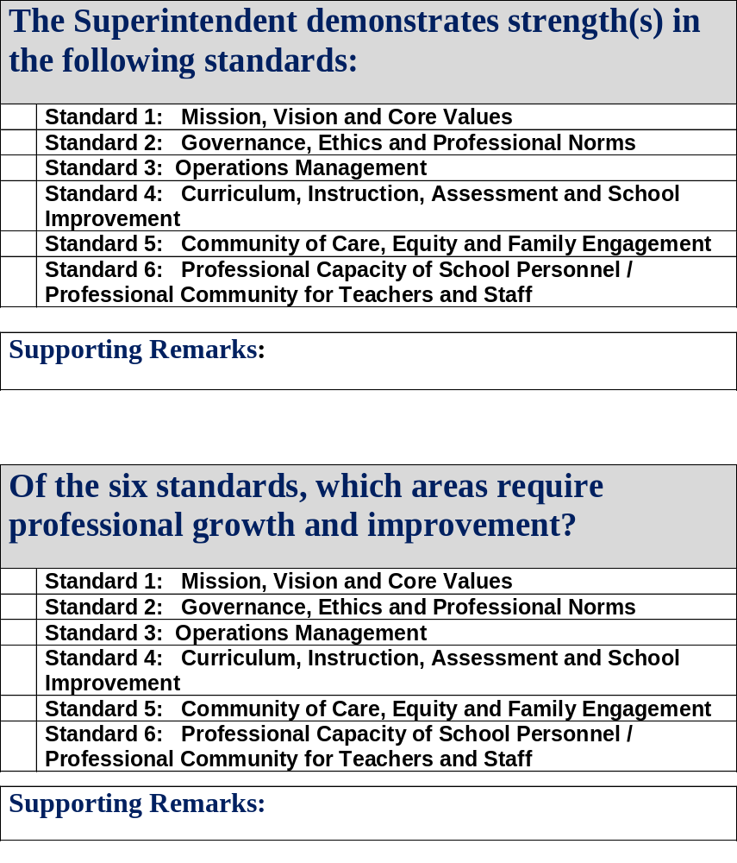
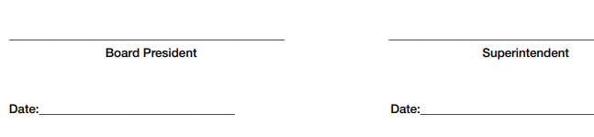
Annual Performance Report
Template
Summary of overall areas of strength and areas for growth.
Can check more than one box.
Open-ended text box.

Slide 25
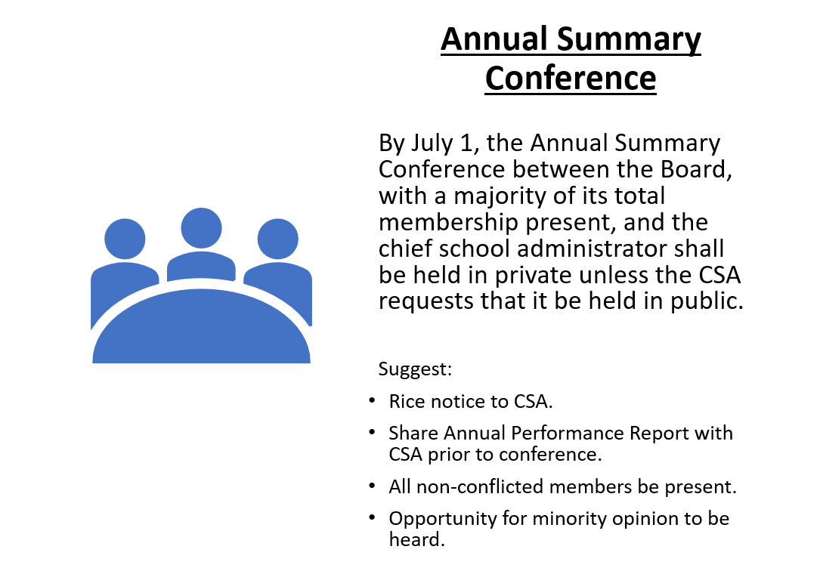

Slide 26

Sample Evaluation Calendar
When | Action | Sample Date
Last Board Meeting in June | Evaluation Conference with Board & CSA | 6/23 meeting – Executive Session
1st meeting in June, | Board reviews Annual Performance Report narrative prepared by President or designee | 6/10 meeting – Executive Session
Last Board Meeting in May | Board discussion of NJSBA compilation report to identify majority opinion. May also include draft | 5/12 meeting – Executive Session.
Late April – Early May | Member completion of evaluation via NJSBA site. | 5/5 – complete 4/23 - start
Mid to Late April | CSA completes their portion of evaluation | 4/21- CSA completed. Board receives access link in 48 hours.
Late March to Mid-April | Board & CSA meet in Executive session for evaluation preconference | 3/24 meeting – Executive Session
Start with July 1
deadline & work
backwards using existing
meetings when possible.

Slide 27

Summary of Effective Evaluation Process
All voices heard individually – Board & CSA.
Board consensus on the majority opinion.
Rights of the minority opinion to be heard.
Building a productive CSA – Board partnership.
Compliance with statute and code.
A framework for student success.

Slide 28
Considerations
Not a “once a year” event – ongoing.
Review performance over a full year.
Develop a system to retain evidence.
Progress updates and two-way communication are critical.
Responsibility of all eligible members to fully participate.
Maintain the evaluation focus on the goals and standards.

