Slide 1
Albemarle Special Education Advisory Committee (SEAC)
Monthly Meeting
March 11, 2025
7-9 pm

Slide 2
Meeting Agenda
Call to Order
Introductions
Approval of the Agenda
Approval of Minutes of Jan. 14 meeting
Update from SEAC Leadership Team
Update from SEAC representatives on other ACPS committees
Presentation of Annual Plan - Katy Compel
Intensive Support Center (see attachment)
Update on School Security / SROs (see attachment)
New Business
  Draft resolution regarding potential changes to U.S. Department of Education (see attached)
  Future meeting agendas
Public comment (in person and spedhelp@k12albemarle.org)
Adjournment

Slide 3
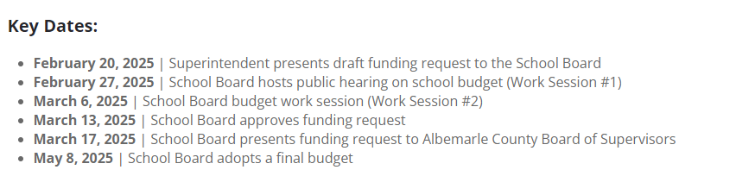
2025-2026 ACPS Budget Process

Slide 4
Highlights:
2025-2026 ACPS Draft Budget
4.5% salary increase for special education TAs (vs. general salary pool increase of 3.0%)
Intensive Support Center: $649k (replacing PREP at Ivy Creek location
Augmenting contingency staffing for special education
Scholar Studio program: $406k (includes 2 FTE EL/SPED positions)

Slide 5
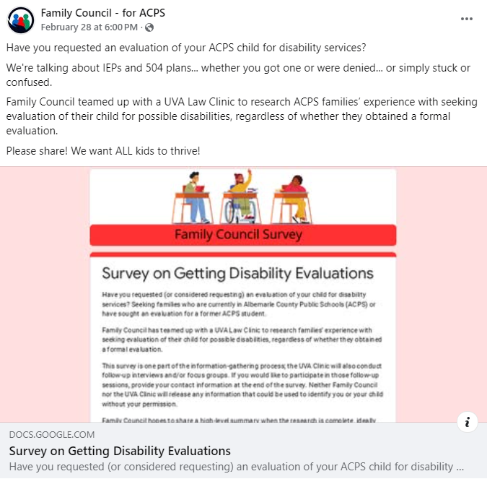
Eligibility Determination –
Survey and Interviews

Slide 6
Upcoming Events
Thr. 3/20, 6:30 pm: “The Live You’re Given” (Light House Studio), RSVP requested
Sat. 3/22, 8:30 am – 1 pm, PRC Program, “Life After High School (PVCC)
Sat. 4/12, 9 am – 1 pm: Reclaimed Hope Initiative, Hope Fest & 5k (VFW 1827), Registration required
Adaptive Baseball for blind/visually impaired, Monticello Little League, Season Starts 4/13

Slide 7
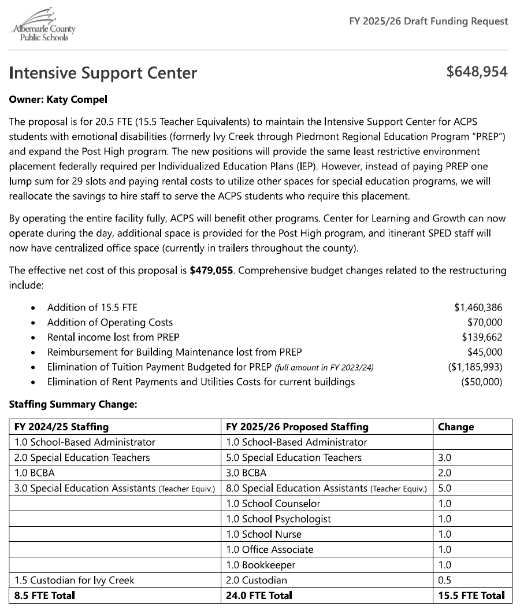

Slide 8
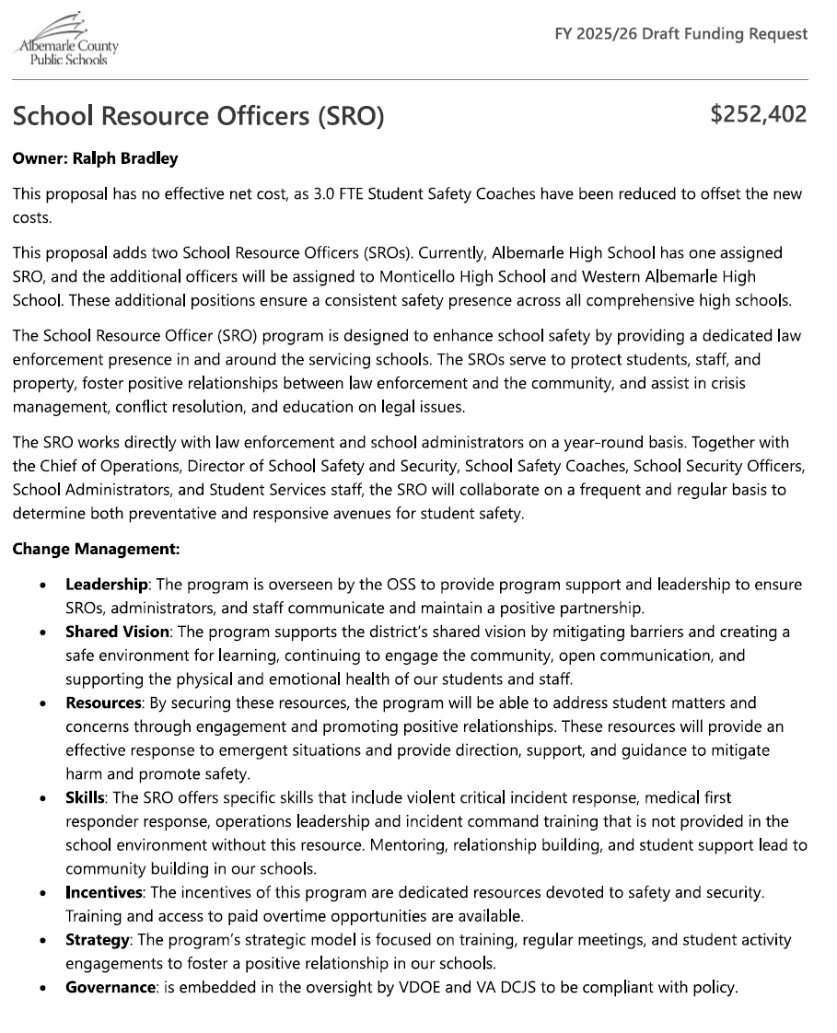

Slide 9

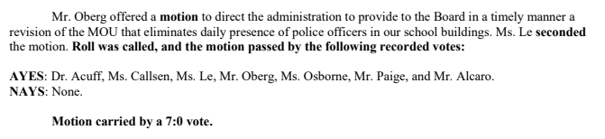
SROs

Slide 10
ACLU Report (July 2020)
“What makes a child most likely to be targeted by a police officer while in school? Simply having a disability. Overall, students with disabilities were nearly three times more likely to be arrested and referred than students without disabilities (and this disparity increases up to tenfold in some states), and the risk is multiplied in schools with police.”

Slide 11
Virginia Board for People With Disabilities,
2022 Assessment of the School to Prison Pipeline
“The presence of SROs… in schools have been shown to increase the incidence of in-school suspension, out-of-school suspension, expulsion, police referral and arrest for students with disabilities, particularly in high schools….
SROs also increase the rate of chronic absenteeism, particularly for students with disabilities.”

Slide 12
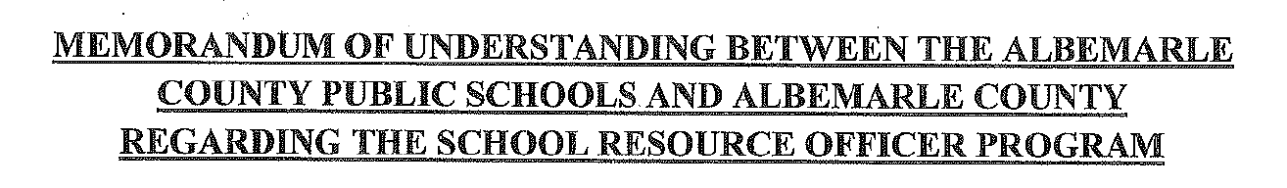
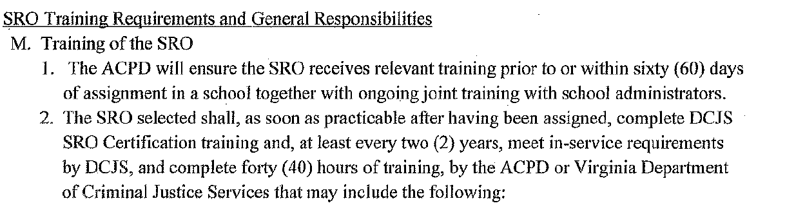
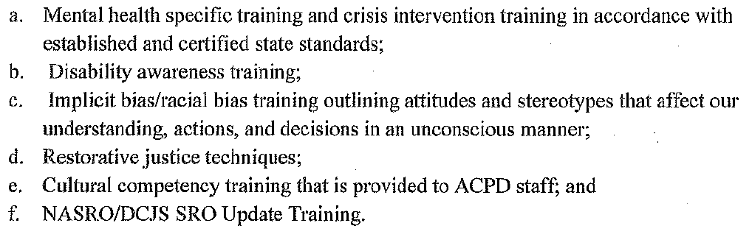

Slide 13

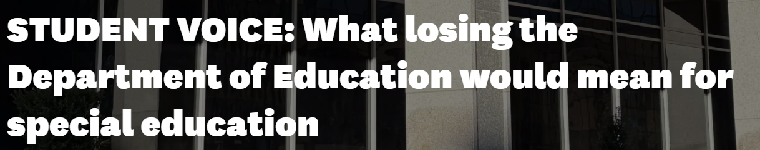


Slide 14
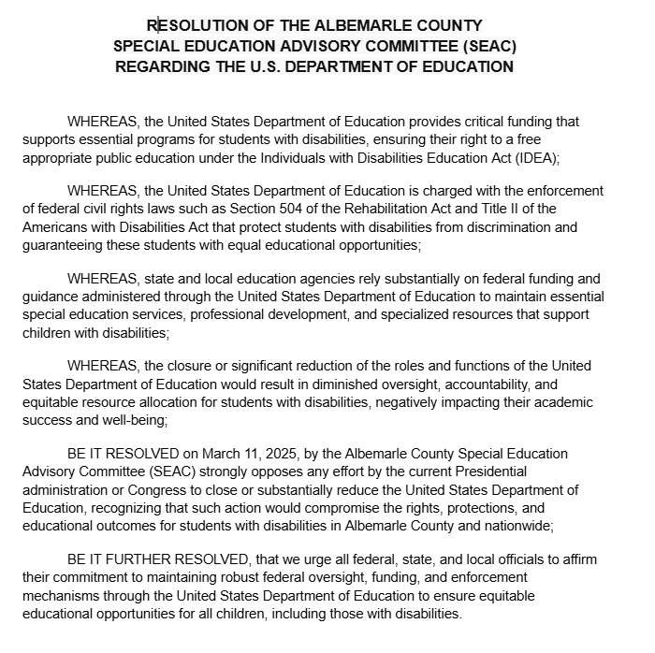

Slide 15
Future Meeting Dates & Topics
April 8: Office of Equity Education
May 13: SEAC Survey form; elect officers for 2025-26
Math curriculum – TBA
UVA Law students’ presentation on eligibility determinations - TBA

