Slide 1
Welcome
Kindergarten Overview: Christy Otley, Principal
Registration: Annette Aratani, Registrar
Immunizations\Health Forms: Nurse Wen Xu
PTA: Rachael Cox

Slide 2

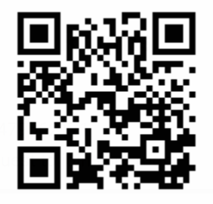
Multilingual Support
ultilingual Support
https://www.123ila.com/app/room/2713849
ILA-2
Chinese (Simplified)
请扫描二维码以获取本次演示文稿的翻译。
Spanish
Por favor, escanee el código QR para acceder a la traducción de esta presentación en su idioma.
Russian
Пожалуйста, отсканируйте QR-код, чтобы получить перевод этой презентации на ваш язык.
Ukrainian
Будь ласка, скануйте QR-код, щоб отримати переклад цієї презентації вашою мовою.
Korean
이 발표 자료의 번역본을 얻으려면 QR 코드를 스캔하세요.
Japanese
このプレゼンテーションの翻訳にアクセスするには、QRコードをスキャンしてください。
Arabic
يرجى مسح رمز الاستجابة السريعة للوصول إلى ترجمة هذا العرض التقديمي بلغتك.
Vietnamese
Vui lòng quét mã QR để truy cập bản dịch của bài thuyết trình này bằng ngôn ngữ của bạn.
ILA-2
2

Slide 3
Kindergarten is a transition year
Sept-Oct
Looks and feels more like preschool
Transition through Kindergarten
May/June
Looks and feels more like 1st Grade

Slide 4
What can we expect at the beginning of the year?
Family Connection Meeting
  Classroom teacher meets individually with each kindergarten family
Whole-Child Assessment: September/October
  Kindergarten teacher observes children during everyday classroom activities
  Helps teachers find out what each child knows and can do at the beginning of the year
  Inventory taken of each child’s developing skills in six areas
    Social-emotional
    Physical
    Cognitive
    Language
    Literacy
    Mathematics

Slide 5
Half Day Option
Parent may opt for half-day
  Student will be placed in full-day classroom in the morning for 3 hours, dismissal @ 12:30
  Transportation is provided in the morning (if busing is provided), parents must transport at the end of the half-day
  Students miss specialist (library, music, PE) and purposeful play time in classroom

Slide 6
Dual Language/
Spanish Immersion Program
Dual Language/Spanish Immersion Program at IVE
The goal is to balance the number of students in each class who are native English speakers with those who are native Spanish speakers.
Fifty percent of the academic instruction will be given in English and fifty percent of the instruction in Spanish. Students are offered the same curriculum as their peers while also having the opportunity to learn a second language.
For more information visit: www.Issaquah.wednet.edu/academics/programs/DLIP

Slide 7
Kindergarten Assessments
April ?????
Assist in making appropriate class placement
You will be sent a link to sign up once your enrollment application is completed and approved

Slide 8

Family Liaison
Liliana Medina (Español)
Family Partnership Liaison
Office Phone: 425-837-7141
Cell Phone: 425-651-5170
Text: 425-331-9555
The Family Liaison role:
Support families transitioning to the Issaquah School district to better understand and navigate our school system. Help with registration.
Serve as the bridge between staff and families. Connect families with school staff about their child’s needs and concerns.
Provide information regarding resources (financial, meal program, school supplies and more) available in the community to families and students.
Host district-wide informative events regarding school to parents throughout out the school year.

Slide 9


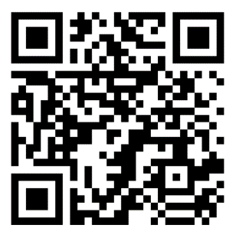
When: Wednesday, March 12, 2025, from 6:30 p.m. to 8:00 p.m.
Where: Zoom Register here Presentations in English, 普通话, and Español
Who: For families new to the US school system of incoming ISD kindergarten students for the 2025-2026 school year. (isd411.org)
What: Information will include:
kindergarten preparedness, general school day schedule, classroom general information
transportation, immunization, on-site before and after school care program and the
differences between school systems in US vs some other countries
If you need interpretation in another language (한국어, 日本語, русский) or have any questions, please contact Lorna Gilmour gilmourl@issaquah.wednet.edu by Monday, March 10, 2025.
Family Partnership Team

Slide 10
How do I register?
If your child will be 5 by August 31, 2025 and you reside within the Clark attendance area:
Step 1: Complete Online Application on ISD website including required documents
Step 2: Complete and return the Required Forms Packet
Step 3: Sign up for Kindergarten Assessment

Slide 11
Required Documents
Proof of Birth Date: Birth Certificate or passport must be provided
Proof of Residency: Your signed lease or purchase agreement, and a utility bill no more that 30 days old. (Utility bill must be power, gas, or cable – not cell phone)
Photo ID: The person registering the child must be the legal parent/guardian listed on the registration form.
Immunizations: Medically verified immunization records.

Slide 12

Information on Immunizations & Life-Threatening Health Conditions for Students New to the Issaquah School District and Incoming Kindergarten Students

Slide 13
Medically Verified Immunization Records
Students new to the Issaquah School District and incoming Kindergarten students need to provide a medically verified immunization record at the time of registration.
A medically verified record can come directly from the Washington State Immunization Information System (WAIIS).
The WAIIS is the database for Washington State and is where medically verified immunization information is maintained. All parents have access to this site to print a validated Certificate of Immunization (CIS) for students. Health Care Practitioner offices also have this information for their families.

Slide 14
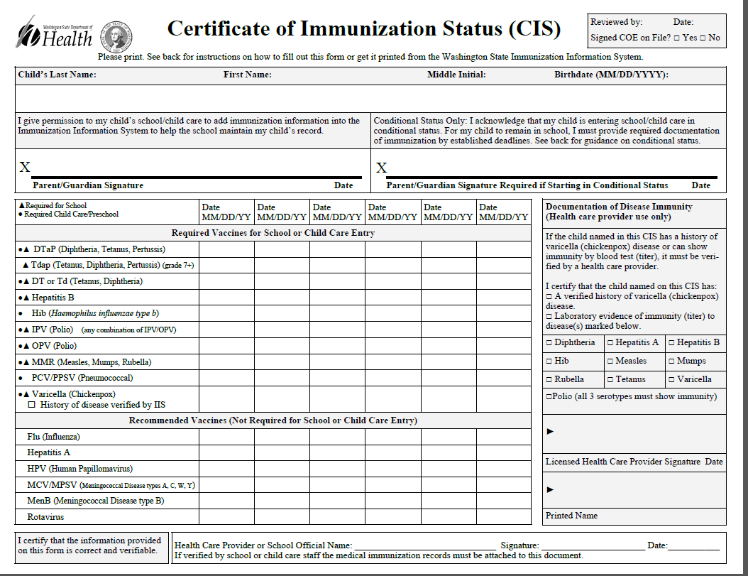
Acceptable Immunization Documentation Includes:
A Certificate of Immunization Status (CIS) printed from the (WAIIS)
OR
A physical copy of the State CIS form with a healthcare provider signature.
OR

Slide 15
WHAT DOES ‘MEDICALLY VERIFIED’ MEAN?
A physical copy of the CIS with accompanying medical immunization records from a healthcare provider verified and signed by school staff
OR
A CIS printed from MyIR.
Wa.myir.net

Slide 16
Required Immunizations for Incoming Kindergarteners
2 MMR’s (measles, mumps and rubella) given in the appropriate time frames
5 doses of DTaP (diphtheria, tetanus & pertussis) given in the appropriate time frames
2 doses of varicella given in the appropriate time frames
4 doses of polio (IPV) given in a specific time frames
3 doses of Hepatitis B, given in the appropriate time frames
At this time, vaccines against COVID-19 are not required for school attendance.

Slide 17
30 Day Conditional Status from the First Day of Attendance no Longer in Effect.
Students will need a completed CIS or Certificate of Exemption (COE) on file at school before the first day of attendance.
If students are missing doses, they will need to get all the doses they are eligible to receive before starting school. They can then attend school in a Conditional Status until the minimum valid date of the next vaccine is reached. They then have 30 calendar days to turn in documentation of having received the dose. This continues on until all vaccines have been administered and documented.

Slide 18
For example:
If a child has all their immunizations except the 2-dose MMR series, and they get dose 1 of the MMR the day before school starts and it is documented with the school that day, the child can enter school because…
Dose 2 of the MMR cannot be given until 28 days after the first dose.
Beginning on day 29 after the first dose, the child has 30 days to get MMR dose #2.

Slide 19
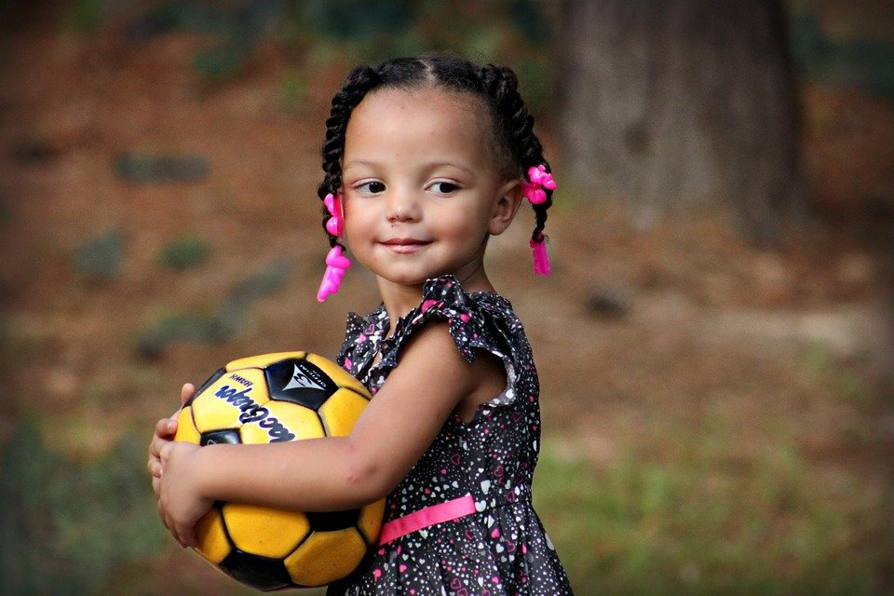
MY CHILD IS NOT 5 YEARS OLD YET…
Children can receive their school immunizations at age 4. Contact your healthcare provider to schedule your appointment.

Slide 20
WHERE CAN I GET MY CHILD IMMUNIZED?
Your healthcare provider
OR
WithinReach, Family Health Hotline: 800-322-2588
http://www.withinreachwa.org/
OR
Community Health Access Program 206-284-0331 or 800-756-5437
https://www.kingcounty.gov/depts/health/locations/health-insurance/access-and-outreach/community-health-access-program.aspx

Slide 21
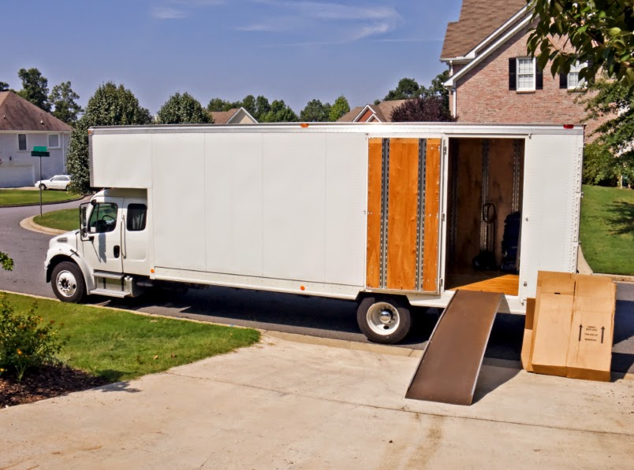
We are moving from another state and cannot find our immunization records. Now what?
Immunization records from another state’s immunization registry are accepted as medically verified records.
OR
Call your provider in the state you moved from and have them send the immunization records directly to the school nurse either by fax or by email.

Slide 22

We are moving from another country and cannot find our child's immunization records. What do we do?
Different Options Available
Immunizations verified by the Immigration Dept are accepted
If possible, contact the provider in your first country via email or phone to have them send you the records
Get established with a provider in this country. They can order lab titers to be drawn which will determine if your child has immunity to the different diseases.

Slide 23
CONCLUSION of IMMUNIZATION INFORMATION
Your student may register for school, but MAY NOT attend school until provider-verified immunizations have been received and validated by the school nurse
AND
The child has received all immunizations they are eligible for
OR
There is a Certificate of Exemption on file signed by the parent AND the licensed healthcare provider.

Slide 24
Children with Life-Threatening Health Conditions

Slide 25
A Life-Threatening Health Condition can be:
A severe allergy for which an epinephrine auto injector device (Epipen™) has been prescribed.
Diabetes
Severe asthma
A seizure disorder
A cardiac condition
Adrenal Insufficiency
Other conditions

Slide 26
Why does the school need to know if my child has one of these conditions?
If your child has a life-threatening condition, WA state law says there must be an emergency care plan and any associated medication in place in the school building before the child attends school.
This is to keep the student safe in the event they experience a medical emergency during the school day.
If your child has a life-threatening condition, please contact the school nurse in your child’s school when you register them.

Slide 27

Questions?

Slide 28
PTA
Rachael Cox - PTA President

Slide 29
Be In The Know
Sign up for ISD weekly Bulletin
Sign up for Clark weekly Bulletin
Opt in to receive text messages
https://www.isd411.org/about-us/announcements/sign-up

Slide 30
Conclusion

