Slide 1

Holland Central
School District
2025-2026 BUDGET PRESENTATION
#2
February 24, 2025

Slide 2
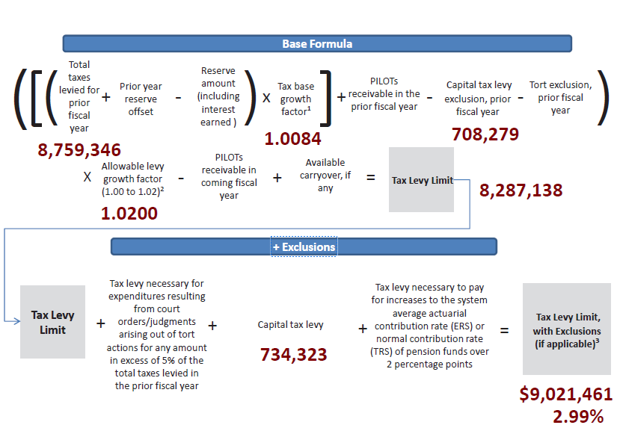
Tax Levy 2025-26
PRESENTATION OVERVIEW
Tax Levy: $9,021,461
Increase % from 24-25: 2.99%
Increase $ from 24-25: $262,115
Does NOT require supermajority vote
Notes:
Adding 1% to the tax cap would gain us $87,593
If our deficit is around 900,000, we would need to add almost 10% to the levy and require a super majority vote for approval

Slide 3
Foundation Aid Update
PRESENTATION OVERVIEW
• Adds a 2% minimum increase for each school district for SY 2025-26 ($146,971)
• Modifies components of the Foundation Aid formula to implement the following Foundation Aid Study recommendations:
o Replace FRPL counts with Economically Disadvantage Data
o Replace Census 2000 poverty counts with the most recent 3-years average of SAIPE Data.
• Amends one of the "greater of" components of the FASSR two tier calculation to (1-FACWR x .628) from (1-FACWR x .64).
• Redefines the State Sharing Ratio, increasing the ceiling (from 0.91 to 0.93) on Foundation Aid calculations for lowest wealth schools.

Slide 4
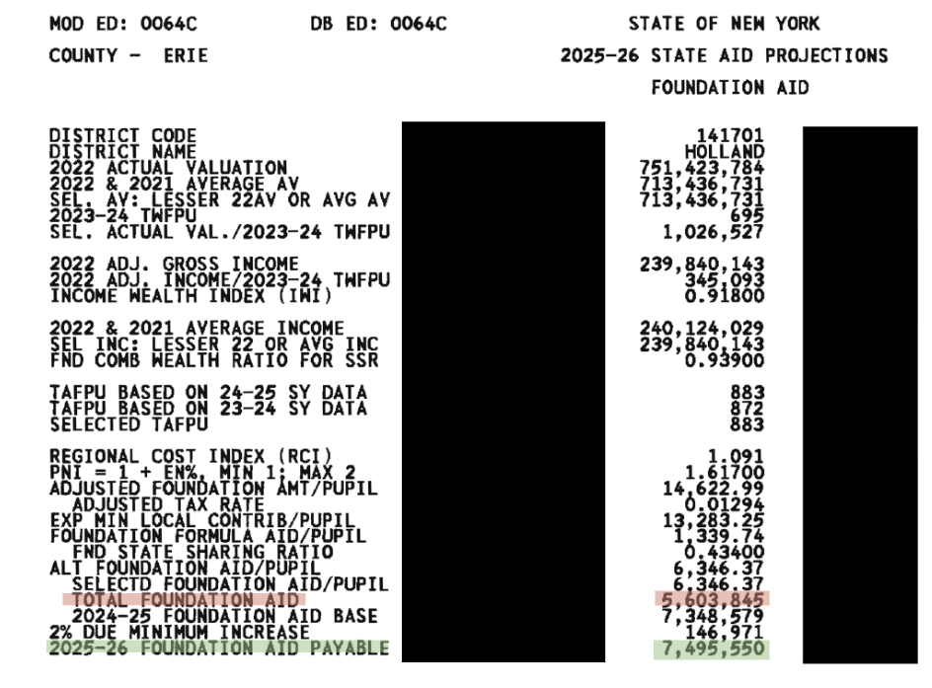

Slide 5
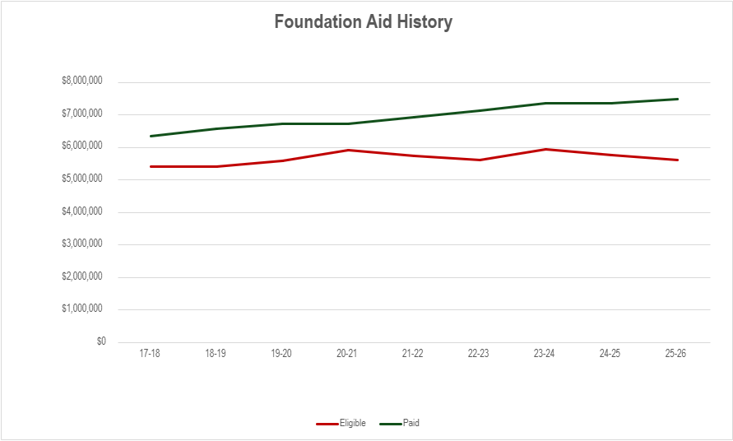
Notes:
Gap is continuing to widen between what we are actually eligible for and what we have been receiving, cannot continue to rely on it

Slide 6
Draft 25-26 Revenues
PRESENTATION OVERVIEW
 | 2024-2025 | 2025-2026 | $ Change
Interfund Transfers & Appropriated Fund Balance | $663,296 | $350,000 | ($313,296)
Misc. Revenues | $465,240 | $586,830 | $121,590
Property Tax Levy | $8,759,346 | $9,021,461 | $262,115
Sales Tax | $1,150,000 | $1,020,000 | ($130,000)
State Aid | ($11,614,565) $11,371,399 | $11,279,287 | ($92,112)
Total | $22,652,447 | $22,257,578 | ($394,869)
Notes:
Reserves/Fund Balance – 50 ERS, 50 EBLAR, 250 unemployment/fb
Sales Tax total for 2024 = $1,084,627
Misc – rental, scrap, donations, interest earnings (bulk of this, rates are down)
State aid + levy = about 94% total revenue

Slide 7
Draft 25-26 Expenditures
PRESENTATION OVERVIEW
 | 2024-2025 | Draft 2025-2026 | $ Change
General Support | $2,960,696​ | $3,146,104 | $185,408
Instructional | $11,730,080​ | $12,241,118 | $511,038
Transportation | $1,119,849​ | $1,160,903 | $41,054
Employee Benefits | $4,596,100​ | $5,110,293 | $514,193
Debt Service | $2,245,722​ | $2,454,421 | $208,699
Total | $22,652,447 | $24,112,840 | $1,460,393
Notes:
6.44% increase year to year

Slide 8

Current Budget Gap
PRESENTATION OVERVIEW
Total Revenues $22,257,578
Current Total Expenditures $24,112,840
Current Budget Gap $1,855,262

Slide 9
Vehicle Proposition - $363,043
PRESENTATION OVERVIEW
Diesel Type C, 64 Pupil Front-Engine Bus $181,521.27
Diesel Type C, 64 Pupil Front-Engine Bus $181,521.27
Total Vehicle Proposition $363,043
Notes:
Replacing both Conventional 2017 IC Model buses Bus #188 106,462 miles and bus #189 105,988 miles
Trade-in approximately 5,000/each
Bond would be issued for the purchase price, less any trades
As the electric bus mandate currently stands, no diesel buses can be purchased by school districts and receive aid on them
Transportation aid ratio: 0.65%

Slide 10
Next Steps
PRESENTATION OVERVIEW
Finalize Expenditures
Finalize amount of fund balance and/or reserves
Second Draft of 25-26 Budget – March 2025 (Audit Committee)
Third Draft of 25-26 – March 2025 BOE Meeting
Adoption of 25-26 Budget – April 2025

Slide 11
Budget Vote
PRESENTATION OVERVIEW
Budget Hearing
6:00pm May 6, 2025 HS Library
Budget Vote
7:00am – 8:00pm May 20, 2025 Community Center
Board of Education Seat
One member for the BOE for 5-year term to end in 2030
Notes:
BOE candidates need at least 25 signatures from qualified voters in the District, must be handed in to District Clerk no later than 30 days prior to the election

