Slide 1

2021 Budget Presentation
Budget Hearing:
October 5, 2020
Budget Adoption:
October 19, 2020

Slide 2

THE FIVE THINGS YOU NEED TO KNOW
ABOUT EVERY PUBLIC BUDGET:
How much do we need to spend and what are the details of these expenditures?
What revenues and resources will we have to support the needed expenditures?
Will our budget be balanced?
What does all this mean to the taxpayer?
What is our long-term outlook?

Slide 3
FIRST:
The Required State of
Indiana Budget Forms and
Related Budget Documents

Slide 4
DLGF’s State Budget Forms for 2020
Form 1 – Detail of Appropriations
Form 2 – Projected Revenues
Form 3 – Summary Totals of Appropriations and Levies
Form 4 – Budget Adoption Form
Form 4B – Calculation of Levies
Required Supporting Documents:
    Current Year Worksheets
    Debt Service Worksheets
    CPF and Bus Replacement Plans
Full copies of all state-required budget forms and documents for 2021 are available in our budget book (hard copy available upon request) which is published on our website.

Slide 5
“Advertised” and “Actual”
The “Actual” Budget
The
“Advertised”
Budget
Projections!
Anticipated revenues based on formulas and laws
Anticipated expenditures based on continuing contracts and other obligations
Required format
Required forms
Rates, levies, calculations pre-ordained or strongly recommended because of statutory process and state level oversight/direction

Slide 6
DISCLAIMER:
THE ESTIMATED EXPENDITURES, PROJECTIONS OF COSTS, TAX RATES, LEVIES, AND
APPROPRIATIONS, AND ALL OTHER INFORMATION AND DATA PRESENTED HEREIN ARE INTENDED FOR INFORMATIONAL OR ANALYTICAL USE ONLY AND MAY NOT BE USED FOR ANY OTHER PURPOSE. THE STATE FORMS SHOWN IN THE OFFICIAL BUDGET (STATE FORMS 1 THROUGH 4B, THE CAPITAL PROJECTS PLAN, THE BUS REPLACEMENT PLAN, AND ALL OTHER STATE-REQUIRED OR RELATED DOCUMENTS) CONSTITUTE THE OFFICIAL 2021 BUDGET OF THE ZIONSVILLE COMMUNITY SCHOOLS.
DIFFERENCES BETWEEN THE AMOUNTS SHOWN ON THE OFFICIAL STATE FORMS AND DOCUMENTS AND ITEMS IN THIS PRESENTATION, IF ANY, ARE SPECULATIVE, BASED ON ASSUMPTIONS ABOUT CERTAIN FUTURE EVENTS, AND CANNOT BE CONSTRUED AS CONTRADICTIONS OF OR DISCREPANCIES IN OR WITH THE OFFICIAL BUDGET.
FURTHER, THE PROJECTIONS AND ESTIMATES SHOWN, WHILE BASED ON THE MOST CURRENT INFORMATION AVAILABLE AT THE TIME OF THEIR FORMULATION, ARE SUBJECT TO UNKNOWN OR UNEXPECTED EVENTS AND CONTINGENCIES AT ANY TIME DURING THE BUDGET YEAR.
THE ACTUAL FINANCIAL RESULTS ACHIEVED MAY THEREFORE BE MATERIALLY DIFFERENT FROM THE PROJECTIONS AND ESTIMATES SHOWN.
About those Projections:
The purpose of our projections is to inform the Board that in our opinion:
If the Board adopts “X” the result will be “Y.”
“Y” may not always be the result we would like, but “X” has been carefully formulated to yield the optimum “Y” we can achieve from the state’s budget process.

Slide 7
Note – Our Primary FUNDS STRUCTURE

Slide 8

Instructional portion of former General Fund
Operational portion of former General Fund plus Capital Projects, Transportation, and Bus Replacement Funds
For 2021 the Debt Service Fund splits into two funds
Education Fund
Operations Fund
Debt
Service

Slide 9

2021 BUDGET:
EXPENDITURES
How much will we spend and on what will we spend it?

Slide 10
DEBT
OTHERS

Slide 11
Teachers
Staff
Staff
Debt Service
Teachers
Proposed Expenditures

Slide 12
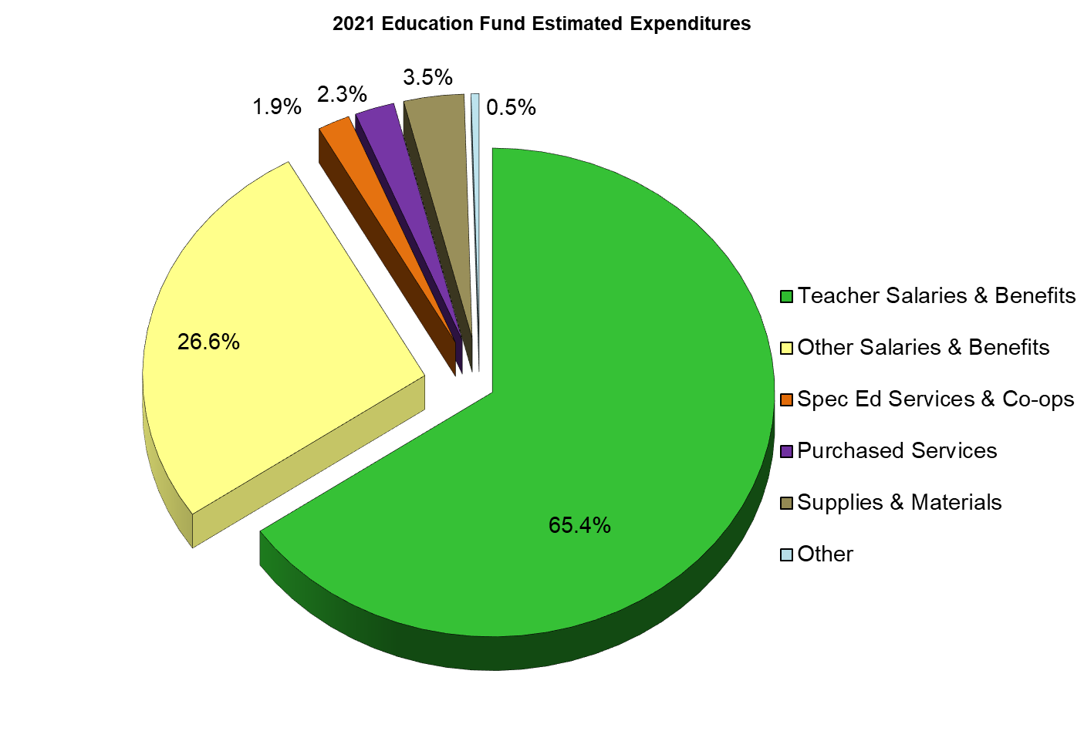
Non-Teaching Staff Salaries and Benefits
Teacher
Salaries and Benefits
But See Next 2 Slides!!!

Slide 13
100% of Referendum Fund will be used for teacher salaries and benefits! These are direct instructional costs!

Slide 14
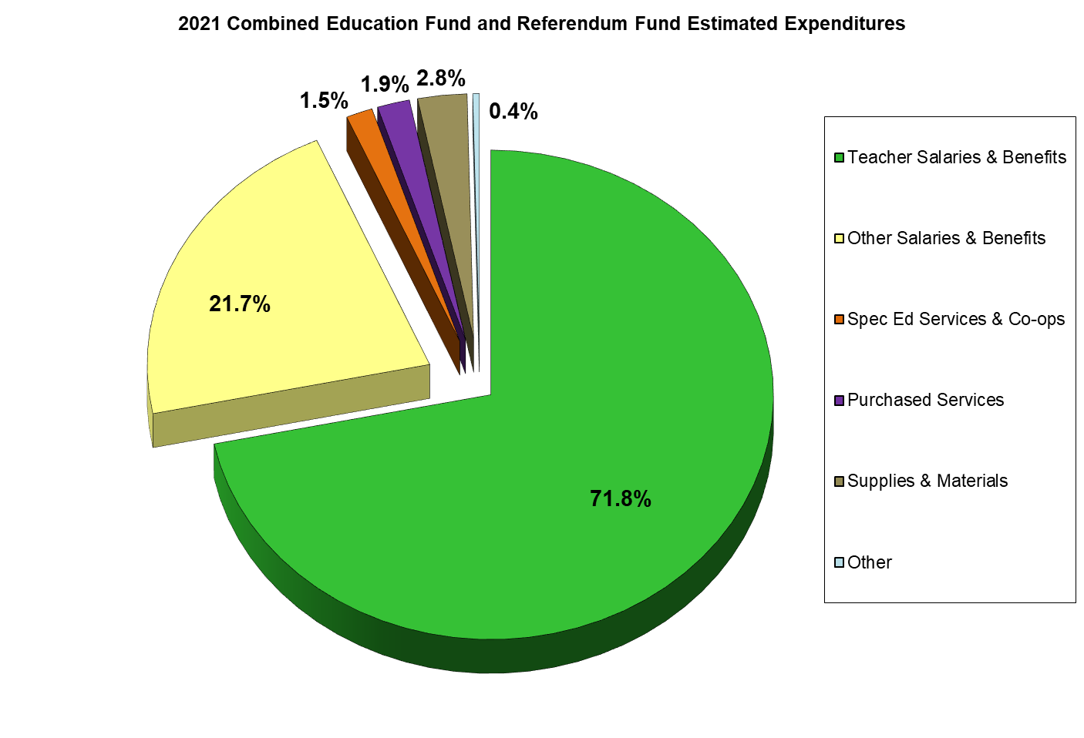
Teacher
Salaries and Benefits
Proposed Expenditures

Slide 15
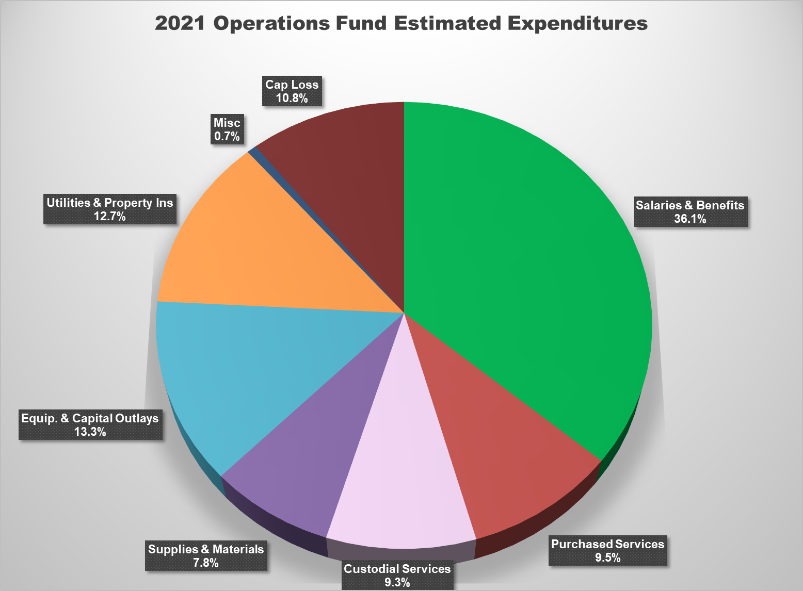

Slide 16
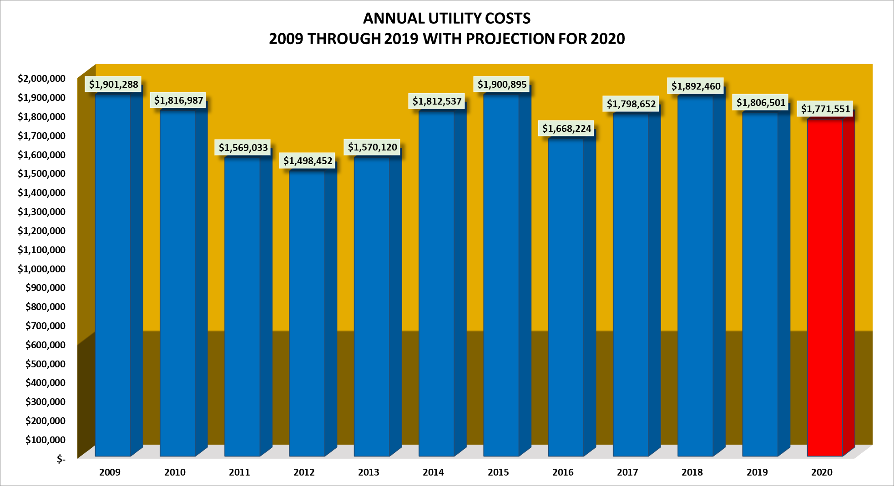

Slide 17
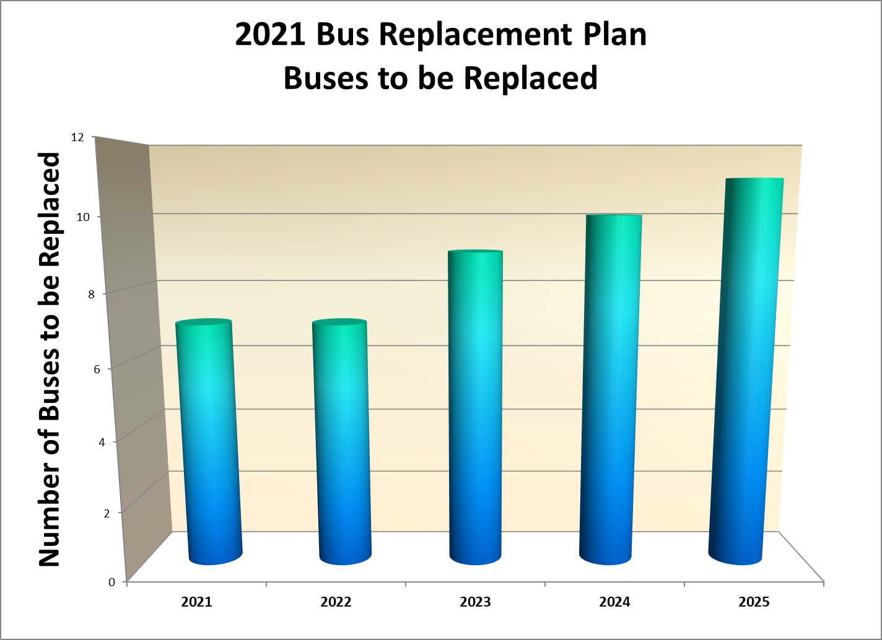

Slide 18
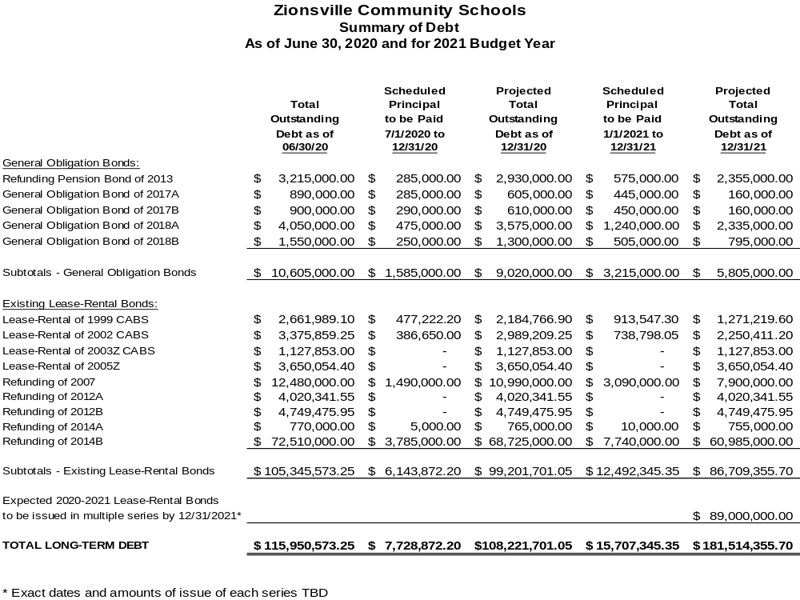
Things to Know
About Debt Service
$138,795,838.05 in principal paid off since 2005 to 6/30/2020.
Refinancing the 2005 bond issues saved $13.1 million (NPV).
Debt Service not expected to increase tax rates in 2021.

Slide 19

2021
BUDGET:
REVENUES
How much revenue will we have? What are the sources of our revenues?

Slide 20
A Brief Tour of Revenues
Our main focus is on the two largest sources of revenues:
  Property Taxes
  State Support
A number of smaller, miscellaneous revenue sources are also considered in budgeting:
  Excise Taxes
  Interest Income
  Indirect Costs
  Facilities Rentals
  Etc.

Slide 21

The REVENUE Structure
$
State Tuition SUPPORT
$
Local Property Taxes
Operations Fund
Debt Service
Operating Referendum
Shared by Education Fund and Operations Fund
Interfund Transfers are now an important part of our fund accounting and budgeting processes!

Slide 22
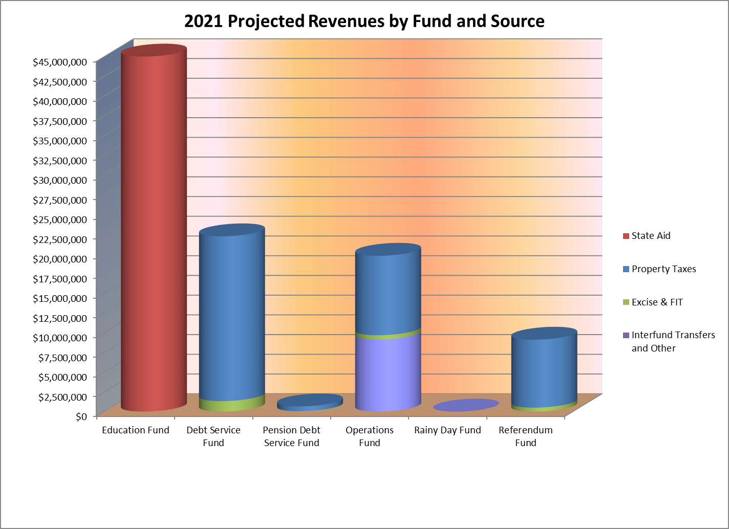
State Aid
Property Taxes
REVENUES

Slide 23
State Funding Formula for
Tuition Support
Five Basic Components:
The two major items:
Foundation
Complexity
The three minor items:
Special Education
Career and Technical
Academic Honors Diplomas
Unrestricted
Approx. 90% of Total State Funding
Restricted
Approx. 10% of Total State Funding

Slide 24

Basic State Funding Formula
Lowest Pct. in Indiana - the state FY2021 average is 19.00%
State Funding Per Pupil = State Foundation Amount +
(State Complexity Amount X Pct. of Students in Poverty)
Here’s the Math for ZCS:
2021 State Foundation Amount = $5,703
2021 State Complexity Amount = $3,675
ZCS Percentage of Students in Poverty = 1.19%
(Students in Poverty are those in TANF, SNAP, or Foster Care)
$5,703 + ($3,675 X 1.19%) = $5,747 per pupil
$44

Slide 25
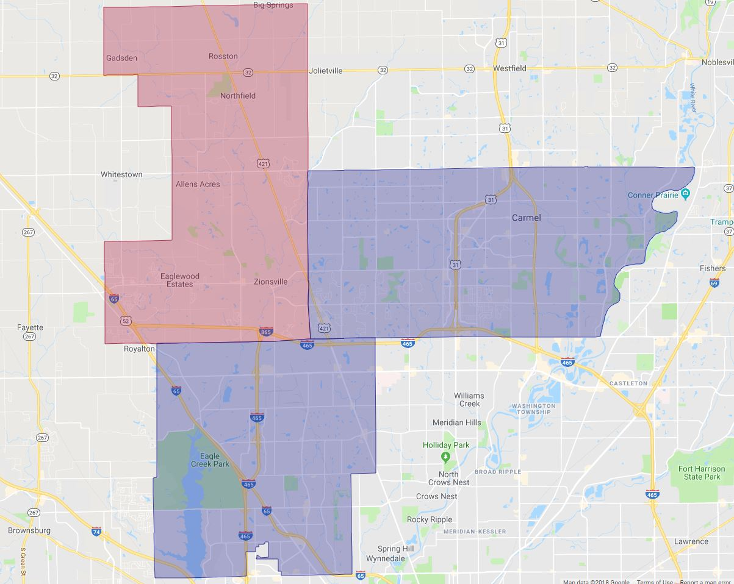

$44
$87
$832

Slide 26
$7,791
$5,747
The Gap!
In 2021 the
difference will be $2,044 per pupil.
This will be approx. $15 million for our entire enrollment.

Slide 29
In 2021 we’ll have 81% of the buying power we had in 2008!

Slide 30
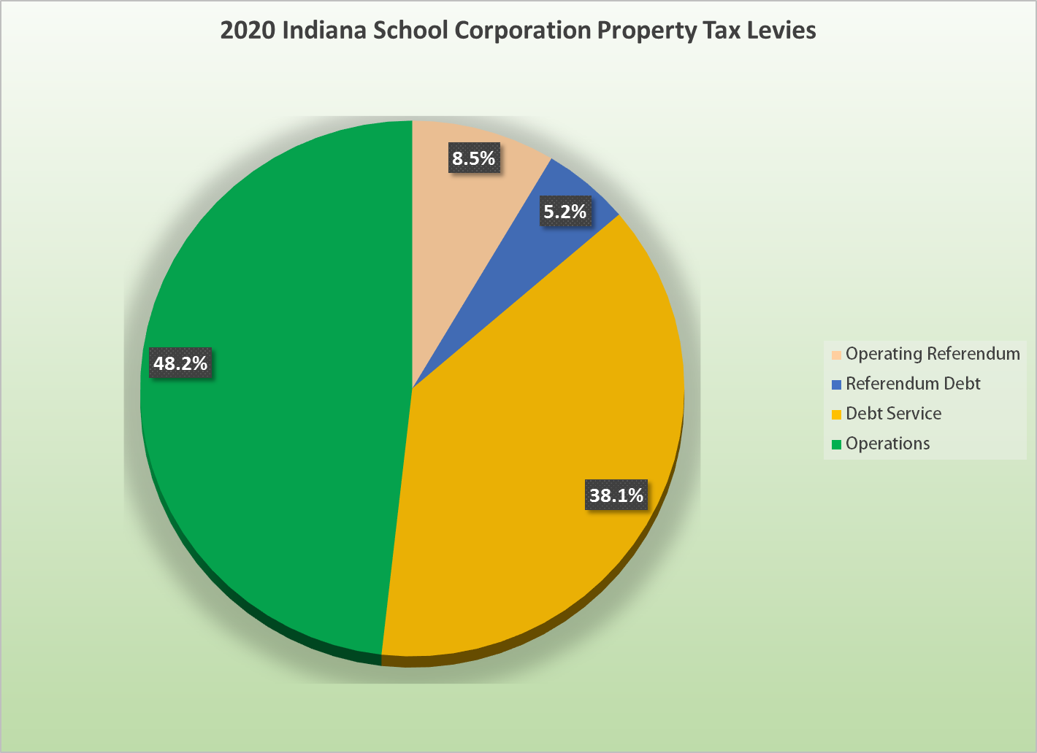
Statewide total is $3.5 Billion!
ZCS is 1.1% of the statewide total

Slide 31

2021 BUDGET:
CASH FLOWS AND
CASH BALANCES
Will our budget be balanced?
YES
*

Slide 32
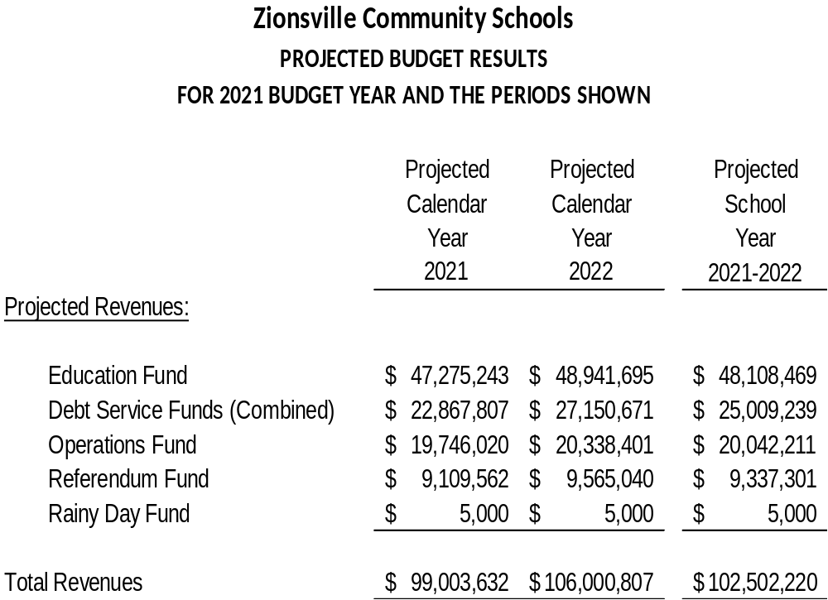

Slide 33
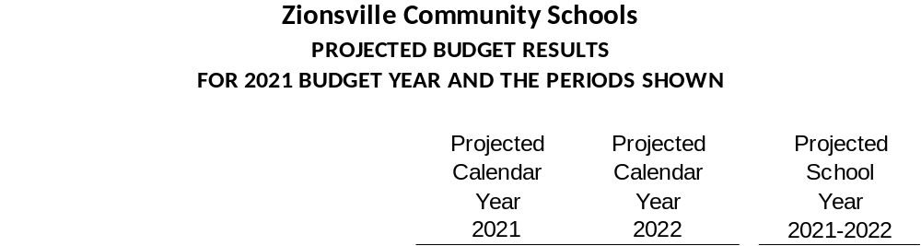
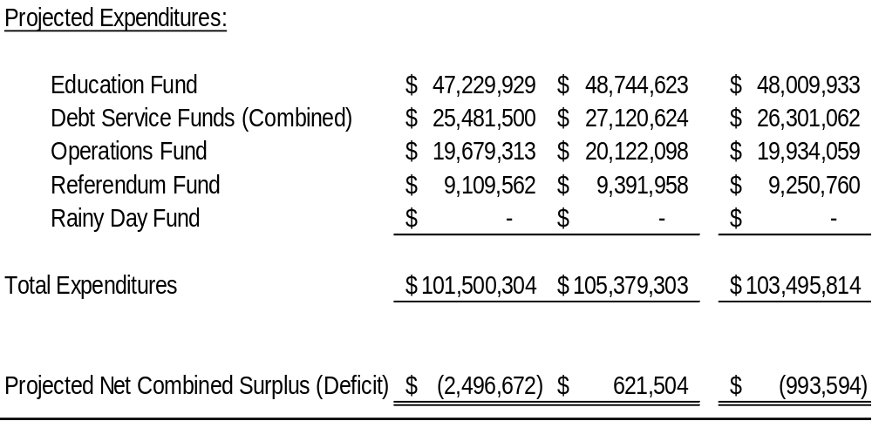

Slide 34
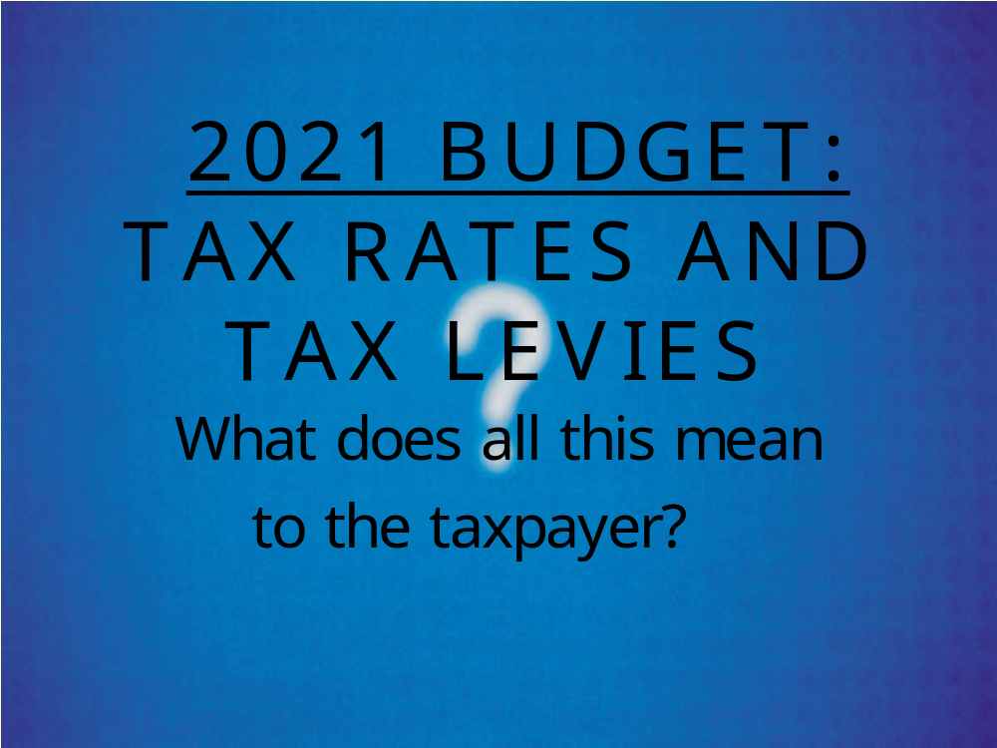

Slide 35

Multi-Year Financial Forecasting?
20-Year Strategic Plan for
Tax Rate Management
Historical Actuals (Rev./Exp. Monthly/Annual Totals)
Multi-year Forecast (defined assumptions for future Rev./Exp.)
Current
Budget Year
2021 is Year Seven!

Slide 36
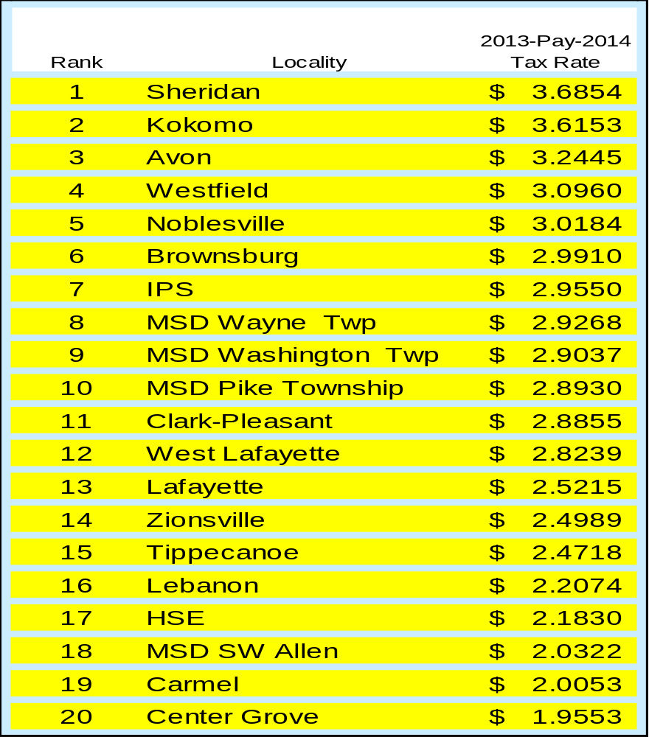

2014 Total local property tax rates compared with peer communities
14th Place!

Slide 37
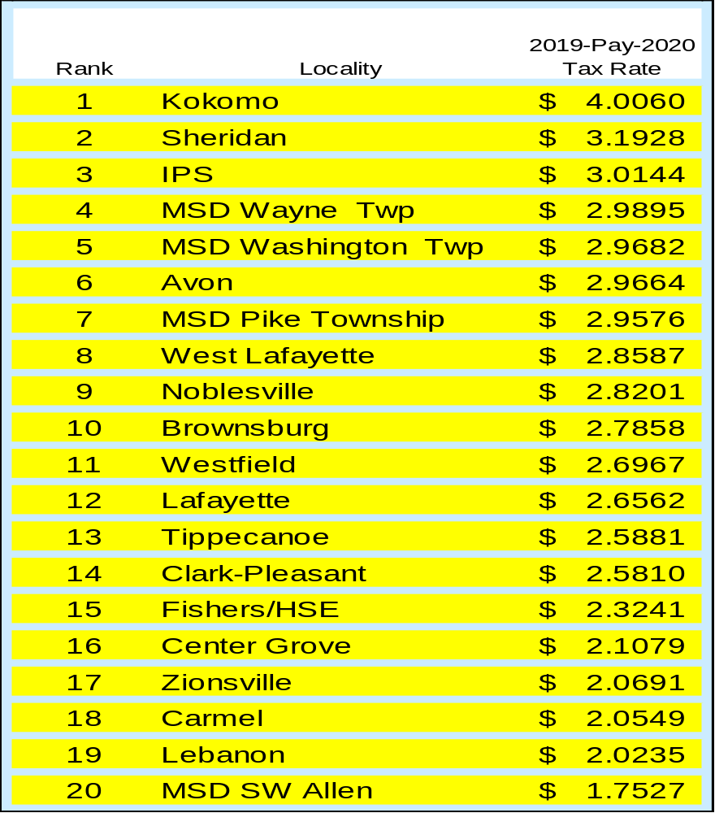
2020 Total local property tax rates compared with peer communities
Are Zionsville’s taxes HIGH like it says on “social media”???
17th out of 20!

Slide 38
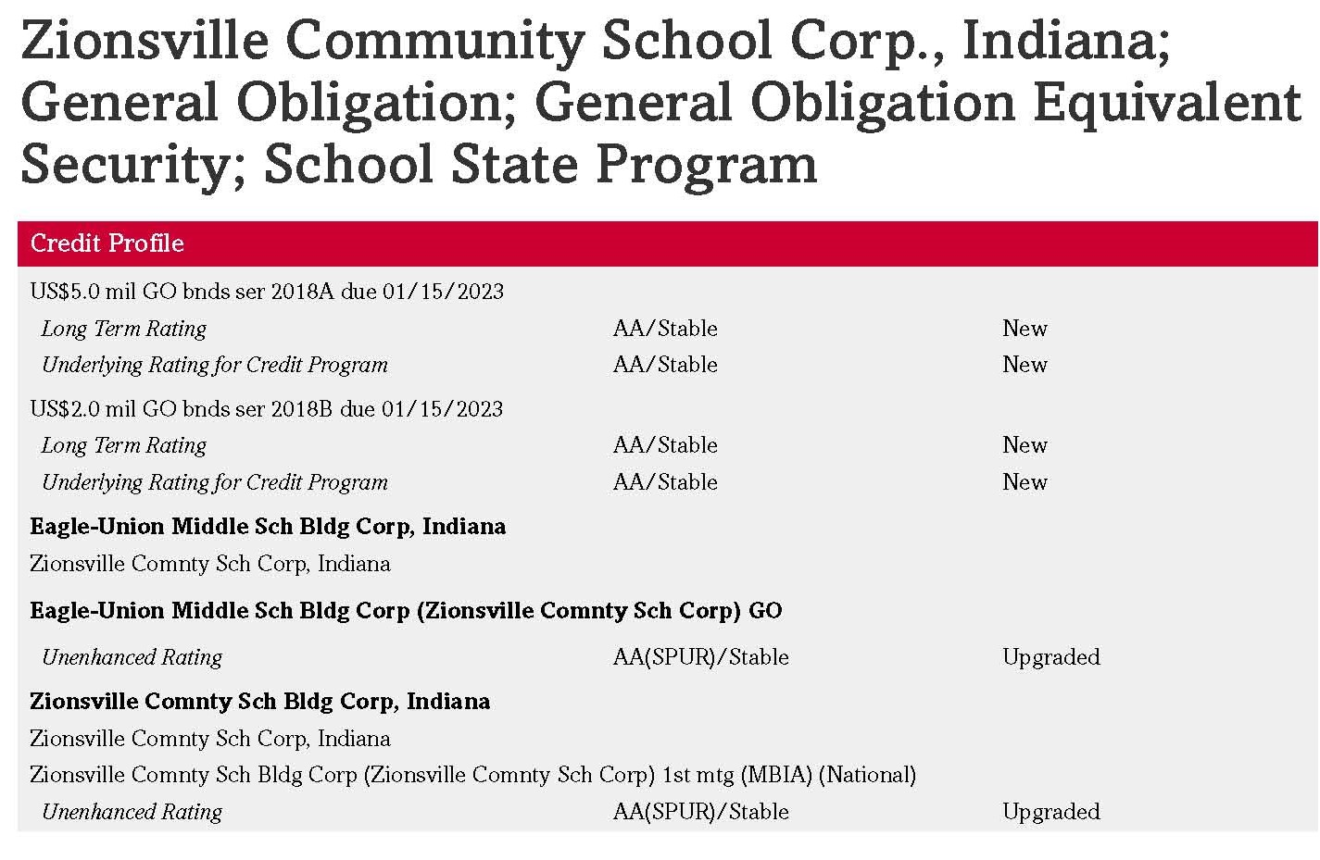

Slide 39
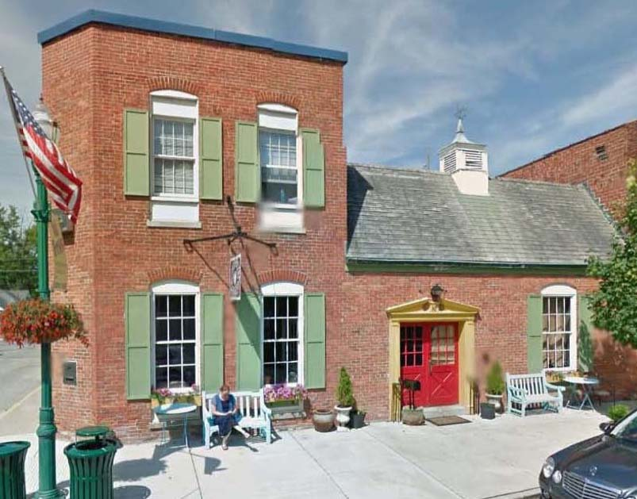
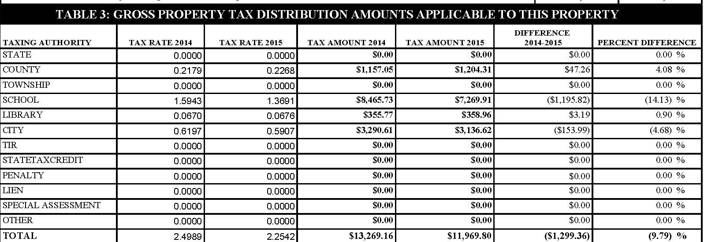
14.13% Decrease in School Tax Rate
drove entire bill down almost 10%!

Slide 40
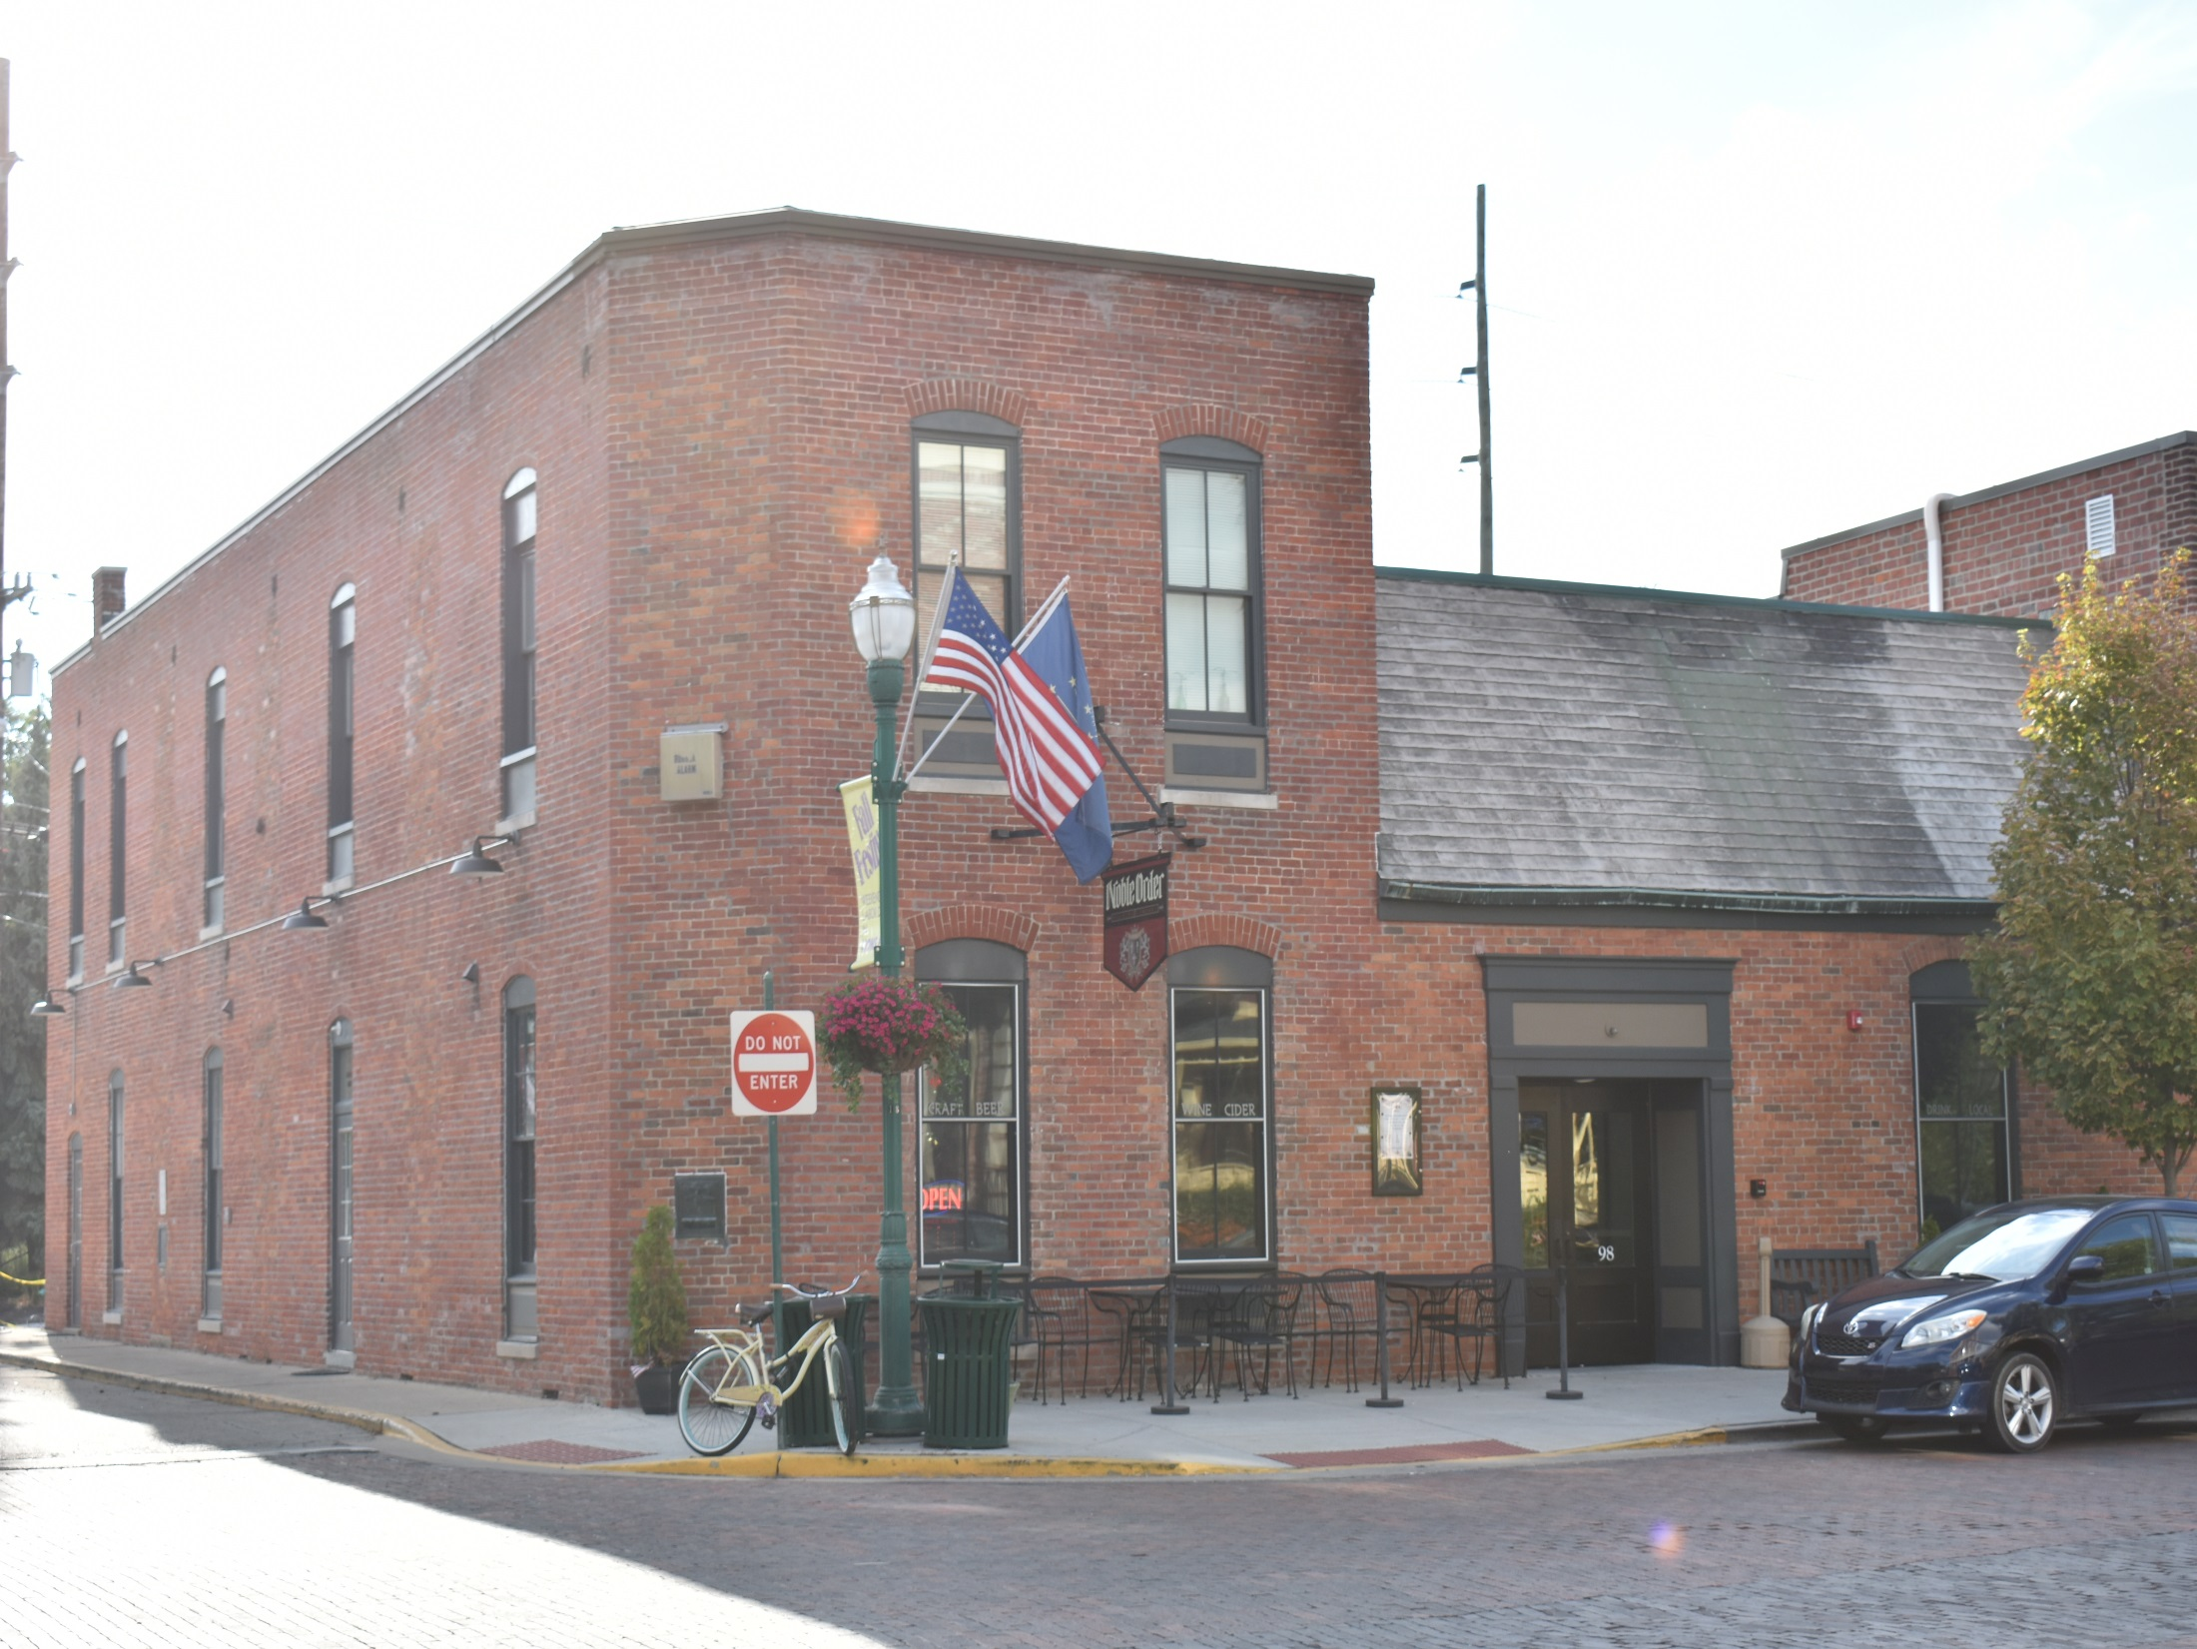
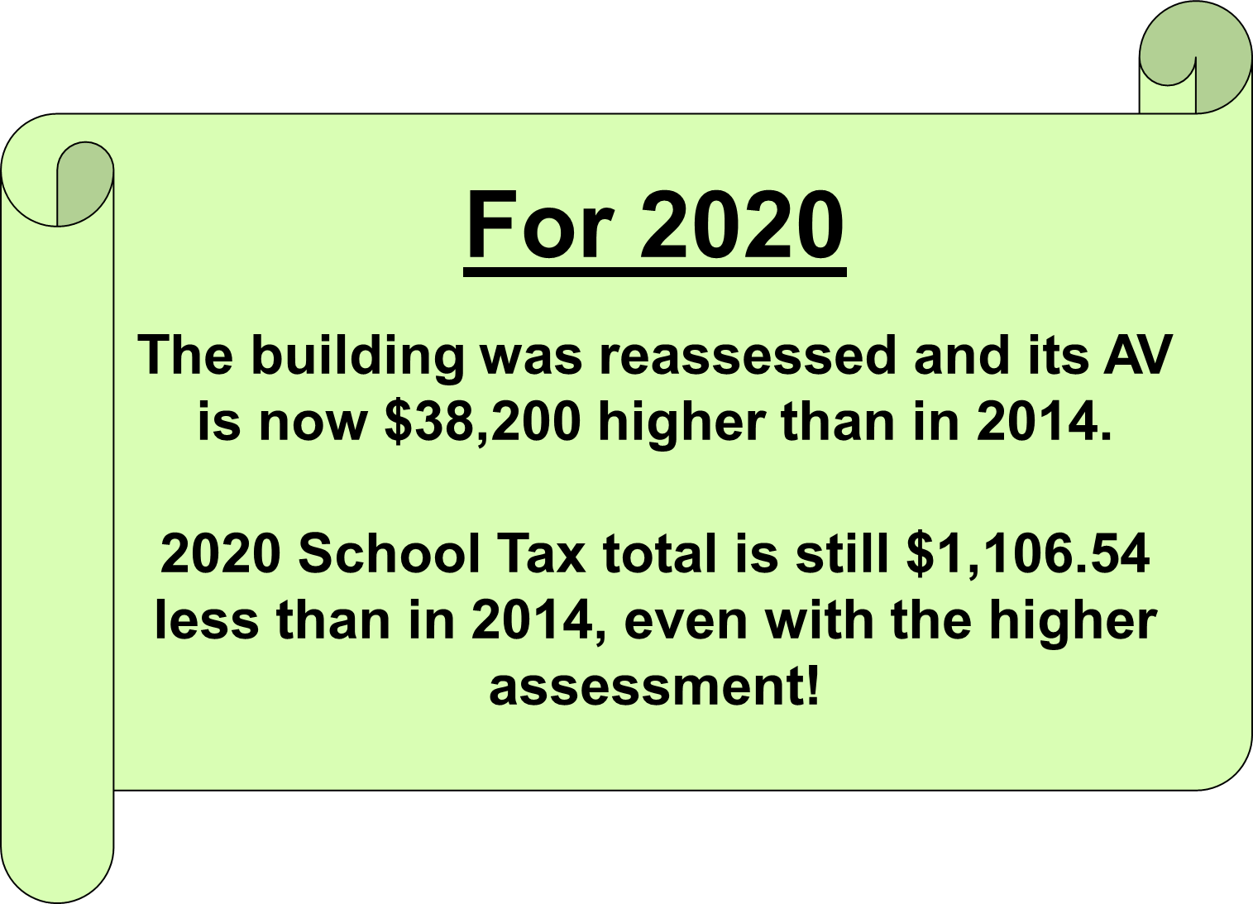
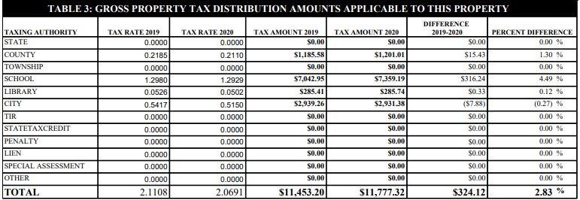

Slide 41
2020 UPDATE:
We are sustaining rates at a level 30 cents below the 2014 rate.
Further, this tax rate level of about $1.30 can be maintained for the next decade and beyond.
21
X

Slide 42
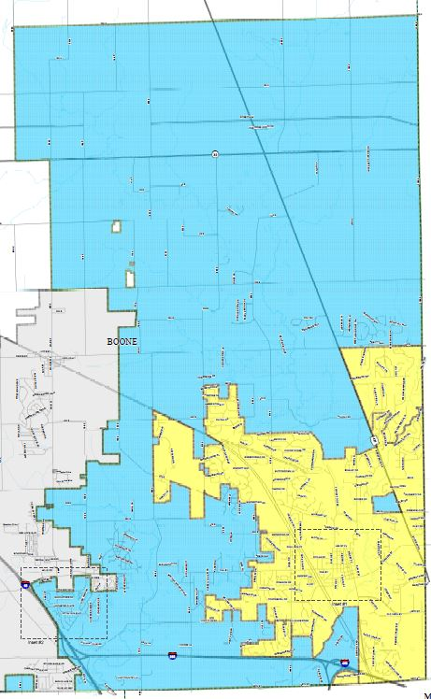
Just ONE ZCS Tax Rate!
Union Twp. Rural Tax Rate $1.9133
Eagle Twp. Urban
Tax Rate $2.0330
Union Twp. Urban Tax Rate $2.0782
SIX separate
municipal
tax rates
Town of Zionsville
Tax Rate $2.0691
Eagle Twp. Rural
Tax Rate $1.8681
Town of Whitestown
Tax Rate $3.0168

Slide 43
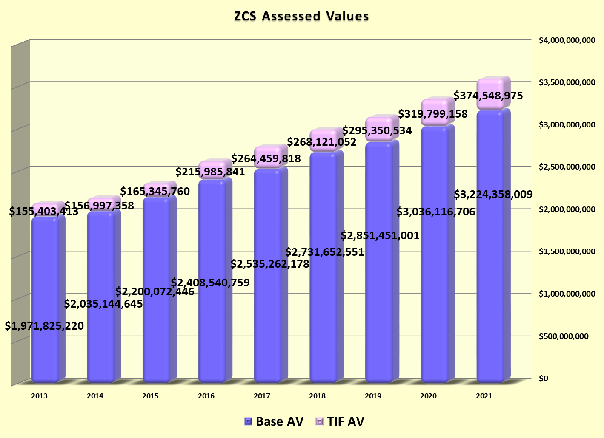

Slide 44



Assessed Valuation Mix Matters!
Property Tax Caps!
3% cap*
2% cap*
1% cap*
COMMERCIAL and All OTHER
FARM and RENTAL
18.12%
13.17%
RESIDENTIAL
68.71%
*Caps are applied to the GROSS Assessed Value

Slide 45
ZCS Property Tax Cap Losses
Per DLGF Property Tax Cap Reports
Total Tax rate unchanged – losses increased!
Total Cumulative Losses through 2020 = $24 Million!

Slide 46
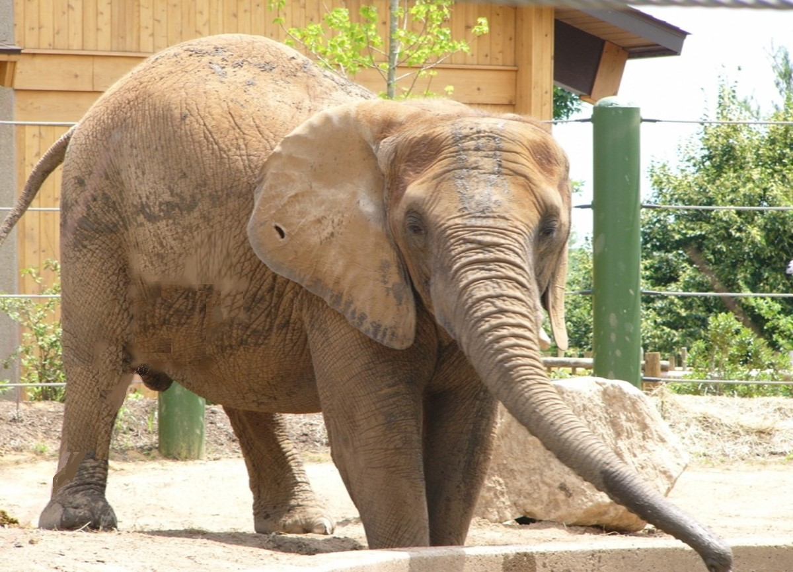
The Elephant
COVID-19

Slide 47
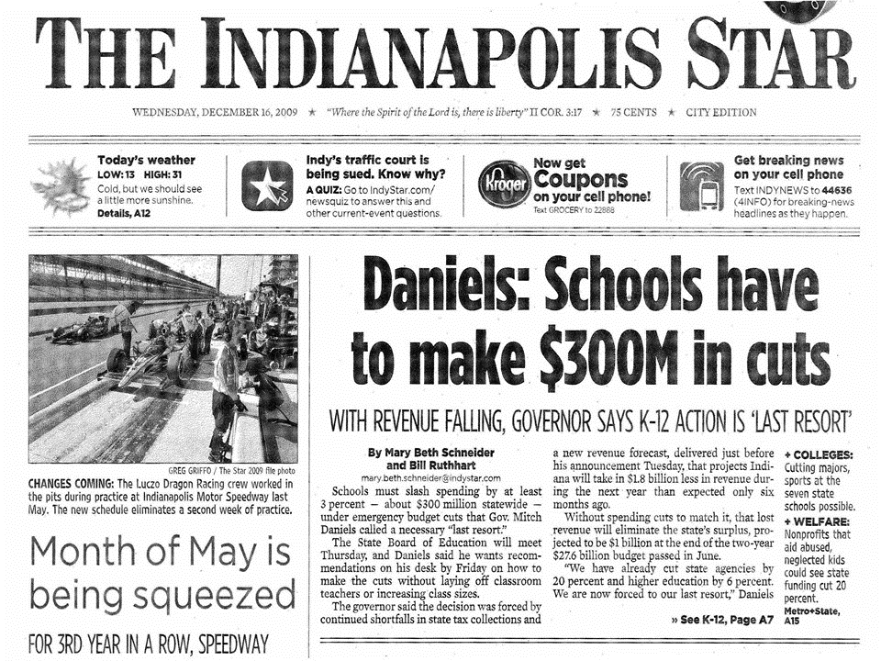
ZCS Financial Issues
What’s happening to state revenues?
What is going to happen next?
What must we do to prepare?

Slide 48
Two Types of Answers
The Political Answers
The Financial Answers

Slide 49

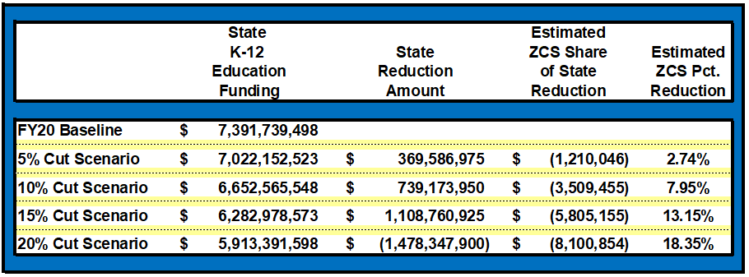
Possibly A VERY Rainy Day

Slide 50
Five-Year Fiscal Plan
Year 1
Year 2
Year 3
Year 4
Year 5
??? Possible State Funding Cuts
Sep 15
FY21
FY22
FY23
FY24
FY25
Jul 1
Jul 1
Jul 1
Jul 1
Jul 1
2020
2020
2021
2022
2023
2024
2024
Today
Jul 1
Jul 1
2021 Biennial Budget Session takes effect - BUDGET REDUCTIONS?
2023 Biennial Budget Session takes effect
Note: This plan is designed to deal with what we will term the “most likely version of the worst-case scenario.” Specifically, we have tailored this plan to address a reduction from our current funding of 10% with a duration of this funding reduction of up to five years.

Slide 51

Financial Solution Possibilities:
Increase Revenues
Use Cash Reserves
Decrease Spending

Slide 52
INCREASE REVENUES (Approx $1 Million)
 |  |  |  |  | Proposed | Estimated |  | Increase | Increase
 |  | Current | Current |  | 2021 | 2021 |  | In | In
 | Fund | Rate | Levy |  | Rate | Levy |  | Rate | Levy
 | Referendum Fund | $0.2355 | $ 7,903,182.00 |  | $ 0.2444 | $ 8,447,914.00 |  | $0.0089 | $ 544,732.00
 | Operations Fund | $0.2987 | $ 9,068,881.00 |  | $ 0.3033 | $ 9,485,495.00 |  | $0.0046 | $ 416,614.00
 | Net Increases | $0.5342 | $ 16,972,063.00 |  | $ 0.5477 | $ 17,933,409.00 |  | $0.0135 | $ 961,346.00
Notes:
Assumes increasing Operating Referendum tax rate to the allowed 24.44 cent maximum, and increasing Operations Fund tax rate to the maximum per the DLGF’s calculations for the 2021 AVGQ, for the 2021 budget year.
We would offset the net tax rate increases shown by a corresponding decrease in the Debt Service Fund’s tax rate to maintain rate neutrality per our 20-Year Strategic Tax Rate Management Plan.

Slide 53

CASH RESERVES?
USE IN LAYERS!

Slide 54
For a HURRICANE Rainy Day
ZCS LAYERS OF RESERVES
  LAYER 1
    RAINY DAY FUND
  LAYER 2
    REFERENDUM FUND
    LAYER 3
      GROW FUND
    LAYER 4
      EDUCATION FUND

Slide 55
POSSIBLE SPENDING CUTS
Cancel ALL discretionary spending
  NO new equipment, goods, or services
Hiring Freeze on ALL new positions
Capture ALL attrition where possible
Consider Pay Freezes
Last Resort Measures:
Reductions in Force
Request Union Concessions
Miscellaneous Other Acts of Desperation

Slide 56

2021 BUDGET PRESENTATION SUMMARY:
The five questions about the proposed budget:
How much would we actually spend and what will we spend it on? An estimated $101 million will be expended. The major expenditure categories will be: personnel costs 52%, debt service 25%, professional and contractual services 5%, interfund transfers 7%, utilities and insurance 3%, supplies, equipment and capital outlays 6%, and other and misc. 2%.
What revenues and resources will we have? All combined, our revenues should be about $99 million, which will be made up of approximately 47% state funding, 40% property taxes, and 13% other.
Will our 2021 budget be balanced? YES - with the caveat that the Debt Service Fund will adjust its cash balance slightly to comply with DLGF regulations and due to the creation of the new Referendum Debt Fund in 2021. All other funds will be balanced.

Slide 57
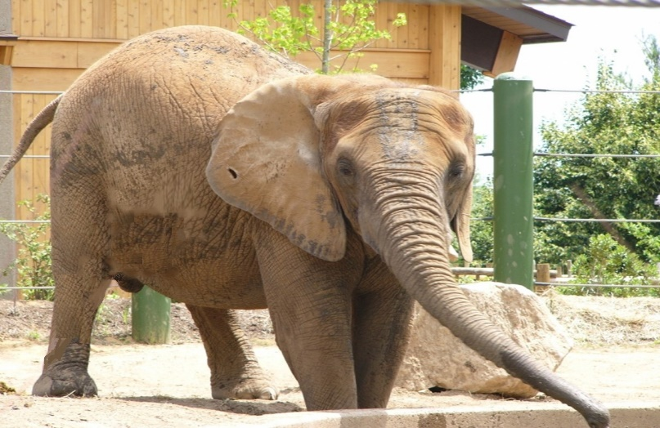

2021 BUDGET PRESENTATION SUMMARY:
The five questions about the proposed budget:
What does all this mean to the taxpayer? The total school tax rate for 2021 should be equal to or slightly below the 2020 rate. The school tax bill for 2021 should be approximately the same as in the past several years for nearly all homeowners. Other property likely will see very small changes depending on their assessment and location.
What is our long-term outlook? Our outlook is fair. Our financial position remains stable unless
however

Slide 58

Thank You for Your Kind Attention!

