Slide 1

2023 Budget Presentation
Budget Hearing:
October 3, 2022
Budget Adoption:
October 17, 2022

Slide 2
DISCLAIMER:
THE ESTIMATED EXPENDITURES, PROJECTIONS OF COSTS, TAX RATES, LEVIES AND APPROPRIATIONS, AND ALL OTHER INFORMATION AND DATA PRESENTED HEREIN ARE INTENDED FOR INFORMATIONAL OR ANALYTICAL USE ONLY AND MAY NOT BE USED FOR ANY OTHER PURPOSE. THE STATE FORMS SHOWN IN THE OFFICIAL BUDGET (STATE FORMS 1 THROUGH 4B, THE CAPITAL PROJECTS PLAN, THE BUS REPLACEMENT PLAN, AND ALL OTHER STATE-REQUIRED OR RELATED DOCUMENTS) CONSTITUTE THE OFFICIAL 2023 BUDGET OF THE ZIONSVILLE COMMUNITY SCHOOLS.
DIFFERENCES BETWEEN THE AMOUNTS SHOWN ON THE OFFICIAL STATE FORMS AND DOCUMENTS AND ITEMS IN THIS PRESENTATION, IF ANY, ARE SPECULATIVE, BASED ON ASSUMPTIONS ABOUT CERTAIN FUTURE EVENTS, AND CANNOT BE CONSTRUED AS CONTRADICTIONS OF OR DISCREPANCIES IN OR WITH THE OFFICIAL BUDGET.
FURTHER, THE PROJECTIONS AND ESTIMATES SHOWN, WHILE BASED ON THE MOST CURRENT INFORMATION AVAILABLE AT THE TIME OF THEIR FORMULATION, ARE SUBJECT TO UNKNOWN OR UNEXPECTED EVENTS AND CONTINGENCIES AT ANY TIME DURING THE BUDGET YEAR.
THE ACTUAL FINANCIAL RESULTS ACHIEVED MAY THEREFORE BE MATERIALLY DIFFERENT FROM THE PROJECTIONS AND ESTIMATES SHOWN.

Slide 3
Budget Process
Working Budget
Approved Budget
Advertised Budget

Slide 4

Our Funds
Education
Operating Referendum
Operations
Debt Service
Exempt Debt Service (Capital Referendum)
Rainy Day

Slide 5
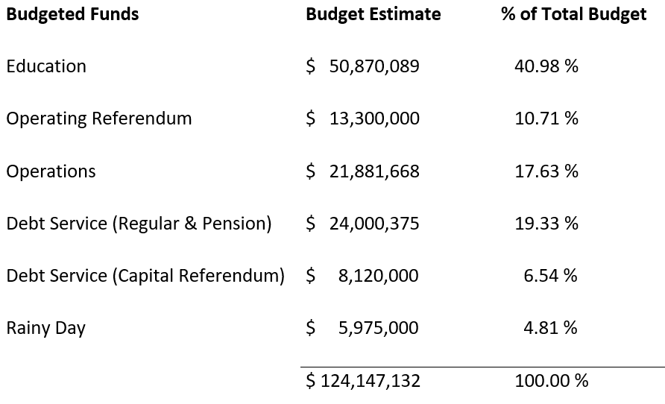
2023 Budget

Slide 6
THE FIVE QUESTIONS WE ARE HERE TO DISCUSS:
How much do we need to spend and what are the details of these expenditures?
What revenues and resources will we have to support the needed expenditures?
Will our budget be balanced?
What does this mean to the taxpayer?
What is our long-term outlook?

Slide 7

2023 BUDGET:
EXPENDITURES
How much do we need to spend and what are the details of those expenditures?

Slide 9
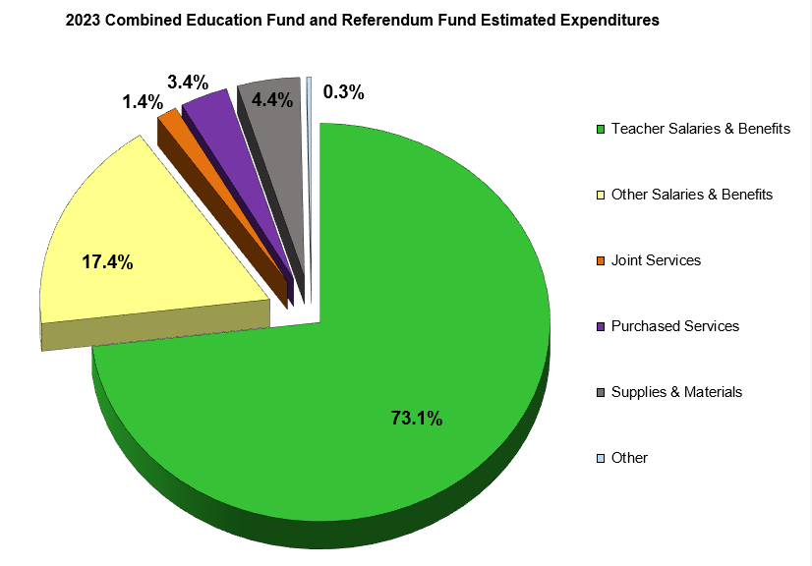
PROPOSED EXPENDITURES

Slide 10
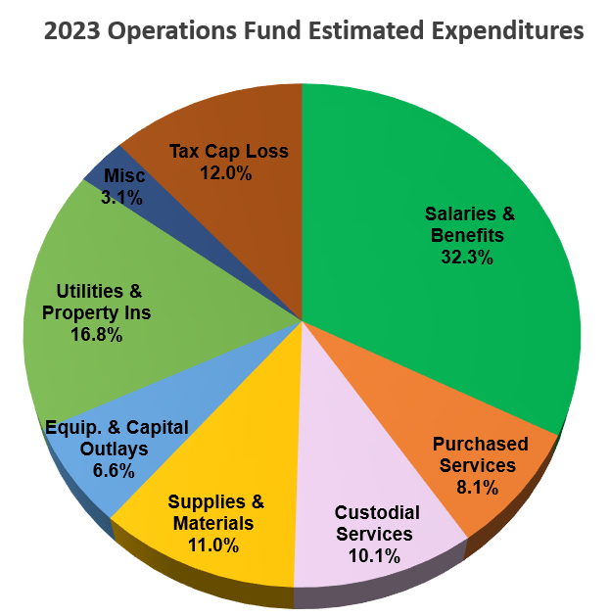
PROPOSED EXPENDITURES

Slide 11
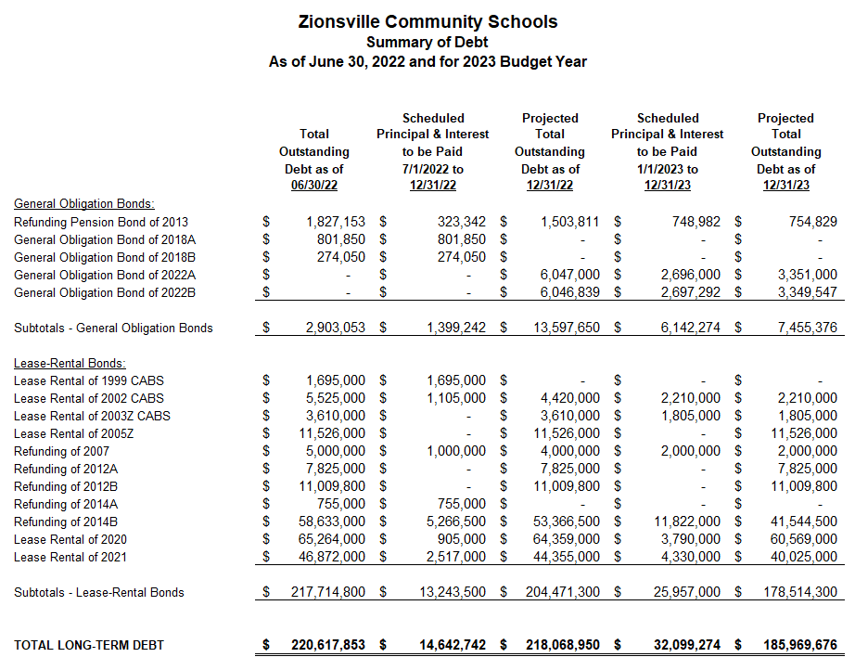

Slide 12

2023 BUDGET:
REVENUES
What revenues and resources will we have to support the needed expenditures?

Slide 13
The REVENUE Structure
$
State Tuition SUPPORT
$
Local Property Taxes
Operations Fund
Debt Service
Referendum Funds (Operating and Capital)
Shared by Education Fund and Operations Fund
Interfund Transfers are an important part of our fund accounting and budgeting processes!

Slide 14
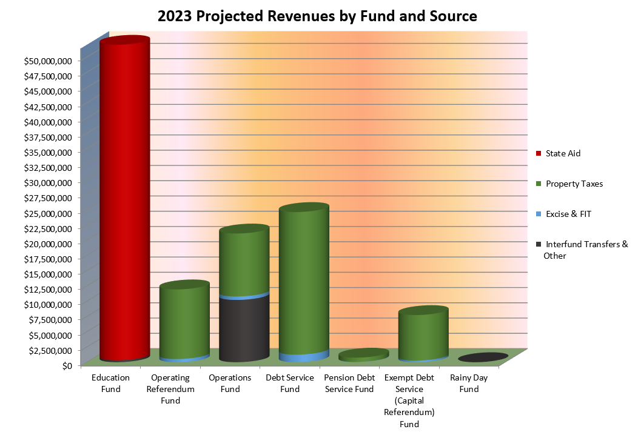
ANTICIPATED REVENUES

Slide 15
State Funding Formula for
Tuition Support
Five Basic Components:
The two major items:
Foundation
Complexity
The three minor items:
Special Education
Career and Technical
Academic Honors Diplomas
Unrestricted
Approx. 90% of Total State Funding
Restricted
Approx. 10% of Total State Funding

Slide 16

Basic State Funding Formula
State Funding Per Pupil = State Foundation Amount +
(State Complexity Amount X Pct. of Students in Poverty)
Here’s the Math for ZCS:
2023 State Foundation Amount = $6,235
2023 State Complexity Amount = $3,775
ZCS Percentage of Students in Poverty = 1.1769%
(Students in Poverty are those in TANF, SNAP, or Foster Care)
$6,235 + ($3,775 X 1.1769%) = $6,279 per pupil
$44.43

Slide 17

2023 BUDGET:
Will our budget be balanced?
YES
*

Slide 18
2023 Budget
Tax Rates and Tax Levies
  What does this mean to the taxpayer?

Slide 19
Tax Rate Stability Plan
“Our goal is to maintain a stable tax rate for our taxpayers at or near $1.30 for the next twenty years.”
2023 is year 9!

Slide 20
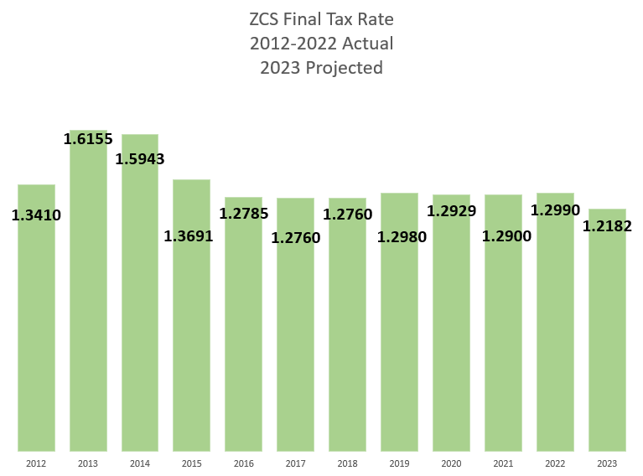
Goal: $1.30

Slide 21
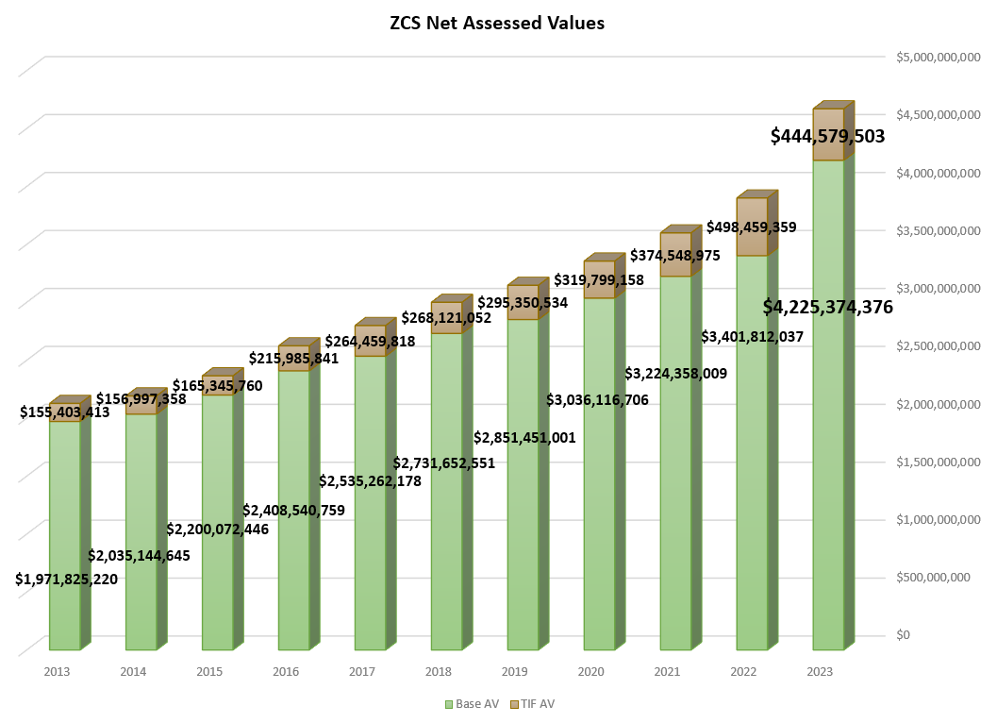

Slide 22
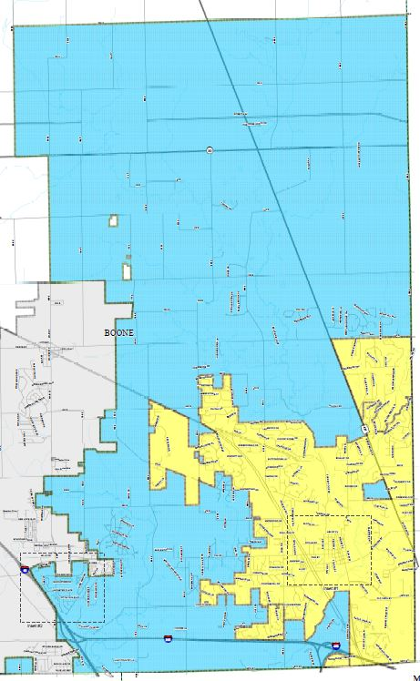
Just ONE ZCS Tax Rate!
Union Twp. Rural Tax Rate $1.8961
Eagle Twp. Urban
Tax Rate $2.0570
Union Twp. Urban Tax Rate $2.0780
SIX separate
municipal
tax rates
Town of Zionsville
Tax Rate $2.0570
Eagle Twp. Rural
Tax Rate $1.8751
Town of Whitestown
Tax Rate $3.0694

Slide 23
2023 BUDGET PRESENTATION SUMMARY:
The five questions about the proposed budget:
How much do we need to spend and what are the details of those expenditures? An estimated $113 million will be expended. The major expenditure categories will be: salaries and benefits 50%, debt service 24%, supplies and capital outlays 11%, interfund transfers 6%, professional and contractual services 5%, utilities and insurance 3%, and other misc. items 1%.
What revenues and resources will we have to support the needed expenditures? All combined, our revenues should be about $112 million, which will be made up of approximately 48% state funding, 47% property taxes, and 5% other misc. sources.

Slide 24
2023 BUDGET PRESENTATION SUMMARY:
The five questions about the proposed budget:
Will our 2023 budget be balanced? YES - with the caveat that the Debt Service Fund will adjust its 2023 ending balance slightly to comply with DLGF regulations and the Rainy Day Fund where the appropriations requested are based on the 2022 fund balance. All other funds will be balanced.
What does this mean to the taxpayer? The total school tax rate for 2023 should be below the 2022 rate. We are anticipating a rate near $1.21 once we are through the complete DLGF review process.

Slide 25
2023 BUDGET PRESENTATION SUMMARY:
The five questions about the proposed budget:
What is our long-term outlook? Our long-term outlook is stable and staying strong financially with a balanced budget and a conservative approach to finances that will allow us to weather economic uncertainty.

Slide 26
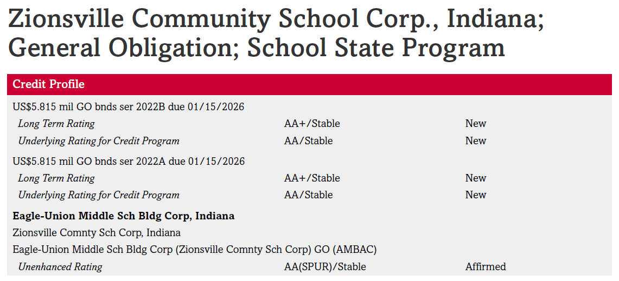

Slide 27
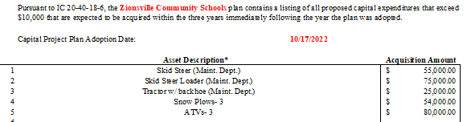
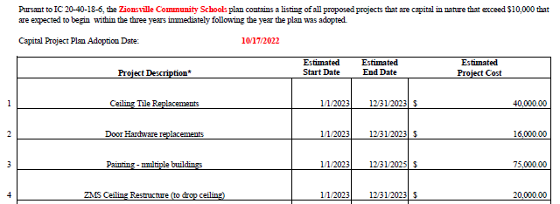
Capital Asset Plan
Full Capital Asset Plan available at:
https://www.zcs.k12.in.us/apps/pages/budgets

Slide 28
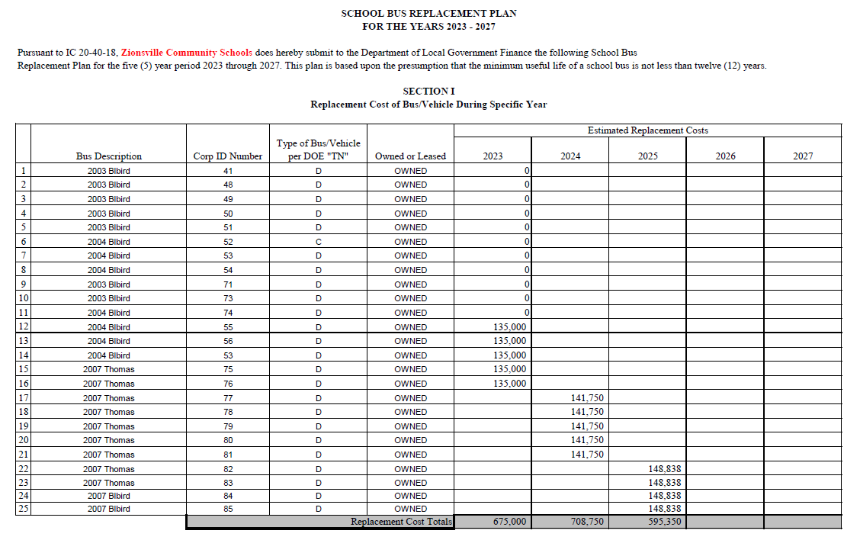
Bus Replacement Plan
Full Bus Replacement Plan available at:
https://www.zcs.k12.in.us/apps/pages/budgets

Slide 29

Thank You for Your Kind Attention!

