Slide 1

Kindergarten Information Night 2025-2026
March 4, 2025
Notes:
Vanessa

Slide 2

Notes:
Dana

Slide 3

AGENDA
Introductions
IVE mission & Facts
Nurse Ana
Registration process
School Readiness
Sample School Schedule
August Bus Ride Experience
Timeline
IVE PTA
Questions
School Tour
GARCIA
Notes:
Vanessa

Slide 4
Team Members
Vanessa Garcia- Principal
Dana Hunter- Assistant Principal
Liliana Medina- Family Partnership Liaison
Wendee Fowler- Registrar
Laura Burnett- Assistant to the Principal
Ana Martin- School Nurse
Darcy Wilson- PTA President
GARCIA
Notes:
Vanessa

Slide 5
IVE Mission
We are a community focused on high-quality learning and the social-emotional well-being of our students. We understand our students’ individual strengths and needs as we prepare them to be global citizens.
Notes:
Vanessa

Slide 6

Welcome to Issaquah Valley (IVE)
Home of the Cougars!​
Mascot: Cougar​
Colors: Blue, Green, and White
Notes:
Vanessa

Slide 7
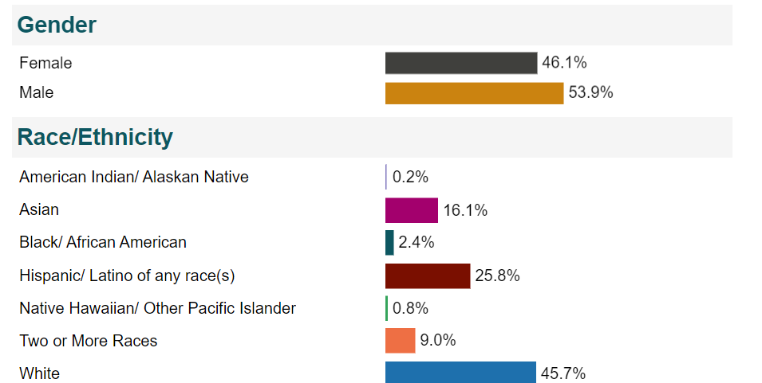
IVE
About 650 students in grades K-5
32 classroom teachers
Dual Language in grades K-5 (242 students)
Mascot is the Cougar
Spirit colors are blue and green
Spirit day is Friday
Diverse population
122 Multilingual Learners
Notes:
Vanessa

Slide 8


Notes:
Vanessa

Slide 9

Immunizations & Life-Threatening Health Conditions for Students
New to the Issaquah School District Including Incoming Kindergarten Students
  2025-2026
Notes:
Ana

Slide 10
Medically Verified Immunization Records
Students new to the Issaquah School District and incoming Kindergarten students need to provide a medically verified immunization record at the time of registration. ​
​
A medically verified record can come directly from the Washington State Immunization Information System (WAIIS). ​
​
The WAIIS is the database for Washington State and is where medically verified immunization information is maintained. All parents have access to this site to print a validated Certificate of Immunization (CIS) for students. Health Care Practitioner offices also have this information for their families.​

Slide 11
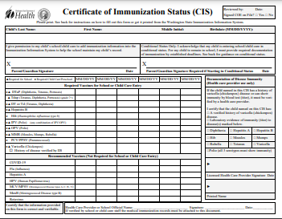
Acceptable Immunization Documentation Includes ONE of the Following:​
A Certificate of Immunization Status (CIS) printed from the (WAIIS) ​
A physical copy of the State CIS form with a healthcare provider signature. ​
A physical copy of the CIS with accompanying medical immunization records from a healthcare provider verified and signed by school staff
A CIS printed from MyIR.
Wa.myir.net

Slide 12
Required Immunizations for New Students
2 MMR’s (measles, mumps and rubella) given in the appropriate time frames​
5 doses of DTaP (diphtheria, tetanus & pertussis) given in the appropriate time frames​
2 doses of varicella given in the appropriate time frames​
4 doses of polio (IPV) given in a specific time frames​
3 doses of Hepatitis B, given in the appropriate time frames​
1 Tdap for students 7th grade and above​
Vaccines against COVID-19 are not required for school attendance.​

Slide 13
30 Day Conditional Status from the First Day of Attendance no Longer in Effect
Students will need a completed CIS or Certificate of Exemption (COE) on file at school before the first day of attendance.​
If students are missing doses, they will need to get all the doses they are eligible to receive before starting school. They can then attend school in a Conditional Status until the minimum valid date of the next vaccine is reached. They then have 30 calendar days to turn in documentation of having received the dose. This continues on until all vaccines have been administered and documented.

Slide 14
Example
If a child has all their immunizations except the 2-dose MMR series, and they get dose 1 of the MMR the day before school starts and it is documented with the school that day, the child can enter school because…​
  Dose 2 of the MMR cannot be given until 28 days after the first dose. ​
  Beginning on day 29 after the first dose, the child has 30 days to get MMR dose #2.

Slide 15
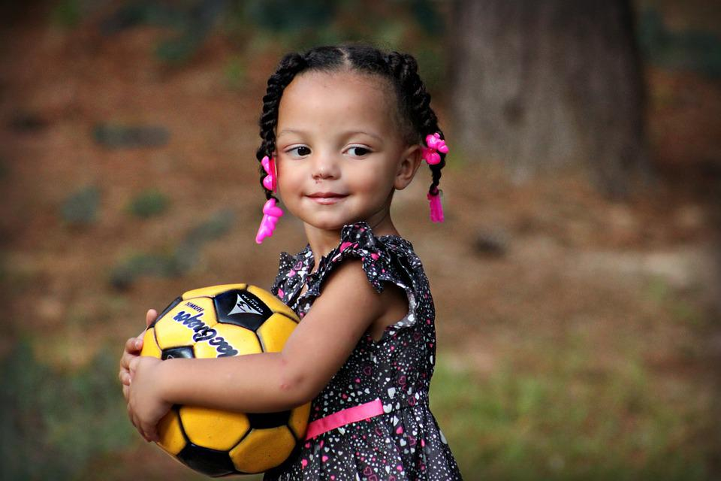
MY CHILD IS NOT 5 YEARS OLD YET…
Children can receive their school immunizations at age 4. Contact your healthcare provider to schedule your appointment. ​

Slide 16
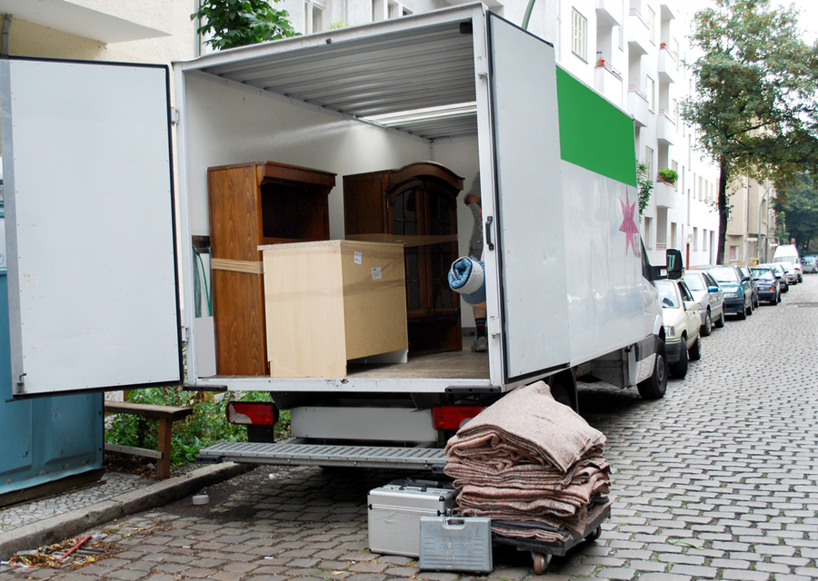
We are moving from another state and cannot find our immunization records. Now what? ​
Immunization records from another state’s immunization registry are accepted as medically verified records. ​
OR​
Call your provider in the state you moved from and have them send the immunization records directly to the school either by fax or by email.
This Photo by Unknown Author is licensed under CC BY-ND

Slide 17

We are moving from another country and cannot find our child's immunization records. What do we do?
Immunizations verified by the Immigration Dept are accepted​
If possible, contact the provider in your first country via email or phone to have them send you the records​
​Get established with a provider in this country. They can order lab titers to be drawn which will determine if your child has immunity to the different diseases.​

Slide 18
WHERE CAN I GET MY CHILD IMMUNIZED?
Your healthcare provider​
WithinReach, Family Health Hotline:
800-322-2588​
http://www.withinreachwa.org/​
Community Health Access Program:
206-284-0331 or 800-756-5437​
https://www.kingcounty.gov/depts/health/locations/health-insurance/access-and-outreach/community-health-access-program.aspx​

Slide 19
SUMMARY of IMMUNIZATION INFORMATION
Your student may register for school, but MAY NOT attend school until provider-verified immunizations have been received and validated by the school nurse. ​
The child must have all immunizations they are eligible to receive prior to starting school.
Or there is a Certificate of Exemption on file signed by the parent AND the licensed healthcare provider.
​

Slide 20
Please Notify the School if your Child has a Life-Threatening Health Condition such as:
A severe allergy for which an epinephrine auto injector device (Epipen™) has been prescribed.​
Diabetes​
Severe asthma​
A seizure disorder​
A cardiac condition​
Adrenal Insufficiency​
Other conditions​ of concern
​

Slide 21
Why does the school need to know if my child has one of these conditions? ​
If your child has a life-threatening condition, WA state law says there must be an emergency care plan and any associated medication in place in the school building before the child can attend school.
​
This is to keep the student safe in the event they experience a medical emergency during the school day. ​
If your child has a life-threatening condition, please contact the school nurse in your child’s school before the student attends. ​

Slide 22

Nurse Contact Information
Ana Martin
martina@issaquah.wednet.edu
425-837-6607

Slide 23
Questions?

Slide 24
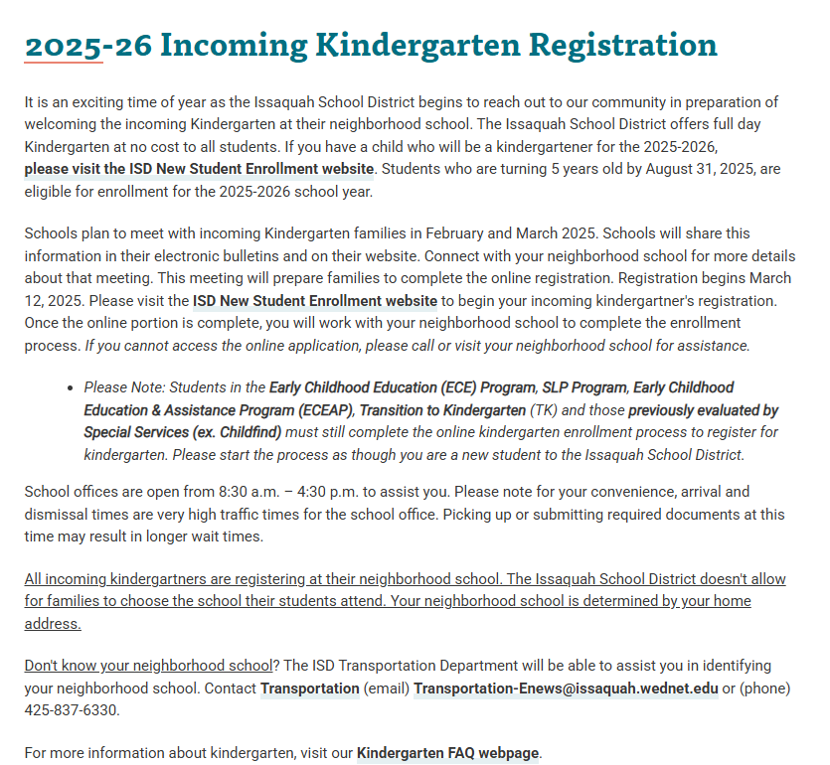
Kindergarten registration
Notes:
Vanessa

Slide 25
REGISTRATION
Students who are turning 5 years old by August 31, 2025, are eligible for enrollment for 2025-2026 school year.
Registration is online some items will need to be brought to the school.
Documents that need to be turned in, please make an appointment, or if you have questions, please contact our Registrar: Wendee Fowler (425-837-6600) or fowlerw@issaquah.wednet.edu
Registration begins: March 12th
Notes:
Vanessa

Slide 26
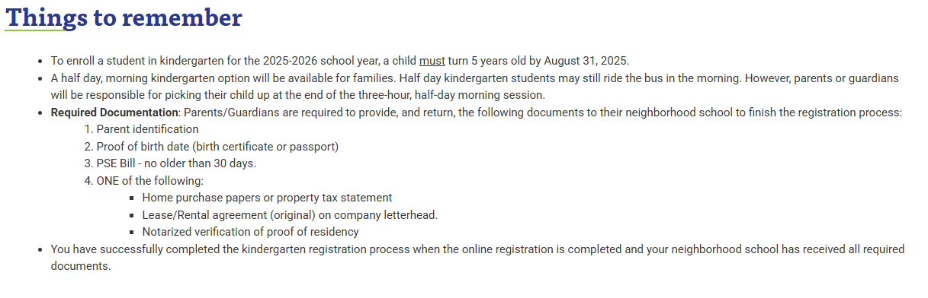

Slide 27
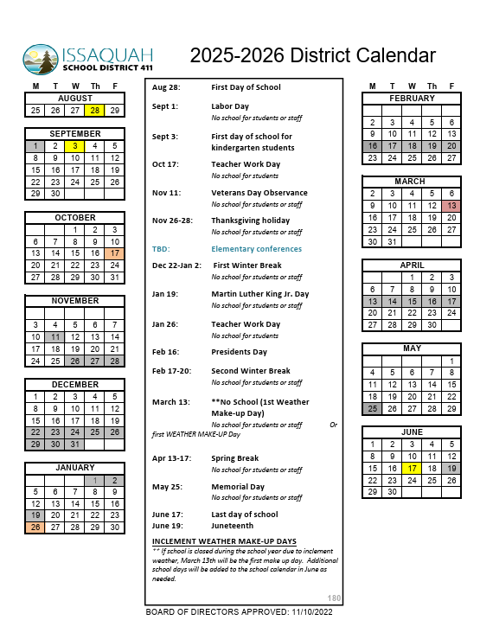

Slide 28
Dual Language Program at IVE
The Dual Language Program is offered at IVE
Priority registration is given to siblings of students already within the Dual Language Program and those living within the IVE attendance area.
We accept applications throughout the elementary years, but in order to fully benefit from the program, it is best when students begin in kindergarten.
We ask that families commit to remaining in the program throughout the elementary years.

Slide 29

Kinder Readiness
Notes:
Dana

Slide 30
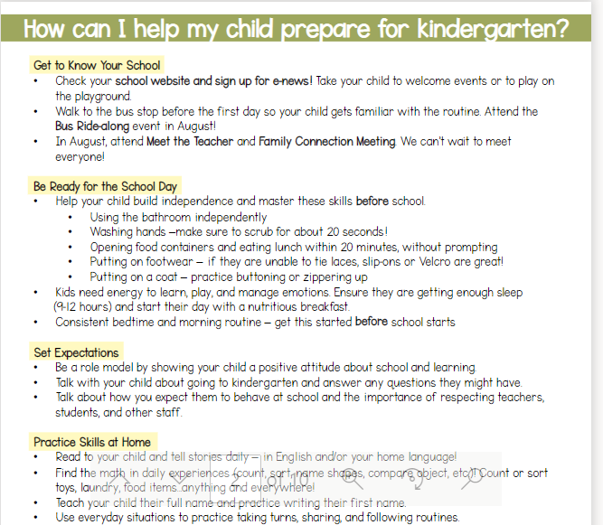
Notes:
Dana

Slide 31
School Schedule
MTTHF- 9:15-3:40 pm
Wed.- 9:15 –1:30 pm
If walking or student drop-off; supervision begins at 9:00 am
GARCIA
Notes:
Dana

Slide 32
Sample daily schedule
9:10- students enter the building/breakfast available
9:15- school day begins
9:15-10:30- classroom
10:30-10:45- recess
10:45-12:30- classroom
12:30-1:10- lunch/recess
1:10-3:40- classroom/specialist (music, library, PE)
GARCIA
Notes:
Dana

Slide 33
Kindergarten Screener
After registration is complete the school will contact you for a screener (Reading and Math)
You will need to bring your child to IVE at your scheduled time
GARCIA
Notes:
Vanessa

Slide 34
Family Connections Meeting
August 28-Sept. 2 - Kindergarten families will be invited to a family connection meeting with your child's teacher during the first 3 calendar school days. This meeting is required.
September 3- First day of school for Kindergarteners
GARCIA
Notes:
Vanessa

Slide 35
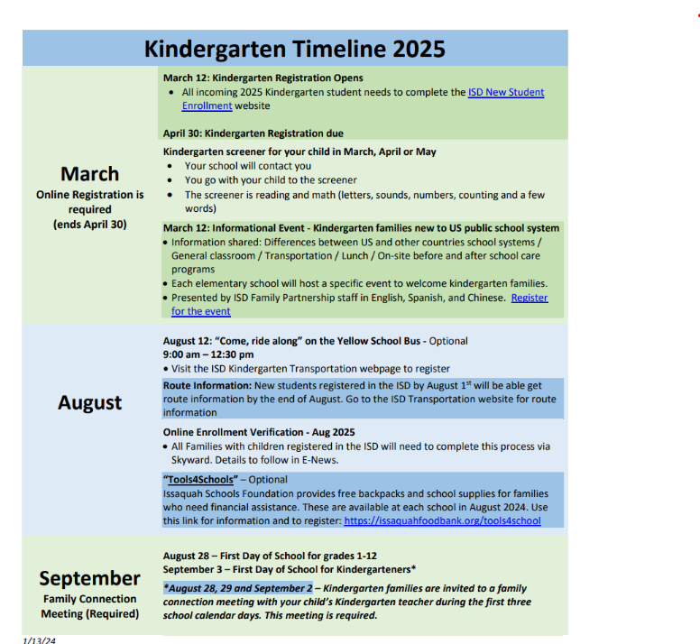
Notes:
Vanessa

Slide 36

Notes:
Vanessa

Slide 37


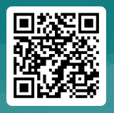

When: Wednesday, March 12, 2025 from 6:30 to 8:30 pm
Where: Zoom – Presentations in English, Español and 普通話 Register for the event
Who: All parents and caregivers of incoming kindergarten students 2025-2026.
What: Information will include:
Kindergarten preparedness
general school day schedule (lunch and recess)
classroom general information
transportation
immunization
on-site before and after school care program
differences between school systems in US vs some other countries
The event is designed for families new to US public schools.
If you need interpretation in another language (한국어, 日本語, русский or Tiếng Việt) or have any questions, please contact Lorna Gilmour gilmourl@Issaquah.wednet.edu
Notes:
Dana

Slide 38

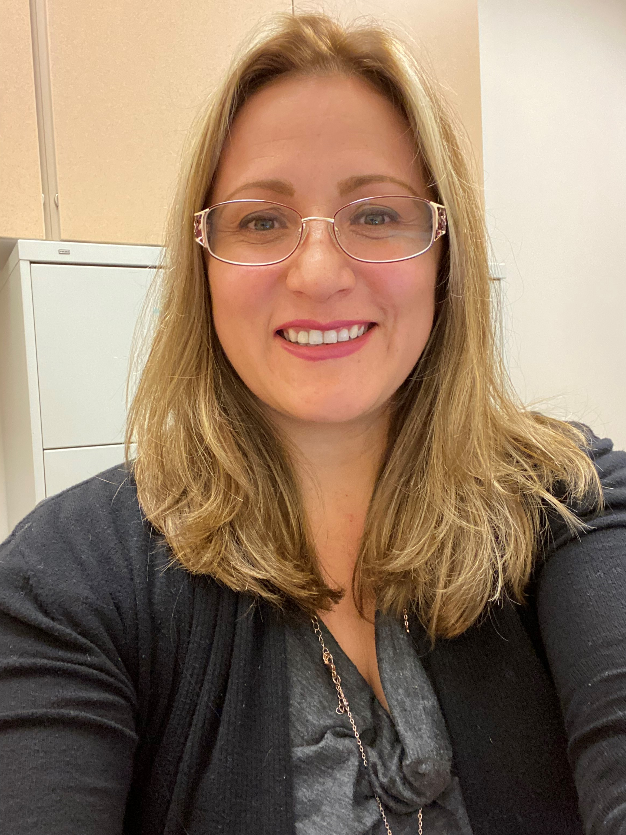
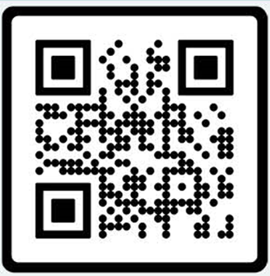
Welcome Families,
My name is Liliana Medina, your Family Liaison.
I am part of the ISD Equity, Belonging and Family Partnership Department. We host information sessions for families with a wide variety of topics throughout the school year. Family Partnerships - Issaquah School District 411
If you need interpretation, we arrange to host these sessions in your preferred language.
Feel free to contact me.
medinal@Issaquah.wednet.edu
(425) 837-7142 - Office
(425)331-9555 Text
Languages spoken: English, Spanish.
How can I help you?
Help families understand school systems, policies, and procedures.
Understand and use school tools such as Family Access, Canvas and Clever as you support your child.
Navigate the school district website and resources.
Support you in connecting with school and district staff.
Schools I support:
Clark, IVE, Sunset
Issaquah Middle School
Pacific Cascade Middle School
Issaquah High School
Notes:
Dana

Slide 39

Notes:
Dana

Slide 40
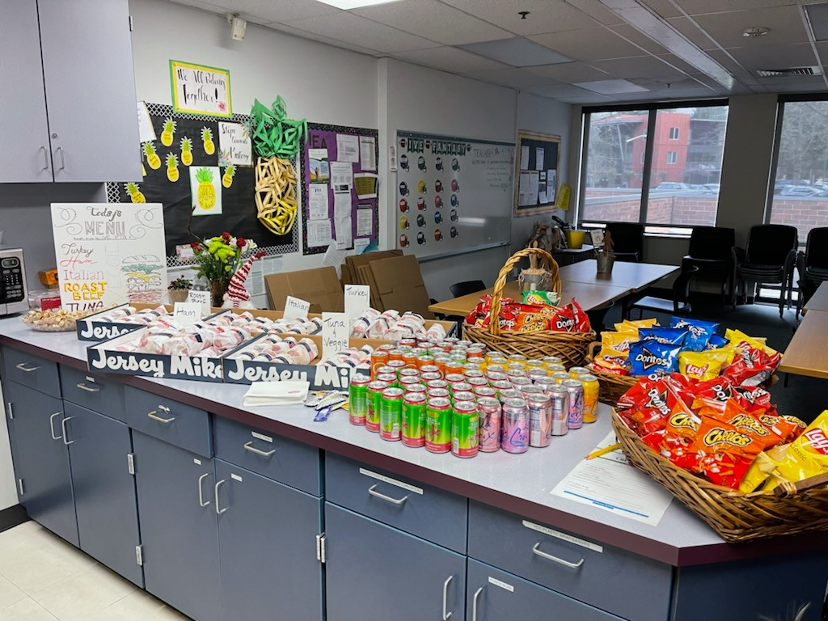
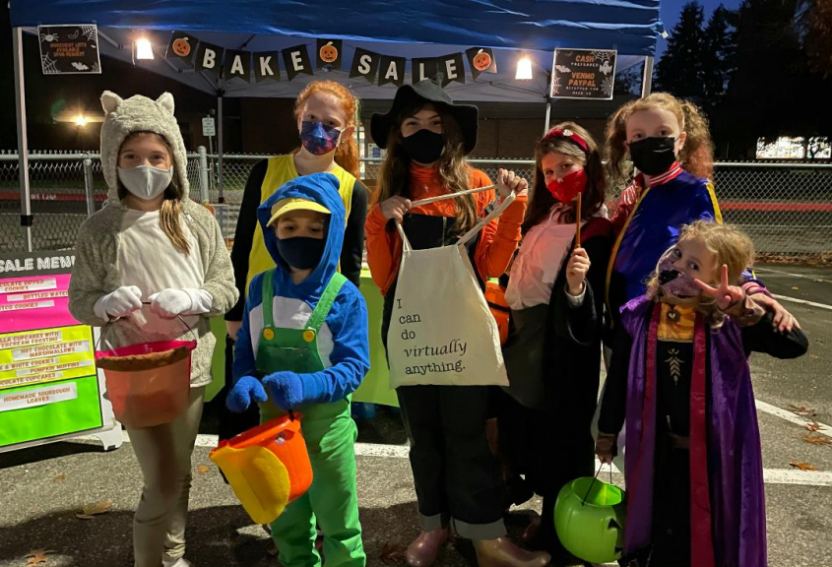

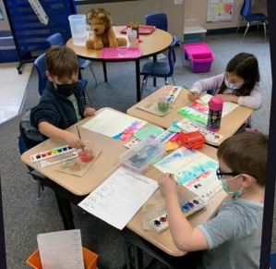


IVE PTA
Fun Things We Do:
Trunk or treat
Fun Run
Art
Science Fair
BINGO
Book Fair
Staff Appreciation
Yearbook
Sprit Wear
And so much more
Get Involved!
Join
Become a member!
Volunteer
Chair a program
Volunteer for an event or program
Help in your child’s classroom
Participate
Attend PTA events as a family
Fundraise
Our programs are funded by the generosity of our IVE families and business sponsors!
Find us online! www.ivepta.org Issaquah Valley Elementary PTA Issaquah Valley PTA
Notes:
Darcy

Slide 41
Questions
GARCIA
Notes:
Vanessa

Slide 42
School Tour
MPR​
Gym
Music room
Kindergarten Hallway​/classroom
Recess Area​
Bus drop-off/Student drop-off & pick-up
GARCIA
Notes:
Vanessa

Slide 43


