Slide 1
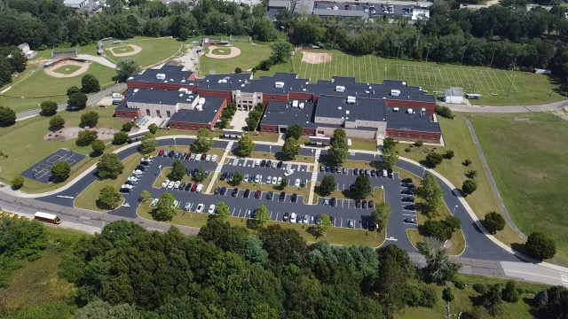
Welcome to East Lyme Middle School!

Slide 2
Who Are We?
Claudine Kelly
Principal
Shayne Anderson
Assistant Principal
Shannon Anusewicz
Assistant Principal

Slide 3
ELMS School Structure
Sound House
Sea Hawks (5)
Ocean House
Seadogs (5)
Bay House
Neptunes (6)
Whelks (8)
Osprey (7)
World Language
Music
Physical Education
Family & Consumer Science
Art
Technology Education
Big Blue (8)
Seafarers (6)
Breakers (7)

Slide 4
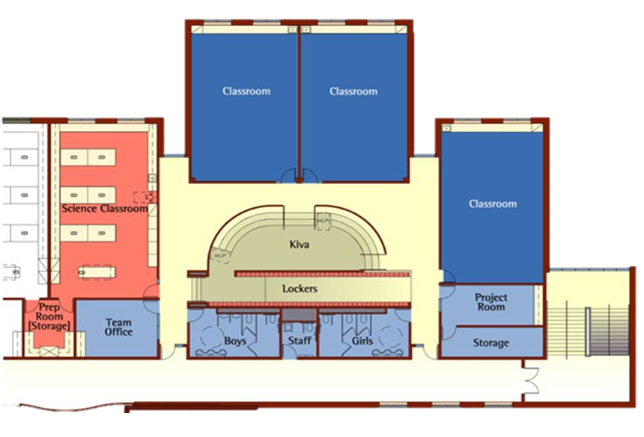
What is Teaming?
A group of teachers and students brought together as a learning community. ​
At ELMS, approximately 90 students with 4-5 teachers delivering the East Lyme curriculum.

Slide 5
Why Do We Team?
“The general goal of teaming is to provide a more personalized learning experience for students:
  To ensure that students are well known by adults in the school
  Their learning needs are understood and addressed
  They receive the social, emotional, and academic support from teachers and staff that they need to succeed academically.”
  (https://www.edglossary.org/teaming/#:~:text=The%20general%20goal%20of%20teaming,teachers%20and%20staff%20that%20they, 2013)

Slide 6
Who is on My Child’s Team?
Science Teacher
Language Arts Teacher
Social Studies Teacher
Mathematics Teacher
Special Education Teacher
Teaching Assistant

Slide 7
Looping
Looping is the practice which allows a team of students to remain together for a period of two years.
Enhances meaningful relationships and learning with students and families.

Slide 8



Digital Platforms @ ELMS
Infinite Campus
Contact Information
Attendance
Grades​
Report Card​s
Student Permissions
Team Messaging​
School & District Communications
Google Classroom
Student Assignments​
Student Resources
Student To Do List
Class Announcements​
Student-Teacher Communications
ClassLink
Dashboard for student to easily access programs​

Slide 9
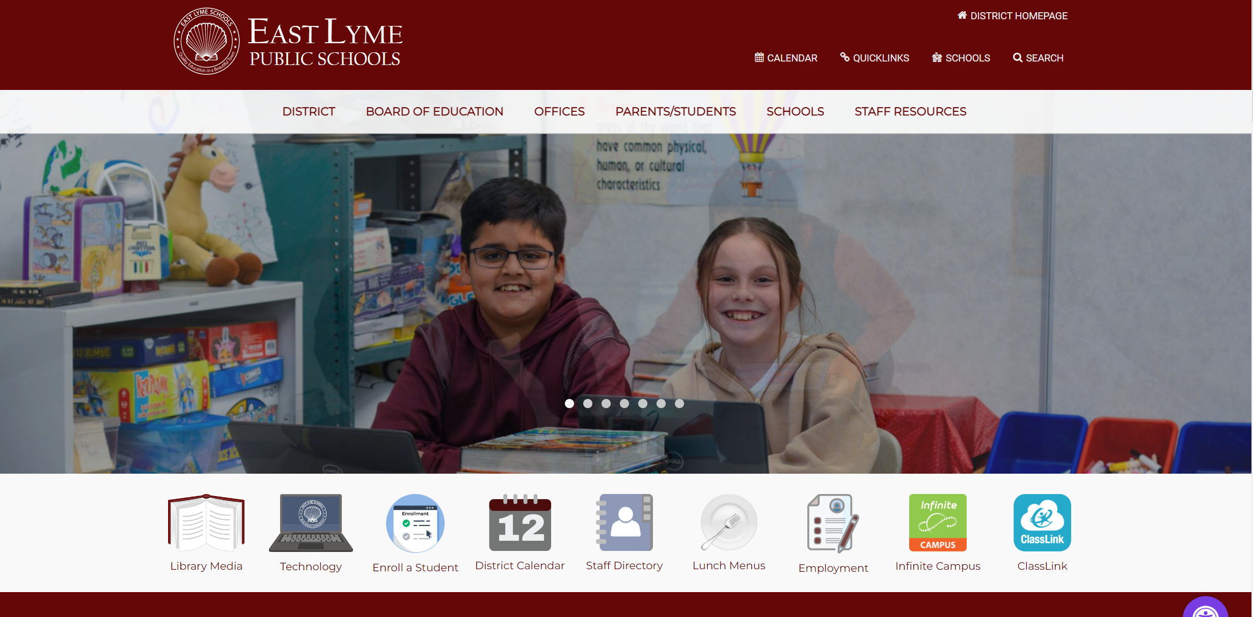
ELPS District Website
Academic Calendar​
Board of Education Policies​
Student Handbook
Staff Directory
Quicklinks
ClassLink

Slide 10




Student Conferences
PROMOTES STUDENT OWNERSHIP OF LEARNING
TWICE PER YEAR, FALL AND SPRING​
STUDENTS FACILITATE THEIR OWN CONFERENCE​
ALL GRADES​

Slide 11
Life Arts Opportunities
World Language
Spanish, French
Music
Choir, Orchestra, Band
Physical Education
Art, Family & Consumer Science, Technology Education
*Students are mixed within grade level for Life Arts classes.

Slide 12
Restorative Practice/Schoolwide Expectations
Mission:
To establish a continuum of effective and positive behavioral support systems to maximize academic achievement and a safe climate for all students.
To provide students with the tools they need to manage challenging situations.
Excellence-Leadership-Mindfulness-Service

Slide 13
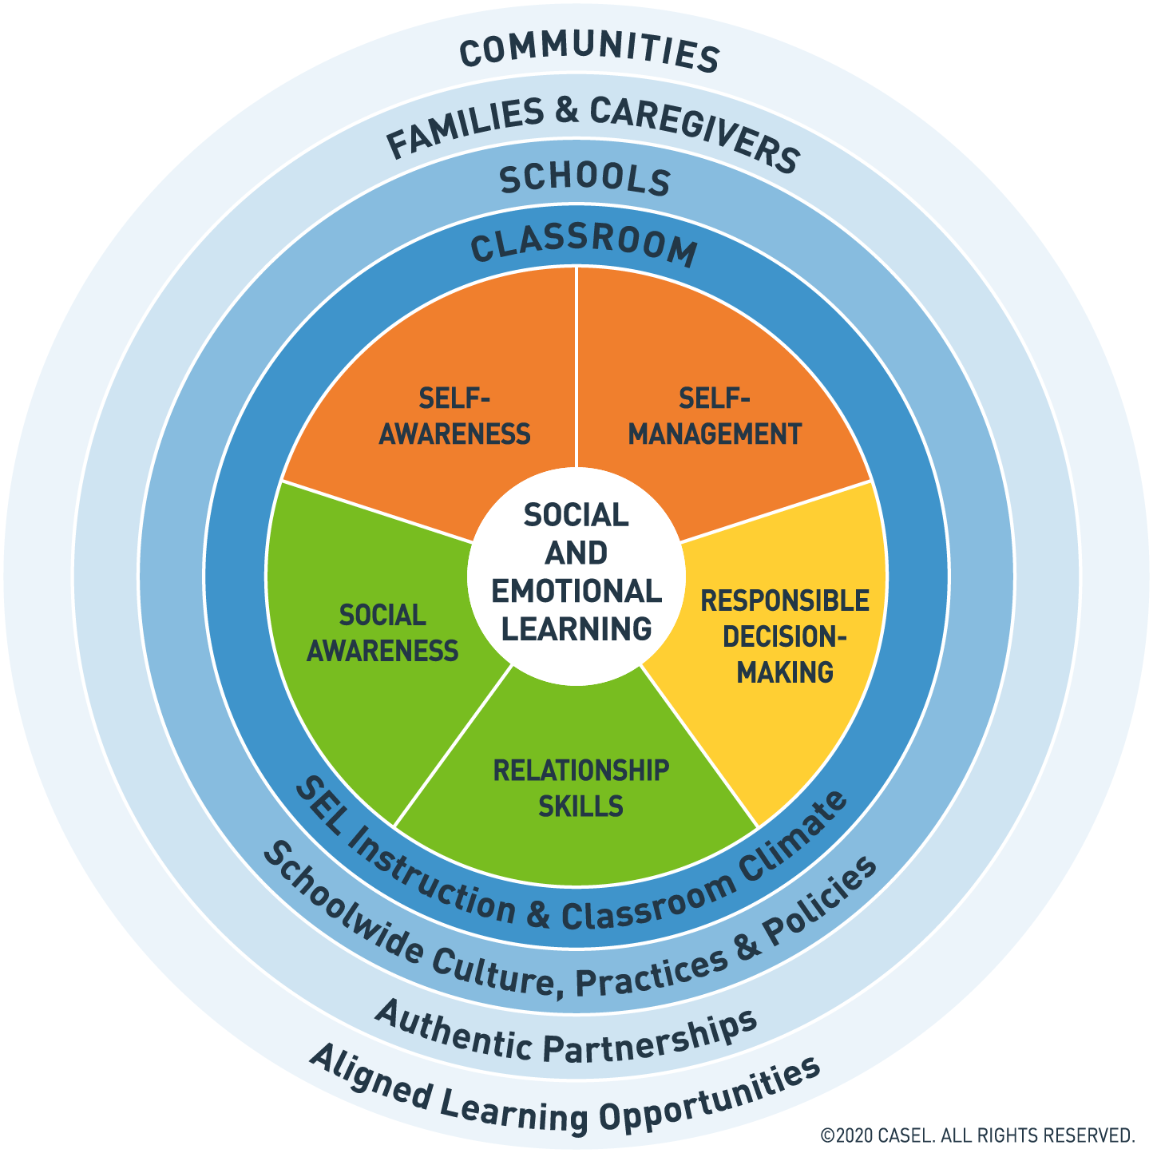
Advisory
Groups of 11-13 students are assigned to one adult advisor.​​
Advisory groups meet two times per month for 30 minutes where they complete lessons and activities related to a monthly school-wide theme.

Slide 14
Themes by Month
September: Relationship Skills
October: Self-Awareness
November: Responsible Decision-Making
December: Self-Management
January: Social Awareness
February: Relationship Skills
March: Self-Awareness
April: Responsible Decision-Making
May: Self-Management
June: Social Awareness

Slide 15
Advisory Programs Have Been Shown To…
Help students grow socially and emotionally​
Contribute to a positive school climate​
Enhance student-teacher relationships​
Promote mutually respectful relationships with peers​
Improve students’ decision-making and communication skills​
Create a sense of belonging to school​
Improve student learning

Slide 16
Social & Emotional Supports
Jennifer Lathrop, School Counselor
Meghan Ciacchero, School Counselor
Molly Berry, School Counselor
Meredith Coffey, Social Worker
Mario Cruz, Social Worker
Chelsey Green, School Psychologist
Samantha Tasker, School Psychologist

Slide 17
Clubs & Activities
Cross Country​
Minecraft Club​
Guitar STEAM Club
Video Journalism​
Math Counts​
Intramural Sports
Interscholastic Sports
Garden Club
Leaders’ Club
Service Club
Festival Choir
SeaPerch
Yearbook ​
Art Club​
Drama Club​
Science Club​
Camp ELMS

Slide 18

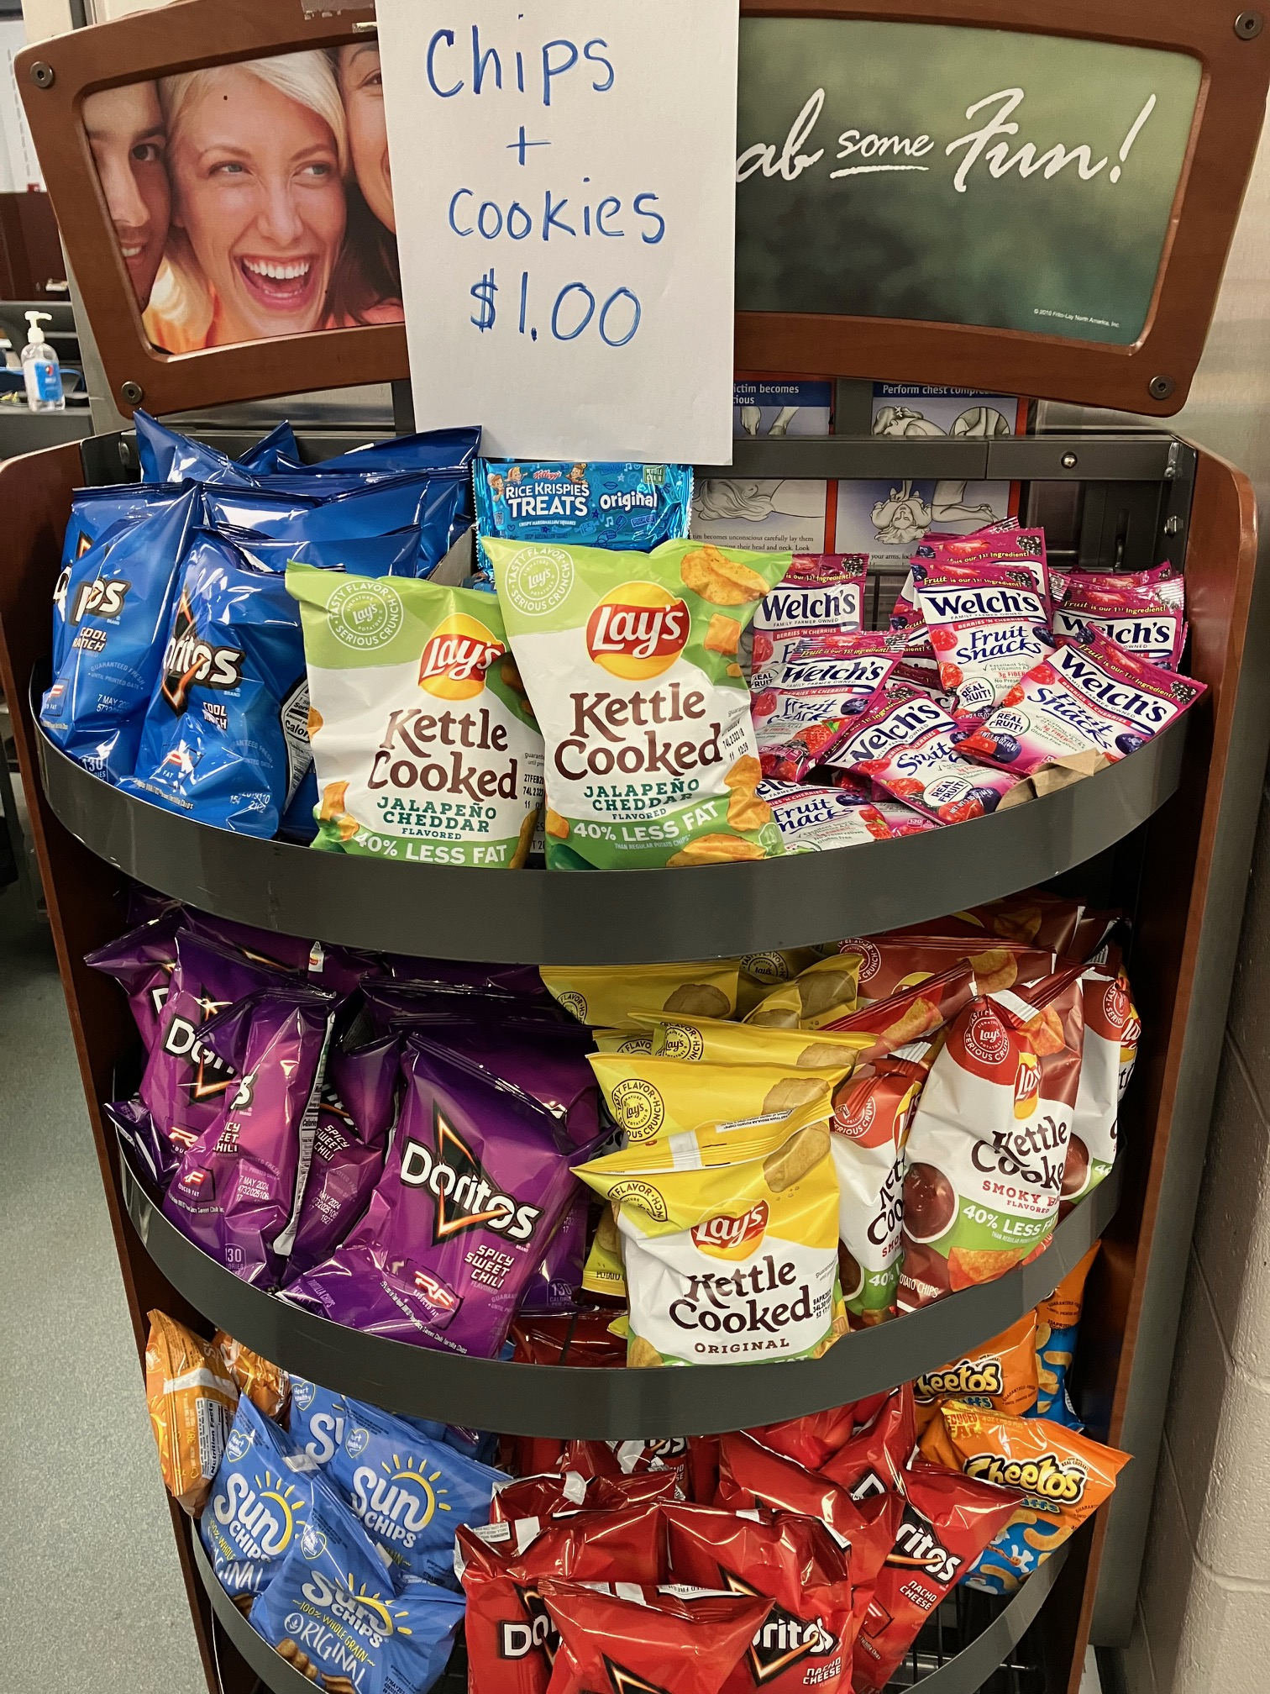
Breakfast:
Grab-n-Go price $2.00
Lunch:
Price $3.60:
Includes meal (protein + whole grain), fruit and vegetables, milk
Pre-order grab-n-go lunch on half days
  30 minutes, including recess
  Grade-level
  Opportunities to eat outside
A la carte:
  We offer à la carte purchases AFTER all students have received their lunch
  All à la carte items are on a government approved list
  Items include chips, cookies, fruit snacks and ice cream
  Students may purchase with money placed on their infinite campus account, cash or check.
  *prices and availability subject to change
Navigating
the
ELMS
Cafeteria

Slide 19
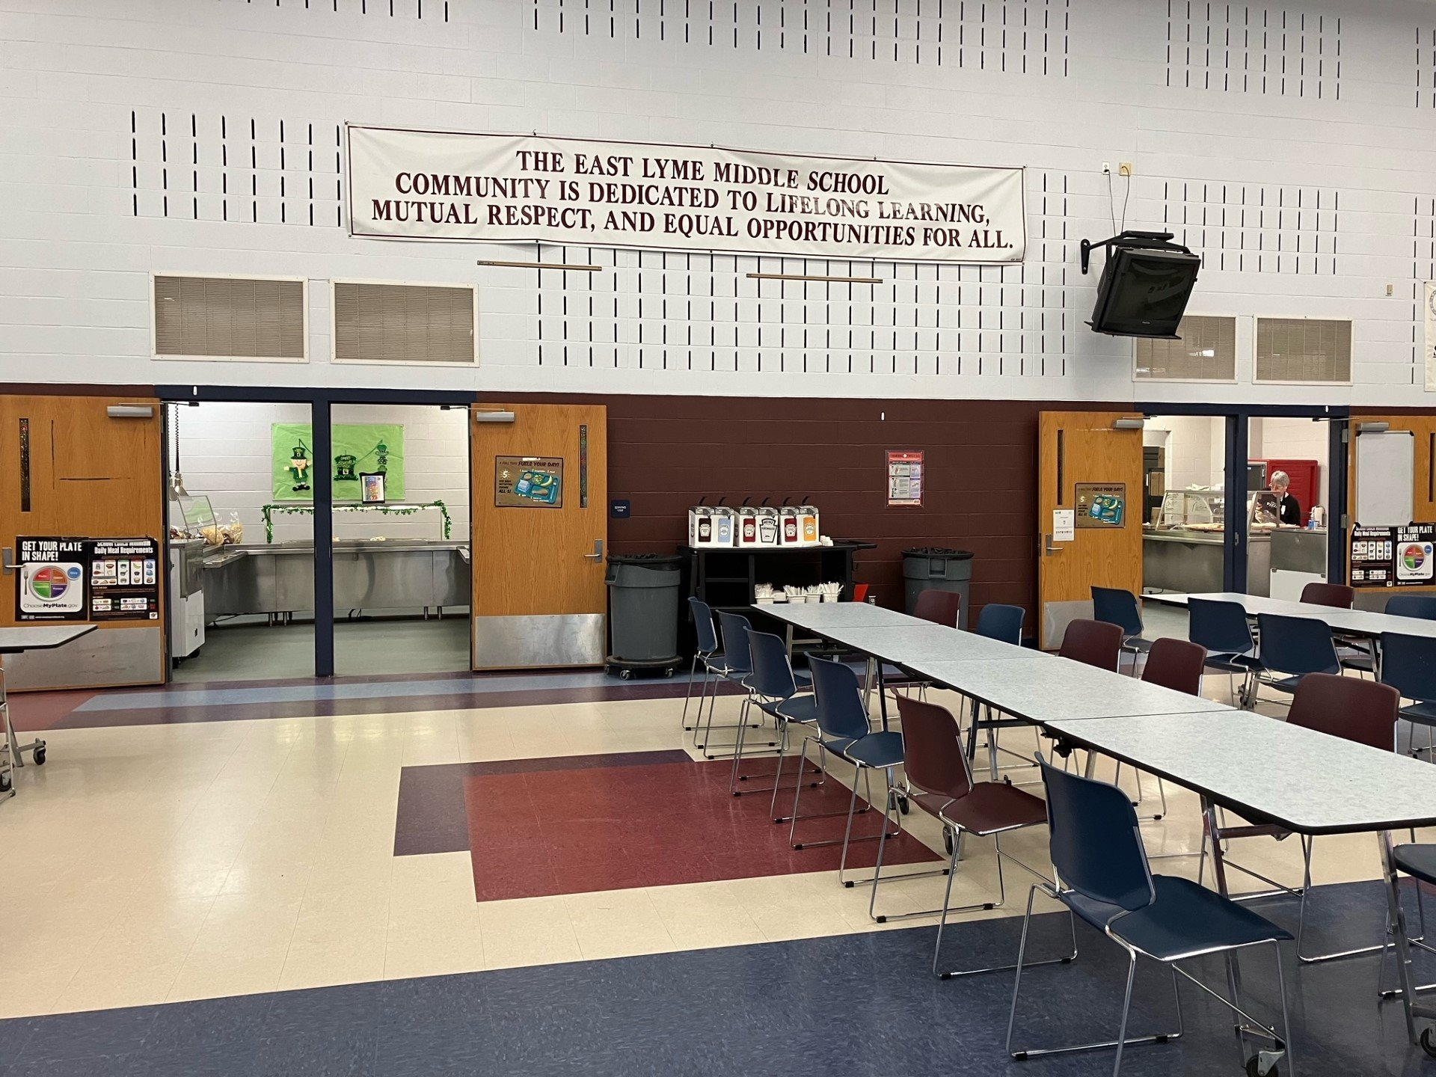
Layout includes:
Two mirrored lines
Hot lunch option(s)
Cold lunch options - daily made sandwiches with Boars Head products, salads, yogurt meal, nacho meal, hummus meal
Daily assortment of fruits and vegetables
Condiment pumps centrally located
Fruits and vegetables acquired fresh from local farms

Slide 20
Save the Date
Upcoming Grade 4 Events:
  Friday, April 4th
    Parent Information Form via Infinite Campus DUE
  Wednesday, March 26th
    Music Expo
  Friday, April 11th
    Music Selection Form via Infinite Campus DUE
  Wednesday, April 30th
    What to Expect: The Middle School Years
    (ELMS School Counselor's presentation for parents/guardians)
  Friday, May 30th
    Student Information & Tour Day at ELMS

Slide 21
Thank You For Coming –
Time for Tours!

