Slide 1
^{Welcome}
Year 8 to 9
Information Evening

Slide 2
Middle School Years 9, 10, and 11
Structure
The Curriculum
The House System
Middle School – an overview
The Role of the Tutor
New Opportunities and Activities

Slide 3
Curriculum - Year 9
Core Compulsory Subjects
English
Mathematics
Biology
Chemistry
Physics
Geography
History
Physical Education
Religious Studies (core)
Health & Social Awareness
Option Subjects:
Art & Design Latin
Computer Science Media Studies
Drama Design Technology
Music P.E. (theory)
French Spanish
Support for Learning
*Performance in the May School examinations will be taken into account when reviewing the choices made

Slide 4
Ellesmere College House System
There are two systems:
The PASTORAL AND ACADEMIC system based upon the ‘Saints’ Houses.
The COMPETITIVE system based upon House names from the College’s past.

Slide 5
Academic and Pastoral (Boarding or Day)
There are three Houses:
Saint Aidan’s – for all Middle School Girls.
Saint Cuthbert’s – Middle School Boys.
Saint Patrick’s – Middle School Boys.
The Boys’ Houses take both Boarding and Day pupils.
Boys are allocated by the school to fill the places available and to maintain a balance of boarding and day within the House. There is no parental choice of Saint’s House unless there would be a current brother in the House.
Tutors are allocated based upon these Houses.

Slide 6
Competitive Houses
There are four competitive Houses:
Meynell Talbot Wakeman-Lambart Woodard.
Pupils remain in their Competitive House for the remainder of their time at Ellesmere.
Pupils are allocated on the basis of a family connection if indicated to us but otherwise to try to provide a balance of talents between the Houses in such as sport, drama, music, academic ability, leadership.

Slide 7
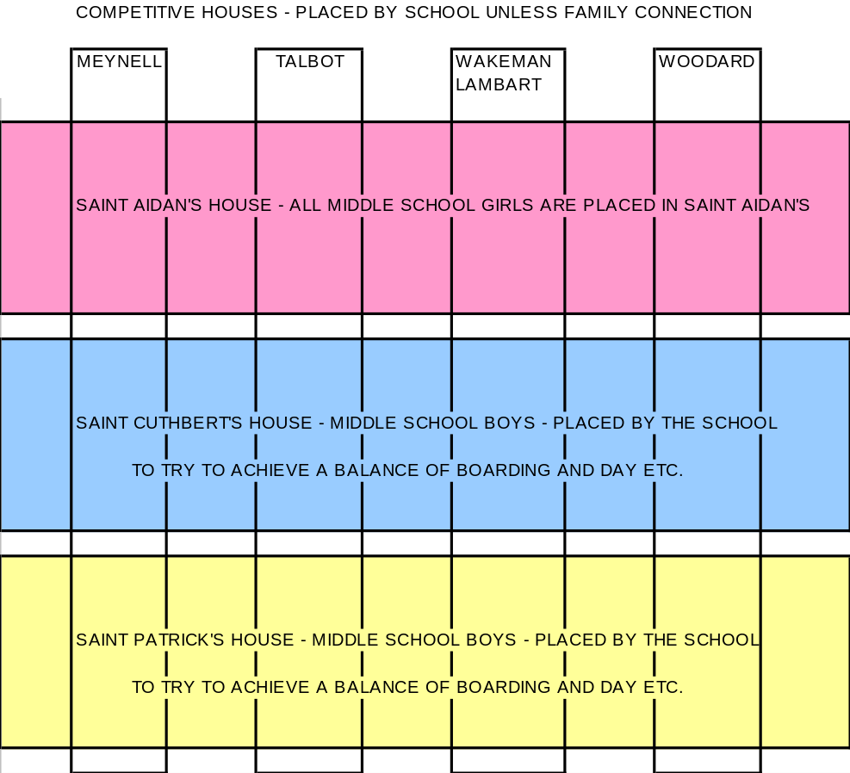
The Ellesmere College
Pastoral System

Slide 8
The Pastoral Team Who’s Who!
Deputy Head Pastoral: Dr R. Chatterjee
Head of Middle School: Mrs S. Phillips
Housemasters/Housemistress = HsMs
HsM of St Aidan’s: Mrs V. Furlong-Hart
HsM of St Cuthbert’s: Mr J. N. Haycock
HsM of St Patrick’s: Mr G. Phillips
Tutors

Slide 9
Head of Middle School Mrs S. Phillips
Matrix of care with House Masters/Mistress, tutors and teaching staff
Clear vision to develop happy, confident and enthusiastic pupils who are well rounded, polite and respectful.
High expectations of behaviour and effort from pupils.
Strive for academic excellence.
Strive to develop the full potential of each pupil.
Firm and fair discipline and individual care to guide each pupil in this crucial academic period.
High standards of behaviour and appearance are expected to enable the school to continue to flourish.

Slide 10
Year 9 Activity Programme
Thursday afternoons
Combined Cadet Force and DofE
Our aim is for all Year 9 pupils to have the opportunity to complete the D of E Bronze Award by the end of the academic year.
There is expedition training in the first term, skills in the second term and final assessed expedition at the end of the year.

Slide 11
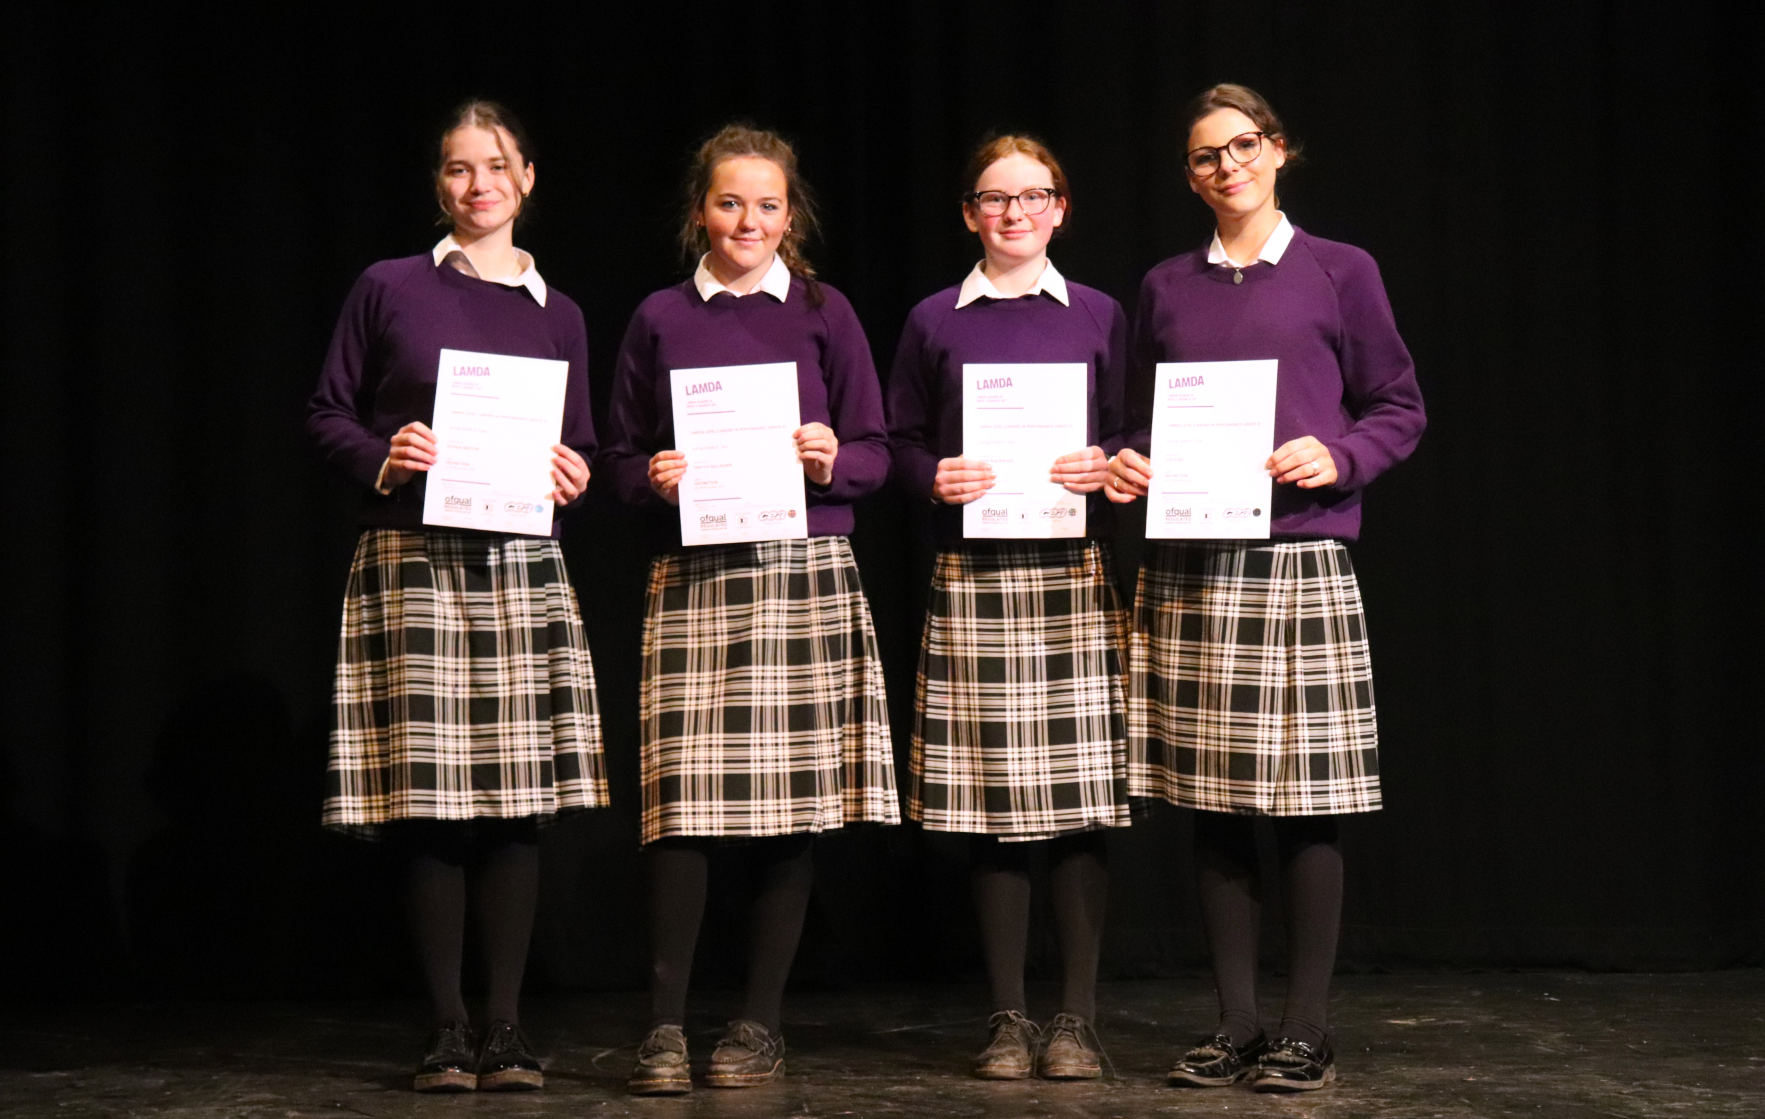
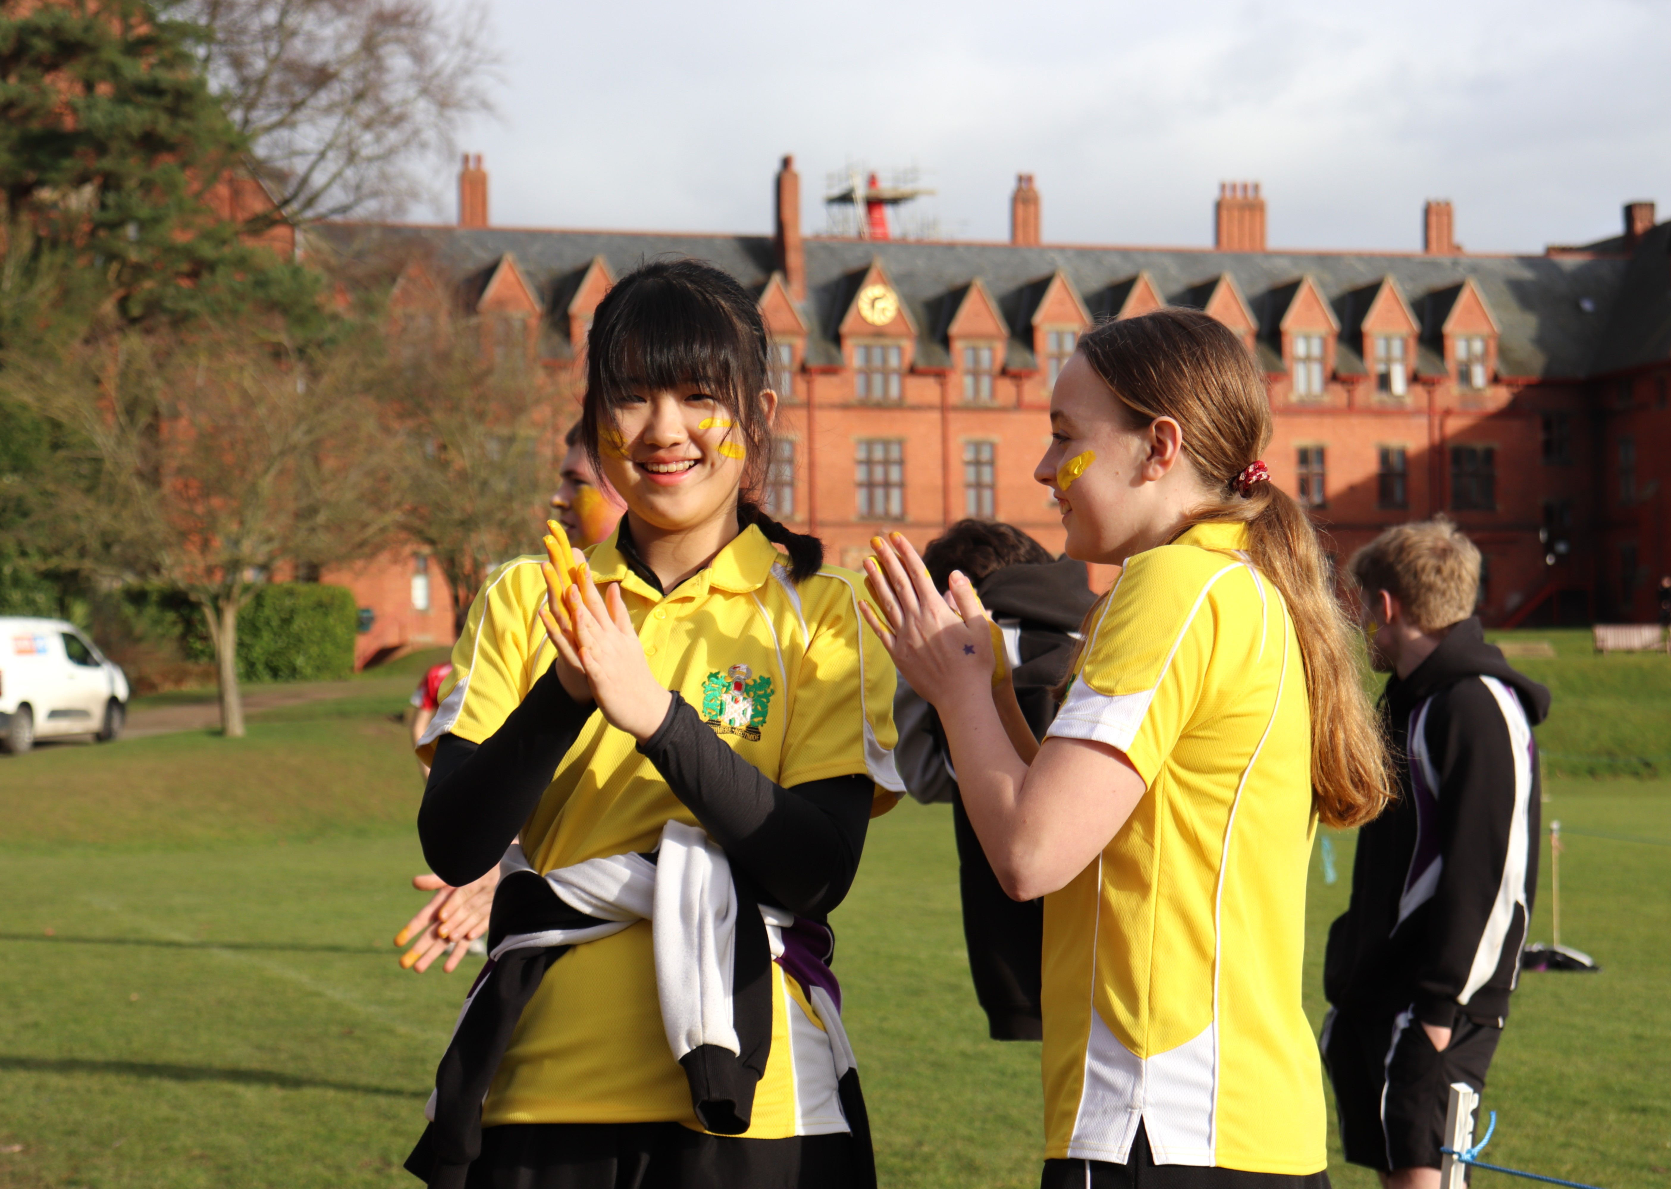
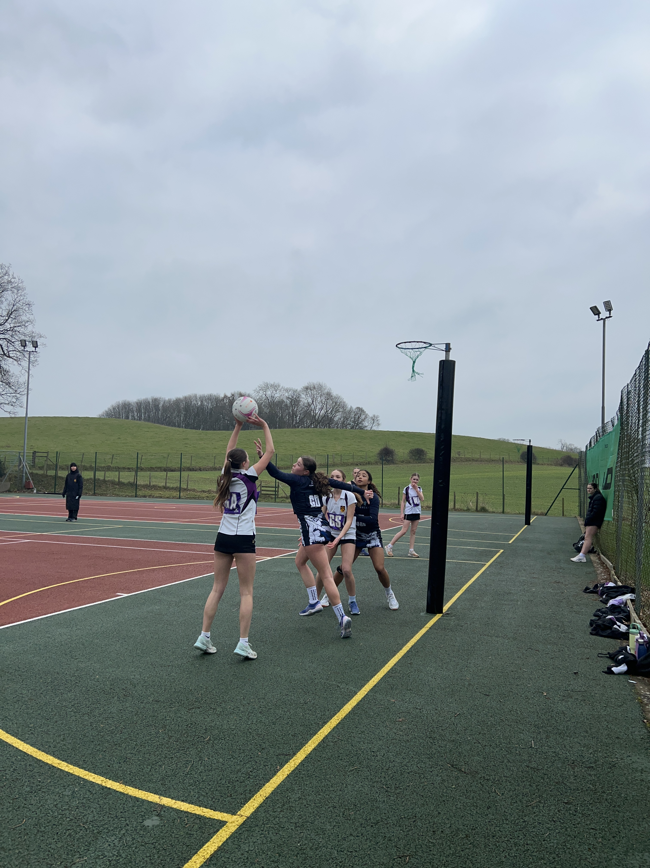
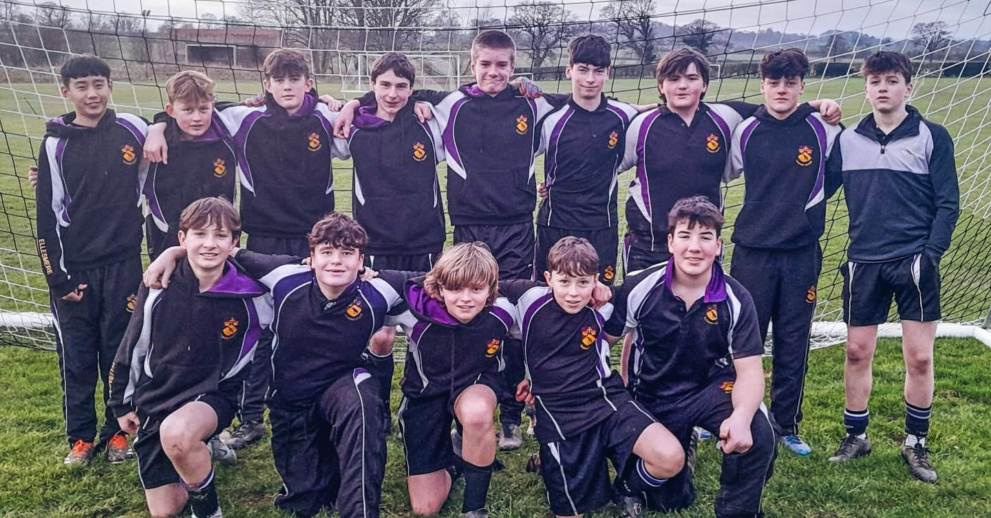
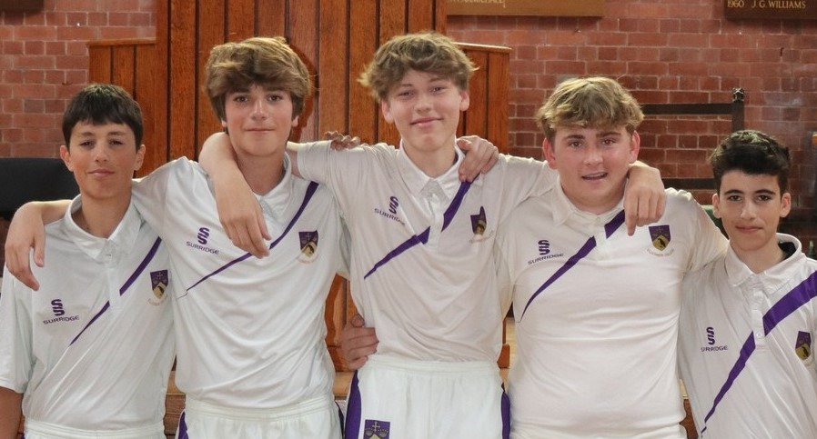
Year 9 pupils to share their experiences of Middle School and what pupils moving up can expect.
Daily routine
Sport
Activities
Academic Day
Competitive House
Saints House

Slide 12
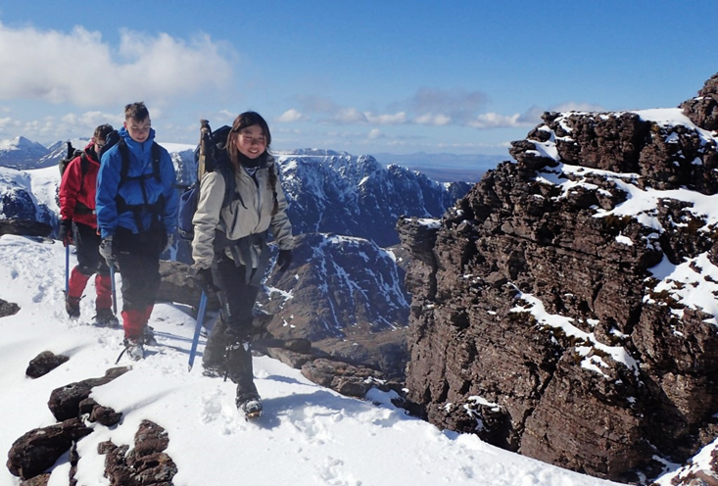
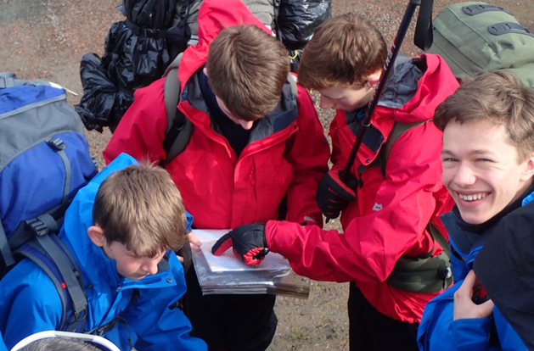
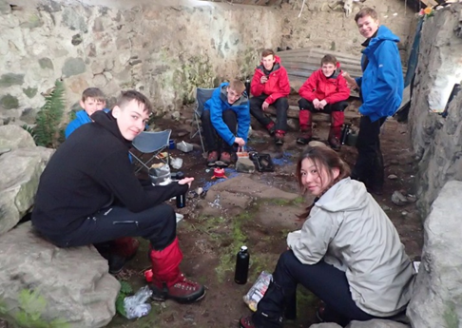
Develop Team Building, Camp Craft and other Expedition skills
These skills provide leadership and valuable personal development opportunities for all involved and they are fun!

