Slide 1


School FIRST rating
Financial Integrity Rating System of Texas
2023-24 Rating
BASED ON 2022-23 School Year DATA

Slide 2


What is School FIRST and
What is its Purpose?
School FIRST is a financial accountability rating system that holds school districts accountable for the quality of their financial management practices.
School FIRST is designed to encourage Texas public schools to manage their financial resources better in order to provide the maximum allocation possible for direct instructional purposes.
School FIRST is a tool that creates transparency and discloses the quality of local management and decision-making processes that the school district uses concerning the financial resources the school district receives.
Notes:
Developed by TEA in 1999
This is the 18th year

Slide 3

District Ratings
2022-23 Rating Year Data 2021-22 |  | 2023-24 Rating Year Data 2022-23
# of indicators | 20 | # of indicators | 21
Ratings: | Points: | Ratings: | Points:
A – Superior | 90 - 100 | A – Superior | 90 - 100
B – Above Standard | 80 – 89 | B – Above Standard | 80 – 89
C – Meets Standard | 70 – 79 | C – Meets Standard | 70 – 79
F - Substandard | 0 – 69 | F – Substandard | 0 – 69

Slide 4

Critical Indicators
# | Indicator Description | 2021-22 Data | 2022-23 Data
1 | Was the complete annual financial report (AFR) and data submitted to the TEA within 30 days of the November 27 or January 28 deadline depending on the school district’s fiscal year end date of June 30 or August 31, respectively? | Yes | Yes
2 | Was there an unmodified opinion in the AFR on the financial statements as a whole? | Yes | Yes
3 | Was the school district in compliance with the payment terms of all debt agreements at fiscal year end? | Yes | Yes
4 | Did the school district make timely payments to the Teachers Retirement System (TRS), Texas Workforce Commission (TWC), Internal Revenue Service (IRS), and other governmental agencies? | Yes (Ceiling passed) | Yes (Ceiling passed)
5 | Was the total net in the governmental activities column in the Statement of Net Position greater than zero? | Not Scored | Ceiling Passed

Slide 5
SOLVENCY Indicators
# | Indicator Description | 2021-22 Data | 2022-23 Data
6 | Was the average change in (assigned and unassigned) fund balances over 3 years less than a 25 percent decrease, or did the current year’s assigned and unassigned fund balances exceed 75 days of operational expenditures? | Ceiling Passed | Ceiling Passed
7 | Was the number of days of cash on hand and current investments in the general fund for the school district sufficient to cover operating expenditures (excluding facilities acquisition and construction)? | 10 | 10
8 | Was the measure of current assets to current liabilities ratio for the school district sufficient to cover short-term debt? | 6 | 10
9 | Did the school district’s general fund revenues equal or exceed expenditures (excluding facilities acquisition and construction)? If not, was the school district’s number of days of cash on hand greater than or equal to 60 days? | 10 | 10
10* | Did the district average less than a 10% variance (90% to 110%) when comparing budgeted revenues to actual revenues for the last 3 fiscal years? | 10 | 10
11 | Was the ratio of long-term liabilities to total assets for the school district sufficient to support long-term solvency? | 10 | 10
*Indicator 10 was not scored this year due to the impact of accounting changes implemented by the Governmental Accounting Standards Board.

Slide 6
SOLVENCY Indicators Cont.
# | Indicator Description | 2021-22 Data | 2022-23 Data
12 | What is the correlation between future debt requirements and the district’s assessed property value? | 10 | 10
13 | Was the school district’s administrative cost ratio equal to or less than the threshold ratio? | 10 | 10
14 | Did the school district not have a 15 percent decline in the students to staff ratio over 3 years (total enrollment to total staff)? If the student enrollment did not decrease, the school district will automatically pass this indicator. | 10 | 10
15** | Was the school district’s ADA within the allotted range of the district’s biennial pupil projection(s) submitted to TEA? | 5 | 5
**Indicator 15 was not scored this year due to the impact of accounting changes implemented by the Governmental Accounting Standards Board.

Slide 7
competence Indicators
# | Indicator Description | 2021-22 Data | 2022-23 Data
16 | Did the comparison of Public Education Information Management System (PEIMS) data to like information in the school district’s AFR result in a total variance of less than 3 percent of all expenditures by function? | Ceiling Passed | Ceiling Passed
17 | Did the external independent auditor report that the AFR was free of any instance(s) of material weaknesses in internal controls over financial reporting and compliance for local, state, or federal funds and free from substantial doubt about the school district’s ability to continue as a going concern? | Ceiling Passed | Ceiling Passed
18 | Did the external independent auditor indicate the AFR was free of any instance(s) of material noncompliance for grants, contracts, and laws related to local, state, or federal funds? | 10 | 10
19 | Did the school district post the required financial information on its website in accordance with Government Code, Local Government Code, Texas Education Code, Texas Administrative Code and other statutes, laws and rules that were in effect at the school district’s fiscal year end? | 5 | 5
20 | Did the school district’s administration and school board members discuss any changes and/or impact to local, state, and federal funding at a board meeting within 120 days before the district adopted its budget? | Ceiling Passed | Ceiling Passed

Slide 8
Total Rating
# | Indicator Description | 2021-22 Data | 2022-23 Data
21 | Did the school district receive an adjusted repayment schedule for more than one fiscal year for an over-allocation of Foundation School Program (FSP) funds because of a financial hardship? | n/a | Ceiling Passed
 | TOTAL RATING: | 96 Superior | 100 Superior

Slide 9
REQUIRED DISCLOSURES
Superintendent’s current employment contract
Summary schedule of total reimbursements received by the Superintendent and each board member
Summary schedule of compensation and/or fees received by the Superintendent in exchange for professional consulting and/or other personal services (NONE)
Summary schedule of the dollar amount of gifts that had an economic value of $250 or more (NONE)
Summary schedule of the dollar amount by board member for the aggregate amount of business transactions with the school district (NONE)

Slide 10
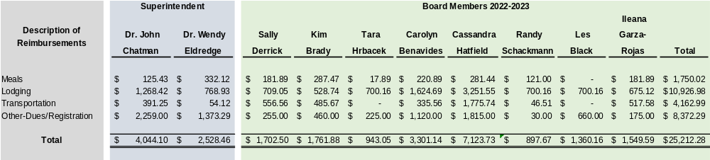
Total Reimbursements
2022-2023
Superintendent and Board of Trustees

Slide 11
First rating Comparison To Area Districts

Slide 12



