Slide 1



Bipartisan Safer Communities Act (BSCA) 2022
Stronger Connections Grant Program
January 10, 2023

Slide 2

Agenda
Welcome
Overview
Allocations
Implementation Plan Templates
  Project Narrative
  Budget Narrative
Timeline
Consultation with Non-Public Schools
Closing & Next Steps
Questions

Slide 3
Grant Overview
On September 15, 2022, the Virgin Islands Department of Education (VIDE) was awarded $809,852.00 in Federal K-12 funding from the U.S. Department of Education under the Bipartisan Safer Communities Act (BSCA) Stronger Connections grant program.
Grant funding is part of Title IV, Part A of the Elementary and Secondary Education Act of 1965 (ESEA) for state educational agencies (SEAs) to provide students with safer and healthier learning environments.

Slide 4
Grant Overview
Hawaii, Puerto Rico, and the Outlying Areas (American Samoa, Commonwealth of the Northern Mariana Islands, Guam, and the Virgin Islands) are not required to award Stronger Connections funds competitively nor are they required to define high-need LEA.

Slide 5
Grant Award Notification Assurances
By drawing down funds awarded under this Grant Award Notification, the State Education Agency (SEA) assures the following:
  The SEA will reserve no more than 1% of its SCG allocation for administration and may use any remaining reserved funds for State-level activities to support safe and healthy students under section 4108 of the ESEA, including providing technical assistance and other supports to LEAs.
  All remaining SCG funds will be used for activities allowable under section 4108 of the Elementary and Secondary Education Act of 1965 (ESEA)

Slide 6
Grant Award Notification Assurances
SHSG funds will not be used for the provision to any person of a dangerous weapon or training in the use of a dangerous weapon as prohibited under Section 13401 of the Bipartisan Safer Communities Act, which amends section 8526 of the ESEA.
Equitable services will be provided with SCG funds to students and teachers in non-public schools as required under section 8501 of the ESEA.
  The SEA will ensure that a public agency maintains control of funds for the services and assistance provided to a non-public school with SCG funds.

Slide 7
Grant Award Notification Assurances
  The SEA will ensure that a public agency has title to materials, equipment, and property purchased with SCG funds.
  The SEA will ensure that services to a non-public school with SCG funds are provided by a public agency directly, or through a contract with, another public or private entity.
  The SEA will ensure that equitable services provided with SCG funds are secular, neutral, and nonideological.
SCG funds will be expended consistent with the supplement not supplant requirements in section 4110 of the ESEA.

Slide 8
Grant Award Notification Assurances
SCG funds will be tracked separately from the regular allocation under Title IV, Part A of the ESEA.
The SEA will submit to the Department, no later than 90 days after the SEA receives its award, an update on implementation of the SCG program, containing such information as the Department may require. (Updated deadline January 31, 2023)
The SEA will submit such other information to the Department as the Secretary may later require, such as:
  How SCG funds are being used.

Slide 9
Grant Award Notification Assurances
    Whether the SEA will evaluate the effectiveness of the SCG program, and if so, how it will do so.
The SEA will participate, as requested, in any Department evaluation of the SCG program and will cooperate with any audit or examination of records with respect to such funds.

Slide 10
Grant Purpose
The Stronger Connections Grant Program aims to provide funding for LEAs to develop, implement and evaluate a comprehensive approach that prioritizes physical and emotional safety for their unique school community (SEC. 4108 [20 U.S.C. 7118]).
Funded activities and practices should prioritize safety, create a sense of belonging, implement trauma-responsive approaches and teach positive behaviors in order to provide safe and supportive learning environments that improve academic achievement and the well-being of students.

Slide 11

Implementation Activities
LEA must demonstrate development and implementation practices and activities to address needs through these areas:
Evidence-based practices,
Connecting students, families, and communities
Developing comprehensive policies and practices.
(SEC. 4108. [20 U.S.C. 7118] ACTIVITIES TO SUPPORT SAFE AND HEALTHY STUDENTS.)

Slide 12
Benefits
Professional development and funding for training.
Technical assistance to support development, implementation, and sustainable practices.
Development of family and community engagement partnerships.
External coaching to support safe and healthy development and implementation.
Trauma-Informed practices, emergency plan development, and site assessments.
Development of personnel for safe and healthy school Initiatives.

Slide 13

Time Period
Stronger Connections funds are to be obligated/encumbered by SEAs and LEAs no later than September 30, 2025.
Year 1 – SY22-23
Year 2 – SY23-24
Year 3 – SY24-25

Slide 14
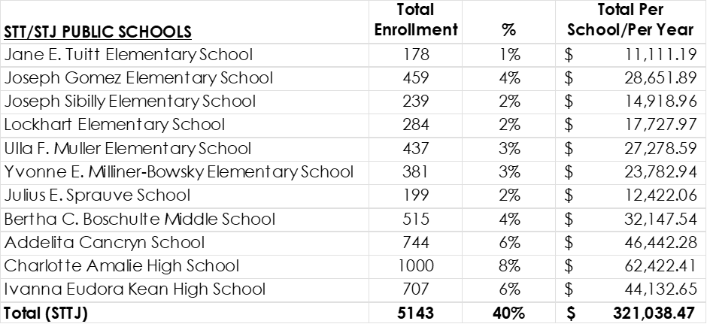
Allocations (Public Schools)
As part of site-based management, each school Principal will be responsible for the obligation and liquidation of the SCG funds.

Slide 15
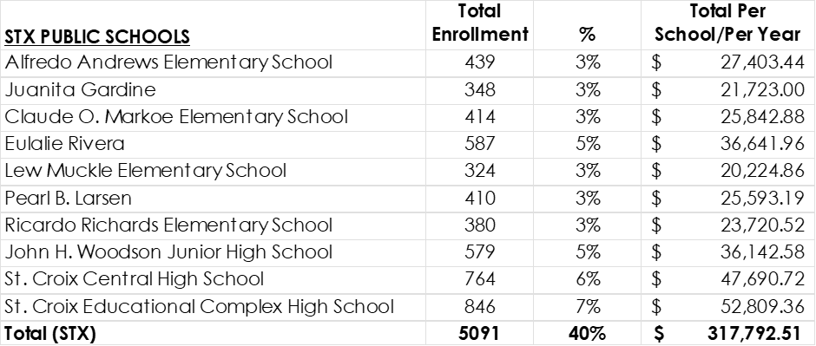
Allocations (Public Schools)
LEA will provide support relative to the writing of the plan and alignment with the SIP.
Federal ERP training is forthcoming.

Slide 16
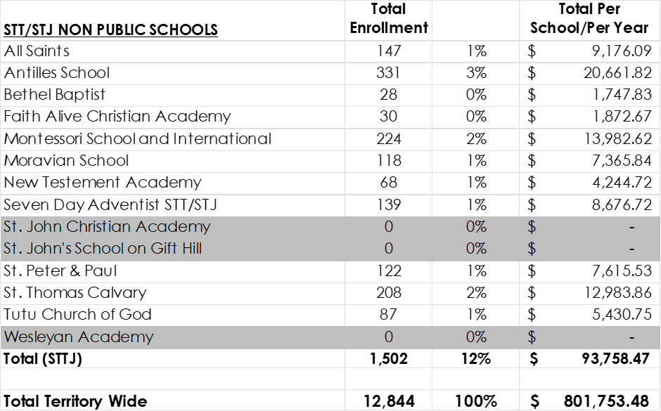
Allocations (Non-Public Schools)
LEAs will complete the mandatory consultation and write the implementation plan.

Slide 17
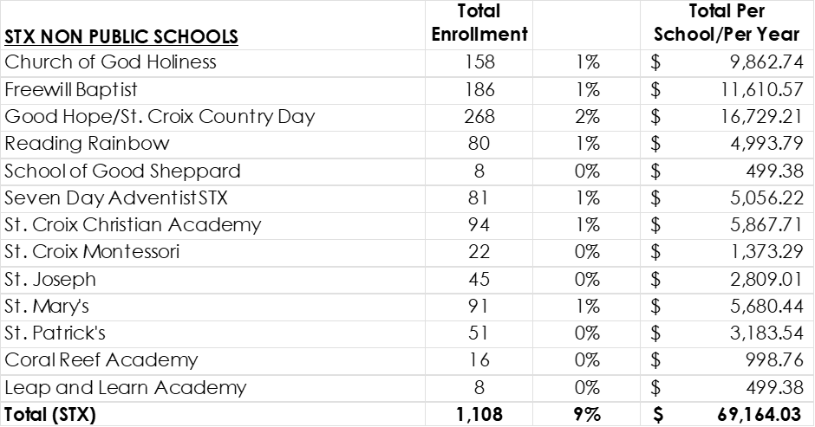
Allocations (Non-Public Schools)
LEAs will be responsible for the obligation and liquidation of non-public schools SCG funds.

Slide 18
Next Steps
The SEA will provide notice to private school officials of the allocation of funds tied to the SCG Program.
The LEAs will consult with private school officials regarding the provision of equitable services. An offer of services by an LEA without an opportunity for timely and meaningful consultation with private school officials does not meet the requirement of the law.
Consultation must occur before the LEAs make any decision that affects the opportunity of eligible private school students and teachers to participate and must continue throughout the implementation and assessment of services.
ESEA sections 1117(b)(3) and 8501(c)(3)

Slide 19
Next Steps
The LEAs will submit to the SEA affirmations of consultation.
  Submit to Dr. Maria Melendez-Tirado via email.
  The LEAs will work with the public and non-public schools to complete the plans.
  The LEAs will complete and submit an evaluation plan.

Slide 20
Deadline
All plans must be submitted to Dr. Melendez-Tirado by 5:00 p.m. on January 25, 2023. maria.melendez@vide.vi

Slide 21
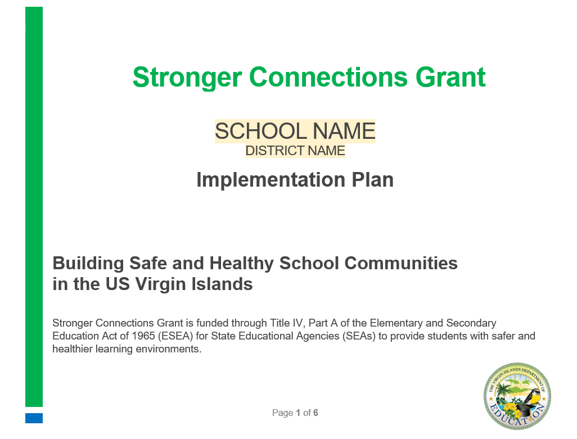
Templates
Project Narrative

Slide 22
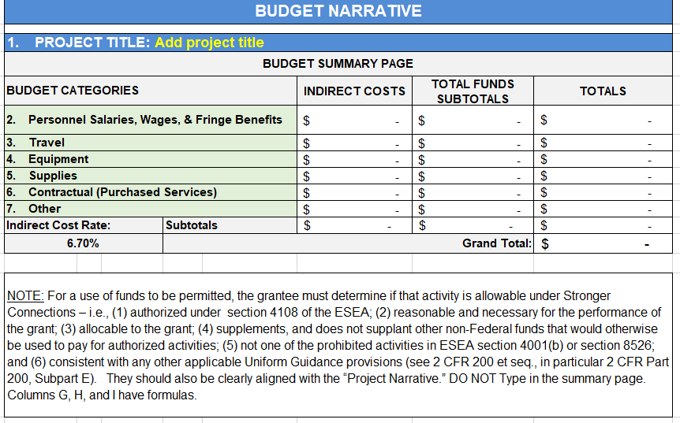
Templates
Budget Narrative

Slide 23

Questions

