Slide 1

An Overview of the
Job Corps Program

Slide 2
What is Job Corps?
The program is the nation’s largest residential career training and education program. VOLUNTARY
The Goal is to help You improve your quality of life through vocational and academic training.
FREE, hands-on career training taught by industry professionals
There are over 30,000 students enrolled and receiving training services today.
We have 121 Job Corps campuses across the U.S. 2 centers in Puerto Rico
Various Career technical trades, HSD, and DL
The Length of training: 8 months-2 years
Self-paced learning environments. (With accommodation's if needed)

Slide 3
Job Corps Statistics
The program was established in 1964 by President Johnson as part of the administration’s “War on Poverty”
Outcomes:
We help enable students to be independent and self sufficient
  Entry-Level Jobs or better
  Registered Apprenticeship
  Hands on experience
  Military
  College
Notes:
The program was established in 1964 by President Lyndon Johnson as part of the administration’s “War on Poverty.”
Since then, more than 3 million young adults have received career training and education.
The outcomes of finishing the program include but are not limited to:
Entry-Level Jobs
Registered Apprenticeship
Military
College

Slide 4
Applying to Job Corps
  Eligibility requirements for all applicants
  Low income program SSI, TANF, Medicaid/CHIP, Pay Stubs, Foster Care, Homeless, Veteran SNAP. (Or we can use a SOS)
  16 to 24 years old (Motivated young people looking for a fresh start)
  A background check is required (14 BUSINESS DAYS)
  Adobe will be sent and must be filled out in a timely manner (preferably today)
  Minors need their birth certificate, SSN card and parents ID (emails)
  Adults need their ID and SSN card if no ID birth certificate (emails)
  Court disposition, school transcripts/diploma, shot record,
  medical documentation.
Notes:
In order to apply to Job Corps, you must meet the following eligibility requirements.
You must be between the ages of 16 and 24 at the time you apply, and you must pass a background check.

Slide 5
10 Industries
Automotive and Machine Repair Maintenance and Light Repair
Construction example electrician, cement masonry, BCT, HVAC, Carpentry
Finance and Business (example office admin)
Health Care example CNA, CMA, PHARMACY TECH and more
Homeland Security example corrections officer and security
Hospitality Human services, advisor, culinary
Information Technology computer tech
Manufacturing example machining, welding
Renewable Resources and Energy landscaping, petroleum services
Transportation
Limited trade choices for minors 16 & 17 yr. old's.
Notes:
The Job Corps program provides training in the following 10 industries:
Automotive and Machine Repair
Construction
Finance and Business
Health Care
Homeland Security
Hospitality
Information Technology
Manufacturing
Renewable Resources and Energy
Transportation

Slide 6
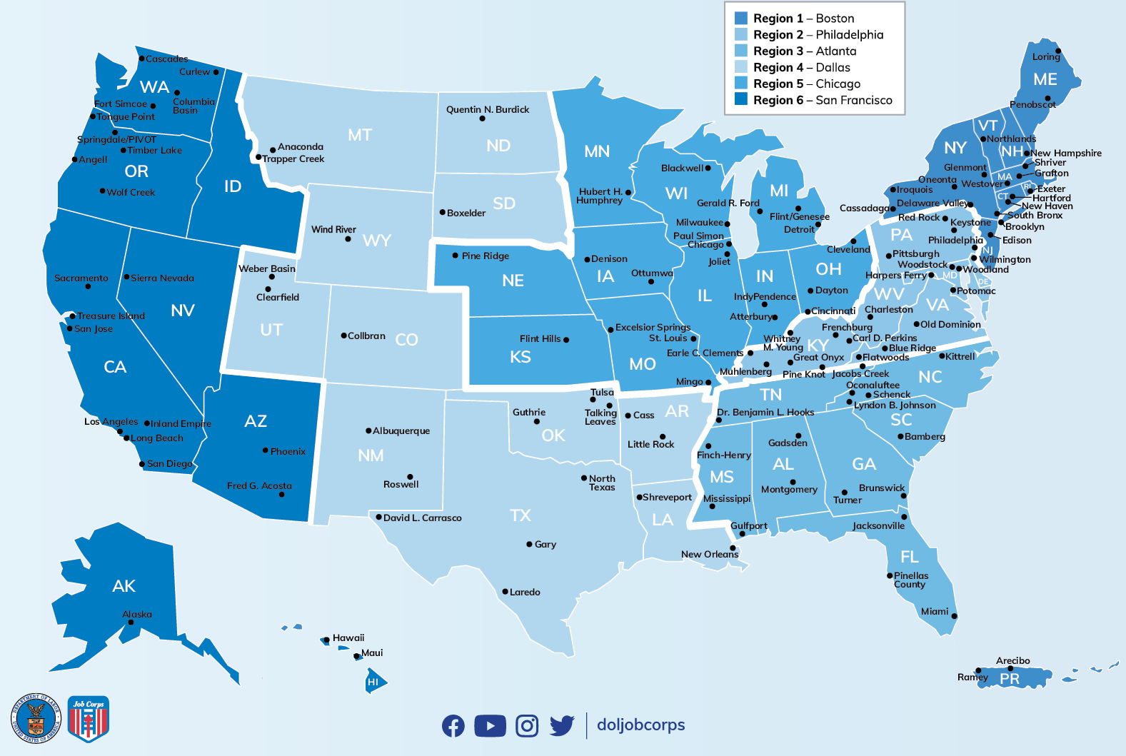
Map of Job Corps Centers
Notes:
On the screen is a map of the United States with the locations of Job Corps’ 121 centers.
Job Corps centers are split into six different regions and are located in every state in the U.S. except Idaho.
Job Corps students do not have to attend a center in the state they are from. Each center has students with a variety of geographical backgrounds.

Slide 7
Job Corps Provides
  As a Job Corps student, you will receive the following for free:
    Full-time housing for students
    Career skills and training instruction
    Academic instruction
    Basic health care
    Bi-weekly Allowance (40$ first 4mths then 70$)
    Internships
Notes:
There are many benefits to joining the Job Corps program.
All Job Corps students receive the following for free:
Full-time housing for students
Career skills and training instruction
Academic instruction (high school diploma and high school equivalency)
Basic health care
Mental health counseling
On-work-site internships
Career placement and transition services

Slide 8

Questions So Far?
This Photo by Unknown Author is licensed under CC BY-SA-NC

Slide 9
How Job Corps Works
When students enter the Career Preparation Period (CPP), they:
  Are introduced to center life
  Take academic assessments- TABE
  Enter a career pathway planning curriculum and develop a career pathway plan
  Participate in training and Job Shadowing
  Complete a medical assessment and introduction to health and wellness services
Notes:
Now we’re going to talk a bit about the Career Preparation Period and what students can expect during their first 60 days on center.
Students will …
Take initial academic assessments to test reading and math levels
Create and enter a career pathway plan
Participate in training area exploration
Complete a medical assessment and introduction to health and wellness services.

Slide 10



C
P
P
TEMPORARY

Slide 11



Slide 12
What to expect from Job Corps
During the Career Development …
During the Career Development Period (CDP), students participate in:
  Work-based learning- Uniform
  High school diploma or equivalency attainment
  Career technical training
  We aid with Employability and social skills development
  Teach you Independent living skills
  Service-learning and community-based projects/activities
  Leadership opportunities
  Weekend Passes
Notes:
The bulleted list on the screen also highlights other experiences that Job Corps students will participate in during CPP. These include:
Earning a high school diploma or equivalency
Career technical training
Work-based learning
Employability and social skills development
Independent-living skills learning
Job search skills development
Service-learning and community-based projects/activities
Leadership opportunities
Progress evaluations
Transition readiness activities

Slide 13
Zero Tolerance Policy
Act of violence…NO GO
Use, sale, or possession of controlled substances… NO GO
Alcohol NO GO
Drugs NO GO
Unauthorized good’s NO GO
Harassment of any kind NO GO
Sharp objects NO GO
Bluetooth speakers NO GO
Vaping NO GO
If you violate these zero tolerance policies you will be sent home. So do not get involved with the wrong crowd.
The Centers have their own Zero Tolerance Policies

Slide 14
How Job Corps Works transition to goals following graduation from Job Corps …
Students participate in the Career Transition Period (CTS) when they:
  Review their employment and career goals
  Receive assistance with obtaining employment, apprenticeship, or ongoing education
  Receive transition money
  Receive assistance with planning for independent living as needed, such as:
    Housing
    Transportation
    Health care
    Financial planning
Notes:
Once students have finished their hands-on training, they will enter into the Career Transition Period (CTS), where they will:
Review their employment and career goals
Receive assistance with finding a job, apprenticeship, or ongoing education
Receive assistance with planning for independent living including:
Housing
Transportation
Health care
Childcare
Financial planning

Slide 15

Thank you!!!
If you feel Job Corps is for YOU please start to send all needed documents to your Admissions Counselor via email:
Pruitt.Whytney@jobcorps.org
254-441-7213
Jackson.Jacolbi@jobcorps.org
404-304-3085
COMMUNICATION IS VERY IMPORTANT DURING THIS PROCESS.
Notes:
Thank you for your time today. We hope you enjoyed learning about the Job Corps program.
On your table, you will find enrollment interest cards. Please fill one out if you are interested in joining.
Later today, you will have the opportunity to apply to Job Corps with an application form. Please feel free to speak to someone at the Job Corps booth with any questions you may have.
On the screen, you see the phone number for the National Office of Job Corps. Please feel free to call that number at any time with questions.
Thank you.

