Slide 1

Leadership Report
January 27, 2025

Slide 2


Slide 3
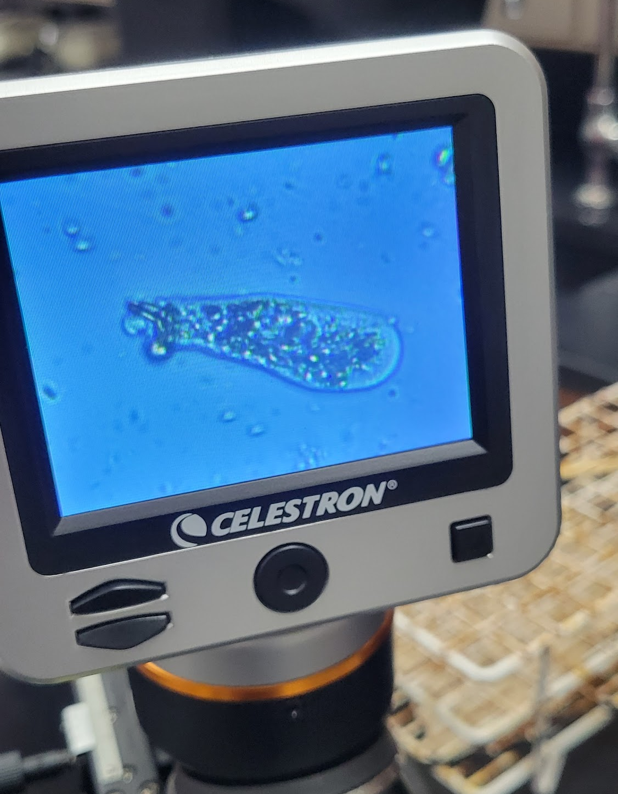
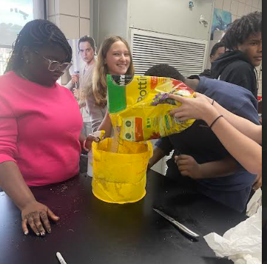
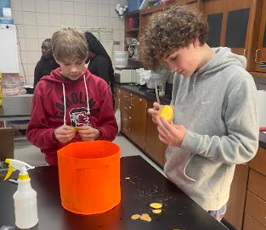
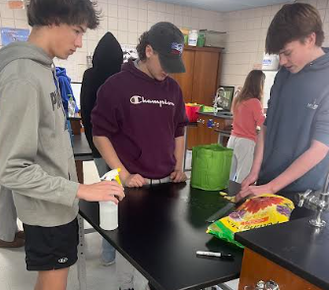
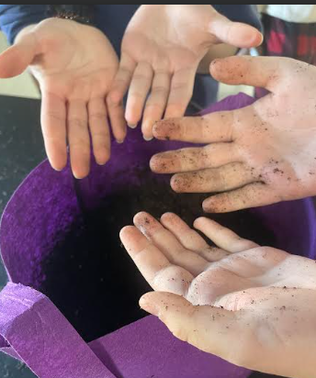
Mrs. Kendrick had a DonorsChoose Project Funded - Too Salty! Sea Level Rise and Freshwater Environments
Click for more great ‘stuff’!
Biology 2 (Cox)
Students have begun our unit on the microscopic world, to include learning about viruses, bacteria, protists, and fungi. We kicked off the unit by searching through pond water and found some great rotifers and other microscopic organisms. Use the following links to see them in action! Vid1, Vid2, Vid3
Mrs. Kendrick:
I had the opportunity to go to the AVID National conference. While there, I completed the AVID PAthways training and was able to sit in on several concurrent sessions. I learned many best practices that will continue to make my classroom a suitable learning environment for all learners.
Honors Earth Science (Lyles)
The new semester brings a new crop of potatoes! Students planted potatoes to mimic the events in the novel ‘The Martian’.

Slide 4
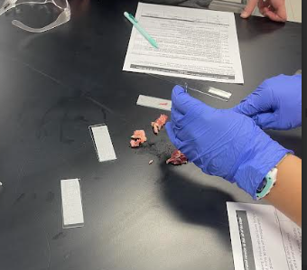
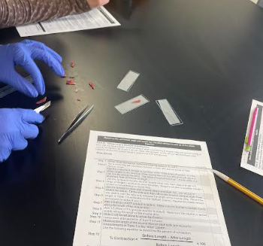
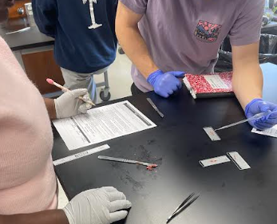
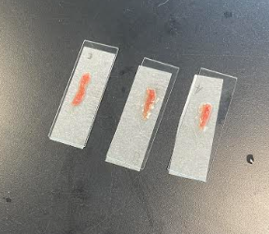
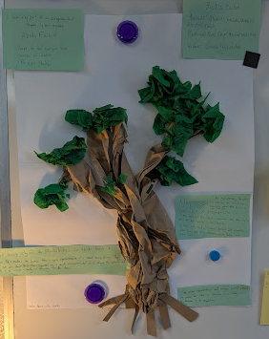
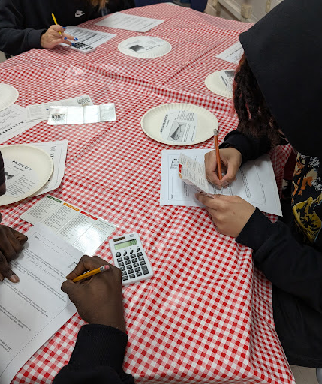
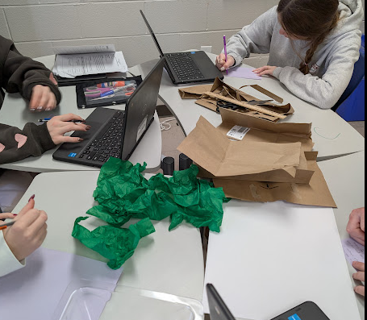
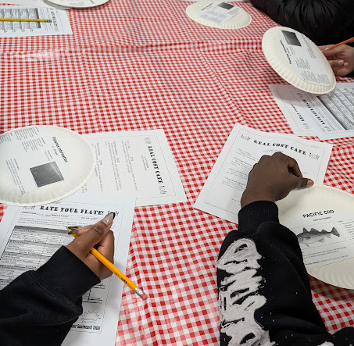
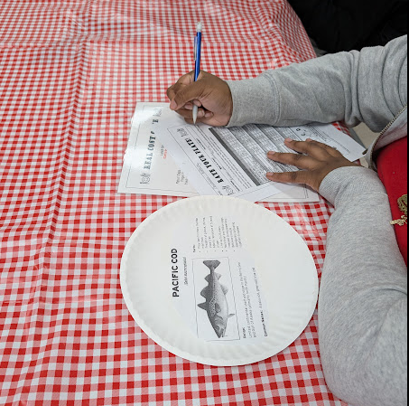
Honors Anatomy and Physiology (Barrett, Lyles)
Students are learning about muscle contraction. They performed a lab using fresh cuts of beef to determine the results of adding different solutions (glucose, Ringer’s and ATP) to the muscle fibers. They had to calculate the change in muscle fiber length and analyze the differences in changes and apply those differences to what they have learned about muscle contraction.
Environmental Science (Kendrick)
Honors Biology (Kendrick and Barrett)
Students make a model of the Baobab tree and research why this iconic African tree is so critical to African ecosystems.
Students in Kendrick’s environmental science continue to explore resource exploitation by analyzing fish species commonly found on a menu at a restaurant. Students pretended they were at a real restaurant and ordered dishes off the menu.

Slide 5

Social Studies

Slide 6
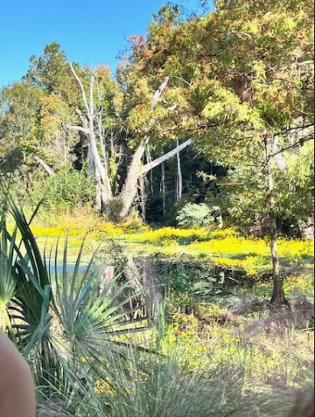
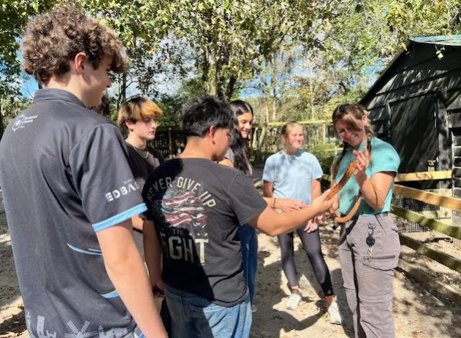
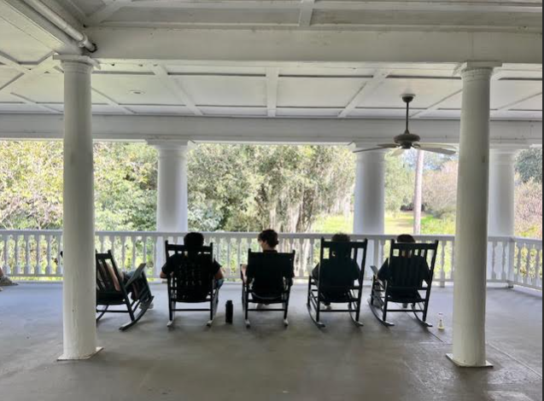
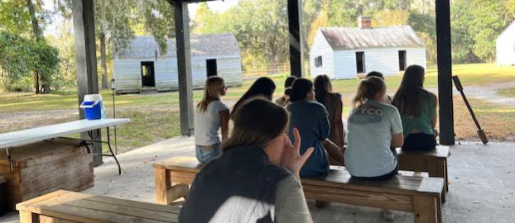
Ms. Wakefield’s USHC Field Trip to Magnolia Plantation

Slide 7
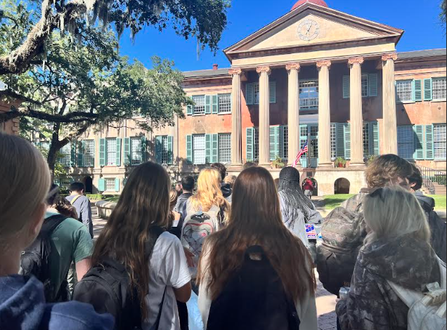
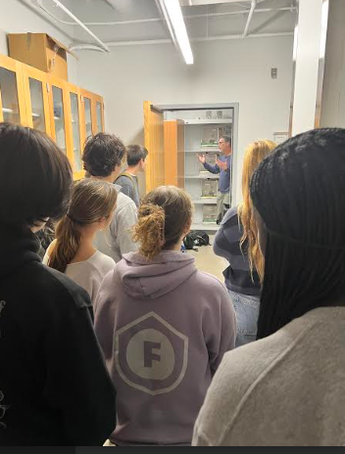
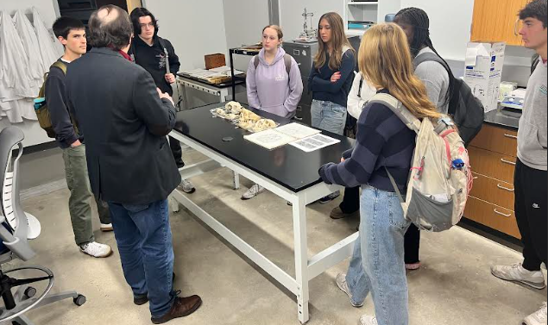
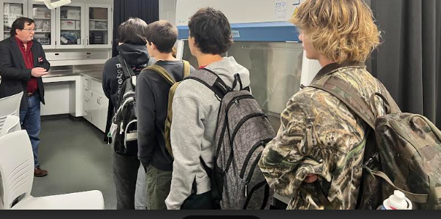
Ms. Wakefield’s Anthropology Field Trip to CofC

Slide 8
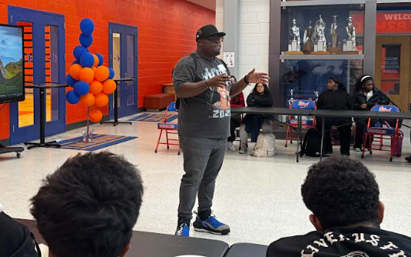
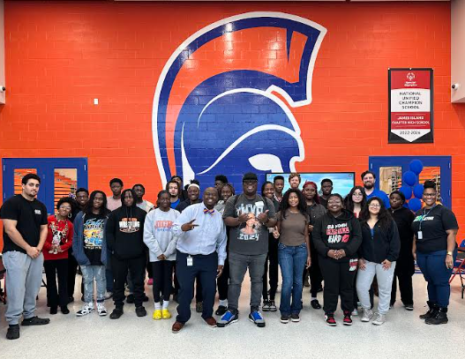
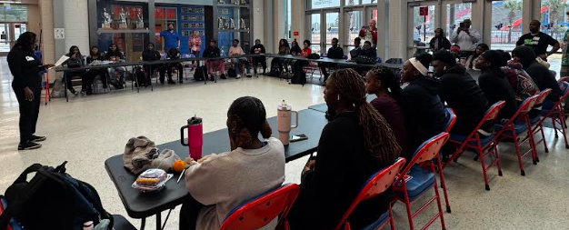
Big Beyond 12/11
The Big Beyond Speaker Series Featured: KJ Kearney: Community Organizer, and founder of the 2024 James Beard Award winning social media account, “Black Food Fridays”

Slide 9
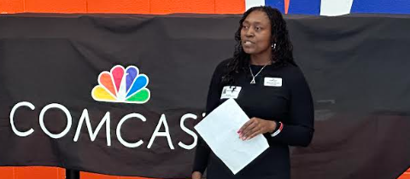
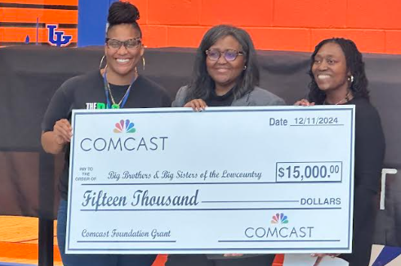
Big Beyond 12/11
James Island Charter High School would like to thank Comcast for the generous donation of laptops to our Big Beyond scholars. We also appreciate Comcast (Ms. Shaneak Brown) for donating $15,000 to our partners at Big Brothers;Big Sisters of the Lowcountry. Special thank you to Ms. Adriane Smalls-Owens, Mr. Christopher Epps, Mr. Philip Kelly, Mr. Nolan Davis, and Mr. Archie Temoney who serve as advisors for the Big Beyond Program.

Slide 10


Slide 11
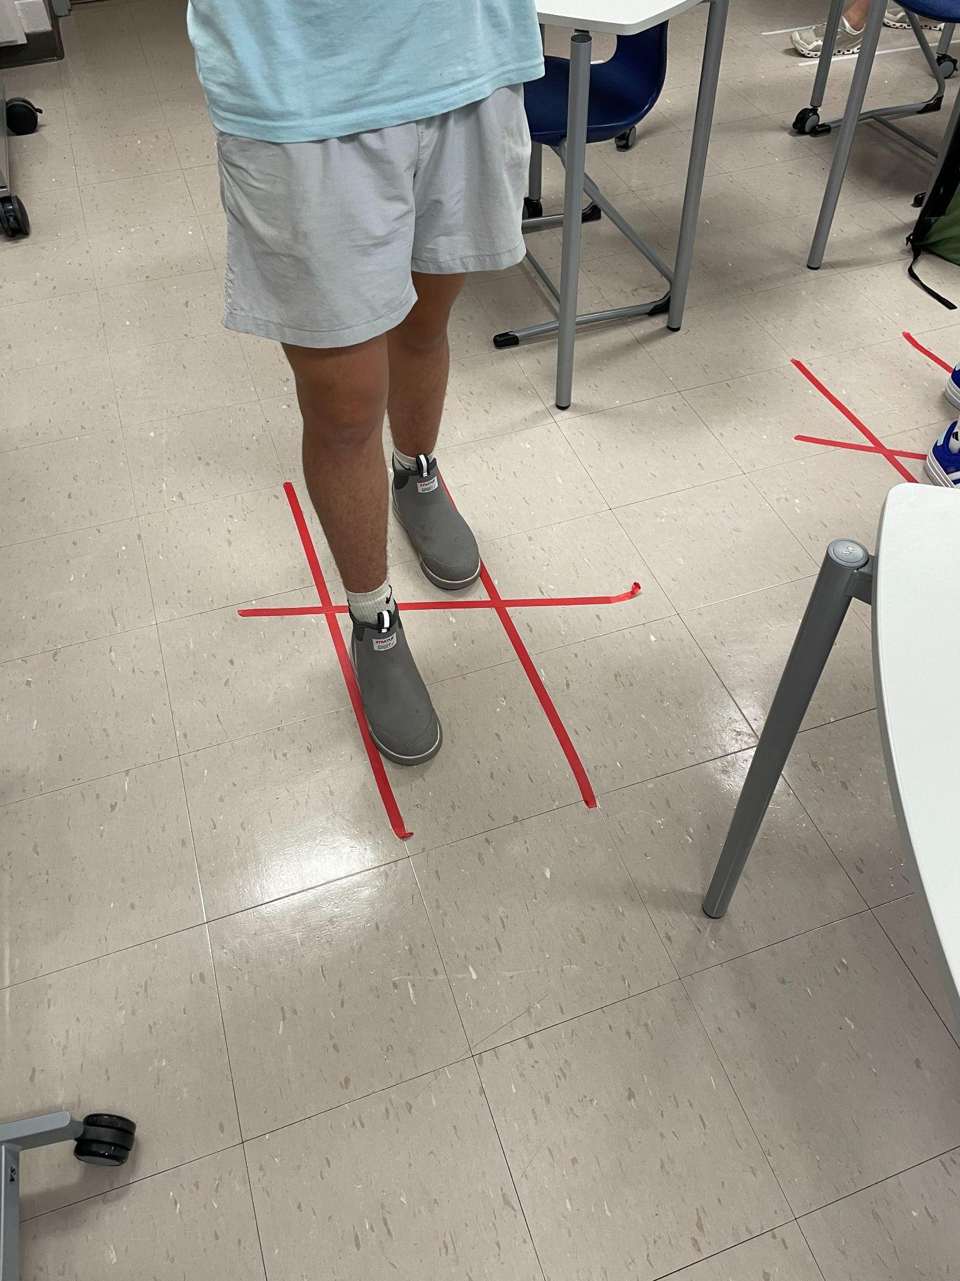
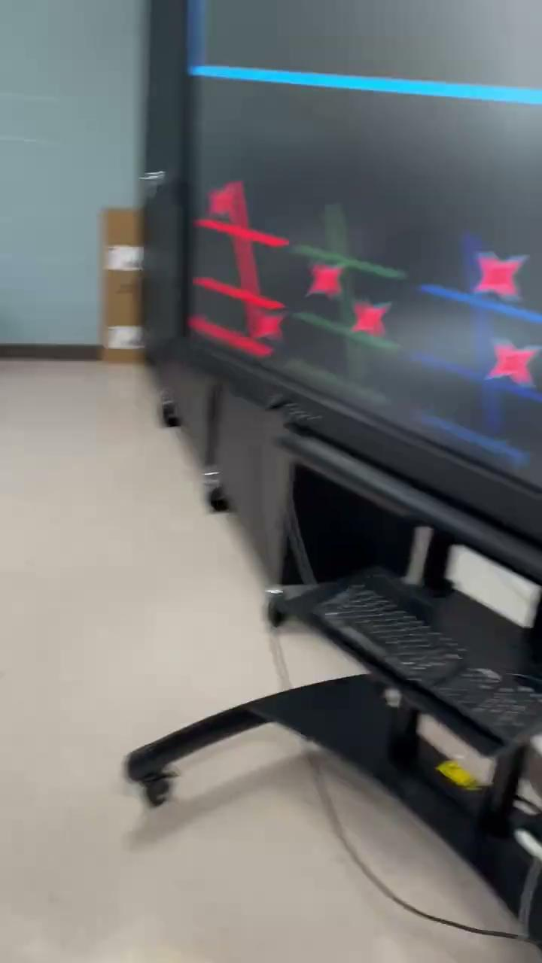
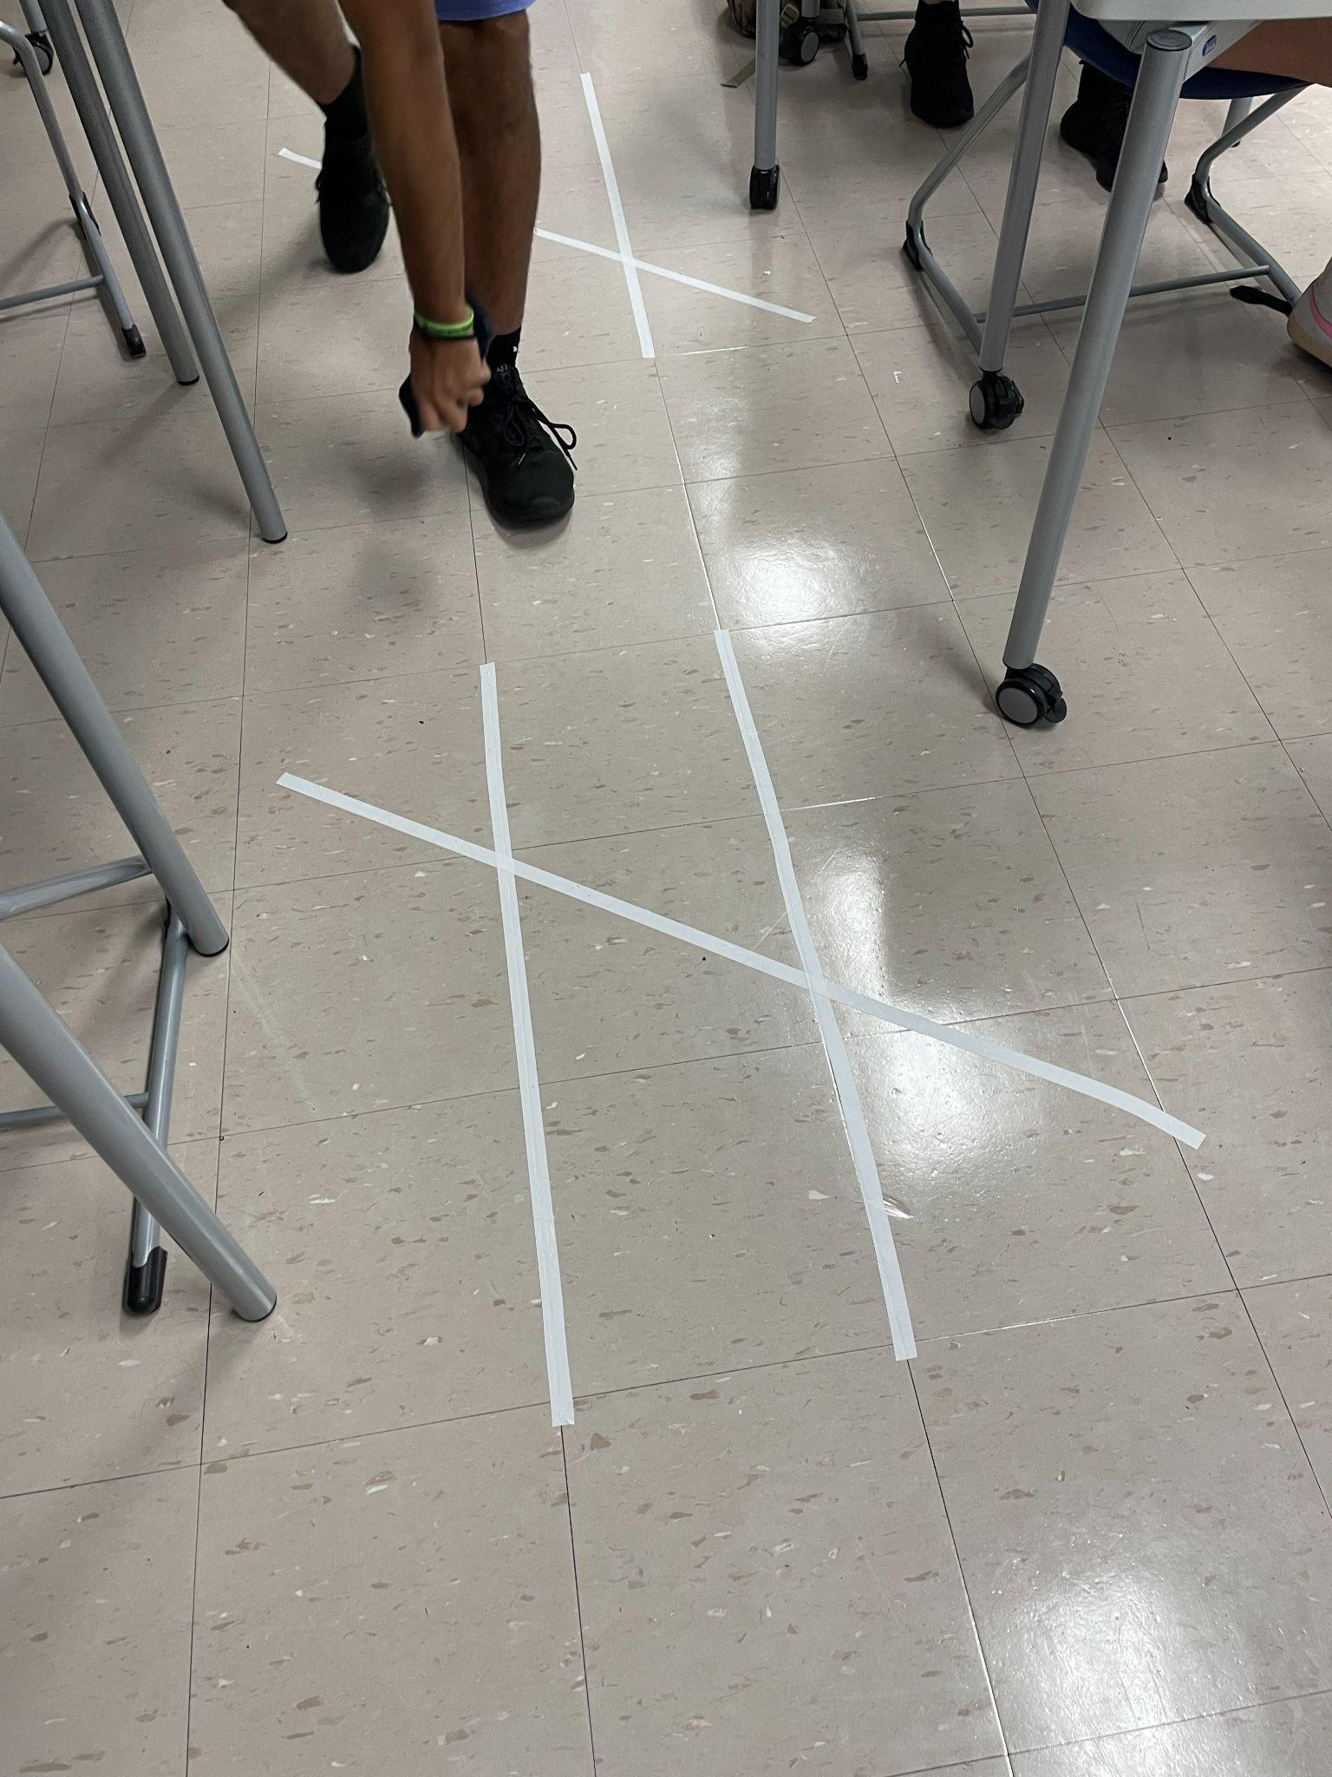
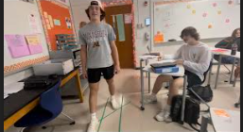
Dance, Dance Transversal - Mr. Taylor using dance moves to teach Geometry!!

Slide 12
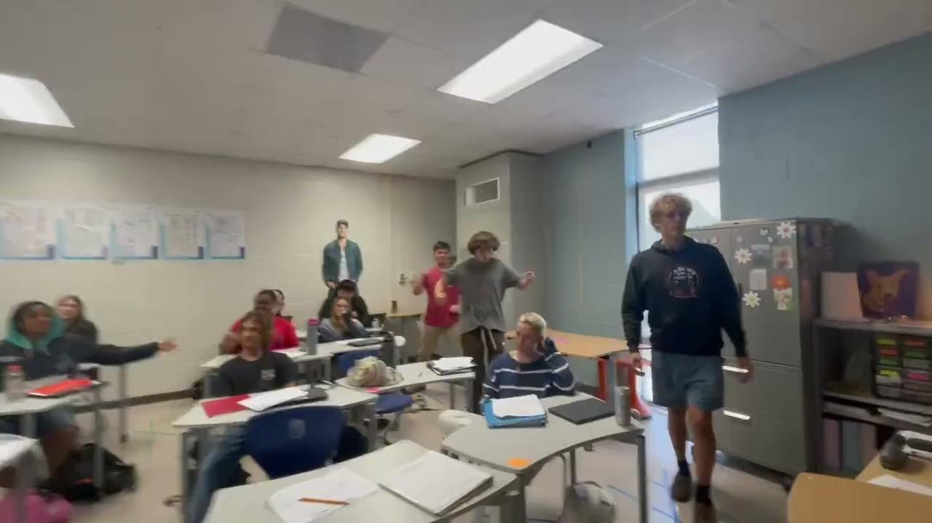

Slide 13

Physical Education and Health Dept.
Healthy bodies. Healthy Minds. Healthy Futures.
JICHS All Stars

Slide 14
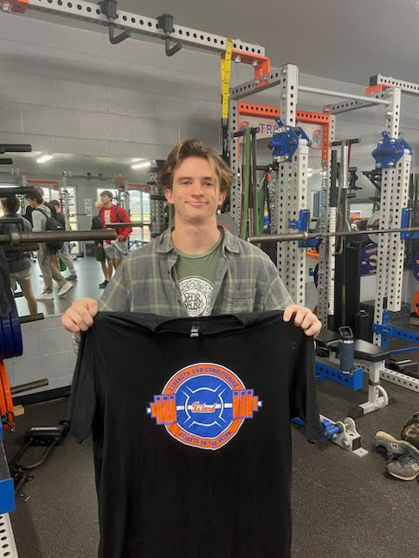
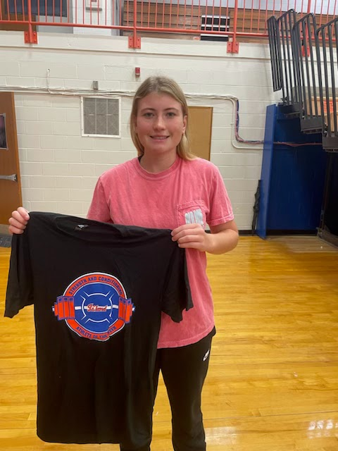
Varsity Sports Class and Training
BREAKING RECORDS!!
Multiple all time records were broken recently: Female squat, female pull ups, male bench, and male & female vertical jump.
Congrats to our Athletes of the Week and all students who broke the record!

Slide 15
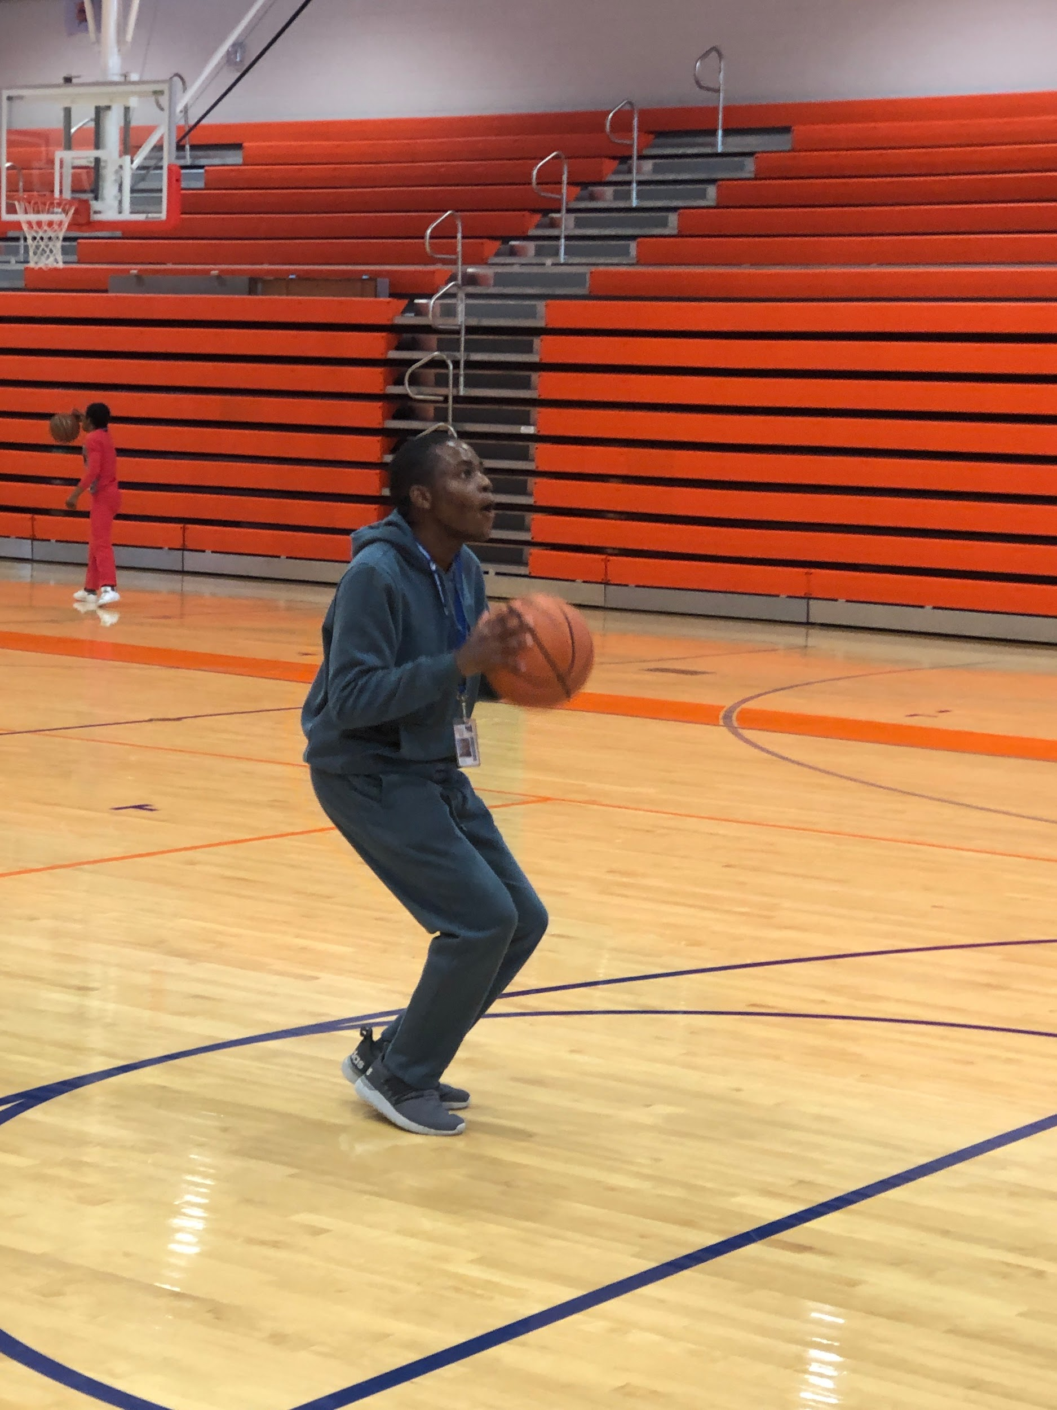
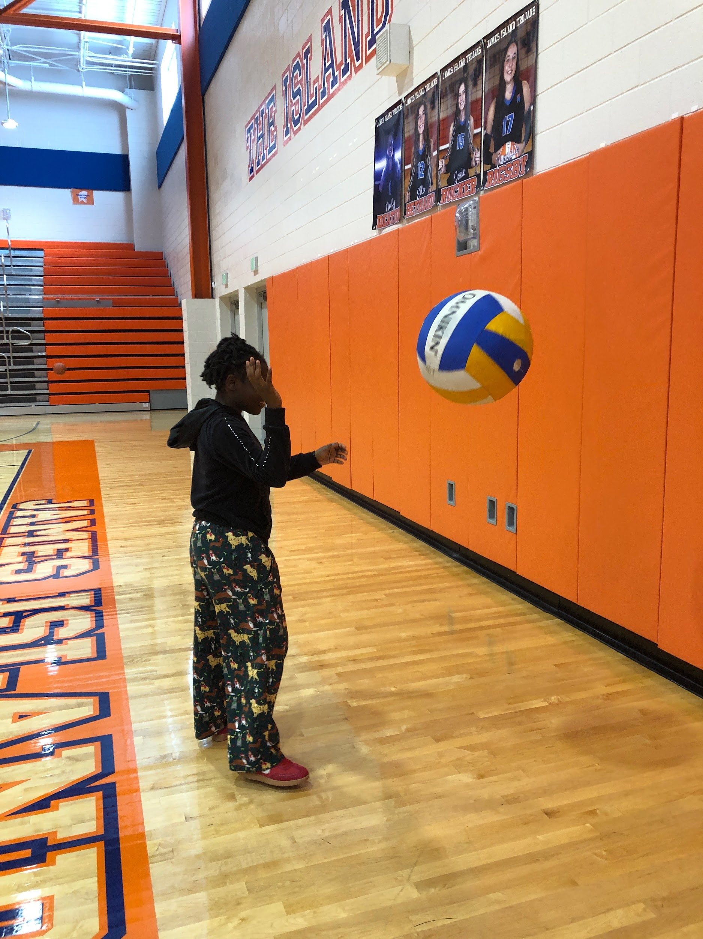
Unified PE
HAVING FUN!
Students earned an open gym day. Each student has their go-to sport they love to play so got to pick their favorite equipment to have fun with.
Aaron in particular is a basketball shooting machine!

Slide 16
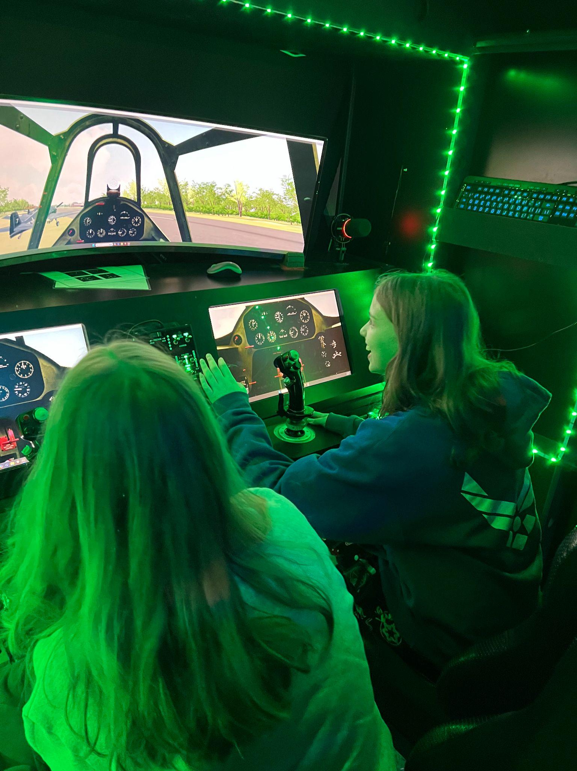
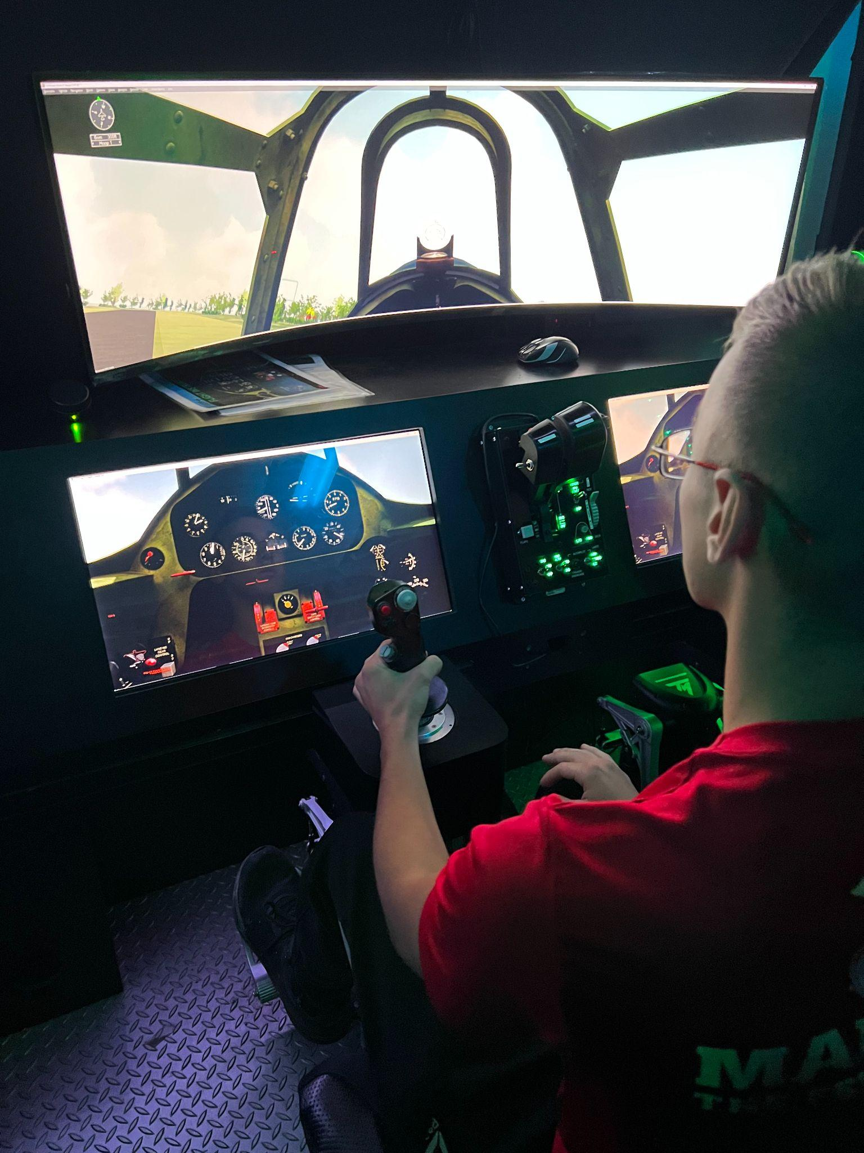


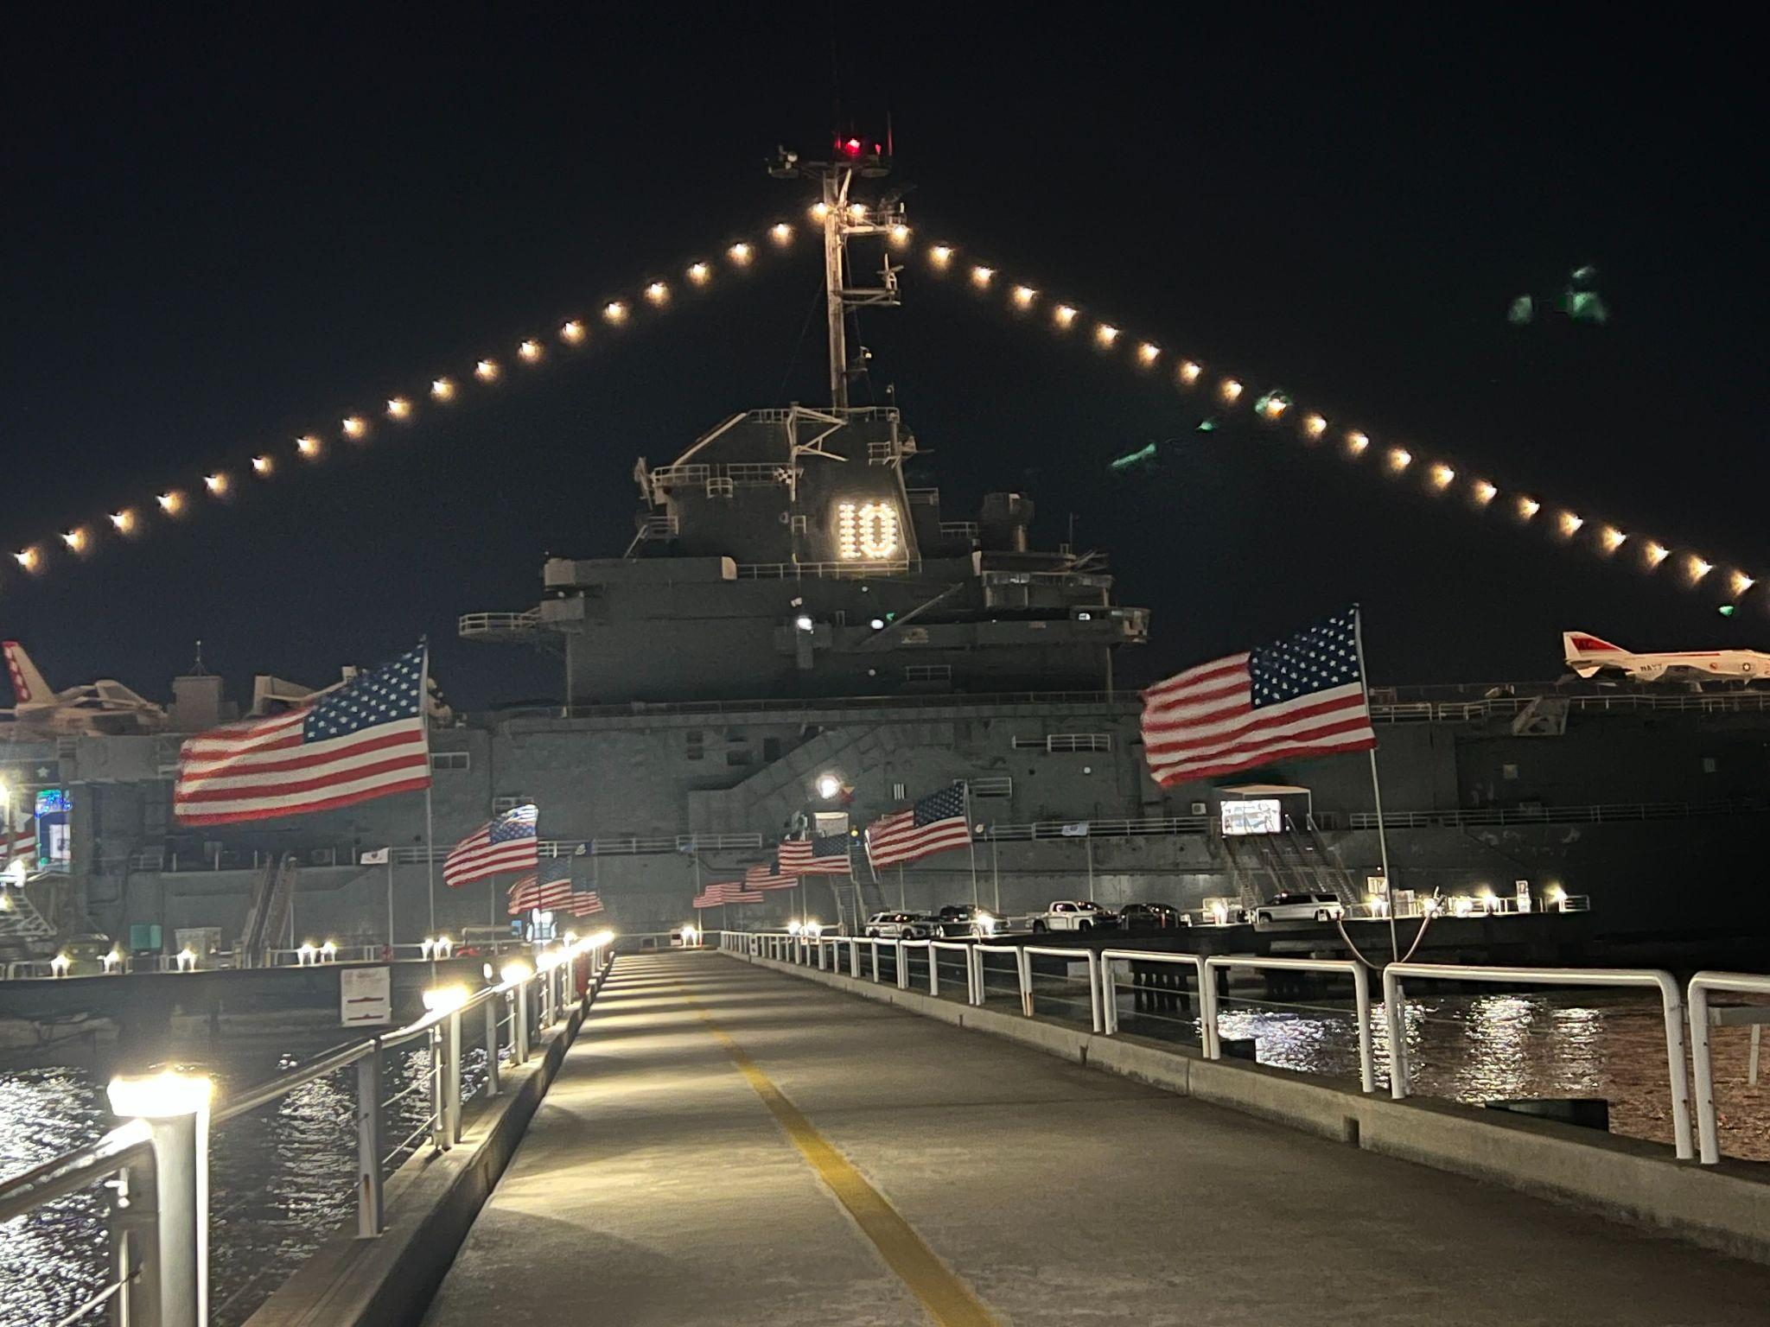
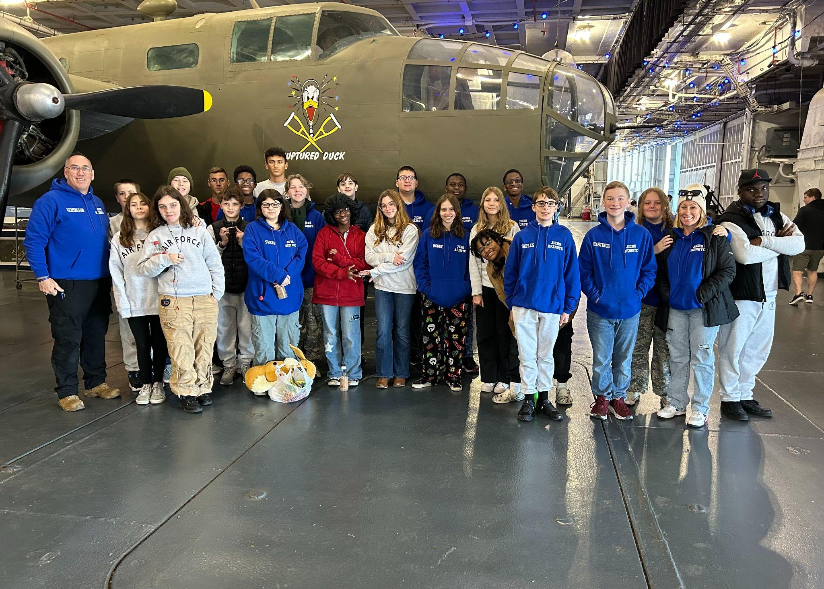
JROTC
Many cadets enjoyed another overnight aboard the USS Yorktown and attended the Yorktown’s “Flight Academy” 12/6–12/7

Slide 17





Students in the CTE Department have been working hard to earn their industry certifications this semester. To date, we have the following number of students that have received their industry certifications:
32 students
12 students
54 students
20 students

Slide 18
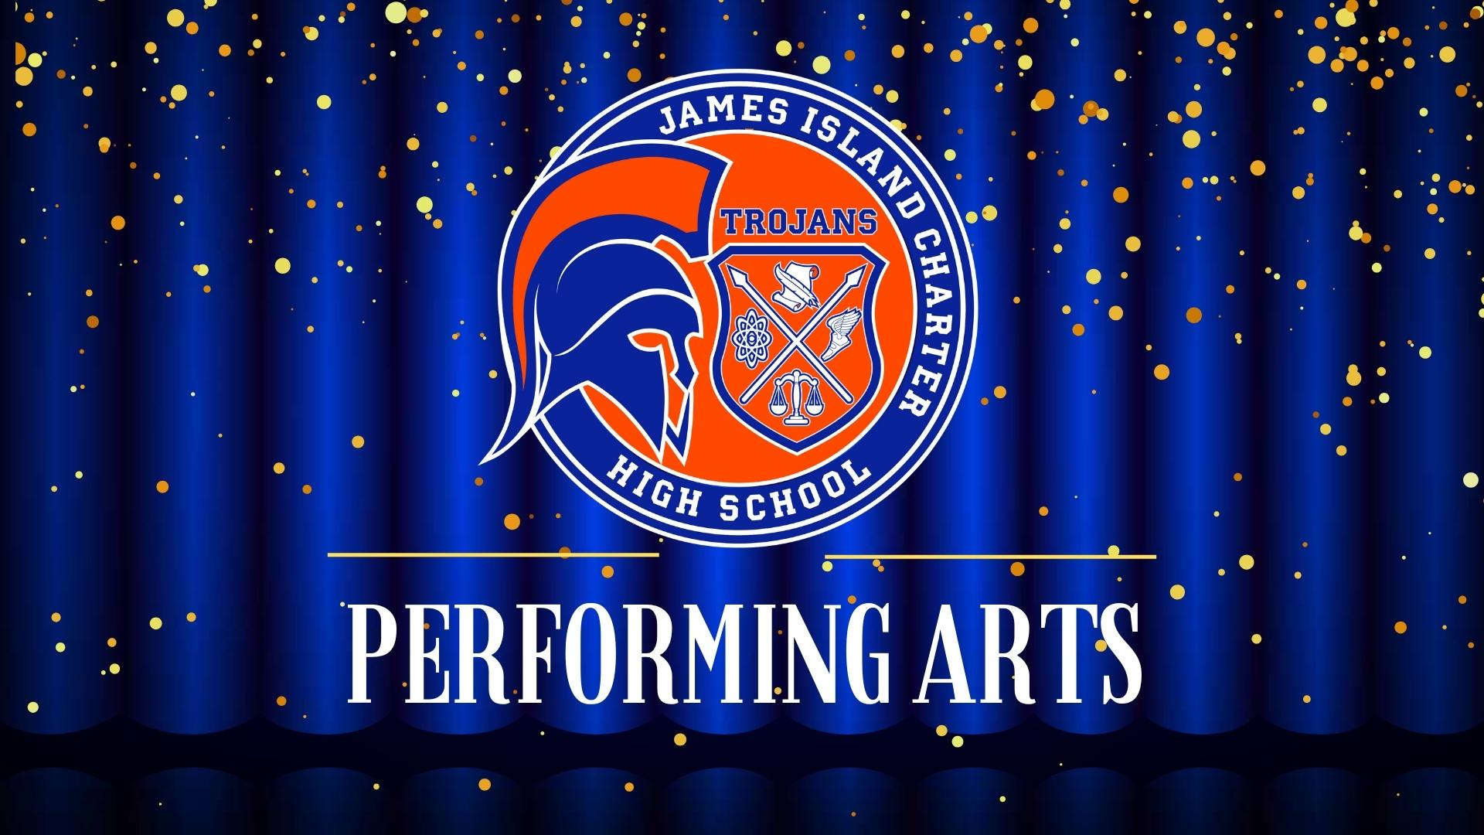


Slide 19
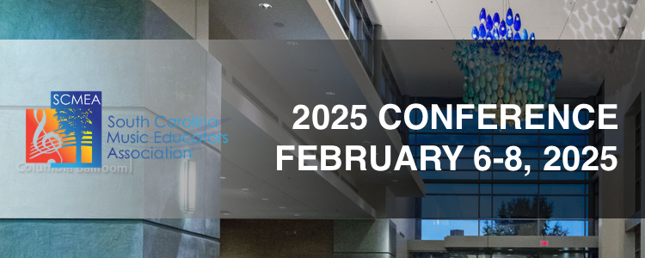
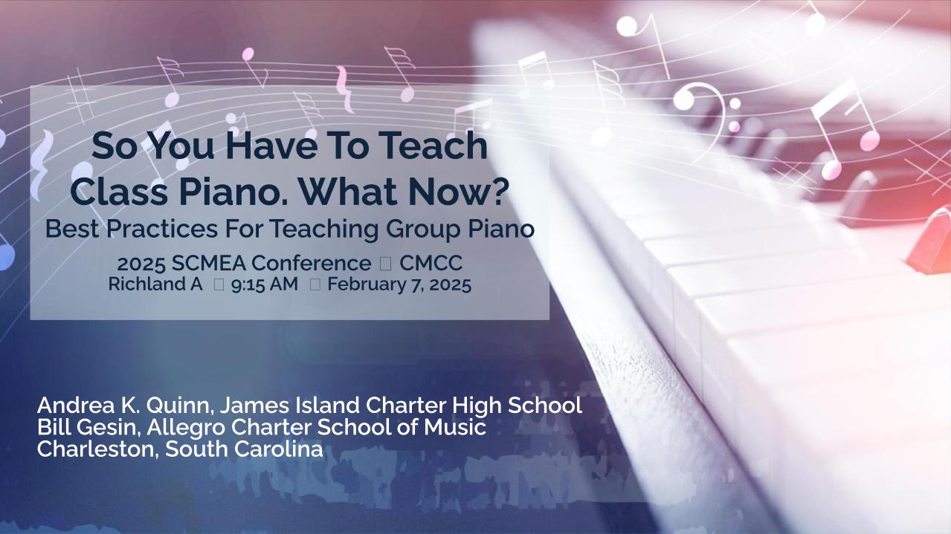

Ike Johnson
Quinn Wagner
Are Invited to Perform At The
2025 Fall Honors Piano Recital
February 8, 2025, in
Columbia, SC
You Are Welcome to Attend!

Slide 20
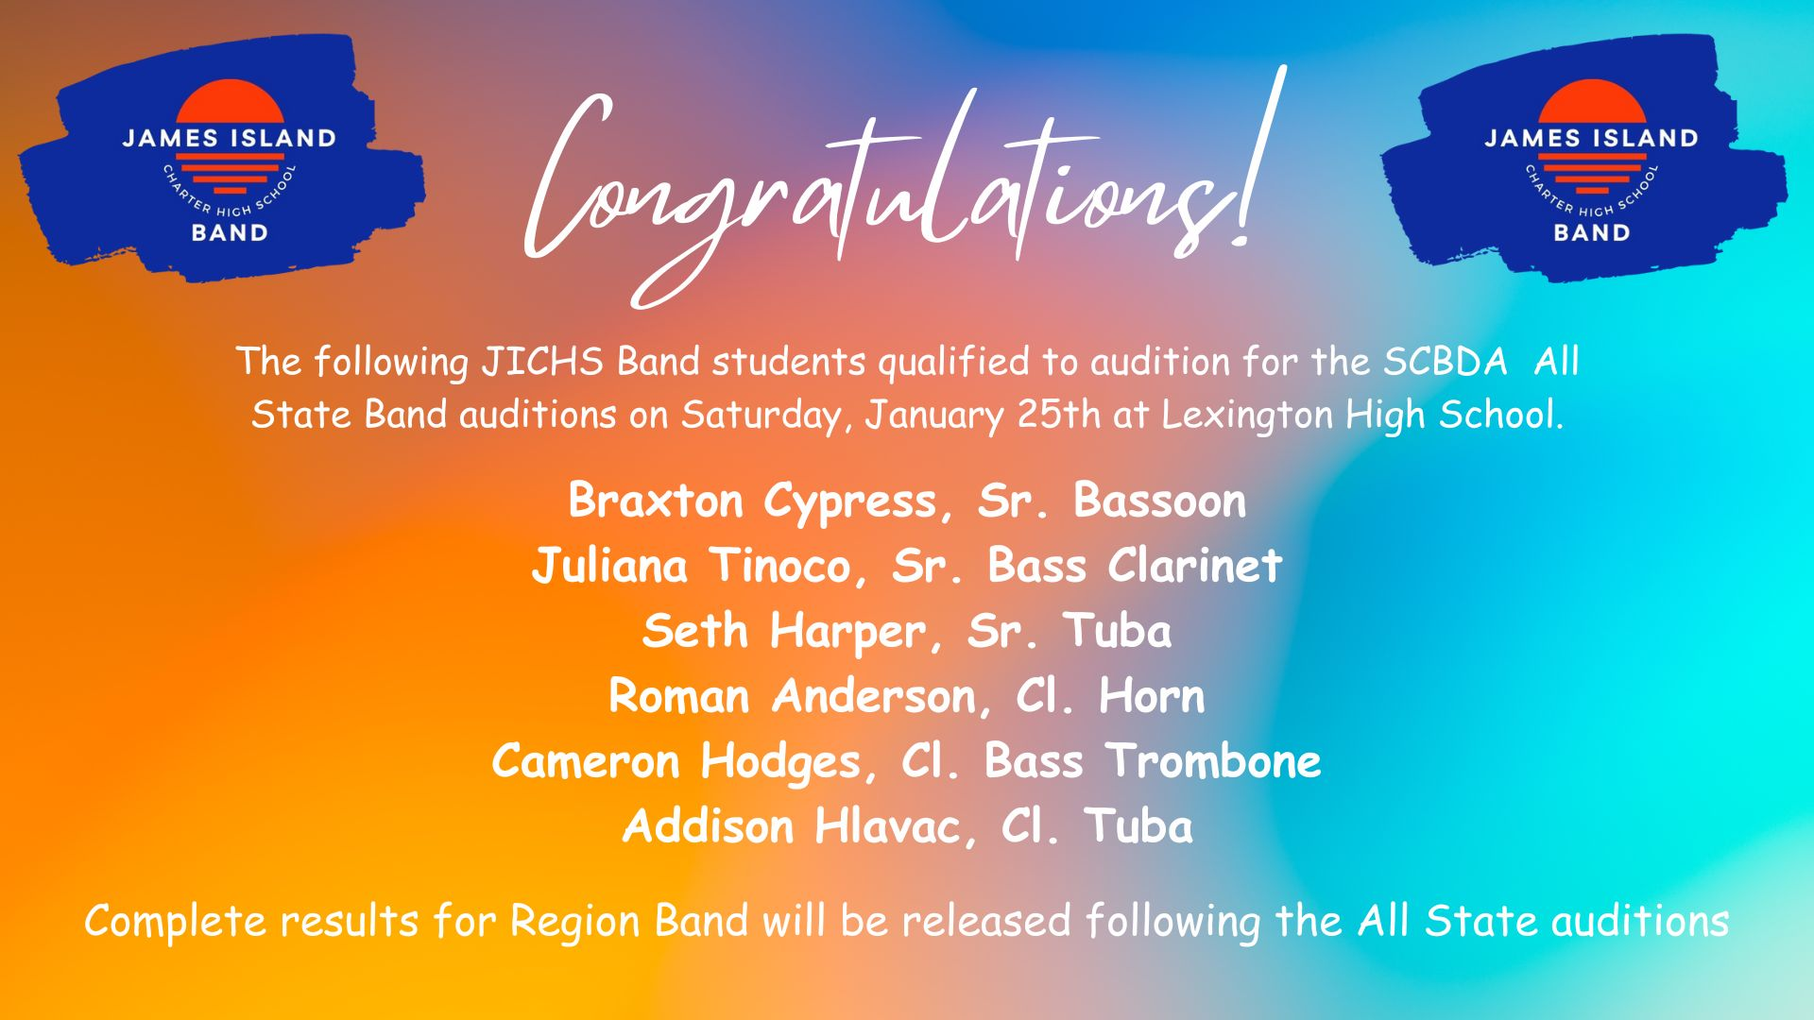

Slide 21

Musical Theatre
The annual collaboration between Drama and Choir began with the start of S2!
SHOWS ARE March 28-30!
JICHS Grease Cast List
Danny……….………Ben Faust Sandy……..….Hannah Hughes Kenickie………….Tanner Fralix Rizzo………………Julia Ramos
Doody……….….…Johan Perez Marty……………Anna Wacaser
Roger……….……Aidan Aubrey Patty……………….Skylar Jones
Sonny………….….Sam Carson Jan…………….….Leila Conyers
Johnny Casino…...Mikah Brown Frenchy………..….Henley Bilbro
Vince Fontaine…..Kenny Peters Teen Angel………..….Kay Bilbro
Eugene.…….Cameron Anderson Miss Lynch………..…..Joy Nixon
Cha-Cha………….Sierra Wiggins

Slide 22

Art Department
Ms. Purvis, Mr. Arnett, Ms. Read, and Mrs. Gunther

Slide 23
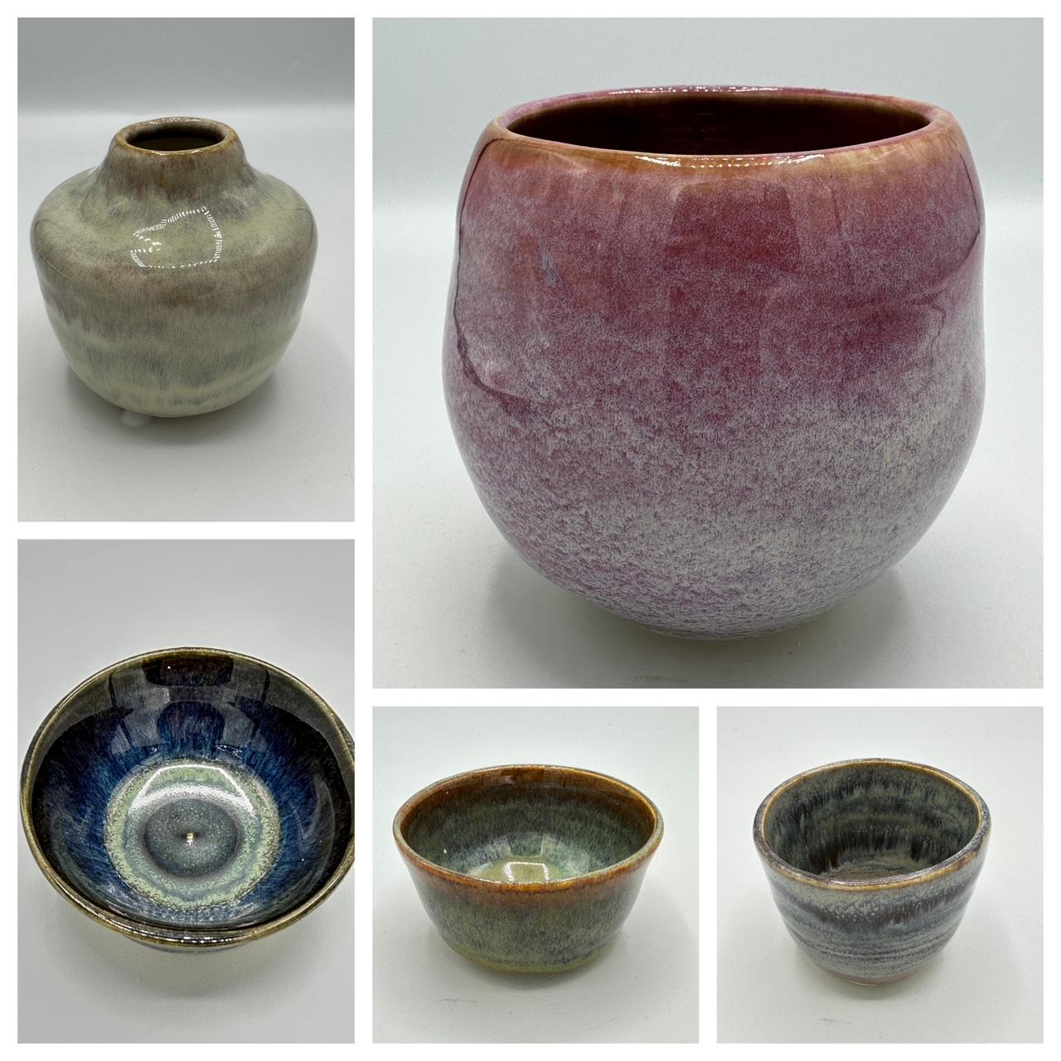
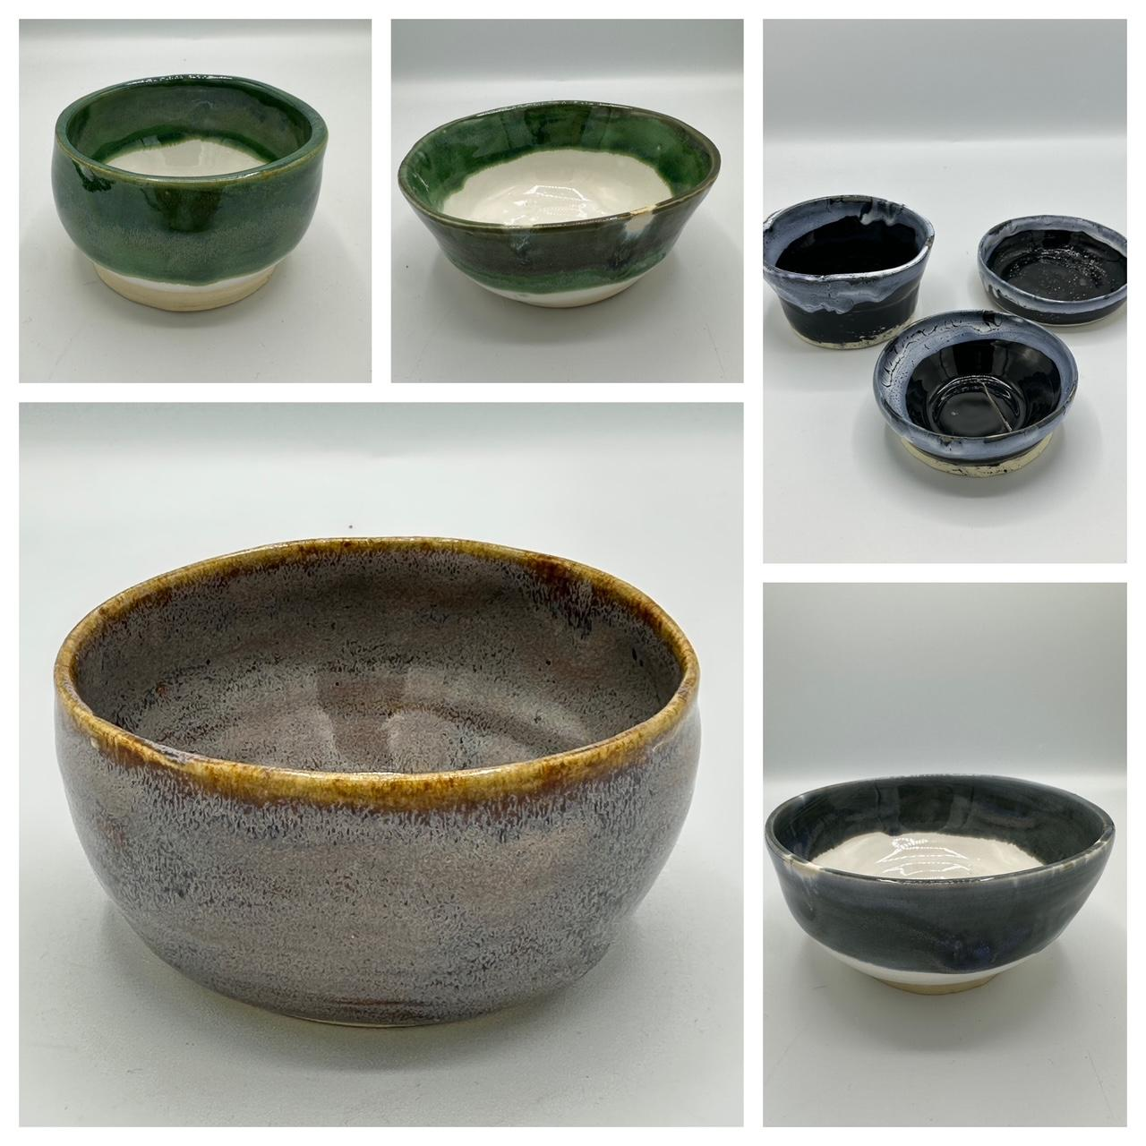
Mrs. Gunther - Ceramics 2

Slide 24
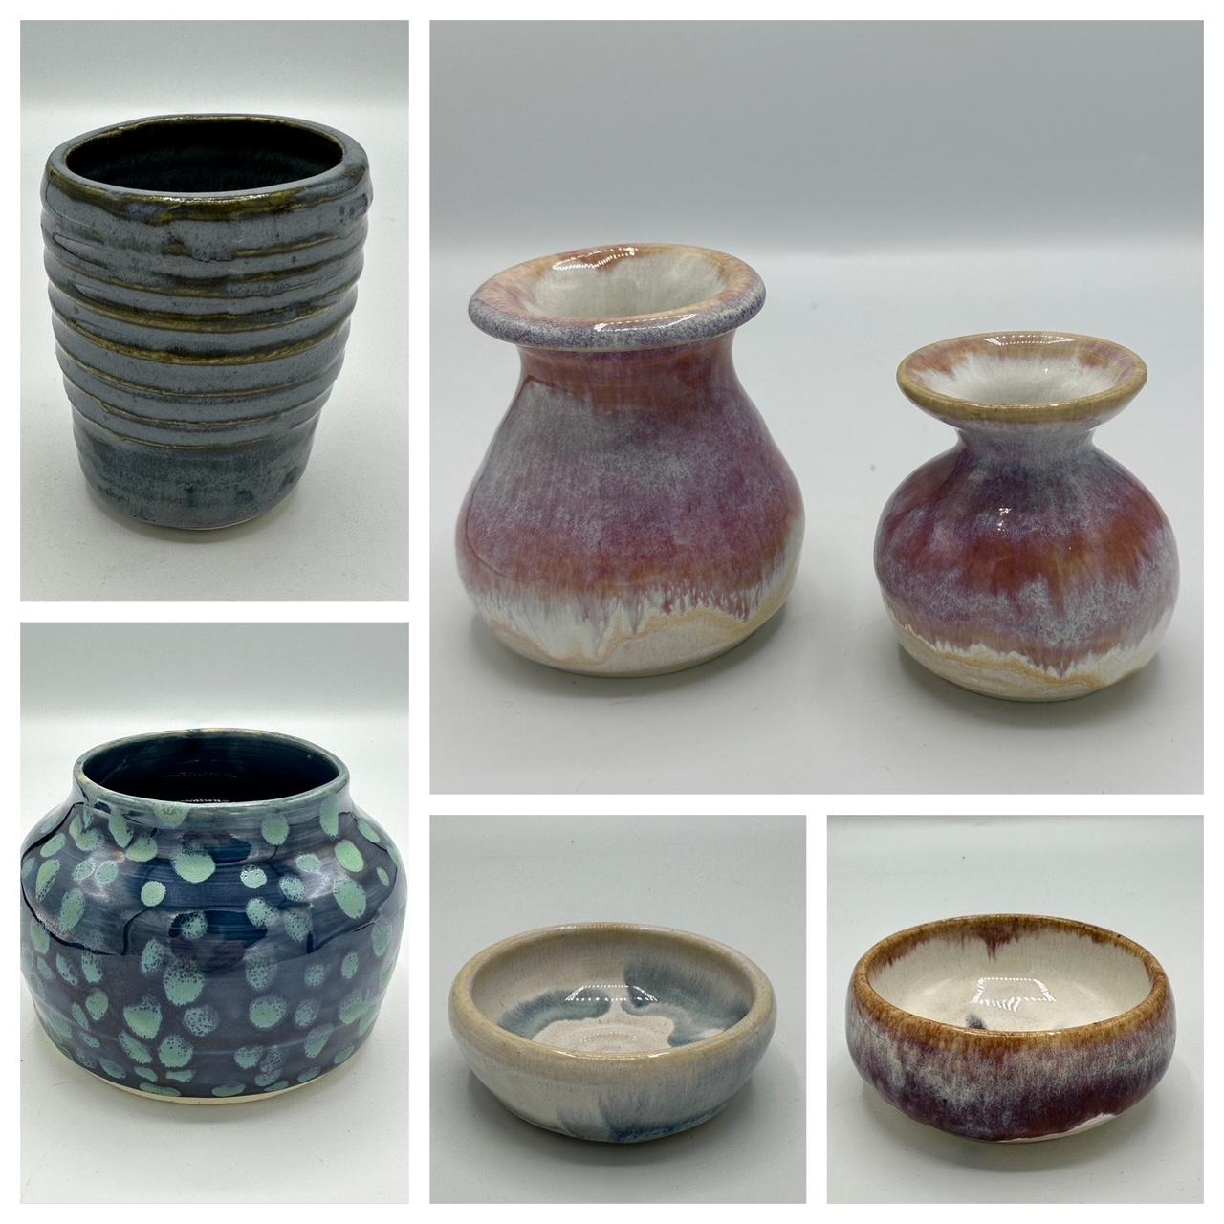
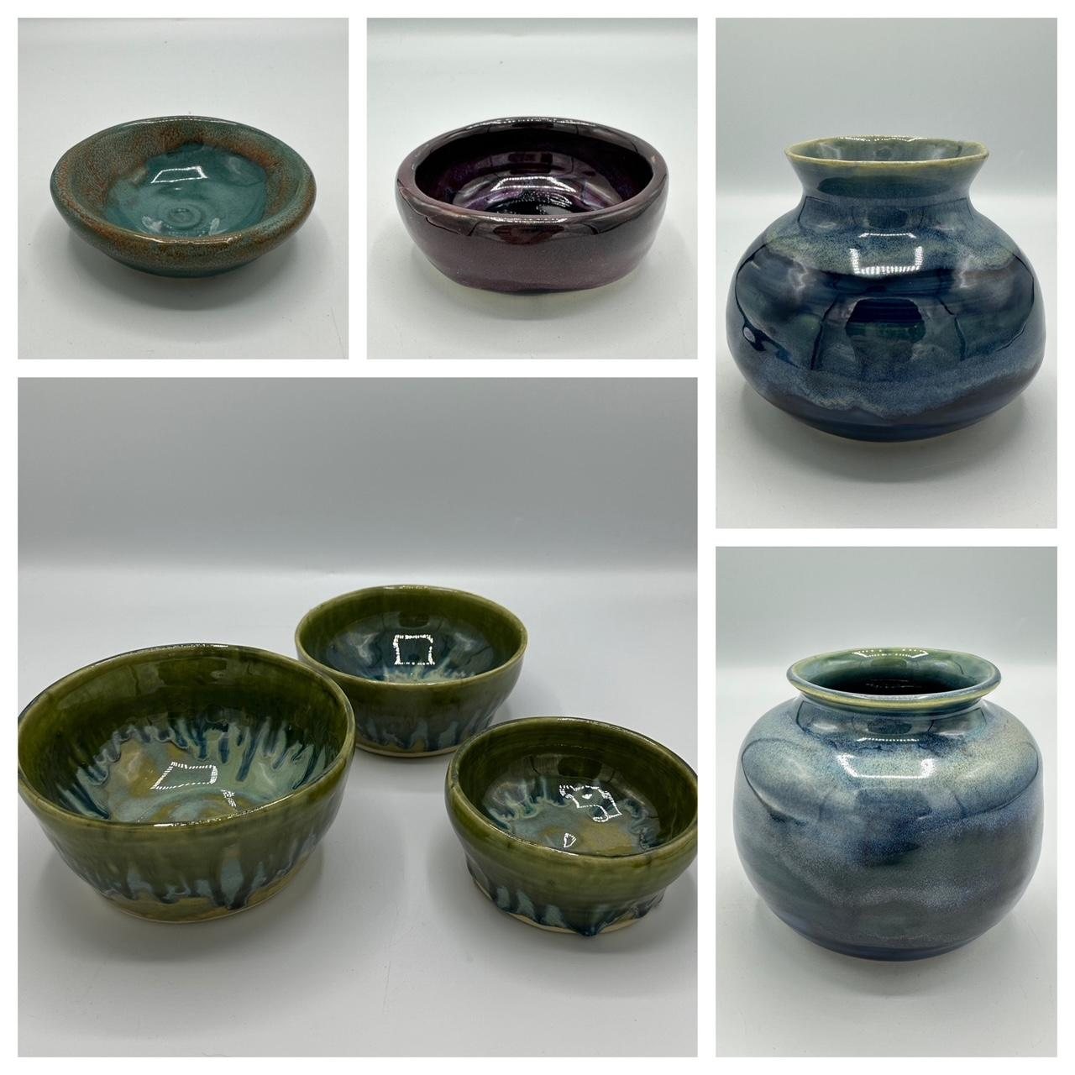
Mrs. Gunther - Ceramics 2

Slide 25
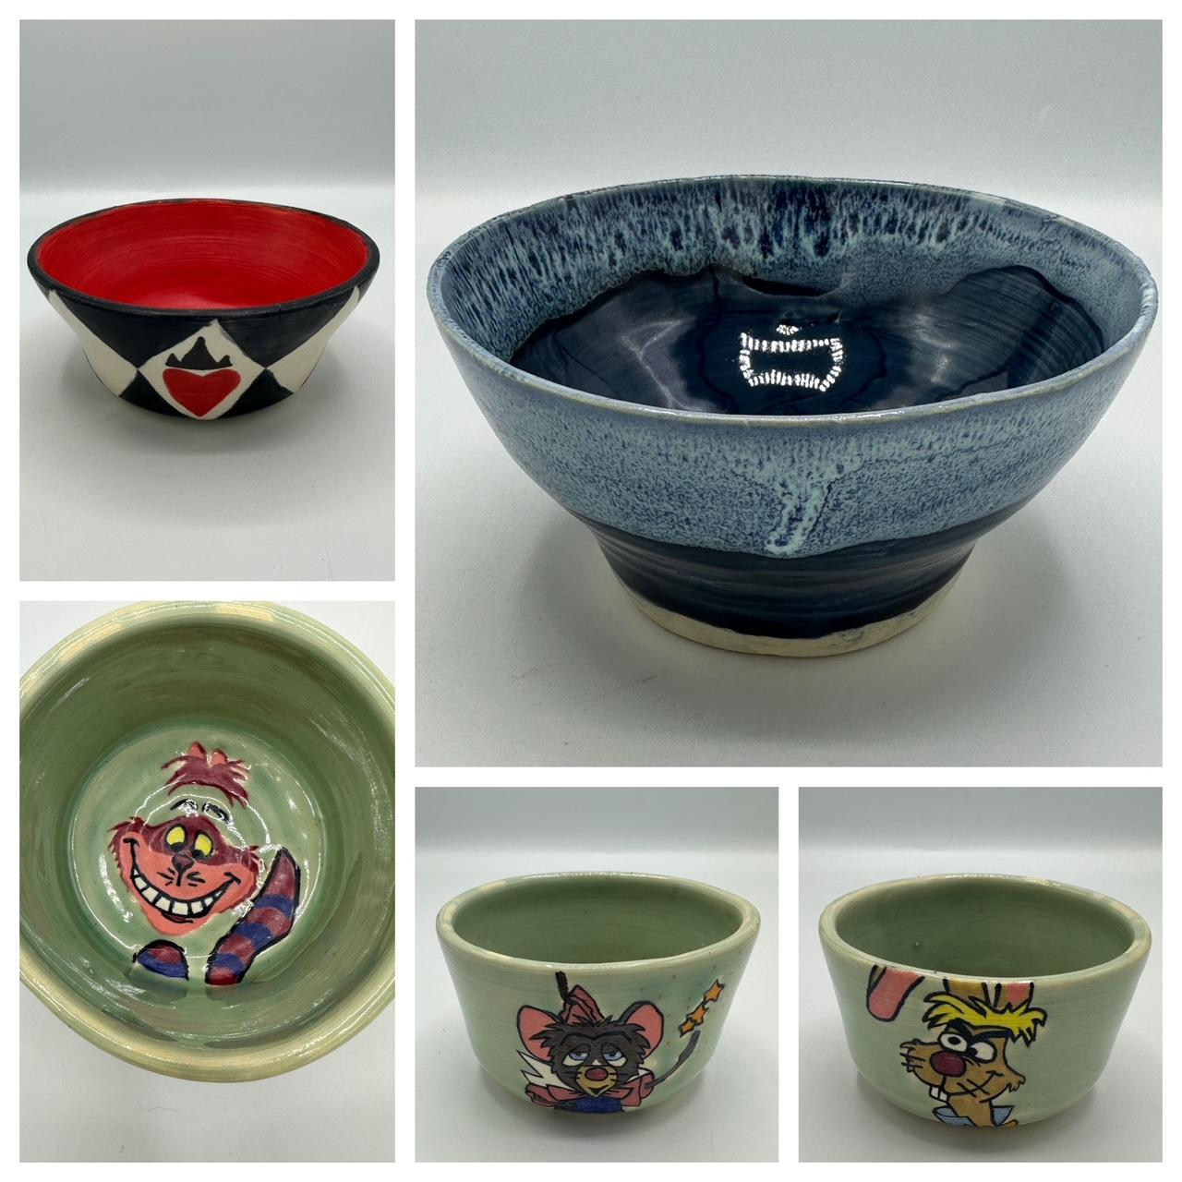
Mrs. Gunther - Ceramics 2

Slide 26
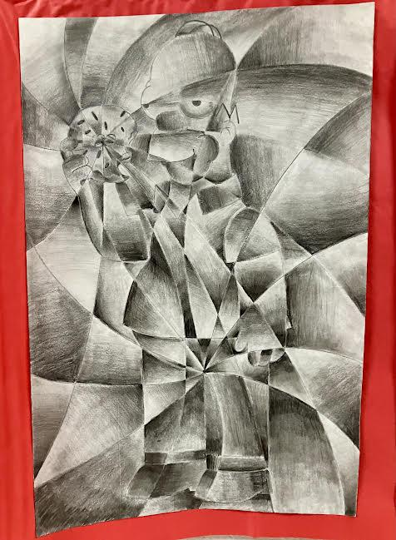

Ms. Read’s Art 1

Slide 27


Ms. Read’s Art 2

Slide 28

Ms. Read’s Art 2

Slide 29


Mr. Arnett: AP Art

Slide 30


Mr. Arnett: AP Art

Slide 31


Mr. Arnett: AP Art

Slide 32


Mr. Arnett: AP Art

Slide 33


Mr. Arnett: Art 2

Slide 34


Mr. Arnett: Art 2

Slide 35

Mr. Arnett: Art 1

Slide 36

Mr. Arnett: Art 1

Slide 37



J I
I B
#jichsib
Notes:
Ji IB Website

Slide 38

Showcasing JICHS in the International School Directory
James Island Charter High School is proud to be featured in the International School Directory, a global listing of schools offering International Baccalaureate (IB) education. This inclusion connects us to a worldwide network of schools dedicated to academic excellence and global-mindedness. Families relocating regionally, nationally, or internationally can identify JICHS as a premier destination to continue their IB education seamlessly.
Our listing highlights the unique value of the JICHS IB Programme, which combines rigorous coursework, holistic development, and a focus on global perspectives. With a growing number of families relocating nationally and internationally to the Charleston area, our presence in the directory enhances our visibility and reinforces our reputation as a leading educational institution.

Slide 39


Expanding IB Access Through AVID Collaboration
The JICHS IB Coordinator recently collaborated with Mary Green, our regional AVID representative, along with the AVID site team and school administration, to explore innovative ways to increase diversity and access in our IB Programme. Drawing from case studies and examples of schools successfully integrating AVID and IB, the discussion focused on strategies to support students who might otherwise be overlooked for rigorous academic programs. These insights align with our charter goals of broadening educational opportunities for historically overlooked populations.
As an outcome of this meeting, we are excited to expand access to the Theory of Knowledge (TOK) course. Starting next year, AVID students will join Global Pathway and Diploma candidates in this foundational IB course, promoting a greater reach and inclusivity within the program. By opening this opportunity, JICHS continues to strengthen its commitment to preparing a diverse student body for success in college and beyond.

Slide 40




Slide 41


Slide 42

Sociedad Honoraria Hispánica hosted a bake sale to raise money for flood victims in Spain!

Slide 43

The SHH hosted a Tertulia where students presented a topic or question to initiate discussion in the Spanish language. Tertulias happen in universities and it is a great way to start preparing our students to get involved at the collegiate level.
Tertulia: a type of Spanish literary salon that was popular in Spain from at least the 17th century and that eventually replaced the more formal academies. Tertulias were held in private homes at first, but from the early 19th century they met in clubs and cafés.

Slide 44



The selection committee for the American Association of Teachers of French (AATF) Société Honoraire de Français 2024-2025 Creative Writing Award have chosen an essay written by Madison Wade (one of Dr. Tucker’s students) to be published in the upcoming Spring edition of Élan, the AATF's literary journal!
This is a significant achievement, as Élan showcases the best work from French language students across the nation! Madison’s talent in creative writing and her dedication to the French language have earned her this well-deserved recognition.

Slide 45


Slide 46


Pumpkin Pies and Life Skills: Class Wins $500 Aldi Grant!
Brewing Skills: Students Serve Coffee and Gain Job Experience at Independent Grounds!
Ms. Schrimsher’s class was awarded a generous $500 grant from Aldi through their Community Gift Card Program, which supports educational initiatives. With this funding, students will focus on developing essential life skills, including planning, budgeting, shopping, checking out, and food preparation. Two students recently took their first venture, shopping for ingredients and preparing pumpkin pies. This rich experience is a key step in helping students build independence and practical skills for everyday life.
Independent Grounds, located outside MUSC, is a coffee cart where our students gain valuable vocational experience. Each Thursday, two students accompanied by our Transition Specialist, Ms. Finley, run the cart, preparing drinks, handling transactions, and developing customer service skills. This program provides practical job training, giving students hands-on experience in a real-world setting. Stop by on Thursday mornings to grab a coffee and support our students as they earn tips and build real-world skills!

Slide 47


JICHS
Guidance

Slide 48


Slide 49


Slide 50


Slide 51





AVID has been in Christmas mode lately!
Below is Ms. Mosbacher’s 201 class making Christmas ornaments for senior citizens.
Toys for tots drive through Dec 18th!
On December 12th, AVID is teaming up the JICHS Spirit Club and JROTC to present The Grinch as a Christmas movie. It will be showing @ the Backyard. Toy donations are welcomed!

Slide 52
Library
Check out our 2nd Quarter Report here!
English Classes learn more about Intellectual Freedom
Ms. Brady’s English 3 Honors class as well as her AP Language classes are learning more about the history of banned and challenged materials and what challenges to intellectual freedom look like today. They looked for patterns in materials that have historically been challenged and compared those to more recent materials.
Students then chose a book to read as well as to learn its history as a challenged material and whether or not they believe it should be challenged or banned after reading it.
Mr. Krysty’s Engineering Class and Research
Mr. Krysty’s Capstone Engineering class is learning more about what the research process looks like in the engineering world. As they begin to plan to build their own product, either new or improved from an existing product, they are learning to assess the need and audience for the product as well as how to improve upon a product that may already exist. They will be learning from real life engineers and inventors as well to learn more about their processes.

