Slide 1

Dual Enrollment Process Information Session
Summer 2025/
Fall 2025

Slide 2
What is Dual Enrollment?
The term “dual enrollment” refers to an arrangement where students are enrolled in courses that count for both high school and college credit. These programs are also called “dual credit” or “concurrent enrollment.” –U.S. Secretary of Education
Significant differences in the program across the country; national/regional differences matter to any decision
Reference: http://ecs.force.com/mbdata/MBQuestNB2?Rep=DE1508
BCA students may participate in Dual Enrollment at Hillsborough Community College

Slide 3
Who can take classes?
Bell Creek Academy is dedicated to providing students with a rigorous educational experience. Through the Dual Enrollment program, students will have the opportunity to complete the 60 hours needed to complete an AA degree. The following track will be followed:
9th/10th grade- 1 class per semester
11th/12th grade- up to 3 classes (10 credit hours) per semester

Slide 4
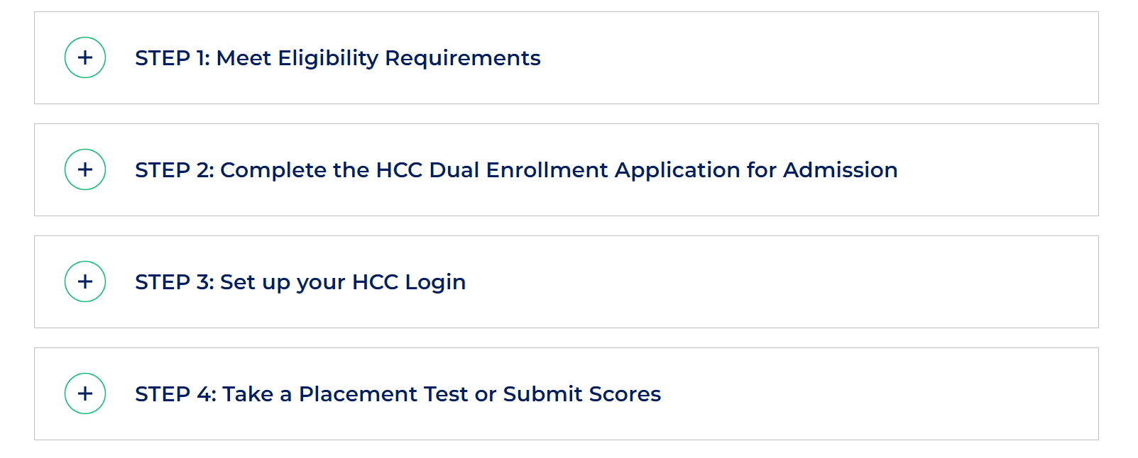
https://www.hccfl.edu/admissions/steps-enroll/dual-enrollment-and-early-admissions

Slide 5
Dual Enrollment Eligibility Requirements
Students eligible for Dual Enrollment must:
  Be a student in a Florida public or nonpublic secondary school with an articulation agreement on file with HCC, or in a home education program
  Have a 3.0 unweighted GPA to enroll in credit courses
  Pass the appropriate sections of the Post-Secondary Education Readiness Test (PERT) or have the appropriate scores on the SAT or the ACT (not more than two years old).

Slide 6
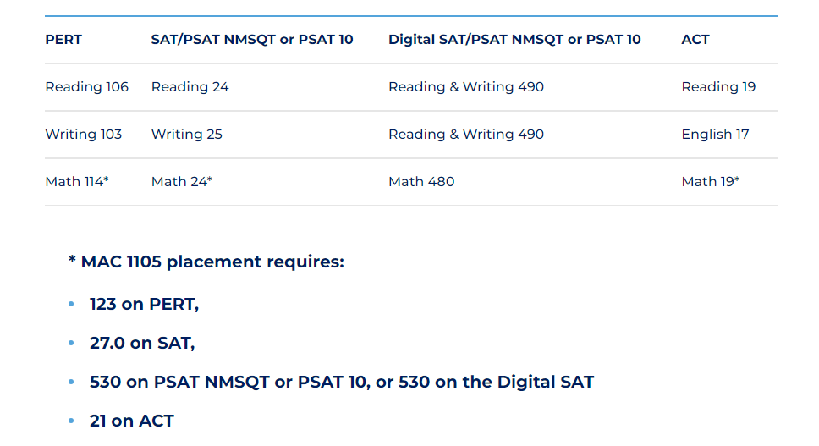
Current Placement Test Requirements

Slide 7
Dual Enrollment Class Types
Online (no "live sessions")
Online (w/ "live sessions")
On-campus (Brandon campus, Dale Mabry Campus, Plant City Campus, SouthShore Campus, Ybor City Campus)
  Locations and Directions | Hillsborough Community College
When choosing sections be very AWARE of which class type you are choosing.

Slide 8
Pathways
Students MUST follow a pathway for an Associate's degree:
  Associate in Arts | Hillsborough Community College
Pathways are the AA equivalent of a Major at a 4 year college/university.

Slide 9
Positives
Flexible Scheduling (jobs, extracurricular, Saturday classes, evening classes, etc.)
Wide menu of classes encompassing many options that do not exist in high school
Over 100 Pages of classes; including Career Tech and Specific Progams not found in High School (students MUST work towards an AA pathway)
Credit by class, not by standardized test
Saving money: very direct way of reducing college costs
Opportunity to explore careers while in high school
Provides students with a perspective of what college is like (increased participation rates in colleges)
AP/IB classes exist in very specific areas; Dual Enrollment can add/enrich to the available classes or provide opportunities beyond the school day

Slide 10
Negatives
Dual enrollment starts a college transcript; low grades in college courses greatly impact future opportunities
No parental ability to monitor; Special Education concerns
No schedule changes beyond a point; drop/add.
Equivalent to AP on paper; is it the same experience?
Is your 14-year-old child ready for adult conversations and the college experience?
Transportation/bureaucratic steps to participate
Not much data exists on student outcomes
• W=Withdrawals impact a student's completion percentage; students must maintain a certain percentage to qualify for financial aid (Ws and Fs affect this number).
• Cap of 60 credit hours (estimated/varies per school) may be transferred
• Undecided major students could be impacted by surcharges (change of major, fail to graduate on-time

Slide 11
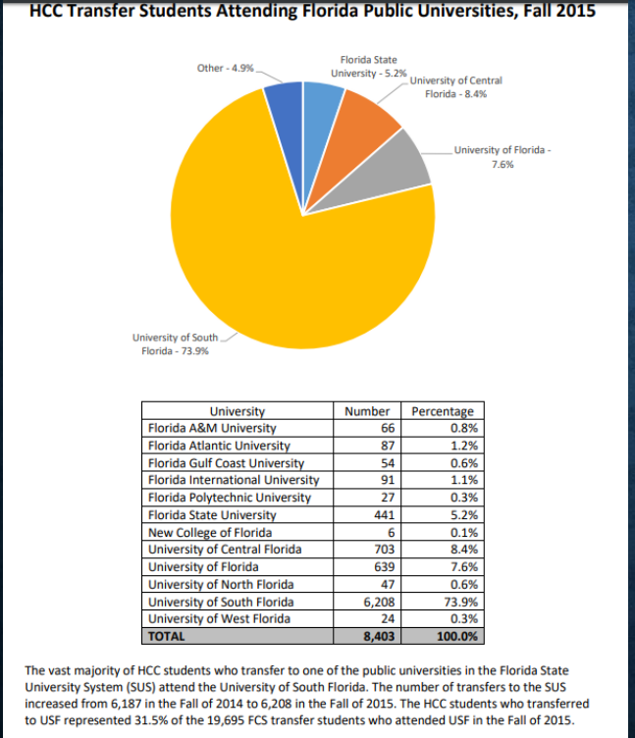
SOURCE: https://www.hccfl.edu/media/3509038/2017-factbook-final-121417.pdf

Slide 12
ACADEMIC IMPACT
Due to college credit being earned at a 2-year institution, this grade will remain a part of the college transcript.
Students are limited to one class each semester as 9th/10th graders and ten credit hours per semester as 11th/12th graders.
Dual Enrollment credits and grades will also be added to your high school transcript.
Dual Enrollment courses will receive the same GPA weighting as AICE and AP courses. Students must earn a C or better to receive the weighted points.
Please note- dual enrollment credits are added to high school transcripts with the equivalent high school credit according to the Academic Dual Enrollment- High School Subject Area Equivalency list.

Slide 13
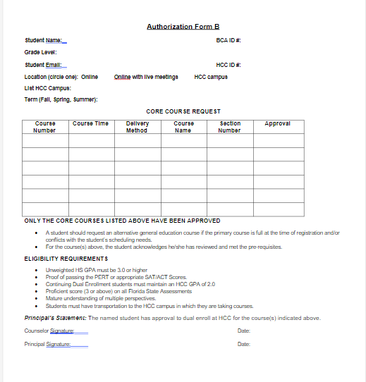

Slide 14
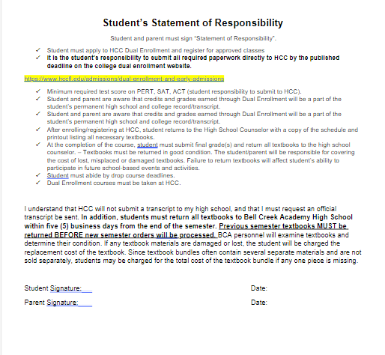

Slide 15
Process Checklist
Student Process to receive BCA Approval:
Complete “Dual Enrollment Interest Form” for the upcoming semester posted in TEAMs
Complete an HCC online Application for Admission
Obtain document showing test scores with date taken if using PSAT/SAT/ACT scores
***Meet with HCC Advisor***
Meet with Ms. Eskridge, CAP Advisor.
Complete Authorization Form B and Dual Enrollment packet
Order transcript for Dual Enrollment (attached to this packet)
Submit your Dual Enrollment paperwork to the BCA Front Office by the deadline set by BCA.

Slide 16
Process Checklist
Procedure to Enroll:
  Obtain SIGNED Dual Enrollment paperwork from the Front Office
  Once signed, the forms will be returned by the Front office, submit those forms to the dual enrollment upload portal
  Once you receive approval (in your HCC email) from the dual enrollment office, you may register for your classes.
  Submit the final page of your paperwork to Ms. Eskridge AFTER you have registered for classes at HCC.
  Respond to the bookstore’s emails to opt in to the new book process.

Slide 17
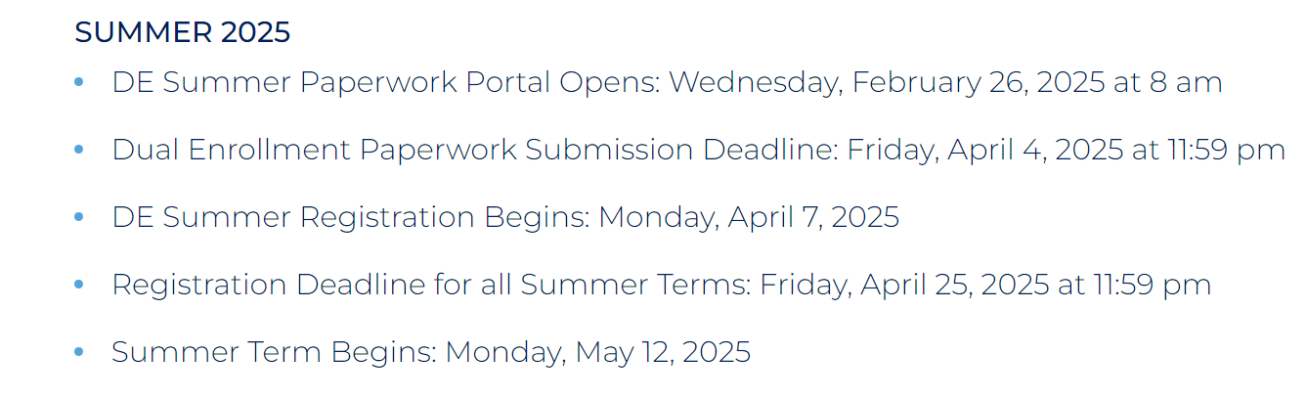
UpComing Deadlines- Summer
BCA Paperwork deadline: Submit to the front office by end of day on Monday 2/24/2025

Slide 18
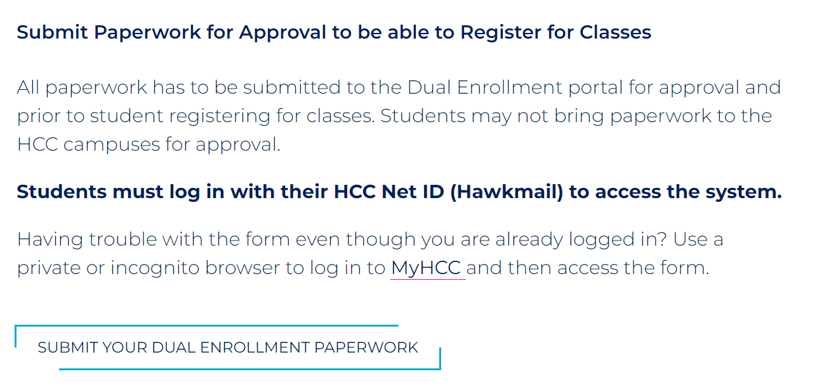

Slide 19
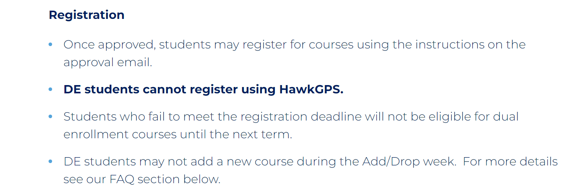
Registration FAQs

Slide 20
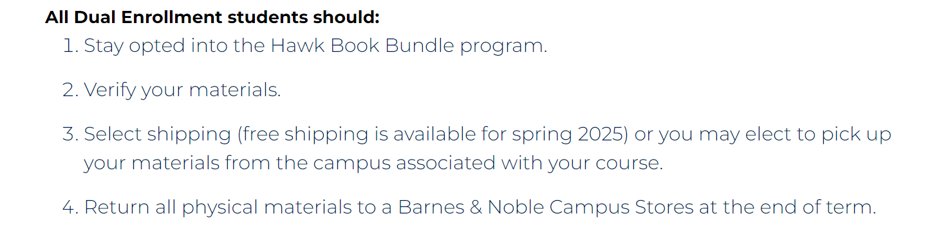
Textbooks
Dual Enrollment Textbooks | Hillsborough Community College

Slide 21
Important To Note
HCC is a separate entity, we are not able to intercede on students' behalf to HCC. Students are enrolled in college classes and the expectation by HCC is that the students reach out with questions and concerns.
All students MUST pick an AA pathway- there are many options: Associate in Arts | Hillsborough Community College
HCC Digital Brochure: Dual Enrollment flyer
Link to HCC application (creating your student account): forms.hccfl.edu/23

Slide 22
Be advised: any student who does not recommit to Bell Creek Academy for the following school year will not be approved for dual enrollment courses for the following term. If a student is recommitted for the following school year, but then decides to go to a different high school during the summer and is enrolled in dual enrollment courses, the student will be withdrawn from those DE courses UNLESS admin is notified of the change in high school enrollment as soon as placement is confirmed or a seat is accepted at the new school.

Slide 23
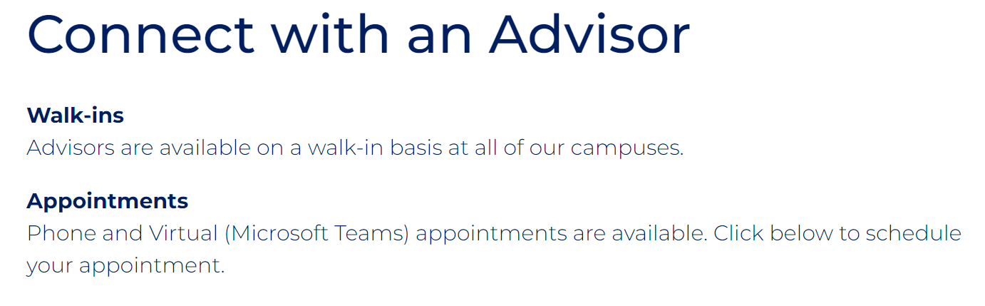
HCC Advisor Appointment
It is critical that students meet with their HCC Advisor. Scheduling a meeting with an advisor is super simple from the website: Academic Advising | Hillsborough Community College
HCCFL : Select an appointment type
  In-person (Photo IDs required for in-person meetings)
  Phone
  Virtual (through Microsoft TEAMs)

Slide 24
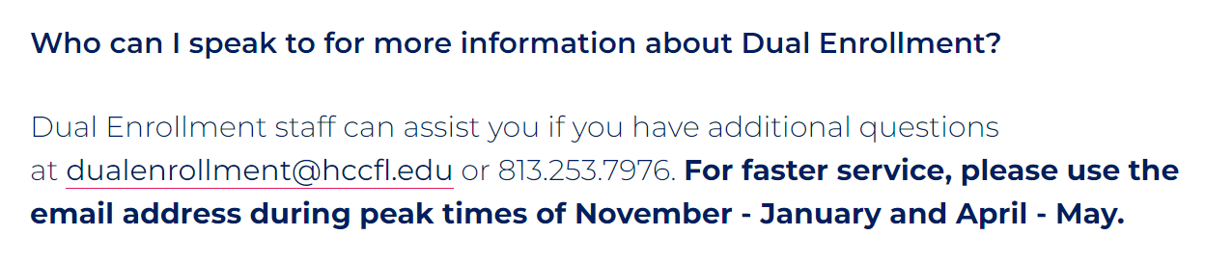
Further Questions- HCC Contact

