Slide 1


Welcome to Oiler Nation
Once An Oiler ALWAYS an Oiler
#Pride Honor Success

Slide 2

Pearland High School
Course Selection
2025-2026
PRIDE ~ HONOR - SUCCESS

Slide 3



IMPORTANT
Dates
FEBRUARY 24, 2025
Course Registration OPENS
in Skyward
FEBRUARY 13, 2025
Academic Planning Night
MARCH 9, 2025
Course Registration CLOSES
in Skyward
PRIDE - HONOR - SUCCESS

Slide 4
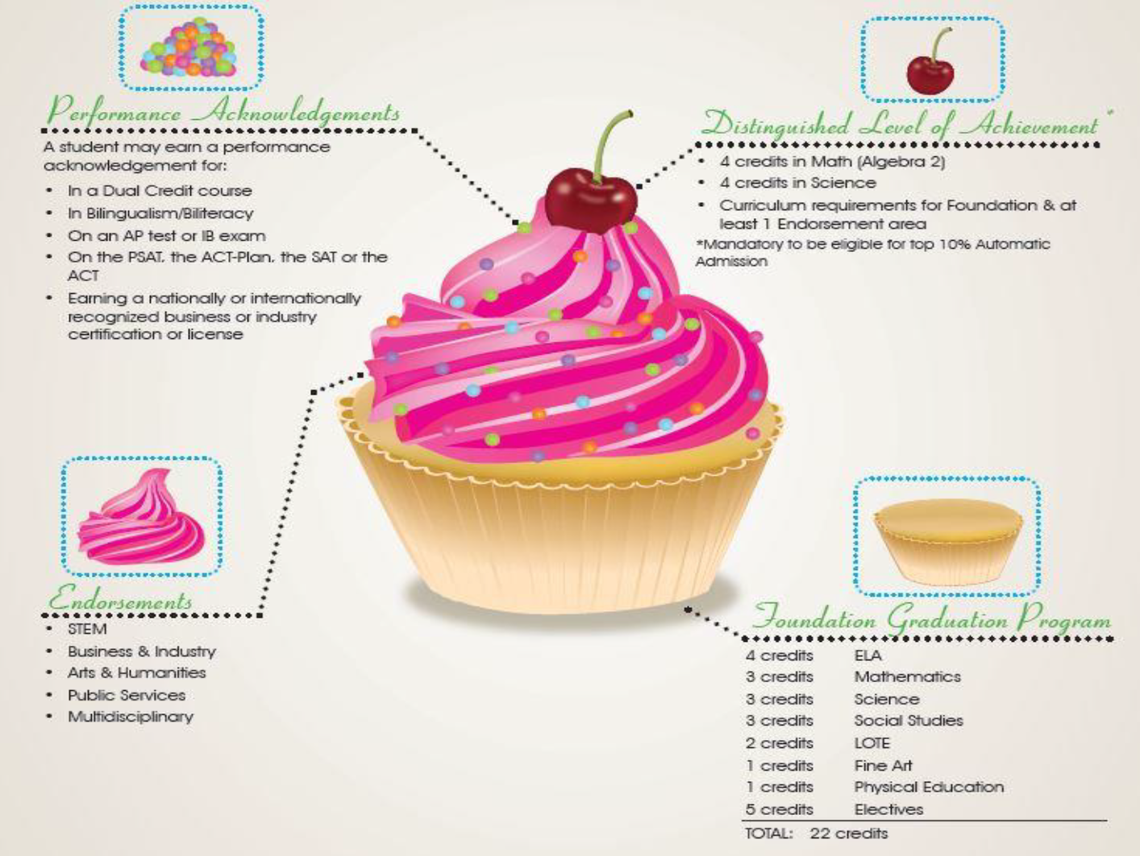
LETS TALK ABOUT
Graduation

Slide 5

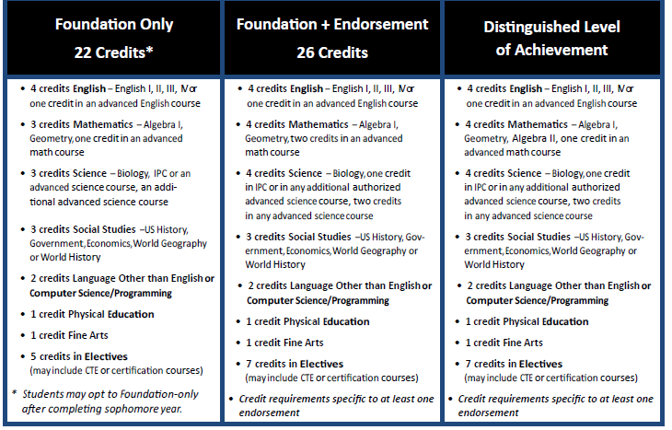
HOW DO I EARN AN ENDORSEMENT?

Slide 6
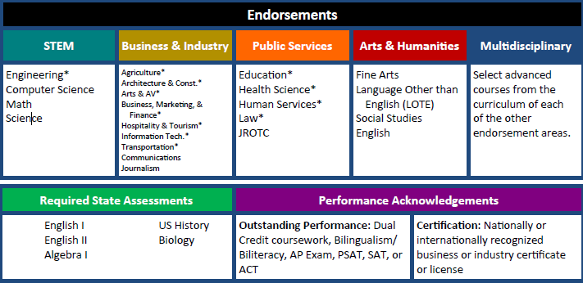
Programs of Study
The purpose of a Program of Study is to earn an Endorsement

Slide 7
Endorsements
HOW DO I EARN AN ENDORSEMENT?
A student may earn an endorsement by successfully completing:
Curriculum requirements for the endorsement
4 credits in math
4 credits in science
A sequence of elective courses in an endorsement pathway

Slide 8
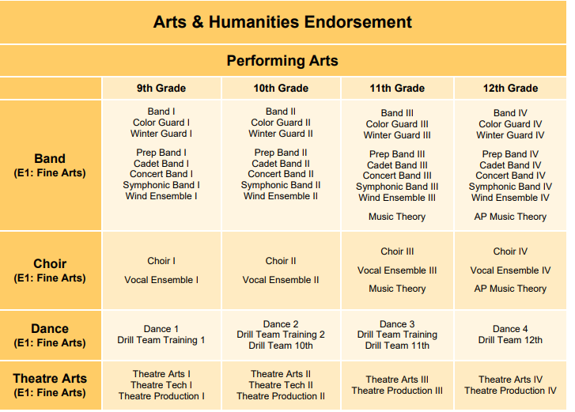
Fine Arts Endorsements

Slide 9
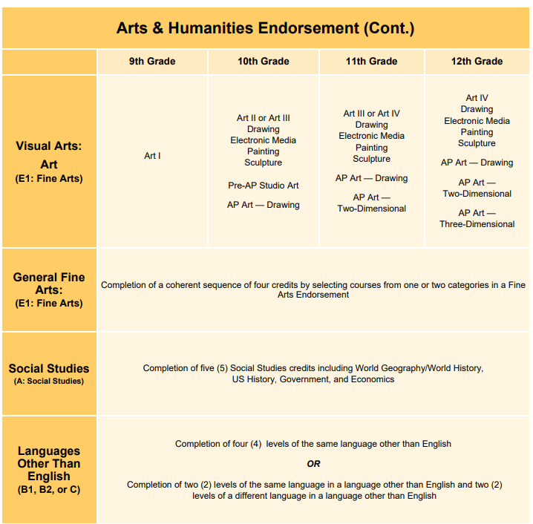
Fine Arts Endorsements

Slide 10
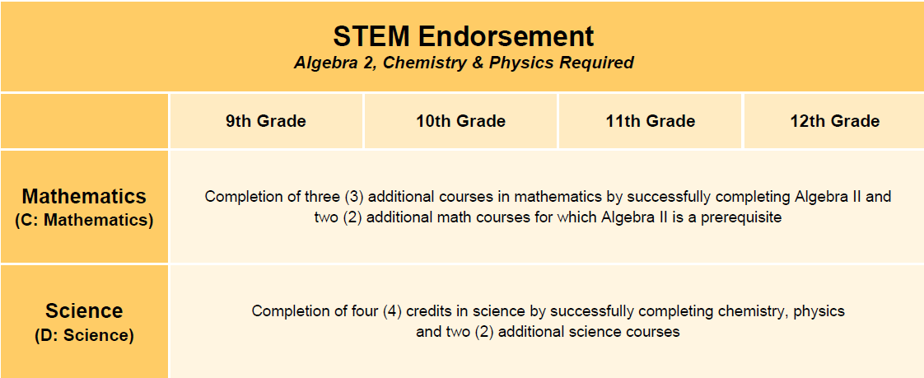
Curricular Endorsements
Math | Science
Algebra I | Biology
Geometry | Chemistry
Algebra II | Physics (Required for STEM)
Additional Upper Level Math | Additional Science (Not IPC)
Additional Upper Level Math | Additional Science (Not IPC)

Slide 11
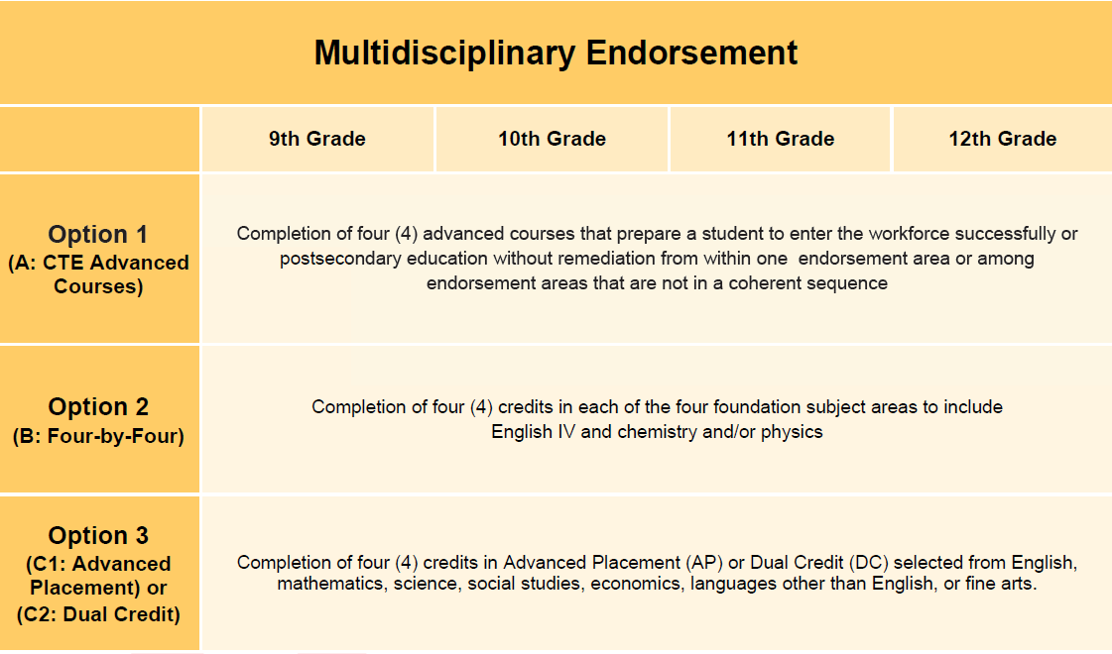
*
Curricular Endorsements
*Please note that Option 2 students MUST complete Chemistry and/or Physics.

Slide 12

Endorsements
WHAT IF I CHANGE MY MIND?
That’s OK!!
If you change your mind all you have to do is visit with your PHS counselor and we will discuss what this will look like.

Slide 13

HOW TO CHOOSE YOUR COURSES
Your courses will be pre-loaded based on the Endorsement and Program of Study that you choose. We will load 4 core courses (English, Math, Science, Social Studies) and a pathway class.
You will choose two other courses to round out your freshman schedule.
You have the option of changing the courses you are taking as well as the level of courses (Ex. PAP Biology instead of Biology)
Choose 3 Alternate Courses

Slide 14
WHY ARE ALTERNATE COURSES IMPORTANT?
If a course you choose is not available due to lack of requests.
If a course you choose does not fit in your schedule
If a course you choose is full
If a course you choose is a lottery course (for example Floral Design or
Intro to Culinary Arts) and you are not chosen for that course.

Slide 15

Questions to Ask Yourself
Is there a program that I know I will be in all four years?
(ex Band, Theater, ROTC, Sports, etc.)
Am I ahead in math by taking a high school course in junior high and plan to take a math course every year
in high school?
Do I have a career or area of study in mind that I know I’d love to study in high school and beyond?
Not a fan of PE? Alternates to PE:
JROTC, Lifetime Recreation and Outdoor Pursuits, Band, Prancers, Cheer, Dance (Dance 2 only)
PRIDE - HONOR - SUCCESS

Slide 16


GRADE
Classification
Freshman - Less than 5 credits
Sophomore - Minimum of 5.5 credits
Junior - Minimum of 11.5 credits
Senior - Minimum of 17 credits
PRIDE - HONOR - SUCCESS

Slide 17
TYPICAL FRESHMAN
Schedule
~ Seven Periods a Day
~ 1st Period Begins at 7:15
~ School Dismisses at 2:35
~ Practices:
3:00pm-6:00pm
(Sponsor Determines Practice Schedule)
~ Competitions:
Tuesday, Thursday and Friday Evenings
4 Core Courses:
English I
Algebra 1 or Geometry
World Geography or AP Human Geography
Biology
Required Elective Credits (choose 3):
Athletics/Physical Education Credit
Foreign Language Credit
Fine Art Credit
CTE / Pathway Course
PRIDE - HONOR - SUCCESS

Slide 18

STAAR
EOC EXAMS
•ALL students are required to take and pass 5 End of Course exams to be eligible for graduation
• Algebra 1, English 1, English 2, Biology, US History

Slide 19
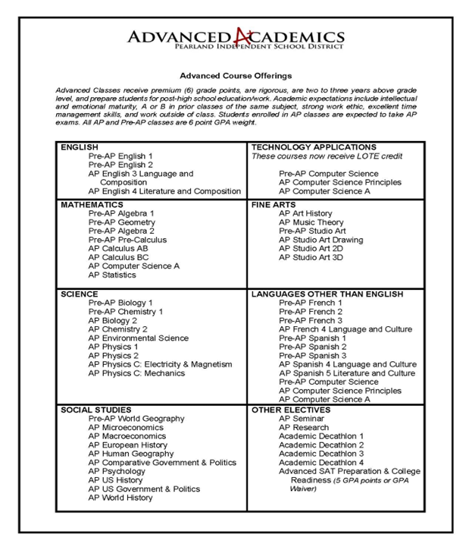
ADVanced
Academics
9th Grade
PAP English I
PAP Math
AP Human Geography
PAP Biology
PAP Spanish or French
PRIDE - HONOR - SUCCESS

Slide 20

Expectations
OF PRE-AP/AP CLASSES
  For each class, expect approximately 30-60 minutes of homework/studying a night, depending on the class
  You will be expected to read chapters and create your own notes.
  You will be expected to create and implement an organization system.
  You will be expected to study on the weekends.
  Be prepared for teachers not to accept late assignments.
  Teachers will expect you to attend tutorials.
  Teachers will expect you to correct tests (2 times per 9 weeks).
  You will be expected to complete weekly online assignments.

Slide 21

WHY CHOOSE PRE-AP/AP CLASSES
  As a freshman, it is important to challenge yourself.
  If you leave the advanced path early, it is very difficult to get back in later
  Foundational need for upper-level AP classes.
  High GPA (6.0)
  Making an 81 in AP Human Geography is out-performing the on-level student making a 100 in World Geography as it relates to GPA and class rank.
  Potential of earning almost a full year of college credit depending on selections and chosen university
  College Preparedness

Slide 22
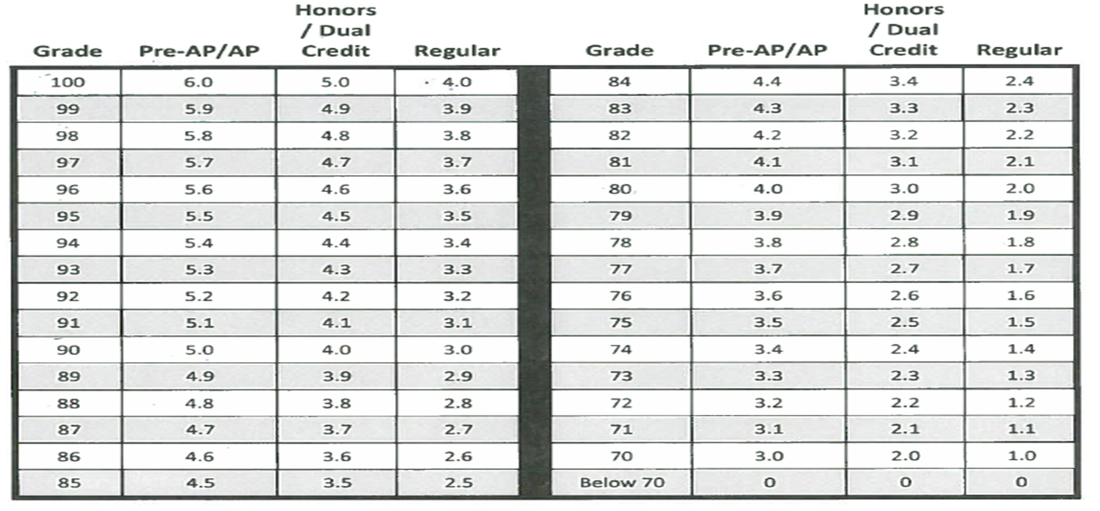
GPA
Scale
PRIDE - HONOR - SUCCESS

Slide 23
AP HUMAN GEOGRAPHY
Myth vs. Fact
MYTH
  3 hours of homework every single night
  AP Human Geography is not that different from
World Geography
  I can’t level down if I discover that it’s too hard
  I am just a freshman, I can’t handle an AP class
FACT
  No PHS class has 3 hours of homework in a night
  It’s a College Board approved course, and is very different
  Yes, you can level down to World Geography
  AP Human Geography can be taught in a semester; therefore, we imbed material that is skills based to prep you for future AP classes
PRIDE - HONOR - SUCCESS

Slide 24
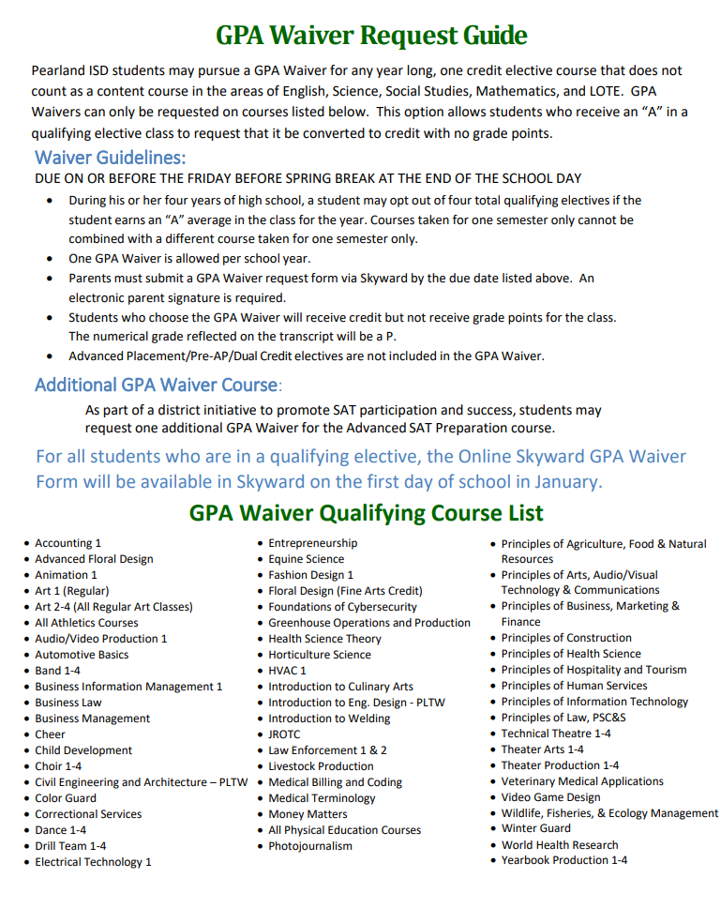
The GPA Waiver
During his or her four years of high school, a student may opt out of four total qualifying electives if the student earns an “A” average in the class for the year. Courses taken for one semester only cannot be combined with a different course taken for one semester only.
One GPA Waiver is allowed per school year.
Parents must submit a GPA Waiver request form via Skyward by the due date listed above. An electronic parent signature is required.
Students who choose the GPA Waiver will receive credit but not receive grade
points for the class. The numerical grade reflected on the transcript will be a P.
Advanced Placement/Pre‐AP/Dual Credit electives are not included
in the GPA Waiver.
Waivers open in January at the beginning of the 2nd Semester.
Waivers are due the Friday before Spring Break – NO EXCEPTIONS.

Slide 25
The GPA Waiver
So, you may be asking yourself “If my student has an “A” in a course why in the world would I NOT want to count it in their GPA/Rank?
If your student in multiple PAP/AP classes that are on a 6.0 GPA scale, and you are consistently making a B or better in your classes then a GPA Waiver might help you. As you
can see in the GPA Scale, if you earn an “A” in a regular course it is only worth a maximum of 4 points. Using your basic knowledge of averaging you could probably figure out that that one 4.0 class when averaged with multiple
6.0 classes would have a negative impact on your overall
GPA and thus impact your rank.

Slide 26
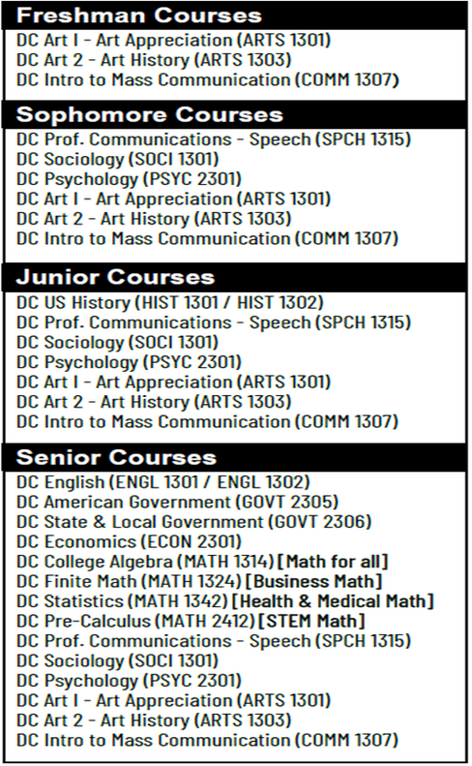
DUAL
Enrollment
  The Alvin Community College Dual Enrollment program allows students to take college courses at the high school. The courses give them high school and college credit.
  Students take courses on the PHS campus with ACC professor. College credit earned will go with student to college.
  Program participation will save students time and money.
  The courses will not have to be repeated in college.
Enrollment steps must be completed by May 30, 2025 to secure your spot in a Dual Credit course next year.
See ACC Advisor Ms. Maartens, in the PHS College & Career Center or email cmaartens@alvincollege.edu, if you have any questions!
PRIDE - HONOR - SUCCESS

Slide 27
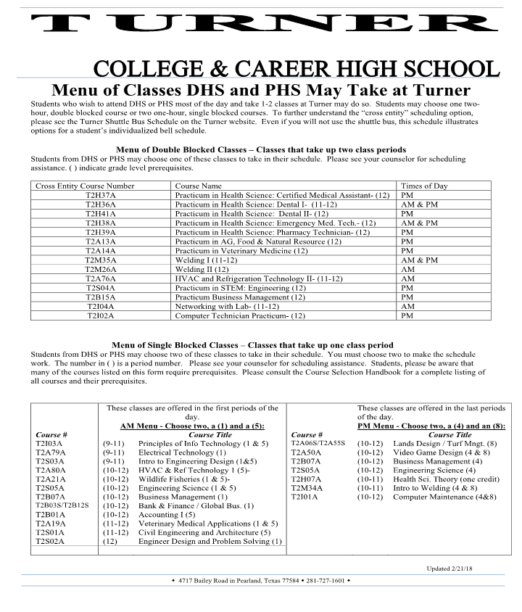
TURNER HIGH SCHOOL
Courses
Students are required to take two courses at THS
Block Schedule vs Traditional schedule
Courses are offered at the beginning (1st period) and end (7th period) of the school day
PRIDE - HONOR - SUCCESS

Slide 28

High School Tips
Decisions need to based on what is best for your child.
Encourage them to be an advocate for themselves.
Encourage them to learn how to ask questions.
Visit with your counselor throughout the semester.
Encourage them to try to solve your own problems.
Encourage them to get involved in clubs and organizations at school.
Encourage them to complete all assignments and turn the assignment in on time.
Implement a system that allows your student to stay organized.
Manners are a vital aspect of your success.
Monitor and discuss social media.

Slide 29
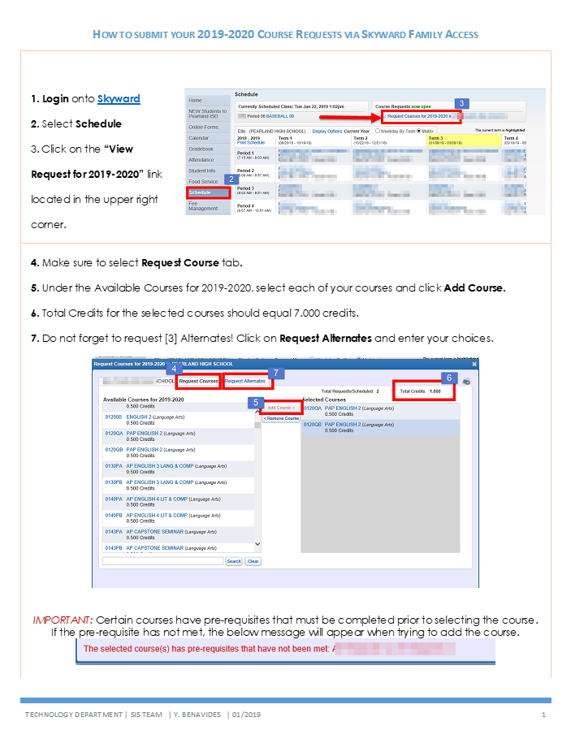

HOW TO SUBMIT
Classes
PRIDE - HONOR - SUCCESS

Slide 30

FREQUENTLY ASKED QUESTIONS
  I plan on taking summer school for Geometry. Do I just enter Algebra 2 in course selection?
    NO, you must put Geometry until we receive your grade.
  I plan on applying for PAP Studio Art but cannot select it. What do I do?
    Put Art 1 and then when approved through the AP Special Request form, we will replace it.
  I plan on trying out for Cheer or Prancers but cannot select it. What do I do?
    Put Dance 1 and after tryouts we will replace it.
  I plan on playing two sports. Do I choose both sports?
    Choose the sport that would come first in season. For example, if you want to play Football and Baseball you would choose Football since it is in season first.

Slide 31

CHECKLIST
  Review course requirements and descriptions in the Course Selection Handbook
  Refer to the Counselor page of the PHS website for Course Selection information and resources
  Review the Turner HS Travel Courses handout if you are interested in taking courses at Turner High School.
  For Dual Credit courses, please see the Dual Credit Advisor, Mrs. Maartens (cmaartens@alvincollege.edu)

Slide 32
CHECKLIST continued ...
  Review Endorsement programs of study in the Course Selection Handbook
  Choose 7 courses and alternate courses using the course legend for 2025-26: Course credit total must equal 7 credits
  Choose alternate courses totaling 2 credits
  Consult with your current teacher regarding recommendations for your 2025-26 courses
  Verify courses are accurate in Skyward Family Access

Slide 33

District Resources
WHERE TO GO FOR MORE INFORMATION
FAQs for Incoming Freshman
https://resources.finalsite.net/images/v1736978965/pearlandisdorg/ty9el8piqlmvnc50gggt/FAQs_8th-9th_course_registration.pdf
Course Selection Handbook
Read the Course Descriptions and Pre-Requisites
https://resources.finalsite.net/images/v1737043353/pearlandisdorg/rh2lztcmw8bpd6cp7phh/2025-2026CourseSelectionHandbook.pdf
Visit the PISD District Website
https://www.pearlandisd.org/departments/curriculum-instruction/course-information-by-grade/graduation-requirements

Slide 34


Stay Connected
Counseling Website:
www.pearlandisd.org/our-school/counselors/pearland-hs-counseling-team
Follow us on Instagram: @pearlandHS_counselors
Follow us on Facebook: @Pearland HS Counselors

Slide 35
IMPORTANT
Dates
FEBRUARY 24, 2025
Course Registration OPENS
in Skyward
FEBRUARY 13, 2025
Academic Planning Night
MARCH 9, 2025
Course Registration CLOSES
in Skyward
PRIDE - HONOR - SUCCESS

