Slide 1


INtroducing
Teen SCHOOL BOARD

Slide 2

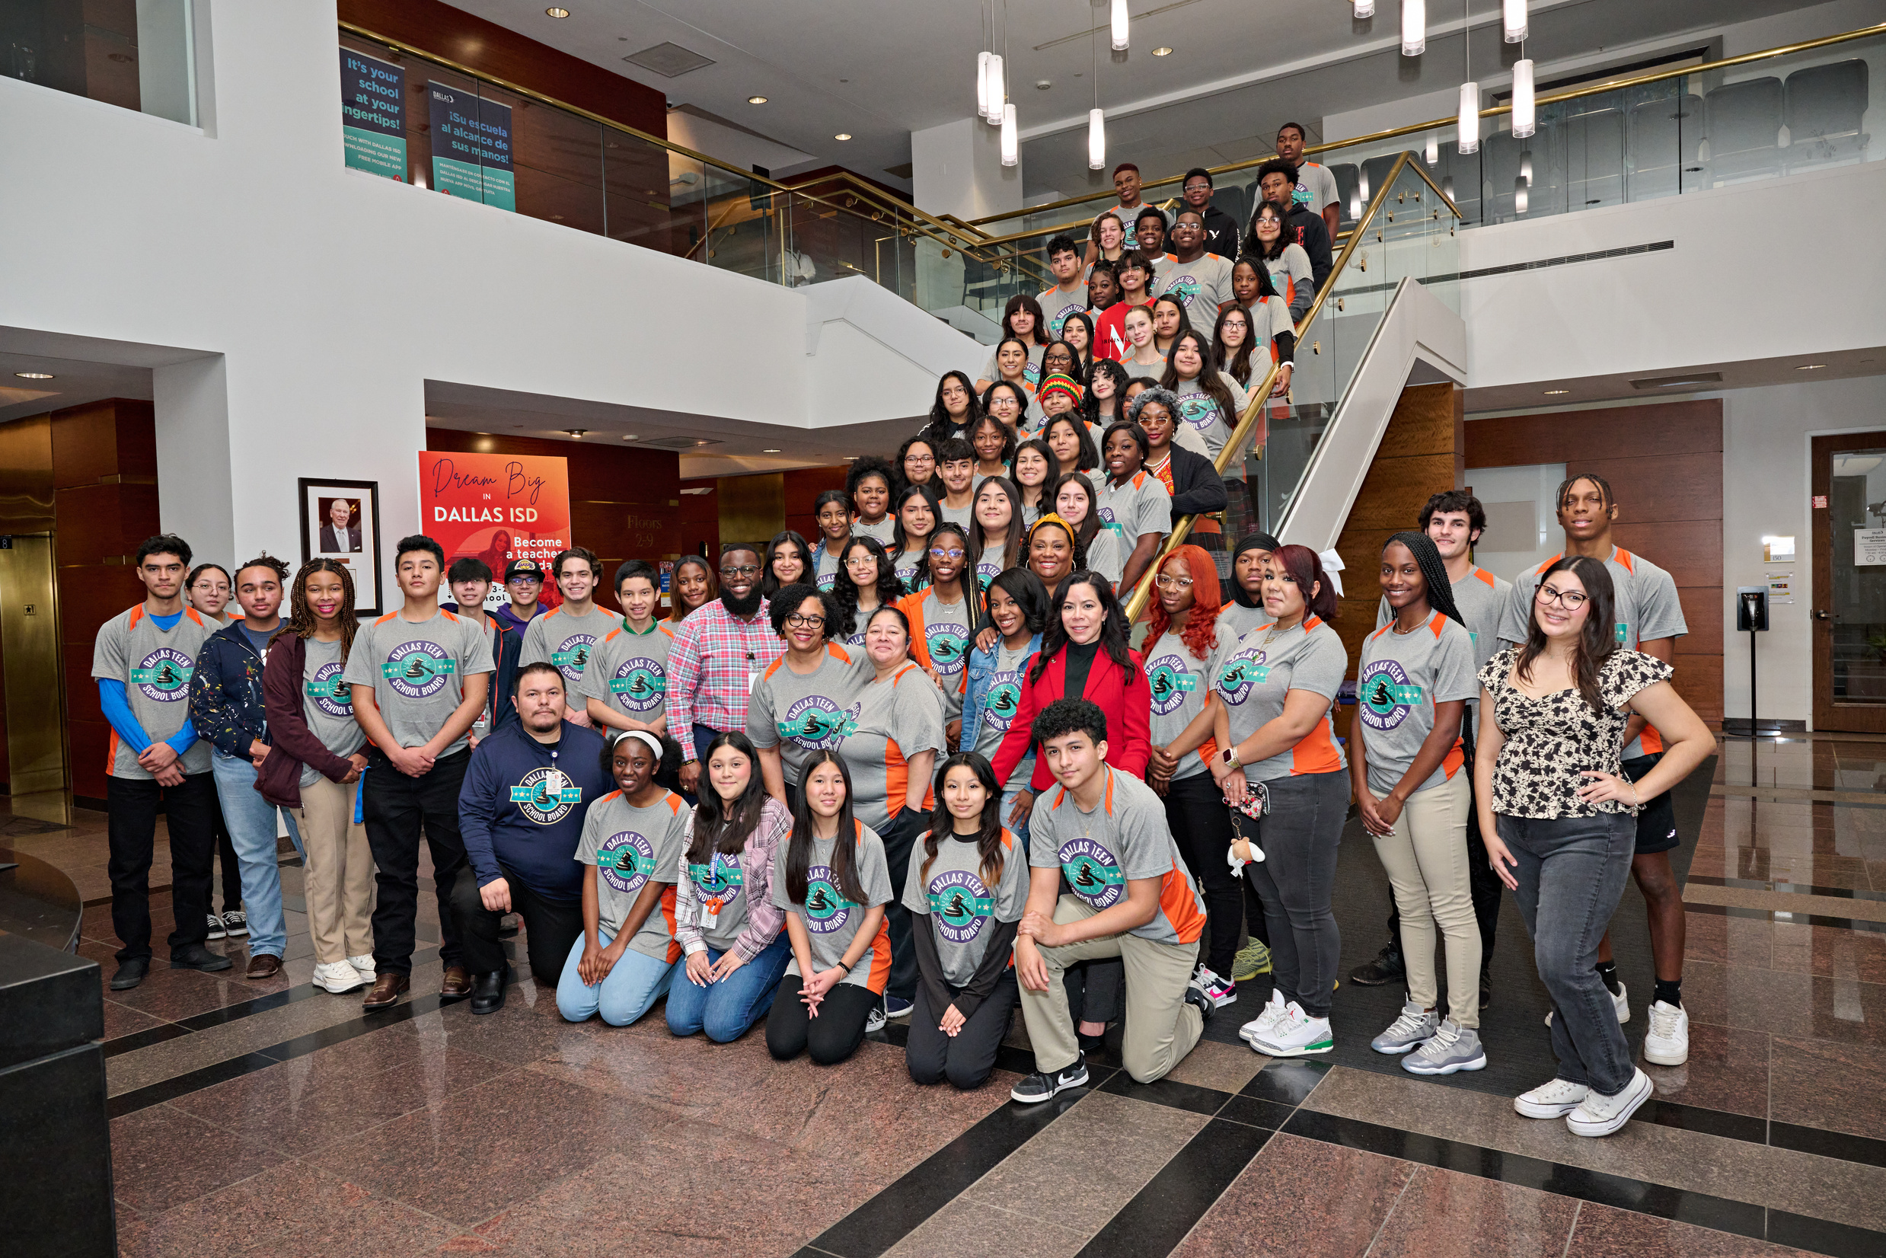

What is teen board
The Dallas ISD Teen School Board (TSB) is a leadership program where two representatives from each high school campus attend monthly meetings & help to advise the Board of Trustees and the Superintendent on student concerns.
Teen Board unites influential DISD student leaders to improve campus safety and environment. Members discuss issues, propose initiatives, and implement change. Each meeting ends with a "Call to Action" to raise awareness on their campuses.

Slide 3

OUR MISSION
The mission of the Teen School Board is to provide a platform for students to engage in district decision-making, and to promote educational opportunities and involvement across all Dallas ISD schools.

Slide 4
Initiatives & Focus areas
THE TEEN SCHOOL BOARD IS COMMITTED TO ADDRESSING :
Instructional Practices & Student Engagement
Civic Involvement &
Voter Registration
Human/Sex
Trafficking Awareness
Educational Opportunities for
All Students
Vaping Prevention

Slide 5


OUr Campus Representatives
Representative Photo
Representative Information
Representative Photo
Representative Information

Slide 6
OUr Campus Initiatives
Place photograph of student/school initiative participation here.
Place photograph of student/school initiative participation here.
Place photograph of student/school initiative participation here.
Provide information about how your campus participated and/or promoted an initiative.
Provide information about how your campus participated and/or promoted
an initiative.
Provide information about how your campus participated and/or promoted
an initiative.

Slide 7

Thank you

