Slide 1


RECRUITING 101:
A GUIDE TO ASSIST IN THE
COLLEGE RECRUITING PROCESS
ROCKDALE COUNTY HIGH SCHOOL
ATHLETICS DEPARTMENT

Slide 2

Ncaa facts:
7,200,000 high school athletes in usa
498,000 high school athletes move on to play in college (7%)
Div I – 182,000 athletes, 350 colleges
Div ii – 122,000 athletes, 302 colleges
Div iii – 194,000 athletes, 439 colleges
Only about 2% of high school athletes are awarded some form of athletic scholarship
Div I & div ii offer athletic/academic scholarships. Div iii does not offer athletic scholarships (only academics)
https://ncaaorg.s3.amazonaws.com/compliance/recruiting/NCAA_RecruitingFactSheet.pdf

Slide 3
OVERVIEW:
As you enter the college recruiting process, keep 3 things in mind:
1. The process is very similar to looking for a job
2. The process operates on two parallel tracks: athletics and academics
3. Approach the process with a team mentality (student-athlete, parents, high school coach, travel/club coach, and school guidance counselor)
  Everyone has certain responsibilities, but, the athlete should lead this group
  A positive attitude & persistence will go a long way during the journey to play collegiate athletics

Slide 4
When to get started?
College Coaches plan around the official signing date
Most recruiting takes place over the spring and summer months (especially for college fall sports)
With the above in mind, the athlete should begin the process during the summer between their sophomore and junior years of high school
  They should develop a list of schools that interest them both academically and athletically (https://web3.ncaa.org/directory/memberList?type=1)
  NCAA regulations permit coaches to respond to prospective student-athlete inquiries, but the coaches cannot initiate contact until July 1 of the summer going into the athlete’s senior year.

Slide 5
High school timeline
Grade 9
Meet w/ counselor to make sure you have the correct NCAA core classes on your schedule
Grade 10
Register with the NCAA Eligibility Center at www.eligibilitycenter.org
meet with high school coach to discuss your potential of playing college athletics - appropriate level (div i, div ii, div iii, naia, juco,), potential major, in/out of state, list of target colleges, etc….
thoroughly research colleges and athletic programs
develop target list of 5-6 colleges
develop a letter of interest
develop resume (including academic & athletic accolades)
Grade 11
Meet w/ counselor to ensure you are on track to graduate on time w/ the required number of NCAA core courses.
Take the ACT & SAT and submit your scores to the NCAA using code 9999.
At the end of the year, get counselor to upload your official transcript to the NCAA Eligibility Center.
Contact college coaches at your target schools
Grade 12
Finish your last NCAA core courses.
Take the ACT or SAT again (if necessary) and submit your scores to the NCAA using code 9999.
Complete all academic and amateurism questions in your NCAA Eligibility Center account at eligibilitycenter.org.
After you graduate, ask your counselor to submit your final official transcript with proof of graduation to the NCAA Eligibility Center.

Slide 6
Letter of interest & resume
Email is best
Be brief & keep it simple
Personalize with name of college, coach’s name, & intended major
Avoid large attachments
Letter should include:
  athletes name, jersey number, position played
  Name of travel/club team & name of high school (include city, state)
  Current GPA & Graduation date
  Projected major
  Upcoming schedule of games, tournaments, camps, etc… (separate document)
  Resume (separate document)
    Height, weight, contact info, GPA/class rank/test scores, academic & athletic awards, link to highlight video, Coach references w/ contact information

Slide 7
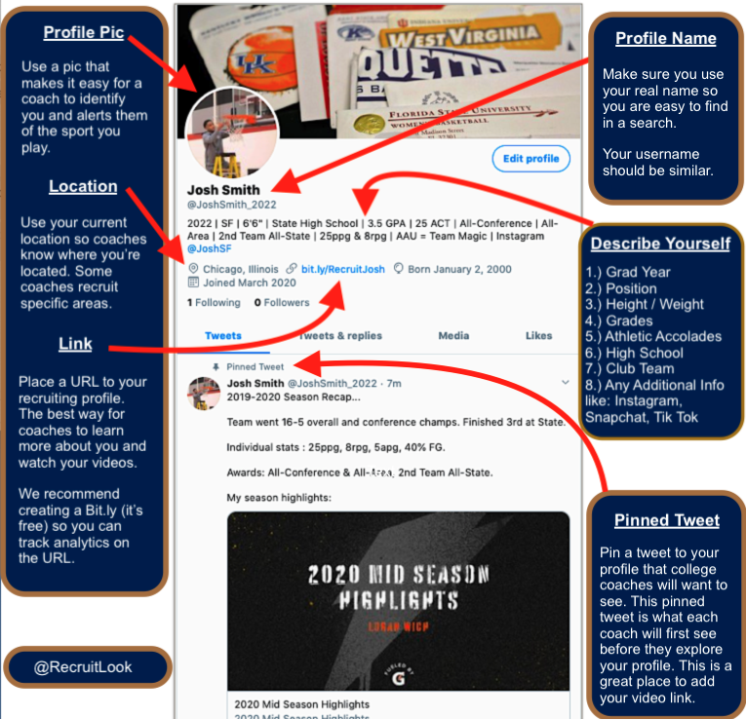
Social media STRATEGIES
HAVE DIRECT MESSAGING OPEN, SO COLLEGE COACHES CAN DM YOU
YOU OWN IT. WHATEVER YOU “LIKE” OR “RETWEET” MEANS YOU SUPPORT IT, SO THINK BEFORE YOU SHARE. COLLEGE COACHES WILL LOOK TO SEE THE PERSON YOU ARE
BLOCK NEGATIVITY. IGNORE THE HATERS.

Slide 8
Recruiting terms
Contact - any time a college coach says more than hello during a face-to-face meeting with an athlete/parents off the college’s campus
evaluation - happens when a college coach observes an athlete practicing/competing.
verbal commitment - happens when an athlete verbally agrees to play sports for a college before they are eligible to sign a National Letter of Intent. This commitment is non-binding for the athlete or the school
National letter of intent – an athlete officially commits to attend a Division I or II college when they sign this binding document, agreeing to attend that school for one academic year. colleges agrees to provide financial aid for one academic year to the athlete. Recruiting process ends – other school prohibited to recruit signed athletes. Div iii uses a non-binding celebratory signing form (offer no athletic funds, only academic money)

Slide 9
Recruiting calendars
NCAA limits recruiting to certain periods during the year to promote the well-being of athletes and ensure fairness. Each sport has different calendar.
During a contact period, a college coach may have face-to-face contact with athletes/parents, watch student-athletes compete, visit their high schools, & write/telephone athletes/parents
During an evaluation period, a college coach may watch athletes compete, visit their high schools & write/telephone student-athletes/parents. But, may not have face-to-face contact with athletes/parents off the college campus
During a quiet period, a college coach may not have face-to-face contact with athletes/parents & may not watch student-athletes compete or visit their high schools. Coaches may write/telephone athletes/parents during this time
During a dead period, a college coach may not have face-to-face contact with athletes/parents & may not watch athletes compete or visit their high schools. Coaches may write/telephone athletes/parents
http://www.ncaa.org/student-athletes/resources/recruiting-calendars/division-i-and-ii-recruiting-calendars

Slide 10
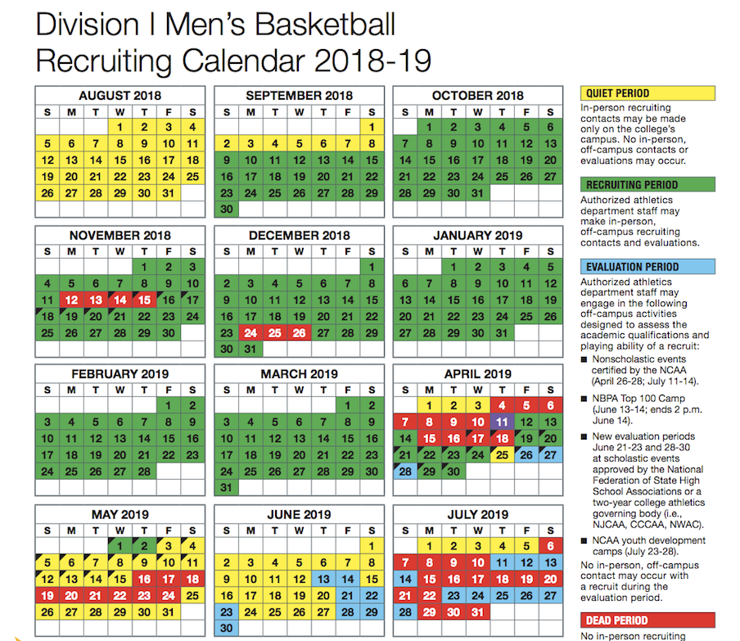
Sample Recruiting calendar

Slide 11
visits
Unofficial visit:
  Paid for by athlete/parents
  No limits on when or how many unofficial visits
  Only expense college can offer is 3 comp tickets to a home sporting event
Official visit:
  Many more regulations
  Must have invitation from college coach
  Expenses paid by college
    Travel to/from, lodging, 3 meals per day for athlete/parents, reasonable entertainment expense (including 3 comp tickets to a home sporting event)
  Athlete is allowed only 5 official visits

Slide 12
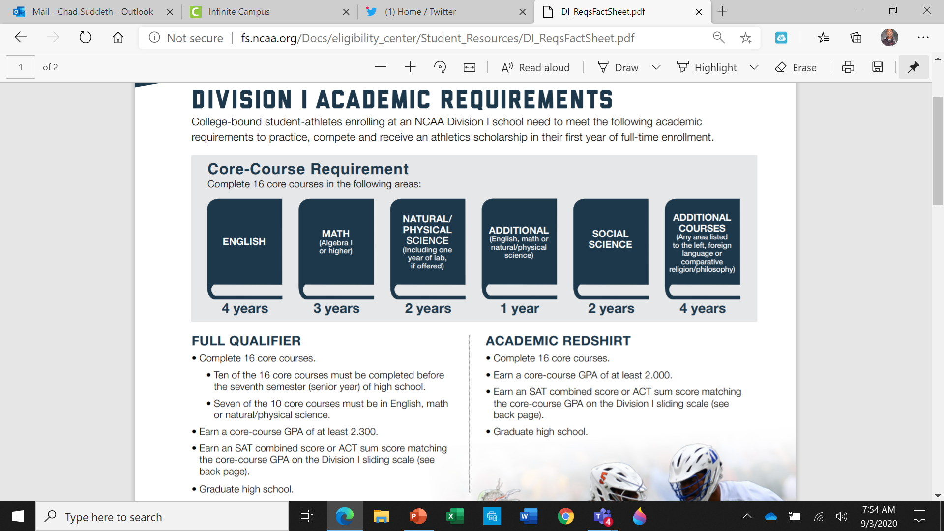

Slide 13
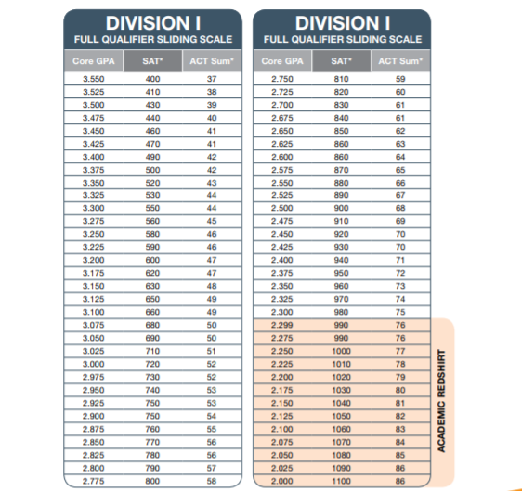


Slide 14
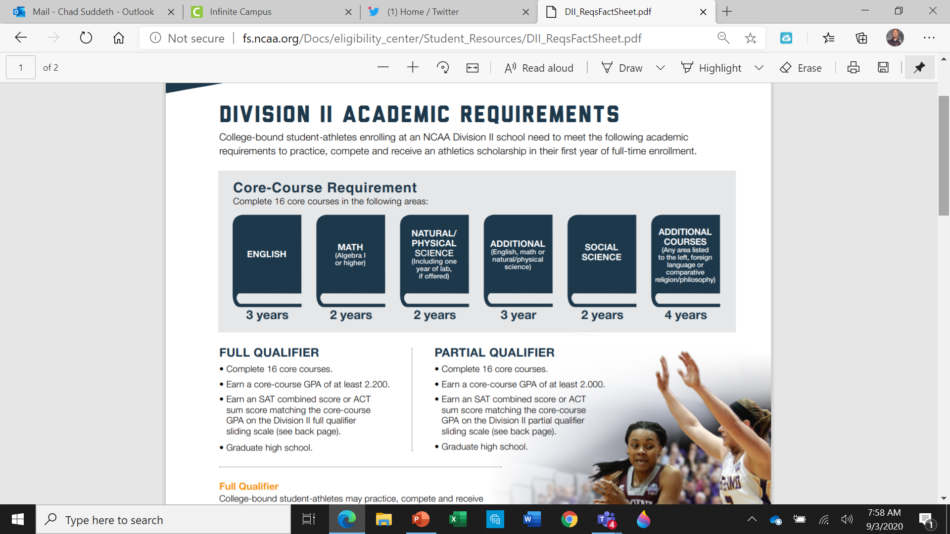

Slide 15
Online courses?
Some online hs courses are subject to ncaa approval
Must be comparable in length/rigor & taught by an instructor with feedback/interaction
the NCAA approves online core courses that are college prep in nature – such as English, foreign language, natural science, math, social science, philosophy, physical science, & comparative religion
students who take online courses in areas like pe, personal finance, or film appreciation may not be recognized by the NCAA
In addition, remedial courses and foundational courses that are below grade level are not approved by the NCAA

Slide 16
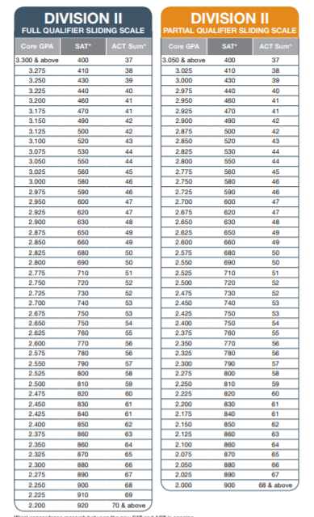
http://fs.ncaa.org/Docs/eligibility_center/Student_Resources/DII_ReqsFactSheet.pdf

Slide 17
Other tips
Be patient (most coaches filter through hundreds of letters)
  Interested college coaches will first invite you to their camp
    Again, want to gauge your level of interest
  Then, if they like what they see – they may come to your game
Don’t expect a full ride, most offers in most sports are only partial scholarships
Clean up your social media accounts (including who you follow & what you “like”)
Register with ncaa clearinghouse (with updated act/sat test scores) https://web3.ncaa.org/ecwr3/
Research your target colleges
Meet with your high school counselor (grad requirements, transcript, college application, etc…)
Follow up to college coach responses within 24 hours
Create a Highlight video, should be no more than 5 minutes

Slide 18
Ncaa covid updates:
http://fs.ncaa.org/Docs/eligibility_center/EC_COVID_Comm.pdf

