Slide 1

Coronavirus (COVID-19) Health & Safety
RCPS Athletic Training Education Resource

Slide 2

Content
Overview/Definition
Transmission
Symptoms
Monitoring/Reporting
Risk Reduction/Prevention
Conditioning considerations

Slide 3
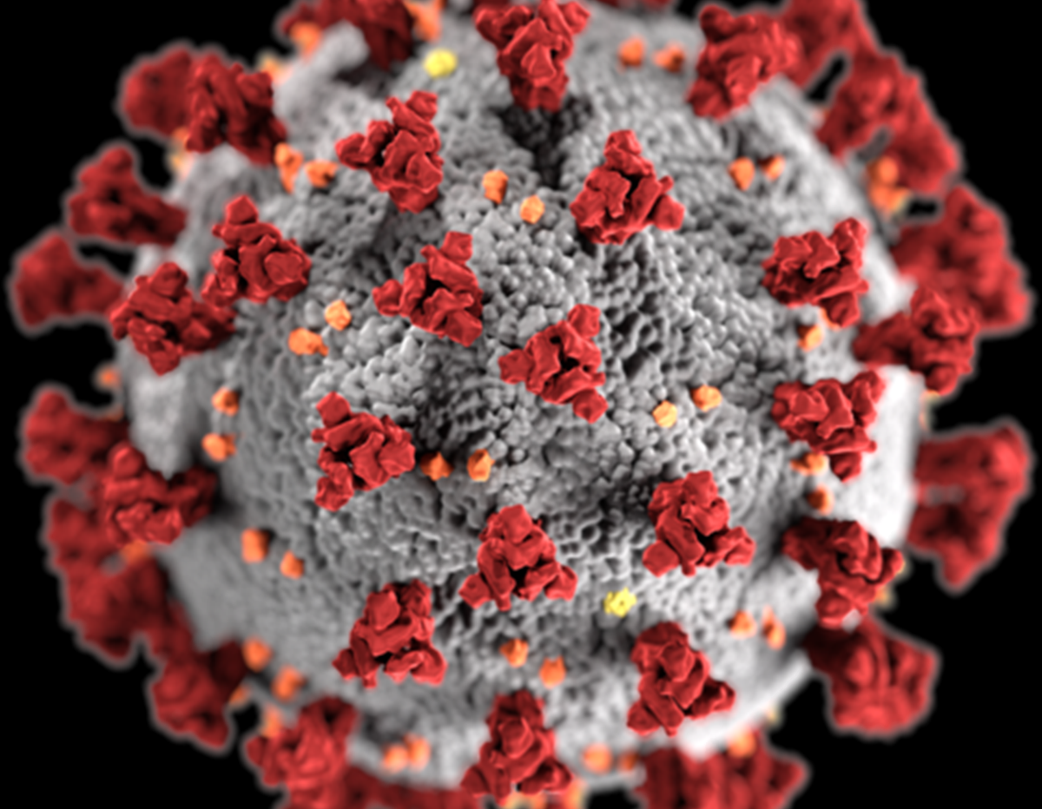
What is it?
COVID-19 is an infectious disease caused by the Coronavirus.
Coronavirus is a kind of common virus that can affect your upper respiratory tract (sinuses, nose, and throat) or lower respiratory tract (windpipe and lungs).

Slide 4
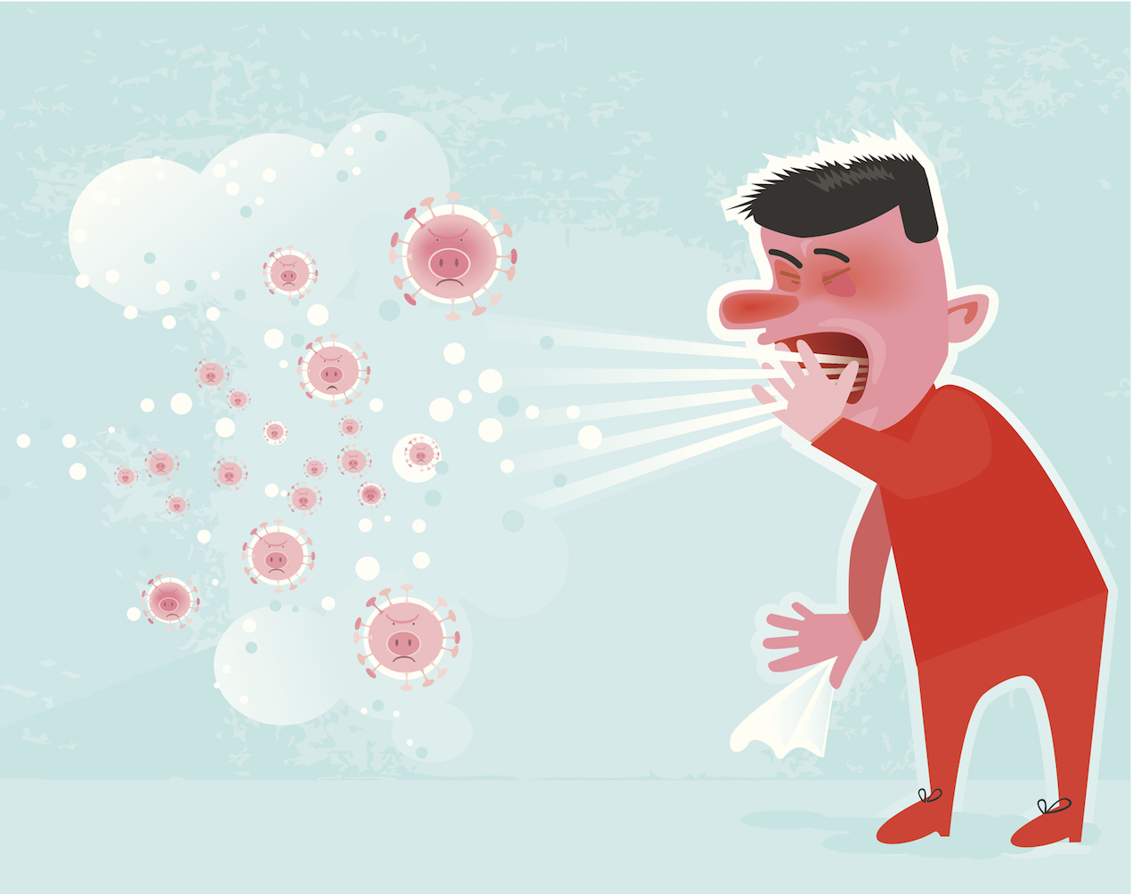
How is it Transmitted?
COVID-19 virus spreads primarily through droplets of saliva or discharge from the nose when an infected person coughs or sneezes. If you breathe or swallow infected droplets, the virus can get into your system.
COVID-19 virus also spreads by touching a contaminated surface or object with virus on it, and then touching your mouth, nose, or eyes.
It spread mainly between people who are in close contact with one another

Slide 5

Signs and Symptoms
Infected individuals may be asymptomatic or symptomatic and can still spread the virus.
The elderly and individuals with underlying medical conditions (asthma, high blood pressure, obesity, diabetes, weakened immune system, etc.) have a higher risk of developing complications from the virus
Symptoms may appear 2-14 days after exposure to the virus.
Emergency care: trouble breathing, persistent pain or pressure in the chest, new confusion, inability to wake or stay awake, or bluish lips or face
Fever or chills
Cough
Shortness of breath or difficulty breathing
Fatigue
Muscle or body aches
Headache
New loss of taste or smell
Sore throat
Congestion or runny nose
Nausea or vomiting
Diarrhea

Slide 6

Reporting / Monitoring COVID-19
All individuals feeling sick should be encouraged to stay home
All athletes should be aware of Covid-19 Symptoms and be encouraged to report symptoms to coaches or ATC
All staff should aim to become familiar with COVID-19 symptoms and the GHSA COVID-19 monitoring form and questionnaire
Coaches & ATC will be responsible for daily checking off and documenting each athlete's status using the GHSA monitoring and questionnaire forms (checks must be done before allowing an athlete to participate)

Slide 7
Contingency Plan for Positive COVID-19 Questionnaire and Symptoms
If anyone answers yes to any of the GHSA questions, is positive for any symptoms, or has had recent exposure to COVID-19 they will self isolate and not participate in any team workouts for a 14-day period.
Coaches/AD Discretion: Anyone that encounters an individual that reports yes for questionnaire, is positive for symptoms, or has had recent exposure to COVID-19 will be notified and should self isolate for a 14-day period.
Individuals should contact their primary care physician for further instruction and testing if warranted
Facilities and Equipment used by the individual will be closed off and undergo thorough cleaning and disinfecting
Coaches are encouraged to design voluntary at home workouts for those in self isolation. (Athletes should only participate in at home workouts if they are feeling well enough to do so)
Individuals in self isolation should continually monitor and record their symptoms
Individuals will not be able to return until Proof of a negative COVID-19 test or 14-day quarantine and symptom free

Slide 8
CDC Guideline to Cleaning/Disinfecting if someone is Sick
Remove/Isolate sick individual
Always use glove and immediately wash hands after with soap and water (20s min) after dealing with a sick person
Close off areas used by the person
Open outside doors/windows to increase ventilation
Wait 24hrs before cleaning and disinfecting (wait if possible if 24hrs unfeasible)
Clean and disinfect all areas and equipment used by the person who is sick
Vacuum the space if needed( room should be empty) (consider turning off fans/HVAC system so articles that escape from vacuuming will not circulate through the facility)
0nce the facility and equipment has been disinfected it can be open for use (persons without close contact to the sick individual can return immediately after disinfection/cleaning)

Slide 9
General Cleaning & Disinfection (When/What to clean)
Most viruses can live for several hours on a surface so it’s important to disinfect surfaces to get rid of the virus.
Facilities and equipment should be cleaned prior to the start of workouts for each group and immediately after (Coaches/Janitorial Staff)
All mats, athletic equipment, and surfaces should be cleaned and disinfected after use by each athlete.(Best to avoid sharing equipment)
Regularly clean and disinfect frequently touched surfaces and equipment (door handles, light switches, chairs, benches, lockers, railing, etc.)

Slide 10
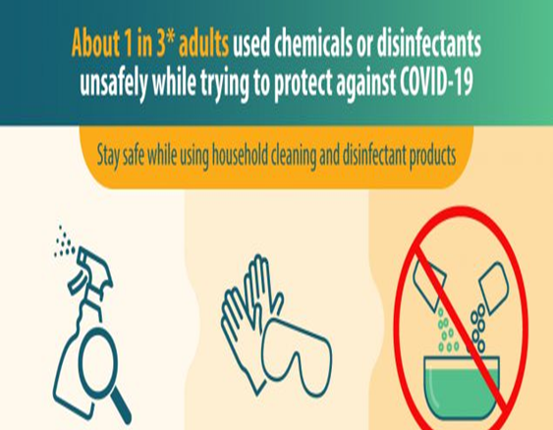
General Cleaning & Disinfection (How to Clean)
Personal Protection Equipment (PPE) to be worn for all cleaning task including handling trash and laundry (disposable gloves, mask)
Clean the surface or object with soap and water (spray bottle mixture)
Disinfect using an EPA-approved disinfectant. (Follow the directions on the label and keep the surface wet for a period of time as directed by product label before drying.)
Alternative Disinfectant : 1/3 cup of bleach per gallon of water, or 4 teaspoons bleach per quart of water, or 70% alcohol solution. (effective for up to 24 hours)
Recommended to wipe with disposable paper towel, single use towel, or air dry
Considerations: adequate ventilation, use recommended amount on label, avoid mixing chemical products, & label/date diluted cleaning solutions
Properly dispose of gloves and soiled cleaning supplies .
Thoroughly was hands for minimum of 20s with soap and water after cleaning

Slide 11
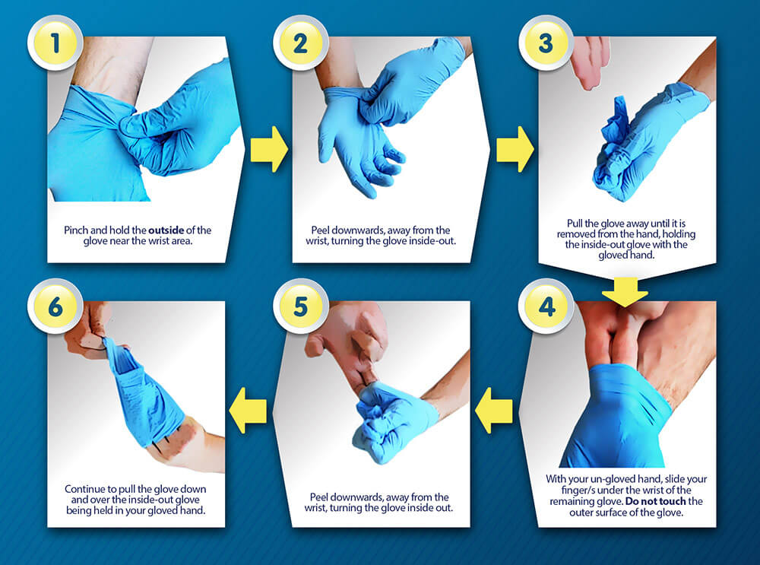
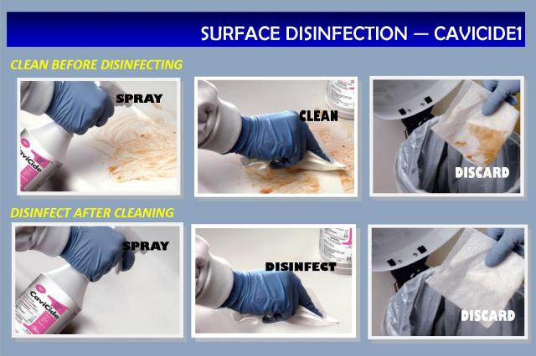
How to take off your gloves and how to disinfect surfaces

Slide 12
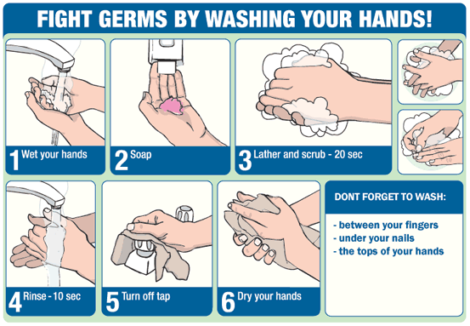
COVID-19 Prevention (Hand Washing)
Wash hands often with soap and water or clean them with an alcohol-based sanitizer.
  Wash with warm water and soap for a minimum of 20s
  Encourage hand washing
    Before /After using equipment/training tools
    When arriving to/leaving the facility
    Before eating and drinking
    After coughing/sneezing/blowing your nose
    After dealing with someone who is sick/ touching others
    After using the bathroom
Hand Sanitizer should be readily available for use at facility

Slide 13
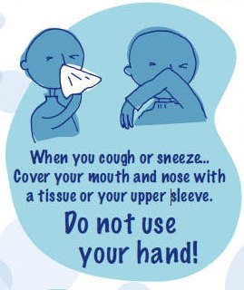
COVID-19 Prevention (Hygiene Tips)
Avoid touching your eyes, nose, mouth, and face
Cover your mouth and nose with a tissue when you cough or sneeze or use the inside of your elbow.
  Throw used tissues in trash and wash hands immediately
Discourage spitting on playing fields and surfaces
If available wear a cloth face cover/mask when out in public
ASAP shower and wash all workout clothing
Clean personal equipment daily (water bottles, towels, clothing, helmets, gloves, pads, etc.)
Do not share personal equipment

Slide 14

Prevention (social Distancing)
Avoid close contact
  (No) team huddles, handshakes, high fives, etc.
  Limit/Stagger use of shared/communal spaces
  Keep personal equipment separate from others(water bottles, bags, etc.)
  Maintain distance of 6ft when on sideline, during rest breaks , and when participating in drills/conditioning
    Use physical markers when available (cones, tape, etc.)
(NO)Limit nonessential visitors, spectators, volunteers
Keep assigned groups together and avoid contact with other groups
  Stagger arrival and drop of times for groups

Slide 15

Physical Conditioning Considerations
Start gradual return to conditioning activities and slowly progress (most athletes will be deconditioned, from time off)
F.I.T.T : Consider exercise frequency, intensity, time, type, & rest interval (Modify as athletes become more conditioned at 1 to 4 work to rest ratio)
50,30,20,10 Rule: suggested weekly % reduction of normal exercise load/intensity (discretion of coach & physical condition of athletes) (Intensity: 50% wk 1→70% wk 2→80% wk 3→90% wk 4)
Implement a variety of activities that incorporate components such as speed, endurance, balance, power, strength, coordination, mobility/flexibility, agility, and skill
All athletes participating in outdoor conditioning must go through heat acclimation period (14day)
Staff should be aware of heat illness symptoms and treatment
  Symptoms: dizziness, confusion, muscle cramps, headache, nausea, vomiting , fainting, fatigue, mood changes ,increased body temp
  Treatment: Remove from activity and cool (911 if necessary)
Encourage athletes to bring 1 gallon - 1½ gallon of water labeled with their name (no refill stations available)
GHSA Heat Index Monitoring and RCPS Inclement weather policy still applies for outdoor activity

Slide 16
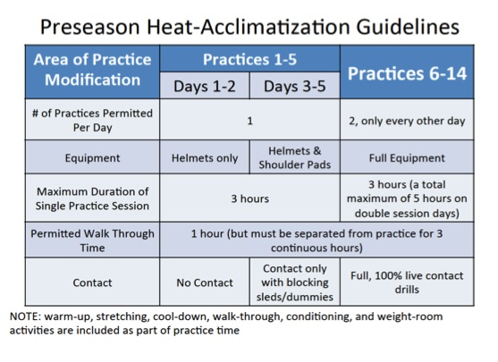
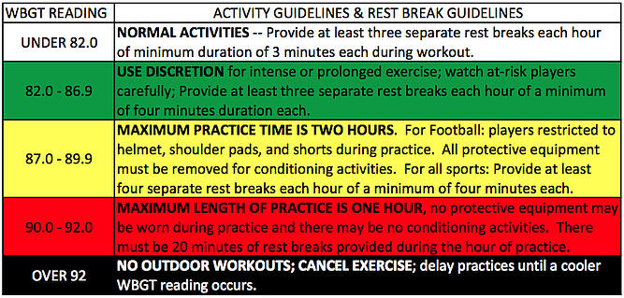
Heat Acclimatization Guidelines

Slide 17
Resources
https://www.cdc.gov/coronavirus/2019-ncov/community/schools-childcare/youth-sports.html
https://www.ghsa.net/latest-ghsa-statements-coronavirus-situation
https://www.cdc.gov/coronavirus/2019-ncov/community/pdf/Reopening_America_Guidance.pdf
https://www.cdc.gov/coronavirus/2019-ncov/community/disinfecting-building-facility.html
https://ksi.uconn.edu/covid-19-return-to-activity/#

