Slide 1



E-SPLOST VI
Facts and Information
December 2023

Slide 2
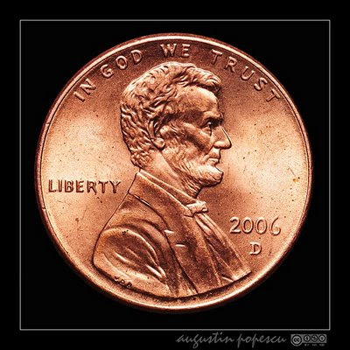
Education
Special
Purpose
Local
Option
Sales
Tax
What is E-SPLOST?
It is a one penny sales tax that allows for shared contribution to education, including visitors to the county who spend money on gas, food, hotels, and retail items.

Slide 3
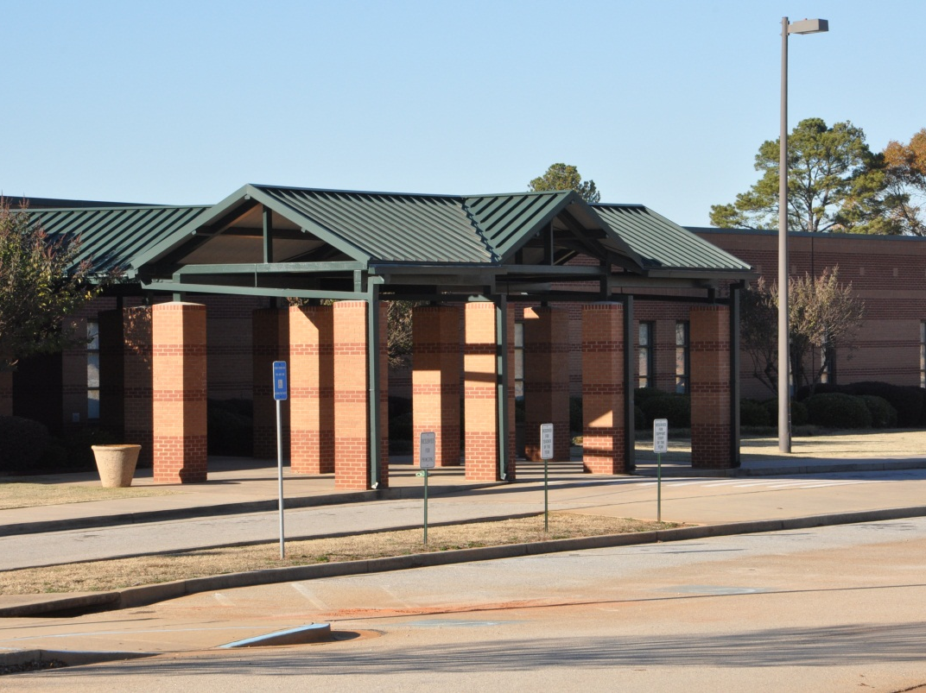
What Can E-SPLOST be used for?
    Capital expenditures
    Debt retirement
  RCPS is a debt –free school system.

Slide 4
E-SPLOST VI will continue a twenty-five-year collection of pennies for public education in Rockdale County
Information & Process
E-SPLOST V = $85 million
  Collection period beginning April 2019
  Collection period ended September 2023
E-SPLOST VI = $135 million
  Collection period beginning July 2024
  Collection period ending July 2029

Slide 5
E-SPLOST History in
Rockdale County
E-SPLOST I Goal $58,952,117 Collected $58,602,335 99%
E-SPLOST II Goal $79,555,700 Collected $65,596,999 83%
E-SPLOST III Goal $94,804,445 Collected $69,843,000 74%
E-SPLOST IV Goal $83,600,000 Collected $75,281,116 89%
E-SPLOST V Goal $85,000,000 Collected $85,000.00+ 100%
E-SPLOST VI Proposed $135,000,000

Slide 6
E-SPLOST VI
Proposed Capital Projects
Safety and Security
    RCPS Strategic Plan: Goal Area IV
Teaching and Learning
RCPS Strategic Plan: Goal Area II
Technology
    RCPS Strategic Plan: Goal Areas II and V
Facilities
    RCPS Strategic Plan: Goal Area V

Slide 7
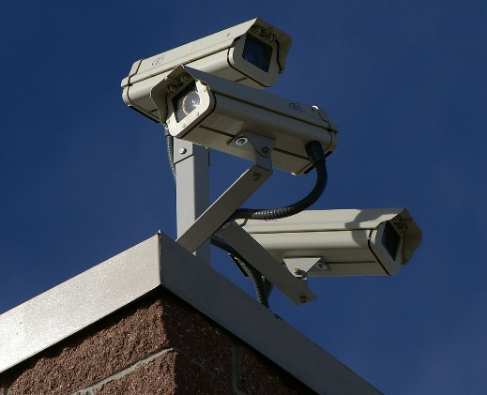

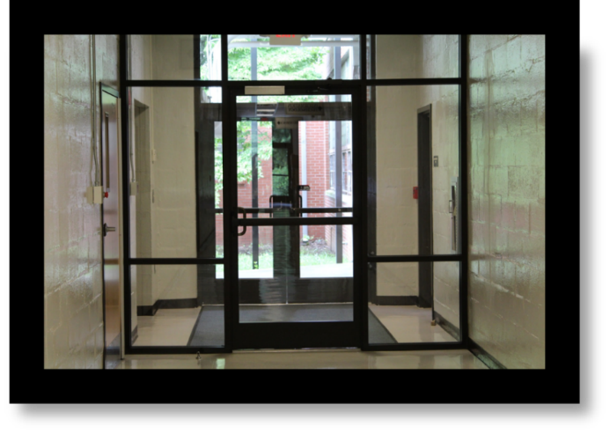
Safety and Security
Communications / Surveillance Equipment
  Security camera upgrades/expansions
  Expand key card access (interior, general use areas)
  Add buzz-in door options at front desks

Slide 8

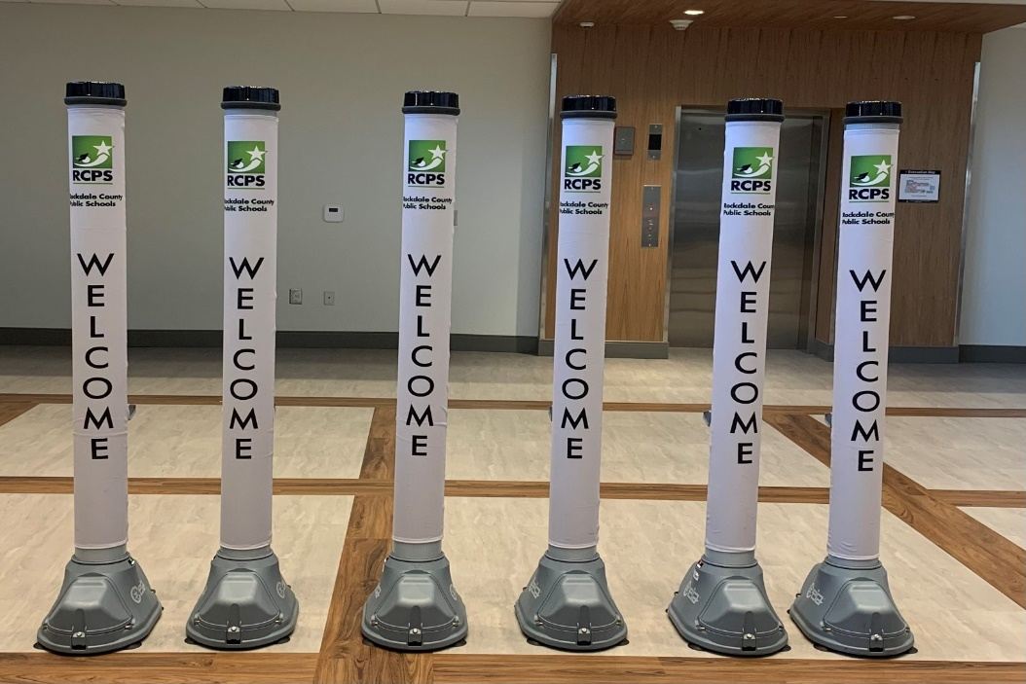
Safety and Security
Safety and Security Equipment
Replace select AEDs districtwide
Security vehicles replaced through the district fleet rolldown process
Open Gate purchases for all site locations

Slide 9

Teaching and Learning
Instructional Supplies
Textbooks
This Photo by Unknown Author is licensed under CC BY

Slide 10

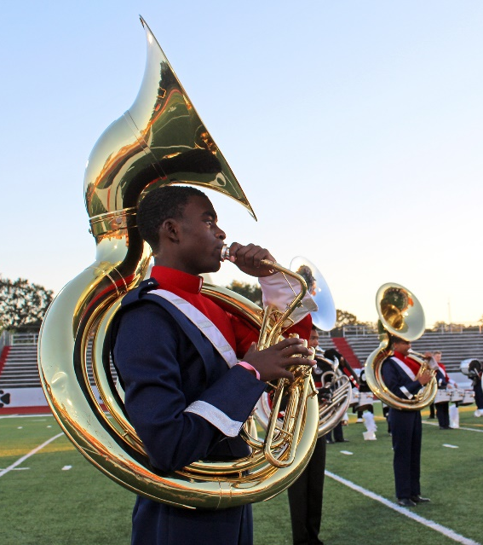

Teaching and Learning
Specialty and School Programs
Band uniform replenish
Athletic safety equipment and uniforms
Musical instruments
Miscellaneous art program equipment
Film career pathway space for training and equipment
This Photo by Unknown Author is licensed under CC BY

Slide 11
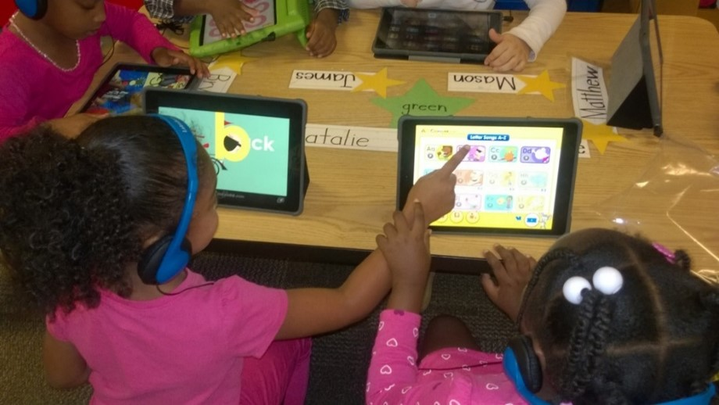

Learning Reimagined 1:1 program
Technology
Replacement cycle for student laptops, grades 2-12
Replacement cycle for student iPads, grades Pre-K – 1
Replacement cycle for teacher laptops
Replacement cycle for staff laptops

Slide 12


Technology
Infrastructure upgrades
Classroom modernization
Wireless network
Administration computers

Slide 13
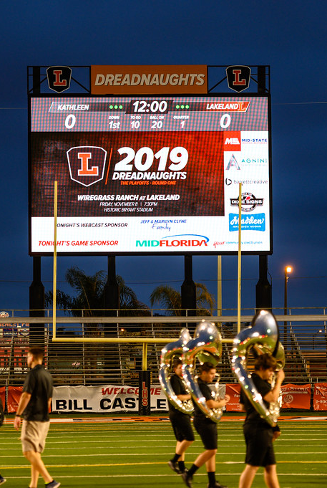

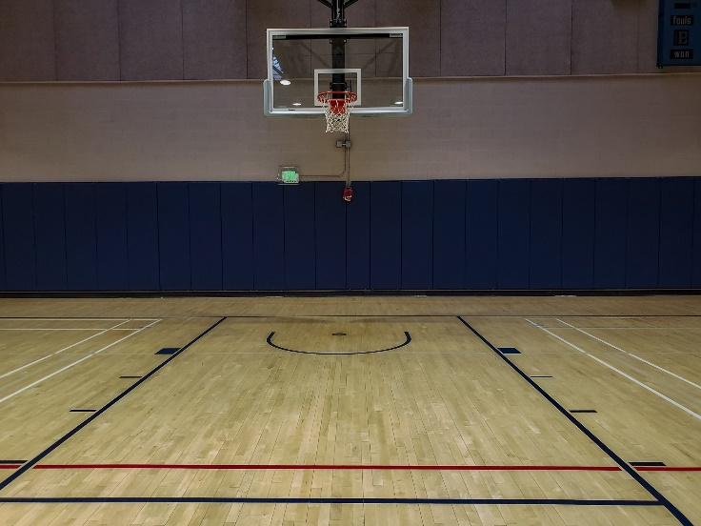
Facilities
Athletic Upgrades/Refurbishing
  Protective athletic equipment
  Digital scoreboards
  Gym floors
  Baseball / softball fields
  Track refresh
  HHS gym

Slide 14
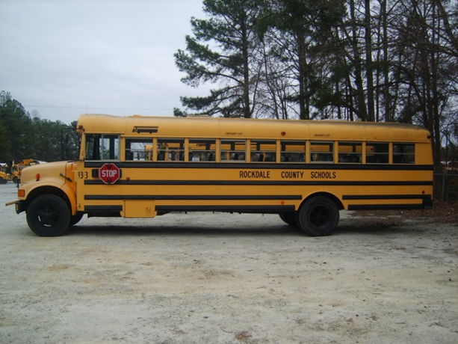
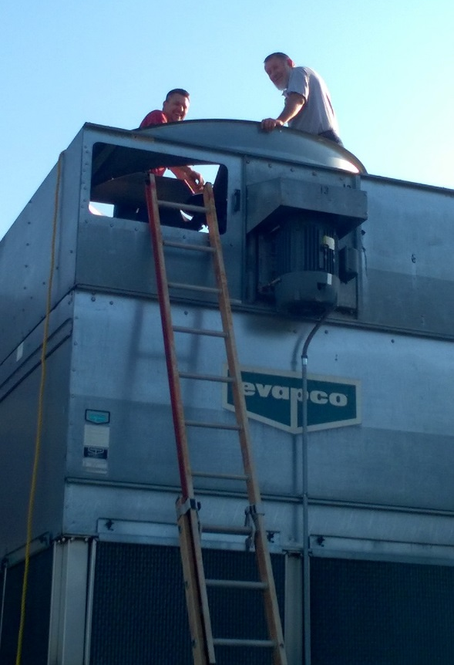
Facilities
Upgrading the Fleet
  Buses
  Fleet Vehicles
Local Facilities Plan - Site Improvements:
  HVAC Upgrades
  LED Lighting
  Back-up Power Gen
  Painting
  Pavement/parking lot striping
  Signage
  Flooring
  Power upgrades
Potential Land Purchase for Future Schools

Slide 15
Completed Projects from
E-SPLOST I and II
E-SPLOST I
  Barksdale Elementary additional land and stage
  Roofing at BES, FSE, and HHS
  RCHS Auditorium, Additions, and Renovations
  HHS and SHS Auditorium Additions
  Peek’s Chapel Elementary
  Evans Stadium at HHS
  Debt retirement
  Bus facility maintenance and underground fuel storage
E-SPLOST II
  The Rockdale Career Academy and additions
  General Ray Davis Middle School
  C. J. Hicks Elementary School
  Athletic facility improvements at RCHS, HHS, and SHS
  Fine Arts Addition at HHS
  Alpha Academy and County Office Renovations
  Technology Infrastructure
  Debt Retirement
  Buses
  Painting, paving, and energy efficient retrofits throughout the district

Slide 16
Completed Projects from
E-SPLOST III and IV
E-SPLOST III
  SHS Addition
  RCHS Annex Renovation for Magnet Program
  PSE Renovations
  CMS Expansion and Renovations
  EMS Expansion and Renovations
  MMS Renovations
  RCHS Gym Addition and Renovations
  Land Acquisition for future school
  Technology and Security Upgrades
  Buses
  Painting, Warehouse and Transportation Facility Renovations
E-SPLOST IV
  Pine Street Elementary
  Track / Turf Fields - RCHS, HHS, and SHS
  Technology - One to One Devices
  Security Vestibules
  Security Access Control at all schools
  GPS Tracking for Buses
  Band Uniforms - for RCHS, HHS, and SHS
  Land Acquisition for JHH
  Specialty Program Equipment and Facility Upgrades
  Painting and Fleet Upgrades
  New JHH (in progress)
  Renovate County Office and Old PSE (in progress)

Slide 17
Completed Projects from
E-SPLOST V
E-SPLOST V
HVAC updates at Lorraine ES, Memorial MS, Rockdale County HS, and Salem HS
Re-roof projects at Rockdale County HS, Salem HS, Memorial HS, Lorraine ES
Backup generators installed at school sites throughout the District
15 schools painted on the seven-year paint schedule
HVAC controls installed through out the District
LED lighting installation throughout the District is underway – TBC E-SPLOST VI
New ceilings and grids at eight schools is scheduled
HHS and SHS baseball field lighting upgrades completed
Paving and striping throughout the District is ongoing
Tennis courts at RCHS and middle schools refurbished; added Pickleball stripping
Digital cameras purchased/installed in all school locations.
Stadium tracks repainted and refreshed
Carpet and VCT replaced at schools in all three tiers
Specialty programs updates completed (i.e. CJH Reading Program)

Slide 18

E-SPLOST, The Power of a Penny!
https://youtu.be/qwBSIMHUqoE

Slide 19
E-SPLOST VI Timeline
August 2023 - E-SPLOST VI process and timeline discussions.
August 2023 - Solicited input on items to be considered in E-SPLOST VI.
August 2023 – Formation of E-SPLOST VI committee.
September 2023 – Executive Cabinet review of the E-SPLOST VI project list.
October 19, 2023 - Board adopted a resolution calling for an E-SPLOST VI referendum.
November 2023 - Resolution sent to the Board of Elections.
January/February 2024 - E-SPLOST VI Campaign by Committee.
March 12, 2024 - E-SPLOST VI Election date.

Slide 20
