Slide 1


FLEXIBLE SPENDING ACCOUNT
125 PLAN
Presented by The Aviben Team
2024

Slide 2
Chris Williams
Benefits Consultant
chris@aviben.com
1995 E. Rum River Dr. S., Cambridge, MN 55008
www.aviben.com
763-552-6053

Slide 3
Katie Bailey – Operations Manager
katie@aviben.com
Emma Pankan – Plan Administrator
Stevie Dickison– Plan Administrator
planadmin@aviben.com
Annie Mohrenweiser– Benefit Processor
benefitprocessing@aviben.com
For assistance with your account or claims, please contact the Aviben
Service Team
Service Team
Mieke Derks
Lisa Money
Julie Annunziata
Carol Owens
claimsupport@aviben.com
Office: 763-552-6053
Fax: 763-552-6055 or 763-552-9160

Slide 4
Welcome to Aviben
Aviben specializes in providing benefit plans to the public schools and municipal governments and is versed in the needs of these industries. Our services make it easy for plan participants to access their benefits with a streamlined user experience.
Aviben is a family-owned and operated benefits administrator located in Cambridge, MN. We take pride in providing excellent service to the hard-working individuals of our partnered employers.
You can find more information on our website, https://aviben.com
Access your claims-eligible benefits in one place by logging into the Consumer Portal, https://aviben.lh1ondemand.com/Login.aspx?ReturnUrl=%2f
We look forward to working with you.
Aviben Benefits Administration
1995 E Rum River Drive S
Cambridge, MN 55008

Slide 5

Aviben Service Team
?
?
?
The Aviben Service Team is available from 7am – 6pm CST, Monday-Friday
If you have questions on your account, please reach out to the Aviben Service Team. Our knowledgeable staff can help with a multitude of requests, including but not limited to the following:
Logging In
Password Resets
Account Information and Status
How to Submit a Claim
Checking Claim Status
Debit card questions
Eligible FSA purchases

Slide 6
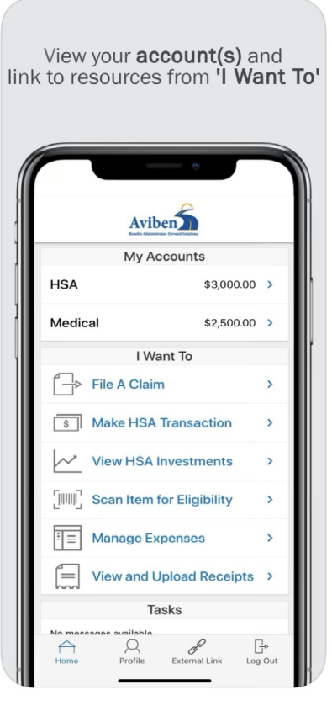
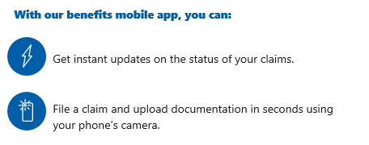
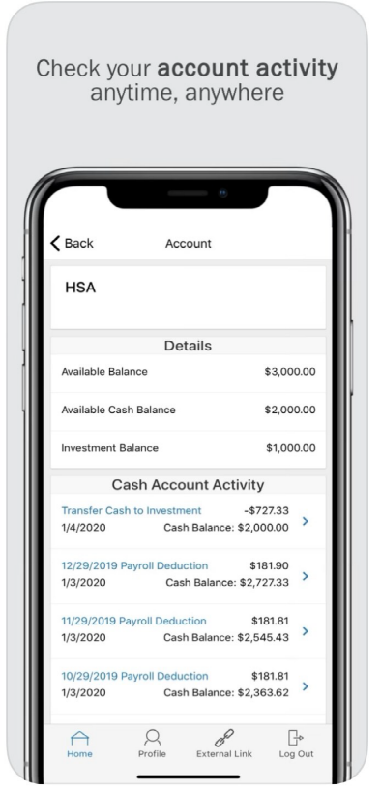
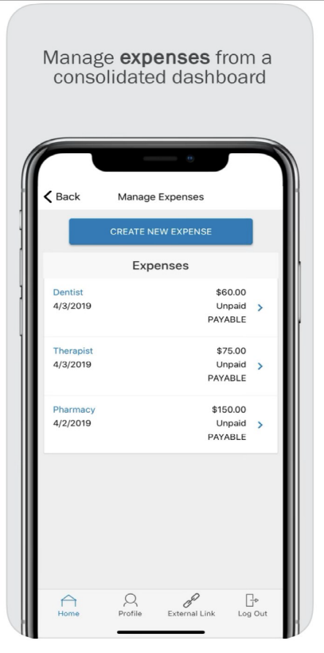
Get the Mobile App!

Slide 7
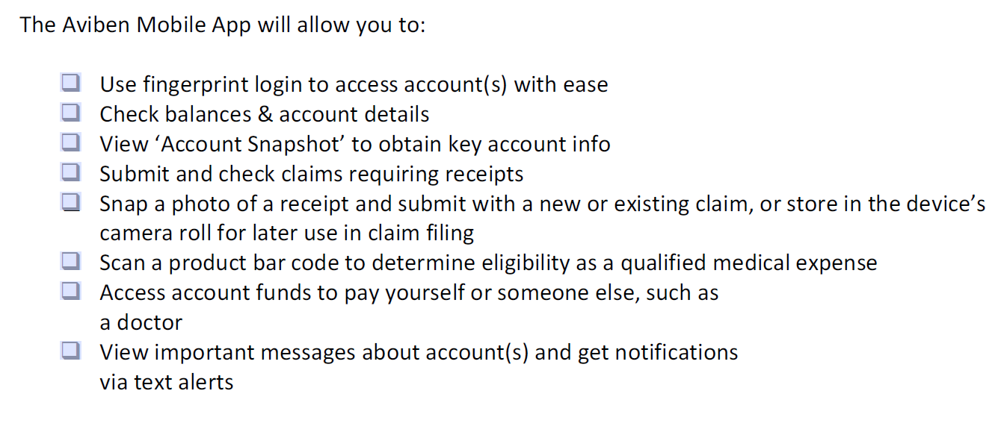
Mobile App
Get the Aviben Mobile App Here:
Apple Store
https://apps.apple.com/us/app/aviben-benefits-administrator/id1535083844
Google Play
https://play.google.com/store/apps/details?id=com.lighthouse1.mobilebenefits.esn

Slide 8
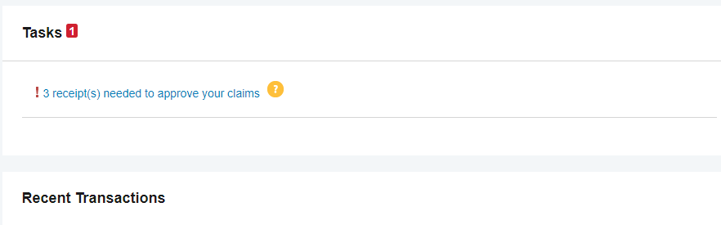
Consumer Task List
Log in to see outstanding tasks
If the information is not provided, your claim may be denied and/or your debit card may be suspended.

Slide 9

Health Scanner
Exciting Feature!!
You can now use your mobile app to scan barcodes & see if the item is FSA eligible
right in the store!
This Photo by Unknown Author is licensed under CC BY-SA

Slide 10

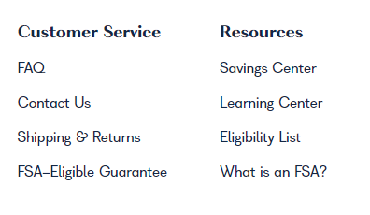
Health Shopper
Click on the Eligibility list to find what items are eligible for purchase with your FSA funds

Slide 11
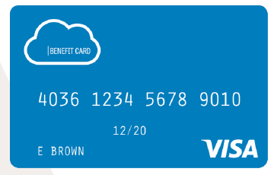
Health Benefit Cards
The Health Benefit Card functions as a debit card to pay for items upfront. Save those receipts, you may still need to send claims in depending on the item paid for.
Debit cards are the default payment when enrolling. You can also add direct deposit information after logging in.
At the bottom of the card there is a note to “Save Receipts”
The card is mailed in an envelope stating “DO NOT THROW AWAY”
There is no fee for the card. These are benefit of the Flex plan.
Use the mobile app to see Debit card claims and attach paperwork.
Remember to save those receipts ☺

Slide 12
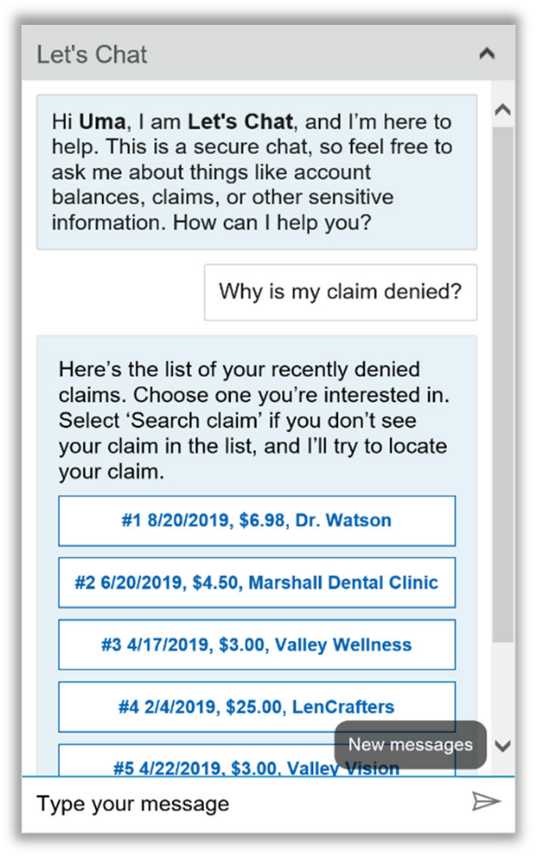
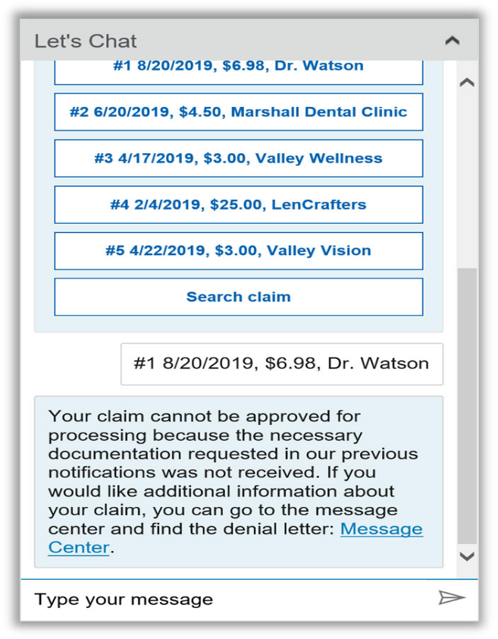

New Virtual Assistant
Click on “Need Help” to answer many of your questions using Uma, our virtual assistant.
This is available 24 hours a day!

Slide 13
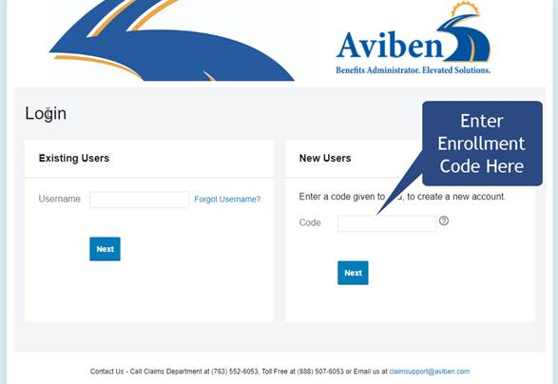
Open Enrollment Consumer Portal Login
Please click this link to enroll https://aviben.lh1ondemand.com/Login.aspx?ReturnUrl=%2f
Enrollment Code is ESN-XXX125
IMPORTANT! Your employer will provide open enrollment instructions. Not all employers use the Consumer Portal for Open Enrollment.
The Enrollment Code is specific to your employer.
It will start with ESN and ends with 125
**For enhanced security password will reset every 150 days**
Notes:
New Enrollees will need to use a password to get logged in. (For the 2021 plan year everyone will need to login and upload the information in the system.)

Slide 14
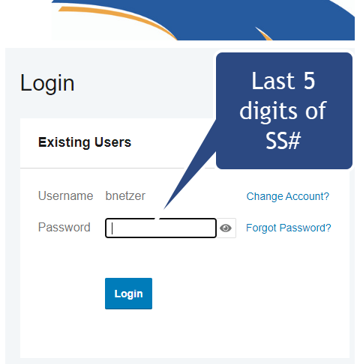
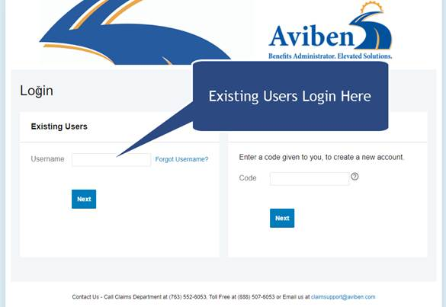
Consumer Portal Login
Step 1. Enter your username & click Next
Username: First name first initial/Last name/last 4 digits of SS# no spaces or dashes
Example: bnetzer1234
Password: Last 5 digits of your SS#
Click Login
Record your Username and Password for future use. If you already have one, please use your existing login.
For enhanced security, your password will reset every 150 days

Slide 15
Employer Sponsored Benefits
FLEX: Flexible Spending Account
As a benefit eligible employee, you can participate in the flexible spending accounts. These accounts allow you as an employee to reclassify some of your income as pretax and get reimbursed tax-free for eligible expenses.
You can not change these elections outside the open enrollment window unless you have a change event. Conservatively make your election as any funds not used in the plan year could be lost.
FLEX: Flexible Spending Account Options
Full Health FSA: Used to pay for out-of-pocket expenses not covered by insurance or another consumer driven health care.
Limited Health FSA: Used to pay for out-of-pocket dental and vision expenses not covered by insurance or another consumer driven health care
Dependent Care FSA: Used to pay for most dependent care expenses

Slide 16
Flex Enrollment
$$$
What to Expect for the Plan Year
FLEX contributions use PRE-TAX dollars. Depending on your tax bracket, you may save up to 30% or more in taxes.
FLEX plans are “Use it or Lose it”. You must use your funds by the end of the plan year, or they will be forfeited.
Choose your Plan Elections and Contributions wisely. Your benefit elections can NOT be changed unless you have a qualifying life event.
See your employer to discuss what FSA benefits are offered.

Slide 17
Claims
How do I use my funds?
You can submit claims through the following methods
1) Visa Benefit Card (if applicable)
2) Aviben Mobile App
3) Aviben Web Portal
4) Mail
5) Fax
Please contact the Aviben Service Team for Claims Assistance
1-888-507-6053
claimsupport@aviben.com

Slide 18
Thank You!
Helpful Links
Find more information on our website
https://aviben.com
Access your claims-eligible benefits in one place by logging into the Consumer Portal, https://aviben.lh1ondemand.com/Login.aspx?ReturnUrl=%2f
Recorded Presentation for Flex:
https://www.youtube.com/watch?v=2xC786uZ2OM

