Slide 1

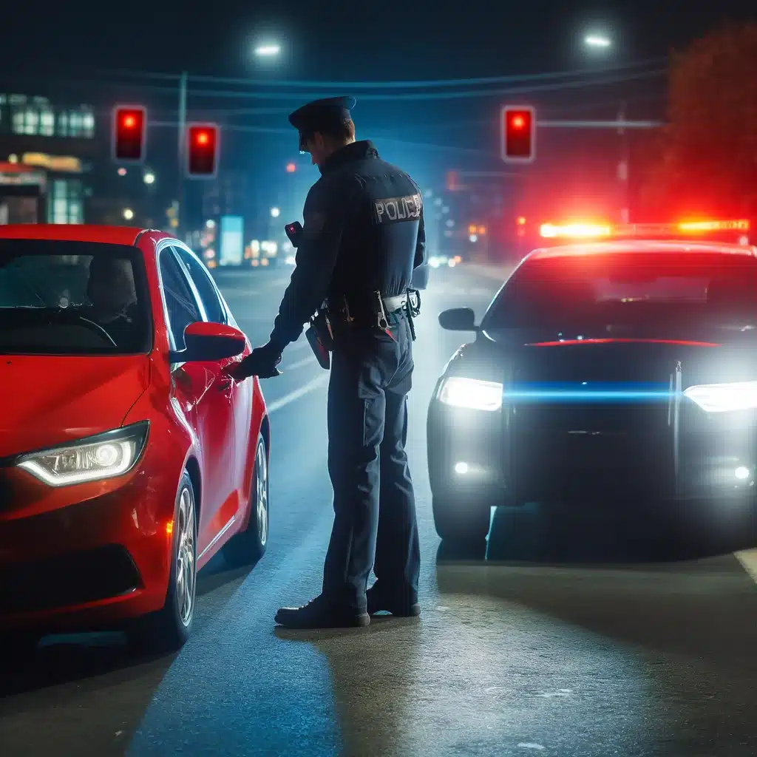

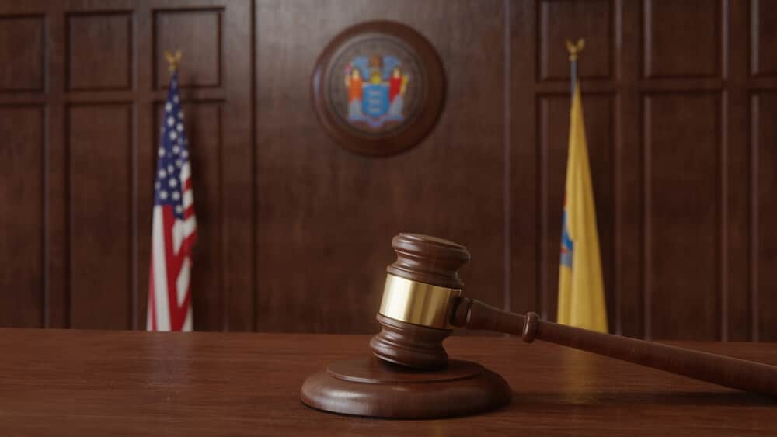
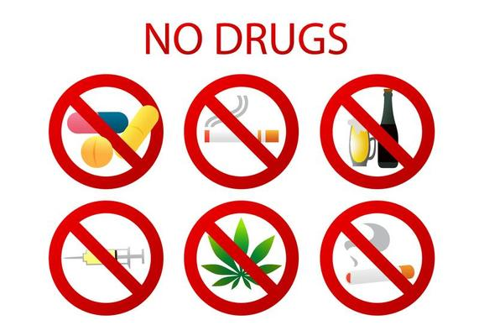

DRIVING EDUCATION
BULLYING PREVENTION
CONSEQUENCE OF BREAKING A LAW
DRUG EDUCATION
INTERNET SAFETY

