Slide 1
SOCIAL SKILLS TRAINING interventions from the frontlines
Presented by Melinda Rogers, SLP and Ruth Dubner, LPC

Slide 2
Targeted Student Population
Students with High-Functioning Autism
Students diagnosed with Asperger Syndrome
Students with Pervasive Developmental Disorder – not otherwise specified
Notes:
The students population we will be targeting during this presentation are…
Definition of High-functioning Autism
Definition of Asperger Syndrome
Definition of Pervasive Developmental Disorder- Not otherwise specified

Slide 3

Things are not always what they seem…
Notes:
Before we get started, we found this clip from a Japanese educational campaign about autism. It starts in a classroom and the teacher is giving the children instructions to draw a picture of an animal- any animal.

Slide 4
What is it like to have HFA/AS?
(High Functioning Autism/ Autism Spectrum)
Imagine going on a trip to a foreign country with a group of people. As you get off the plane everyone is handed a little handbook that explains the language and customs of that particular country EXCEPT YOU.

Slide 5
When you have AS/HFA
You are living in a foreign land when no one has told you what the customs are.
You may be rejected
You may frustrate others
People may engage with you disrespectfully.
People may not take the time to understand you.

Slide 6
When do we educate a child with AS/HFA that they have autism?
Notes:
Ruth- specific examples
Pro vs. Con-
Why parents should consider- examples of kids who thought they were mentally ill or retarded.

Slide 7
Self-Advocacy
Why is this so important?

Slide 8
Who else do you tell?
Exploring your options
Just what teachers and employers need to know?

Slide 9
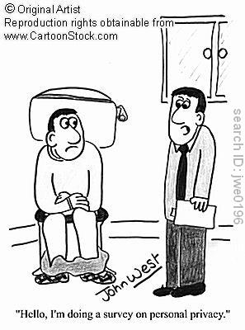
RESPECT, AWARENESS, AND PERSPECTIVE
Why are each of these so important?

Slide 10

The Social Arena
Notes:
Now, we are going to discuss the social arena. This can be a very scary place for these students. What comes so automatic and natural to most people is actually quite difficult for students with AS/HFA.

Slide 11
Effective Techniques from the Frontlines
Use of code words
Role-play
Discussing the Hidden Curriculum
Increase awareness: The INCREDIBLE 5-Point Scale
Social Autopsies
Social Blueprints

Slide 12

Socially Appropriate?
Notes:
This is another video from the UK Autism education campaign. Here, there are 4 young adults in a fast food restaurant. One girl has just broken up with her boyfriend. Pay close attention to the facial expressions, figurative language, rhetoric questions used.
Does this sound familiar? When something has taken place within your classroom that is embarrassing or awkward, how did you handle it?

Slide 13
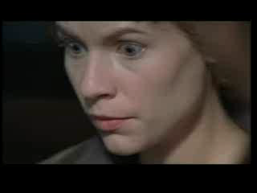
Question your child’s learning style
Is your child a visual, auditory, or kinesthetic learner? By and large, children with Autism are more sensitive in one area vs. another. Information should be presented initially in their best learning capacity.
Notes:
From: HBO Temple Grandin

Slide 14
The Hidden Curriculum
The hidden curriculum refers to the set of rules or guidelines that are often not directly taught but are assumed to be known (Garnett, 1984: Hemmings, 2000; Jackson, 1968; Kanpol, 1989).
Notes:
Raise your hand if you are familiar with the “Hidden Curriculum?”
There will be a book on the back table and a daily calendar. I also have a video tape that is a lecture by an expert in the field discussing the Hidden Curriculum

Slide 15
Why is teaching the Hidden Curriculum to HFA/AS students so important?
Being able to navigate through the social area is imperative if an individual wants to be successful in the workplace and in developing personal relationships.
Most students with HFA/AS leave school and end up in jobs that are low paying, below skill level.
Why? Not that the knowledge isn’t there, it is they don’t understand the hidden curriculum.
Prime targets for bullying

Slide 16
Why is this so difficult for AS/
HFA students?
Don’t pick up on environmental cues
Have difficulty interpreting body language (remember in dating some nonverbal messages are very subtle!)
Don’t understand hierarchical ranking (i.e. co-worker vs. boss)
Don’t understand the “gray” areas.
Have difficulty understanding rhetorical questions.
Bottom line…didn’t get the handbook like everyone else did.

Slide 17
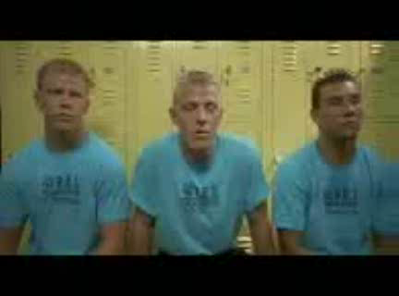
How Bullying can get started by not following the hidden curriculum…
From Napoleon Dynamite

Slide 18
Breaking one of the hidden rules…
May be painful!
May result in one becoming a social outcast.
One might hear phrases like:
  “I shouldn’t have to tell you, but…”
  “It should be obvious that…”
  “Everyone knows that…”
  “Common sense tells us…”
  “No one ever…”

Slide 19
Life transitions
Elementary School to Middle School
Middle School to High School
High School to College or post-secondary training

Slide 20
Differences in the Hidden Curriculum
Age (boy likes girl)
Gender (boy interaction vs. girl interaction)
With whom (with peers vs. with adults/ authority figures)
Setting (in public or in private)

Slide 21

Hidden Curriculum in Dating
There are more gray areas in dating than there are black or white areas.
What to say, when to say it,
how to say it….
Confusing for most teens but imagine how confusing to students with HFA/AS.
Quote from a HS student, “I tried in middle school to meet girls. I didn’t do so well. Now I am fine with being alone for the rest of my life.”

Slide 22
If a 7 year old boy has a crush on a girl…
What does he do?

Slide 23
Now that boy is 16…
Can he do the same thing
he did when he was 7?
What would happen if
he did?

Slide 24

Now that boy is a 25 year old man…
And he likes a lady at work.
Can he do what he did when he was 7 years old?
What could happen if he did?

Slide 25

Social Etiquette

Slide 26
Where are you?
How does your behavior change when you are in different settings?
At home vs. at a friends house
In the community
Casual vs. formal restaurant
Coping with private matters
Gym showers

Slide 27

Visualization lesson
A way to explain the Hidden Curriculum to a child is to go outside and look at cloud formations. Discuss how your perception of a cloud is different from your child’s. Show appreciation for having different views, but explain that having different behaviors in a situation can cause problems in school, work, etc…

Slide 28
Skill Sessions at Home
Practice having your child “read your face” without words. The “Hidden Curriculum” can often be found in non-verbal communication.
REWARD every time the child is accurate in their interpretation
MIRROR your child’s behaviors back to them in a non-confrontational way, to show him/her what behaviors you see.
CATCH every opportunity to praise and review positive social skills interaction, no matter how basic or obvious it may seem to you.

Slide 29
Bullying… self advocacy and embracing AS/HFA
Kids sometimes know they are AS/HFA, but don’t understand the true definition of what it truly is.
“I might have autism, it might be an inch of autism where some people have a mile of autism. Or people have a millimeter of it. It doesn’t really have meaning. It’s just a word.”
Wyatt, 6th grade (Autism the Musical)

Slide 30
Use of Code Words
Dynamite
Bunny vs. Bull
Bummer
“A Biggy”
Expected vs. Unexpected

Slide 31
Conversation Lead-ins
How to start a conversation with less familiar people
Be a social detective- what do you know about the person and what do you have in common?
Listen for leads

Slide 32
The INCREDIBLE 5-point Scale
Purposes:
  Help the student understand social boundaries
  Help the student control emotional responses
  Other applications- endless
Notes:
Watch video to get information re: how this is so helpful for students understanding

Slide 33
5-point Scale for Understanding Social Boundaries
5- Physically hurtful or threatening behavior.
4- Scary behavior.
3- Odd behavior.
2- Reasonable behavior.
1- Very informal social behavior.

Slide 34
Applying the 5-point Scale to Dating
5- Against the law.
4- Going out of your way to follow a girl in the hallway.
3- Staring at a girl that you like without ever talking to her.
2- Talking to a safe person about the girl you like.
1- Just looking at a girl you like BRIEFLY and smiling.
Notes:
Applying the 5-point Scale to Dating
1- Just looking at a girl you like BRIEFLY and smiling. You can say “Hi” if you see here outside of school.
2-Talking to a safe person about the girl you like. Eating lunch at the same table as a girl you like. Working in a small group together. Sitting next to someone in an after-school activity club.
3- Staring at a girl that you like without ever talking to her. This can look very strange and might make the girl not want to be around you. Remember: She cannot read your mind, so you must use words if you are going to look at her for more than just a second. Remember also to look at her face. If her face looks upset, then stop looking.
4- Going out of your way to follow a girl in the hallway. Some people might think this is too close to stalking behavior, which is against the law and scary.
5- Against the law. Making comments about a girl’s body. This can scare the girl and make her think you are dangerous. Also, never kiss or touch a girl unless she tells you it is okay.

Slide 35
Individualizing the 5-point Scale
(Example 1)
5- I need to leave!
4- I need some space
3- Please don’t talk
2- I am a little nervous
1- I can handle this!

Slide 36
Ways to use the 5-point scale
Role-play activities
Unstructured conversation and provide feedback
“You are a 3- bring it down to a 2.”
“You are a 3- what do you need to do to bring it down to a 2?”
Teach different perspectives- why one person sees the behavior as a 4 while you think it is a 2.

Slide 37
Individualizing 5-Point Scale
(Example 2)
5- Screaming/emergency only
4- Recess/outside voice
3- Classroom voice/talking
2- Soft voice/whisper
1- No talking at all

Slide 38
Making a Social Blueprint
Prepare in advance before social opportunities
Role play conversation starters
Role play possible scenarios
ROLE PLAY helps your child prepare in advance for the unexpected, leading to confidence in situations that he/she can handle independently
        REWARD, REWARD, REWARD, and REVIEW

Slide 39
ACADEMIES
Practice makes perfect– look for opportunities all the time in all situations for your child to practice skills
Try, try, try again. There is no fail.
Use stickers/reinforcement charts
ALWAYS use appropriate skills when teaching skills (take child aside privately to discuss private matters, such as corrections for behavior)
Provide opportunities for your child to correct you by having fun with social skills

Slide 40
Empowering the AS/HFA student
Ideas from the frontlines…
Brainstorm with the child the pros of having AS/HFA
Discuss career options that are ideal for people with AS/HFA
Use the positives from AS/HFA for classroom jobs and activities (having the child keep score during PE)
Suggest books to review with the child

Slide 41
Sometimes it is hard to understand why people with autism do what they do…

Slide 42
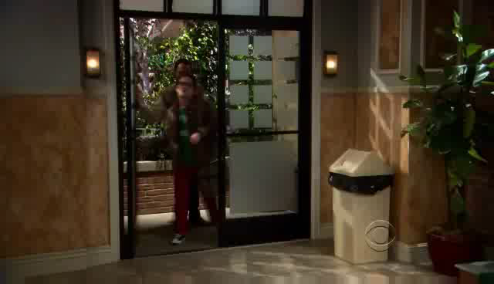
Social Autopsies
Video Clips
from The Big Bang Theory

Slide 43

It’s not just those on the spectrum who don’t get social skills!
From Planes, Trains, and Automobiles

Slide 44

When working with HFA/AS students, keep in mind…
Instead of there being limits for people with HFA/AS, perhaps expectations should be limitless.

Slide 45
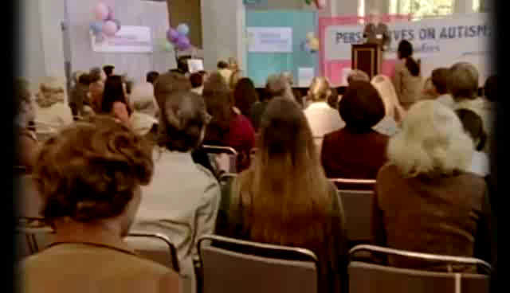
REMEMBER:
You are your child’s best teacher who will always be accepting, loving, challenging, and encouraging.
Seize every opportunity you have!

Slide 46
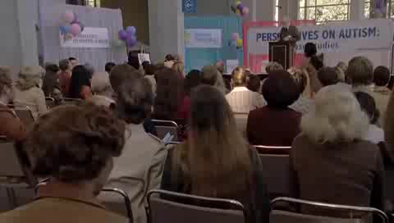
From HBO Temple Grandin

