Slide 1
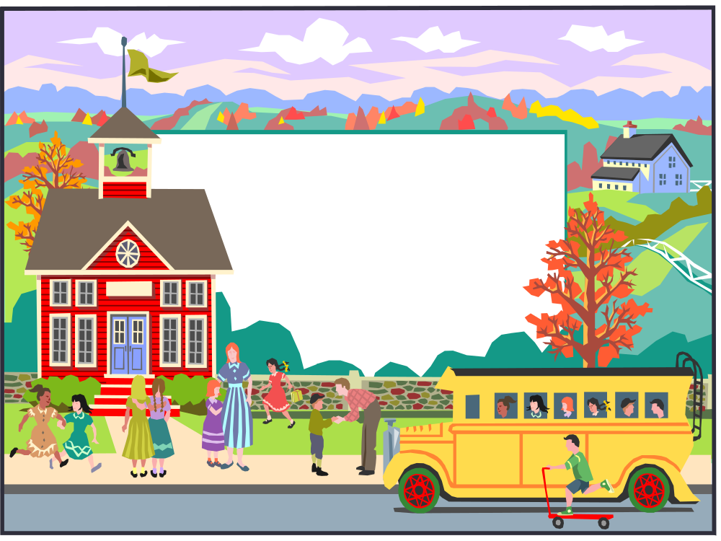
Discipline & Disabilities
Effective Strategies and Techniques

Slide 2
About the Presenters
Syliva Garcia
  Special Education Interventionist
Jennifer Key, Ph.D.
  Licensed Psychologist, Licensed Specialist in School Psychology
Valerie Weed
  LISD Practicum Student
  Doctoral Candidate – Texas Woman’s University

Slide 3
Purpose of Discipline
For Children who do not have ASD
For Children who have ASD
Notes:
Punish, decrease the liklihood that behaviors will occur again
Teach-teach new skills or behaviors that can replace maladaptive behviors
Purpose of discipline is generally the same, although you may need to focus more on teaching desired & replacement behaviors due to the skill difficulties often associated with ASD
(difficulties with nonverbal communication, social initiation, social reciprocity & terminating interactions, social cognitions, perspective taking & self-awareness, social anxiety & avoidance
Goal is not to alter the behavioral expectations, but to increase our methods of teaching skills that children need in order to be successful behaviorally

Slide 4
Tenets to Keep in Mind
Children want to behave and do what is expected of them
If we want children to be successful behaviorally, we must teach them the skills to be successful
Successful behaviors are not always “appropriate” behaviors
Success is dependent upon the child’s ability to adapt to his/her environment
    Behavioral Skills are not the equivalent of academic skills
Notes:
Focus on teaching functional behaviors- those that elicit positive responses from others and/or desired consequences
Demonstrating appropriate behavior in a given situation is more similar to a quarterback dropping back to pass, reading the defense in a football game than it is to reading a book or doing a math problem
-can’t expect to teach behavioral skills in the same way you teach academic skills
Children with ASD often do not learn how to behave simply by listening to someone tell them what to do or watching someone behave. Like social skills, behavioral skills sometimes must be explicitly taught
Behavior occurs in a social context, difficulties with social perception
Behavioral skills are learned and mastered through practice & performance; need to provide opportunities to practice & develop newly learned skills just as we would provide those opportunities to an athlete dancer, a gymnast

Slide 5
Common Behavioral Difficulties
Transitions
  From preferred to non-preferred activities or settings
Difficulties surrounding family or social activities or routines
  Mealtimes (remaining at the table, engaging)
  Bedtime & sleep
  Toilet training
  Avoidance behaviors
  Sensory sensitivities (food refusal, avoiding specific locations or tasks)
Notes:
Difficulties with cognitive flexibility, adaptability, anxiety all play a role

Slide 6
First, Determine the Function
To better understand why behavior occurs, we need to understand what purpose the behavior serves.
What happens immediately before the challenging behavior occurs?
What happens as a result of the challenging behavior?

Slide 7
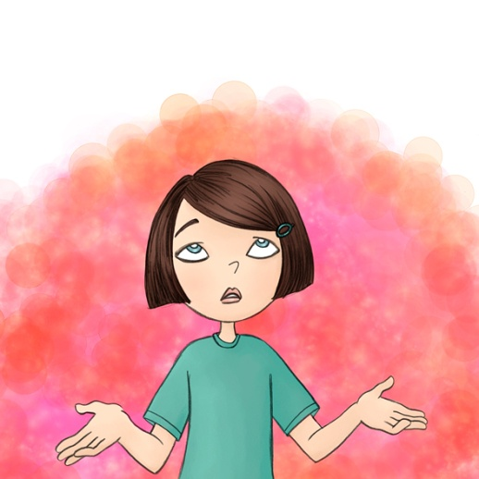
Why do they do this?
To understand children’s behavior we need to figure out why they are doing what they are doing. What is the function of their behavior?
What happens immediately before the challenging behavior, such as a tantrum or biting, occurs?
What happens as a result of the challenging behavior?
Functions of behavior usually include getting something you want (attention, toys, food) or getting out of or away from something you don’t want (clean up, bath time, demands).

Slide 8
Functions of Behaviors
Ask yourself what is a possible function of the behavior.
Examples of possible functions:
  Attention
  Avoiding an activity
  Getting something you want

Slide 9

The ABC’s of Behavior
A=what happens before the behavior.
B=the behavior
C=what happens after the behavior.
To change the B, we need to
  Teach the B
  Change the A
  Change the C
Notes:
Tell them what you want them to do, not what you do not want them to do

Slide 10
Things to Pay Attention To
How often do the behaviors happen?
How long have the behaviors been going on?
How severe/intense are the behaviors?
How many different problem behaviors does the child display?
Where/When do the behaviors happen?
What else may be going on that could explain the behaviors?

Slide 11

Changing “the befores”
Modify what happens directly before a challenging behavior occurs.
  Expectations
    Be clear
    Communicate
    Be flexible
    Be reasonable
  Change the way the direction is given.
    Timing
    Choices
    The Premack Principle or “Grandma’s rule”

Slide 12
Some more “befores” to consider
  Alter the difficulty of the task
    Break it up
    Offer assistance
    Make it a game
  Provide attention before the behavior begins
    Identify “hot spots”
    Give attention to positive behaviors
    Accentuate the positive (even if it is not there yet)
  Use behavioral momentum

Slide 13

Changing “the afters”
Modify what happens directly after the challenging behavior occurs.
  Enforce demands and requests with prompts and physical assistance.
  Provide limited attention and ignore when possible.
  Promote and support use of appropriate skills to get something you want.
  Reward those behaviors you want to see again.
The “afters” or consequences should:
  Be immediate
  Be specific
  Be consistent

Slide 14
Other Changes
Teach responses children can use instead of using challenging behaviors.
Provide opportunities for children to use their new skills.
Reinforce children’s use of skills.
Teach children how to communicate without using challenging behavior.

Slide 15
Some rules to remember
Behaviors that are reinforced positively (rewards, smiles, praise) are more likely to occur again.
Behaviors that are not reinforced positively are less likely to occur again.
Behaviors that are reinforced negatively are more likely (allowed to escape) to occur again.
Behaviors that are not reinforced negatively are less likely to occur again.

Slide 16
Modifications
Modify your reactions to the challenging behavior.
  If Julie tantrums every time you ask her to turn off the TV and get ready for bed, and she is sent to time-out every time she tantrums, she is avoiding bedtime by going to time-out. Julie is getting a desired outcome as a result of her challenging behavior.
  Instead, ignore the tantrum and keep the demand that she get ready for bed

Slide 17
What can you do?
  Reinforce appropriate behavior.
  Follow rules and routines.
  Provide children with opportunities to make choices.
Notes:
Comment on children who use appropriate social behaviors. Reinforce children when they are exhibiting appropriate behavior.
Have a few simple rules for the classroom.

Slide 18
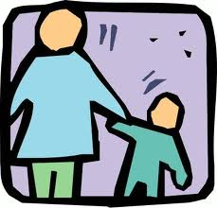
What can you do?
Teach children to communicate feelings in appropriate ways.
  Explain appropriate ways to express feelings
    Teach words for different feelings.
    Teach how to recognize feelings in self an in others

Slide 19

Giving Effective Commands
Make sure you mean it
Do not present the command as a question
Do not give too many commands at once
Tell your child what to do rather than what not to do
Avoid competing distractions when giving commands
Be cautious of commands that involve the concept of time

Slide 20
Acknowledgment vs. Praise

Slide 21
Reinforcement vs. Punishment
Reinforcement - strengthens or increases the probability of a specific response
  Positive - Adding a stimulus, such as a treat or reward, in order to increase a response
  Negative – Taking away a stimulus, such as stop nagging after trash is taken out
  Punishment – adding an aversive stimulus to decrease unwanted behavior
Notes:
Aversive - spanking

Slide 22
Extinction
Removing a stimulus to decrease a behavior; withhold the reinforcers that may be maintaining the behaviors
The connection between the behavior and the consequence ceases
Useful for behaviors such as: whining, complaining, tantruming, attention-seeking behaviors

Slide 23
Shaping/Successive Approximations
Shaping/Successive Approximations
  Can lead to the acquisition of new behaviors by rewarding behaviors that move toward the desired behavior in some way
Useful for behaviors such as: teaching social initiations, increasing participation in activities, taking initiative, teaching communication skills, toilet training

Slide 24
Chaining
  Teaches a sequence of behaviors by successively rewarding each individual step & training the learner to put the steps together
  Useful for behaviors such as: social initiations (go to peer, make eye contact, say hello)

Slide 25
Positive Consequence Strategies
Manipulation of consequences may be used to influence a child’s motivation, and change long-standing behavior patterns.
Manage consequences so that reinforcement is given for desired behavior and withheld in response to problem behavior.

Slide 26
Positive Consequence Strategies

Slide 27
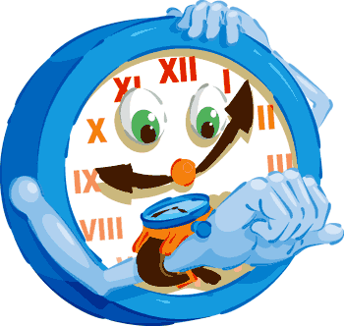
Reinforcement Schedules
Continuous Schedules
  Fixed Ratio
  Fixed Interval
Variable schedules
  Variable Ratio
  Variable Interval

Slide 28
Active Ignoring
Notes:
Use to weaken
-whining or fussing
-pouting or sulking
-loud crying intended to punish parents
-loud complaining
-continuous begging or demanding
-breath holding or mild tantrums

Slide 29

Alternative Behaviors

Slide 30
Other Changes
Teach responses children can use instead of using challenging behaviors.
Provide opportunities for children to use their new skills.
Reinforce children’s use of skills.
Teach children how to communicate without using challenging behavior.

Slide 31

Behavioral Contracts
Choose behavior(s) to reinforce
  Rank or order behaviors by ease of time, effort, and compliance
  Construct list of “privileges”
  Specific, desired by child, but must be enforced by parent
  Written document to be signed by parent and child

Slide 32

Behavior Management Plans
READY: Develop a plan
  6 steps to define who, what, when, where, and how?
SET:
  Outline the plan to follow each day
  Prepare materials.
GO:
  Use praise
  Follow through on the plan
  Be consistent

Slide 33
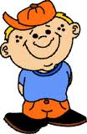
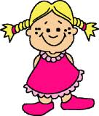
Ready - Step 1: Who
Who needs the plan?
  1 or more of your children
  NOTE: The more issues/behaviors you can address and prevent early on, the better.

Slide 34

Step 2: What
What do I want them to do?
  Define the target behavior (specific, observable, simple)
  Examples:
  Be nice =
  Use materials together by handing them to each other (not throwing). Talk to each other to solve a problem (not hitting or yelling).
  Clean up =
  Pick up the toys or other materials used during the activity and put them in the right place on the shelf.

Slide 35
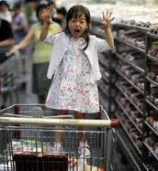
Step 3 - Where/when
Where do they need to do the behavior?
  Setting(s)
  Examples:
  In the living area =
  While in the living area, or at the dinner table, children will…

Slide 36
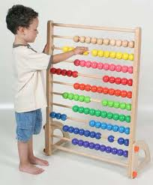
Step 4: How often?
How often do the children have to do the behavior?
  Number of times during the day (or activity or week)
  Be reasonable
  Example
  All day =
  I will choose 3 times during the day (e.g., center time, lunch, circle time) to identify children who are…

Slide 37
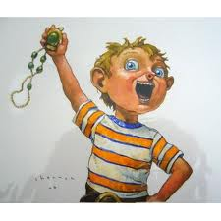
Step 5: What reward?
What will the children receive when they do the behavior?
  Desired by the children
  Simple to follow through with
  Example
  Play money = (be more creative?)
  When I see a child doing X, they will receive one dollar. If they receive four or five dollars during the day, he may “buy” something from his reinforcer menu that night.

Slide 38
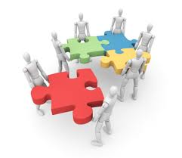
Step 6: Put it together
Put all of your steps together and evaluate it.
  Does it make sense?
  Is it possible to do? (easy to carry out?)
  Would a family member or babysitter be able to follow it?
  Will the children understand it?
  Can I explain it to the children?

Slide 39
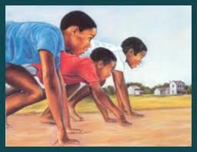
Get SET!
Be creative:
  Develop a theme
  iPhone and iPad Apps are great tools
Gather materials
  Tokens, charts, rewards
  Visual reminders for children
  Visual reminders for you
List and review rules
  Should include the behavior you are looking for

Slide 40


Now you are ready to GO!
Remember
  Be immediate
  Be positive
  Be specific
    You earn a point for picking up all the toys in your center. Good job!
  Be consistent
    Monitor when you say you will
    Reward when you say you will

Slide 41


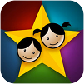


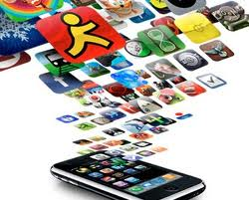

Multimedia Resources
Behavior Journal ($9.99)
iReward ($4.99)
iReward Chart
iEarnedThat
Chore Pad Lite (Free)
Earn It Stars

Slide 42
App Websites
http://momswithapps.com/2011/03/31/app-friday-autism-awareness/
http://www.autismspeaks.org/family-services/resource-library/autism-apps
http://www.matchacollege.com/blog/2011/40-amazing-ipad-apps-for-the-learning-disabled/
http://www.stellamarie.com/index.php/Android/apps-i-found-on-net
http://www.ipadsforeducation.vic.edu.au/userfiles/files/DEECD%20iPad%20support%20booklet%20for%20special%20education.pdf

Slide 43
Questions?

