Slide 1
Verbal Behavior for Early Learners
FOCUS
Carin Shearer (Thompson), M.Ed., BCBA
Brooke Wallace, M.A.

Slide 2
Basic Principles of Operant Conditioning / 3 Term Contingency (Skinner, 1938)
A
B
C
Reinforcement
Punishment
Extinction
Stimulus Control
Motivating Operation MO/EO
Response

Slide 3
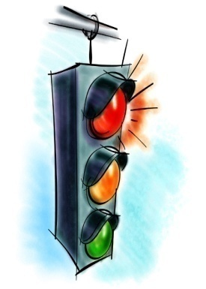

Operant Condition Example
A B C
Stimulus Control Response/ Consequence
Behavior
Red Light Step on brake Car Stops

Slide 4


Operant Condition Example
A B C
Motivating Response/ Consequence
Operation/MO Behavior
Thirsty Pours drink into Thirst is glass and drinks quenched

Slide 5
Video
http://www.youtube.com/watch?v=guroaQRFsX4

Slide 6
Verbal Behavior (Skinner 1957)
Extend operant conditioning to verbal behavior
Verbal operants (functional units of language)

Slide 7
ELEMENTARY VERBAL OPERANTS
Mand – asking for what you want; Saying “cookie” because you want cookie (request)
Tact – Naming or identifying objects, actions or events; Saying “cookie” because you see a cookie (Label)
Notes:
7

Slide 8
ELEMENTARY VERBAL OPERANTS
Intraverbal –Answering questions in which words are controlled by other words; Saying “cookie” because someone says “What is your favorite dessert?” (conversation)
Echoic– Repeating what is heard; Saying “cookie” because someone else says cookie (vocal imitation)
Listener Response – Following the directions by another person; Touching a picture of a cookie when told to do so (Receptive Language)
Notes:
8

Slide 9

OPERANT CONDITION EXAMPLE – VERBAL BEHAVIOR
Stimulus Control Response/ Consequence
Behavior
red light & asked Person says “stop” Social
“What do you do reinforcement
at a red light?”
Wants a piece of candy student asks for candy receives candy
“What does a pig say? “oink” social reinforcement
Notes:
9

Slide 10
TEACH ALL MEANINGS
Mand
Tact
Intraverbal
Cookie
Echoic
Receptive
Notes:
10

Slide 11
Verbal Operant/Skill Group Cheat Sheet
No Stimulus (item) present – Intraverbal
Item Present and student signs or says something – Tact
Item present and student does what is told – Listener Response
Student copies motor action – Motor Imitation
Student copies vocal - Echoic

Slide 12
Video Example

Slide 13
Using ABLLS and the VB-MAPP
ABLLS/ABLLS-R provide us a detailed task analysis of language skills based on the verbal operants
The VB-MAPP also provides a task analysis of language skills based on the verbal operants but it also it written in progress with typical development of skills.

Slide 14


Slide 15
VB-MAPP
There are 5 components of the VB-MAPP:
The VB-MAPP Skills Assessment contains 170 verbal behavior milestones across 3 developmental levels (0-18 mos., 18-30 mos., 30-48 mos.), and 16 different verbal operants and related skills
The VB MAPP Barriers Assessment examines 24 common learning and language barriers faced by children with autism
The VB-MAPP Transition Assessment contains 18 assessment areas to help identify whether a child is making meaningful progress and has acquired the skills necessary for learning in a LRE.
The VB-MAPP Skills Task Analysis and Skills Tracking provides a further breakdown (900 skills) of the 16 different skill areas in the form of a checklist for skills tracking
The VB-MAPP: IEP Goals provides over 200 IEP objectives directly linked to the skills and barriers assessments, and verbal behavior intervention program

Slide 16
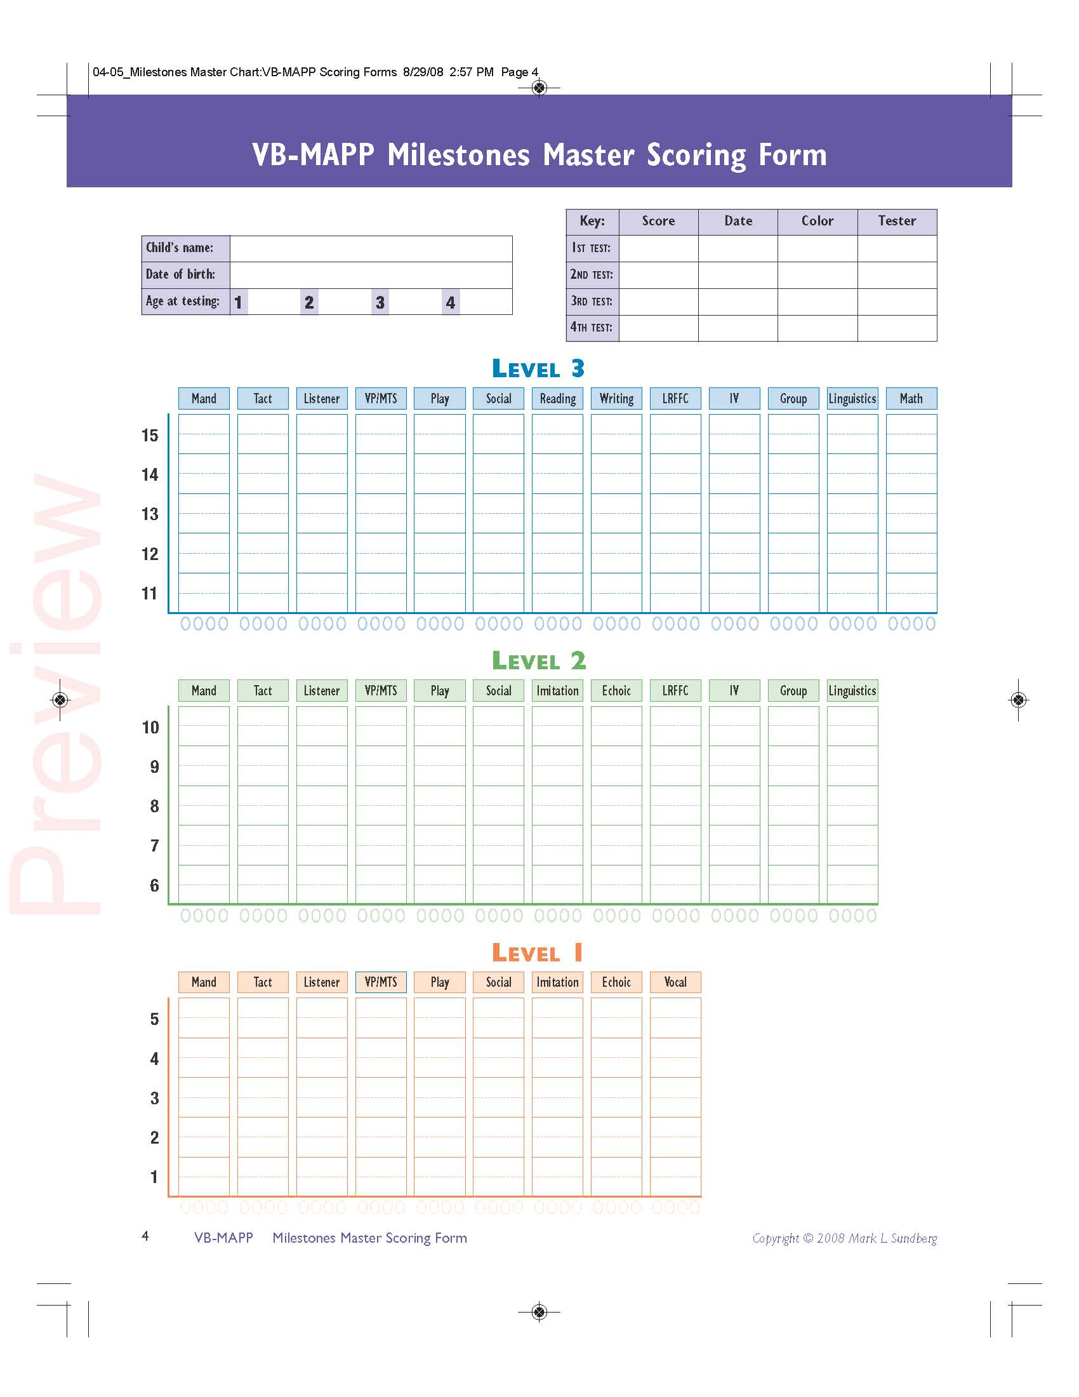

Slide 17
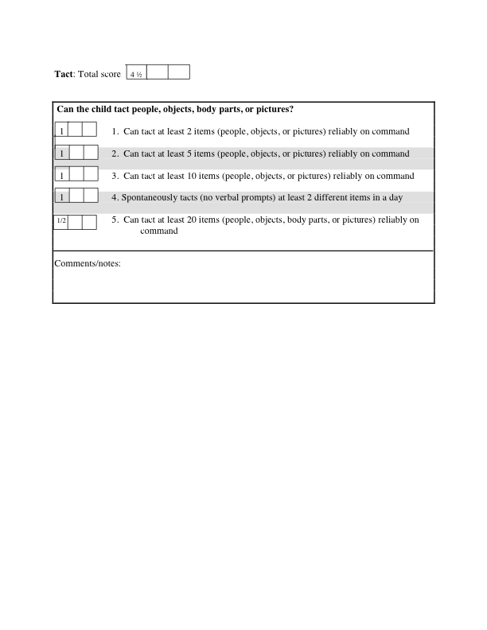
Example score from VB-MAPP

Slide 18
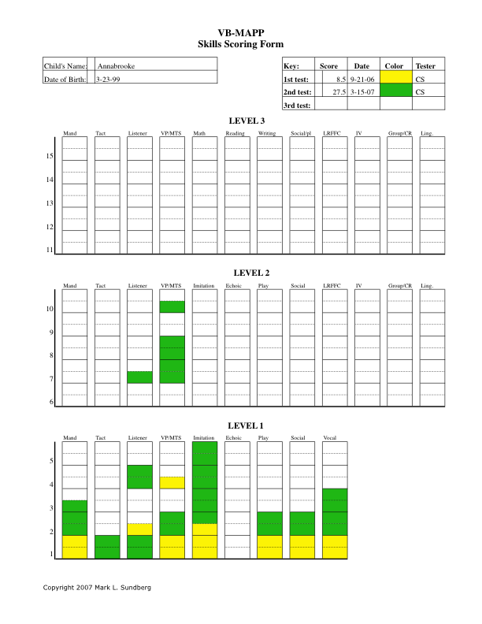

Slide 19
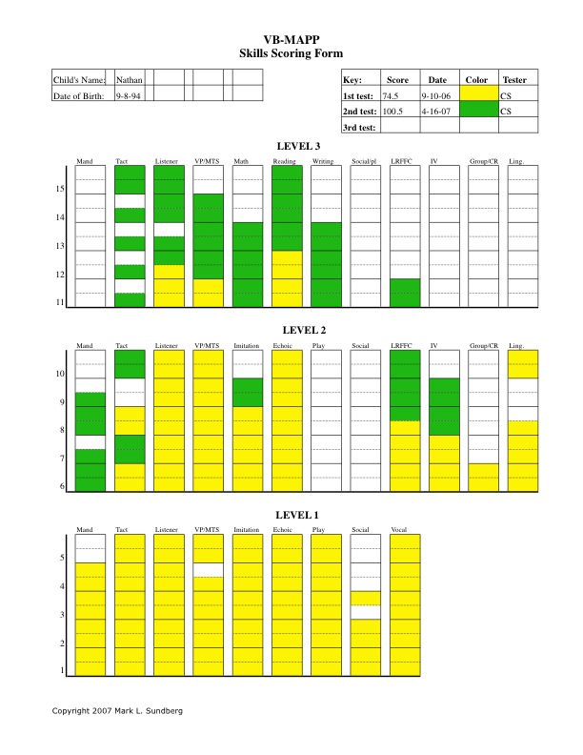

Slide 20
VB-MAPP Barriers
It is important to find out what a child can do (The VB-MAPP Skills Assessment), but also important to know what they can’t do, and analyze why they can’t do it
The VB-MAPP Barriers Assessment is a tool that is designed to identify and score 24 different learning and language acquisition barriers
Once a specific barrier has been identified, a more detailed descriptive and/or functional analysis of that problem is required
There are many ways that a verbal repertoire or related skill can become defective, and an individualized analysis will be necessary to determine what the nature of the problem is for a specific child, and what intervention program might be appropriate

Slide 21
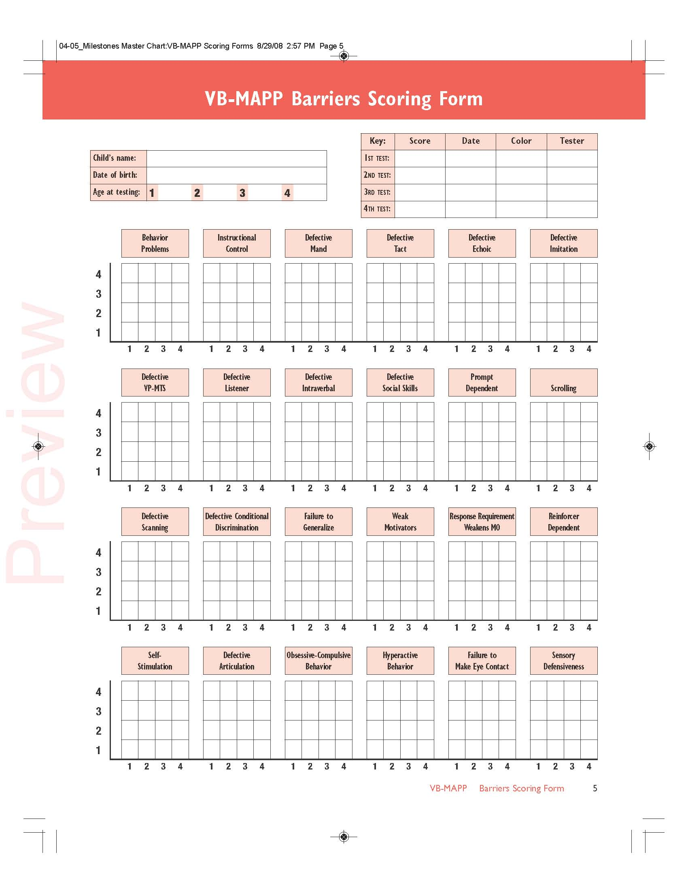

Slide 22
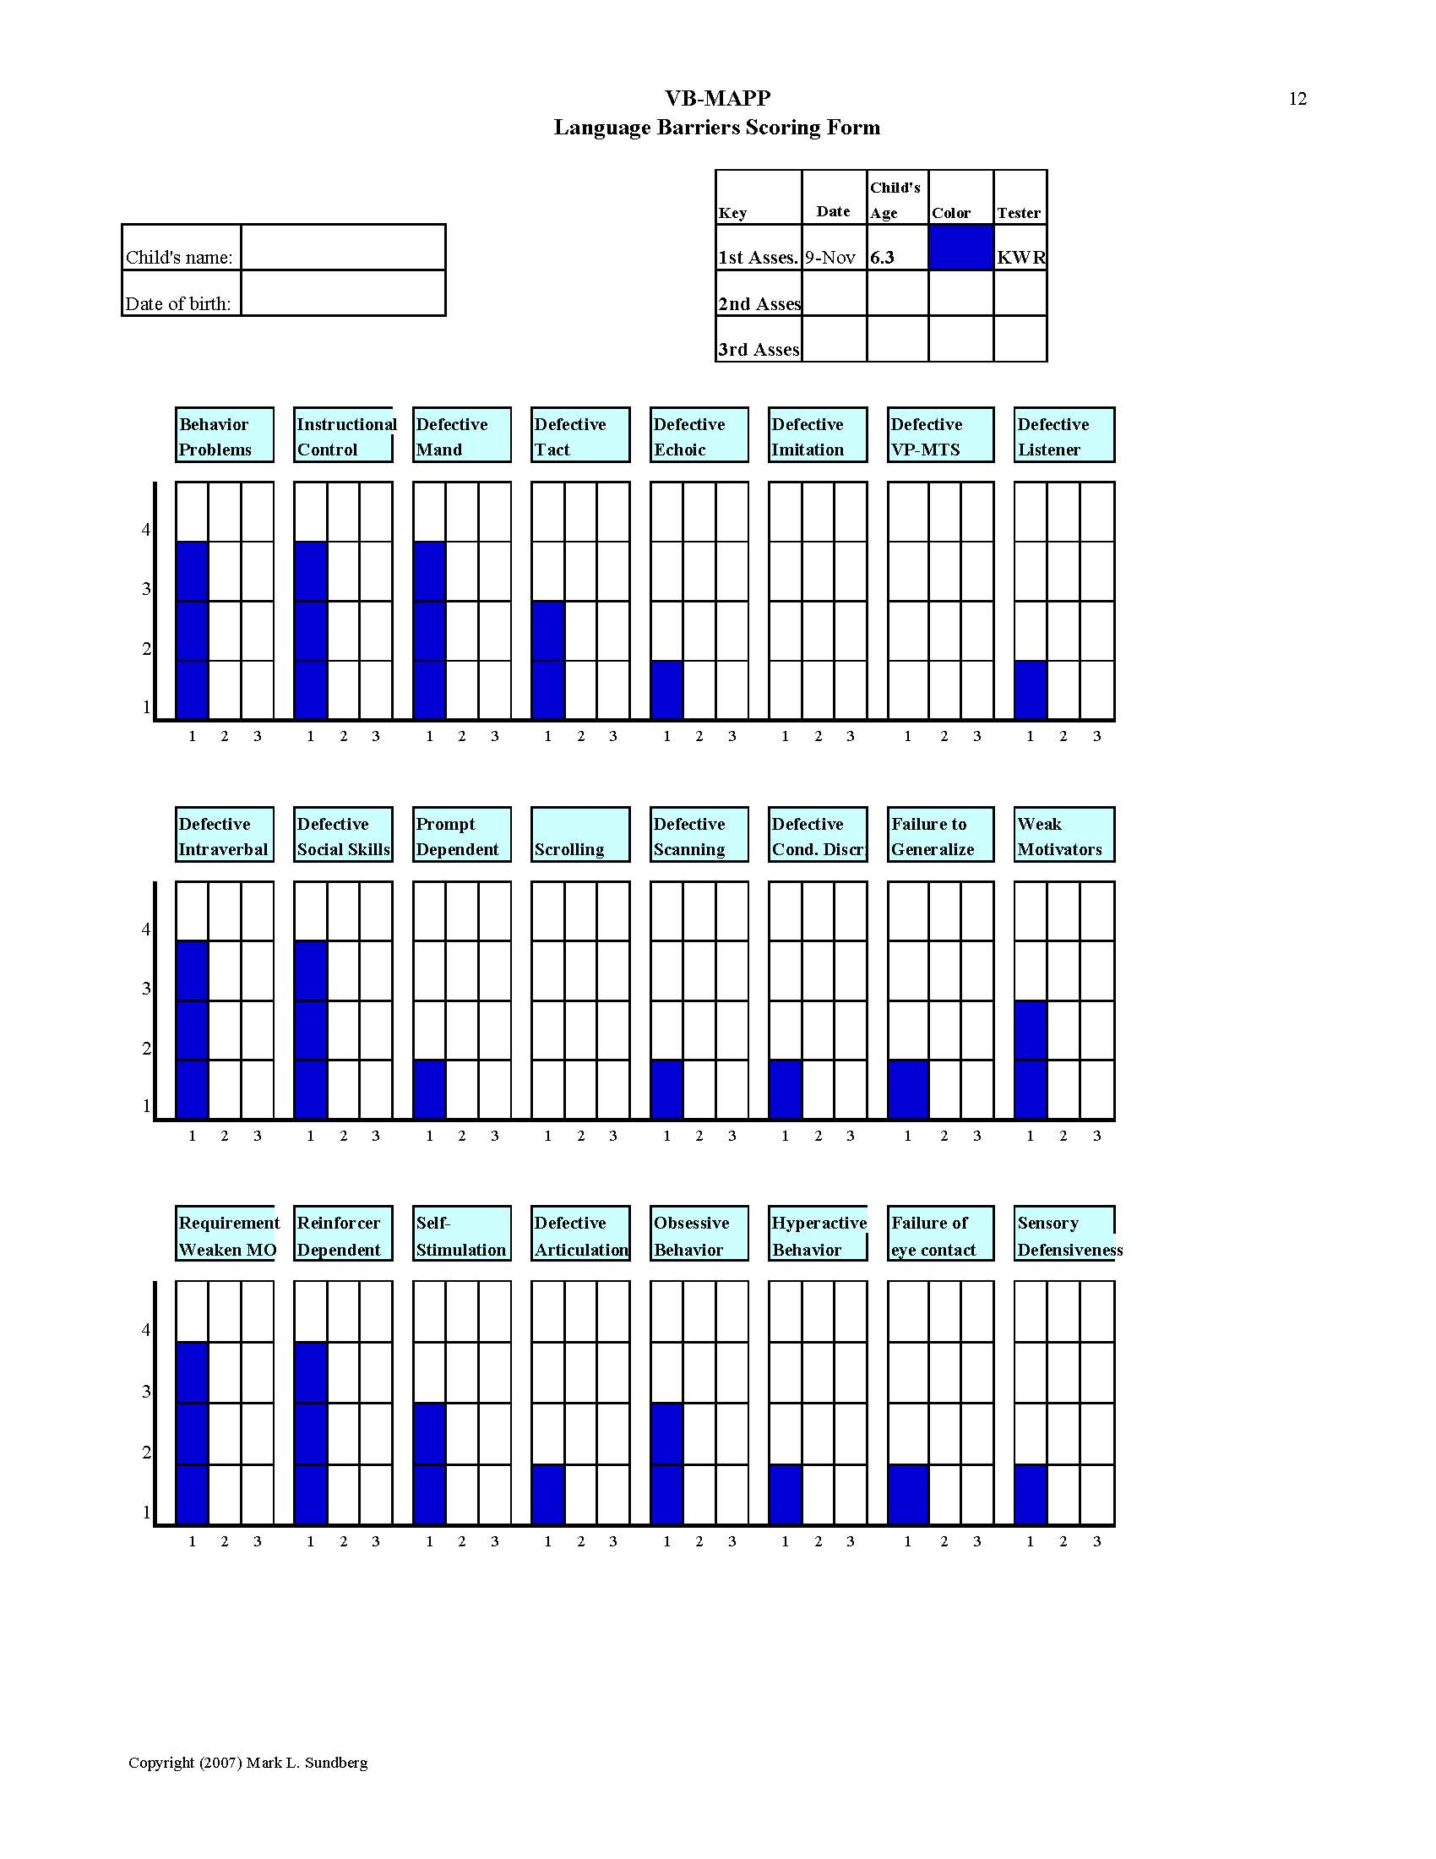

Slide 23
VB-MAPP Transition Assessment
Designed to provide an objective evaluation of a child’s overall skills and existing learning capabilities.
18 measureable areas to help educators and parents make decisions about IEP and placement
No individual item or score on this scale is a determining factor.

Slide 24
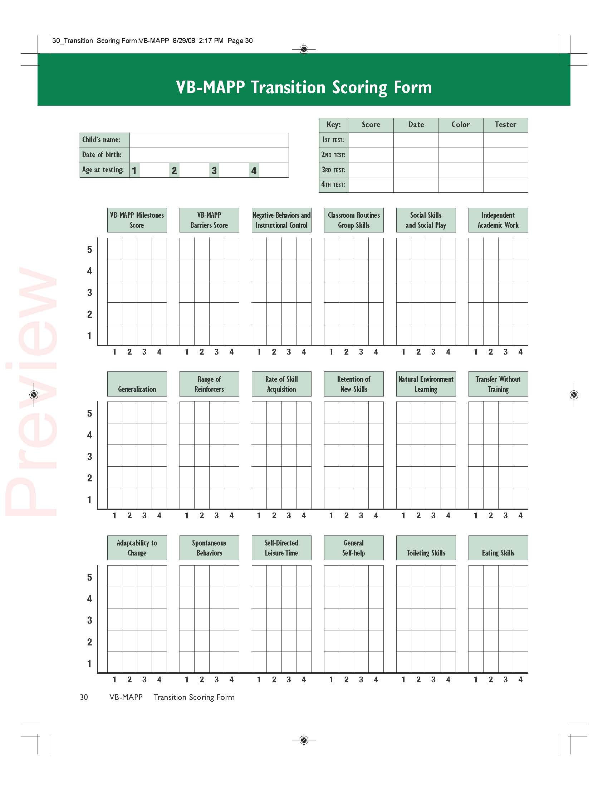

Slide 25
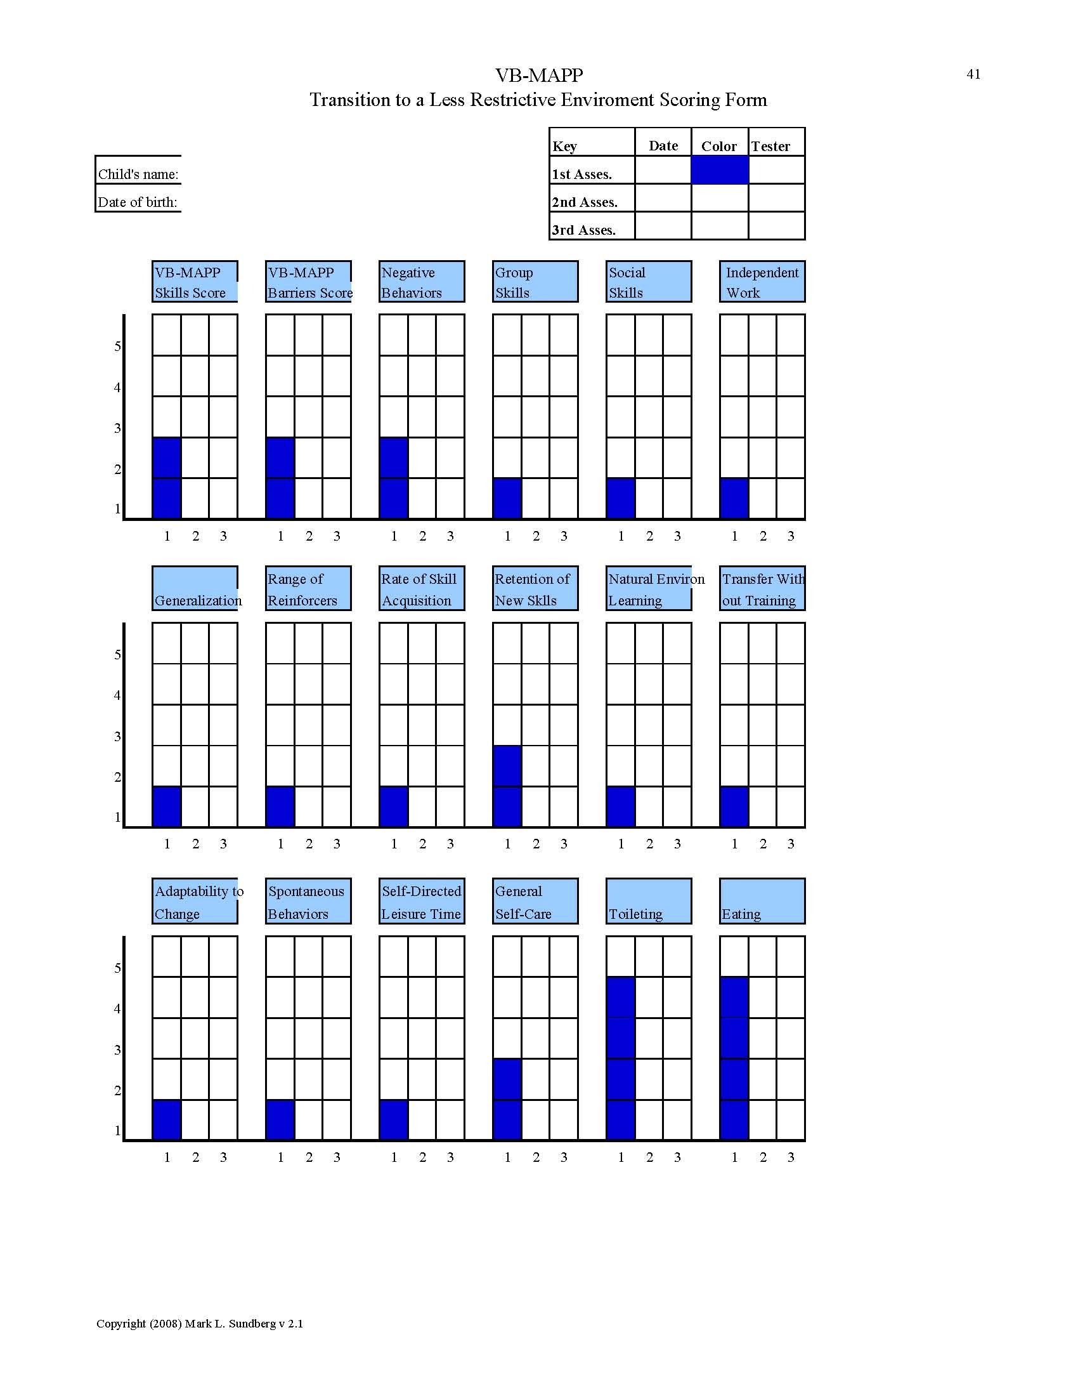

Slide 26
VB-MAPP Transition Assessment
Category 1: VB-MAPP Scores and Academic Independence
  Overall VB-MAPP score
  Overall VB-MAPP Barriers score
  VB-MAPP Barriers score on negative behaviors and instructional control
  VB-MAPP scores on classroom routines and group skills
  VB-MAPP scores on social behavior and social play
  Works independently on academic tasks

Slide 27
VB-MAPP Transition Assessment
Category 1: yields the most significant content regarding language, social and behavioral skills, academic independence
  Guidance on how restrictive the placement should be

Slide 28
VB-MAPP Transition Assessment
Overall VB-MAPP Score
  If daily verbal content of a classroom is beyond student’s comprehension, the placement may be of some value (social modeling and peer interaction) but valuable educational time and skills may be lost
  This score may serve as a foundation for placement decisions
  While all children may benefit from regular contact and integration with typically developing peers
    Issue is educational priorities
    Teaching format
    Determining the educational setting can deliver an intervention program that meets these priorities

Slide 29
VB-MAPP Transition Assessment
Overall VB-MAPP Score
  Level 1-
    Still needs intensive and specialized intervention program involving high number of teaching trials, with carefully arranged contingencies and careful measurement of progress.
    Focus on mands, echoics, motor imitation, listener discriminations, tacts and visual performance skills.
    Peer interaction important but not priority at this time (play-dates, etc.)

Slide 30
VB-MAPP Transition Assessment
Overall VB-MAPP Score
  Level 2
    Child has acquired basic repertoire of mands, tacts and LD’s
    May be acquiring skills more rapidly and in a less intensive teaching format
    May begin to benefit from more group teaching, natural environment teaching, start focus on interactions with more verbal peers

Slide 31
VB-MAPP Transition Assessment
Overall VB-MAPP Score
  Level 3
    Has acquired many basic verbal and social skills
      Including answering and asking WH questions
      Spontaneously commenting on physical features of the environment
    Shows has the linguistic foundation for a more advanced academic and social placement in a less restrictive setting
    A carefully designed intervention program is still necessary, 1:1 or 1:2 tabletop may become less of a focus

Slide 32
VB-MAPP Transition Assessment
Overall VB-MAPP Score
  Level 3
    Some 1:1, 1:2 may still be necessary for academics, generalization, expansion of concepts, independent tasks
    Absent of severe behavior problems (Barriers Assessment), integration should become more of a focus
      Peer models
      Better positioned to benefit from teaching format and curriculum characteristics of a least restrictive classroom placement.

Slide 33
VB-MAPP Transition Assessment
Transition Category 2: Learning Patterns
  Generalization
  Variation of reinforcers
  Rate of skill acquisition
  Retention of new skills
  Natural environment learning
  Transfer of new verbal operants

Slide 34
VB-MAPP Transition Assessment
Category 2: provides information about the child’s ability to learn new skills outside of an intensive teaching format.

Slide 35
VB-MAPP Transition Assessment
Transition Category 3: Self-help, spontaneity, and self-direction
  Adaptability to change
  Spontaneous behaviors
  Independent play skills
  General self-help skills
  Toileting skills
  Eating skills

Slide 36
VB-MAPP Transition Assessment
Category 3: does not bear as directly on placement but is still important areas to consider
  Ex: 1st grade child scores high on Categories 1 and 2 but is not toilet trained. Should not preclude his placement in 1st grade.
  Ex: 1st grade student scores very low on Categories 1 and 2 but is toilet trained, does not mean that he will benefit from 1st grade placement

Slide 37
Major Points
0-18 months
Desired item can be present
Avoid using “What do you want?”
Focus on generalization of mands to different people, places, materials
Increase frequency of daily manding
Increase number of different mands
Do not teach generalized responses like more, please, help

Slide 38
Major Points
18-30 months
Manding for items not present and generalization across settings, people etc.
Increase mands within activities (actions)
Remember mand is totally dependent on the existence of an MO for a particular item or activity
Prompt free mands with high rates
Expand to 2 word statements

Slide 39
Major Points
30-48 months
Manding for information is crucial for development of a complex verbal behavior repertoire
Manding steps/sequence is crucial for play
Manding for others to listen to stories/events –increase mands for attention, help and socialization

Slide 40
Selecting Response Form:
Things to Consider
Ease of Acquisition for The Learner
Development of Vocalizations
Full Linguistic System

Slide 41
Sign Language
Advantages
Disadvantages
May lead to talking when mands are taught first
Each word is felt differently when paired with the vocalization
Can develop a full verbal behavior repertoire
Sign provides an expressive system that may support the development of sophisticated receptive understanding
Don’t need to carry devices
Requires 1 less level of discrimination
Opportunity to teach is always present because you don’t need pictures to communicate
Teacher needs to be trained in special teaching procedures to shape the signs
Listeners need special training

Slide 42
Selection Systems – pictures, voice output
Advantages
Disadvantages
May lead to talking when mands are taught first
Listener does not need special training
Teacher may not need special training
First responses may simply be match to sample
Pictures become increasingly complex
When language becomes more complex, response effort increases/ efficiency decreases
Need your pictures to talk
An added level of discrimination is needed
You will not be able to teach all the functions of VB

Slide 43
Why Sign Language May Fail…
First signs taught…
    are not mands
    are too complex (please, more, thank you)
    may resemble each other too closely
    may involve a complex response form
    not enough training trials provided
Training is conducted under multiple sources of control (motivation, verbal prompts, imitative prompts) and prompts are not faded so spontaneous responses can occur

Slide 44
Why Sign Language May Fail…
Stuck at one level too long, not a progressive curriculum in place
Single verbal operant focused on almost extensively
Failure to establish a signing verbal community
Failure to require signs outside of the training sessions
Failure to generalize to novel stimuli, staff, settings, home

Slide 45
Challenges with sign manding
Prompt dependency
Scrolling

Slide 46
Solutions
Prompt Transfer Trials -After full physical prompt, fade to a partial prompt before delivering
Have an easy target and then represent sign
Increase manding opportunities

Slide 47
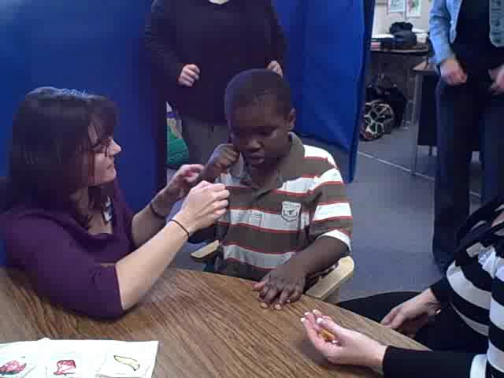
Video - Scrolling

Slide 48
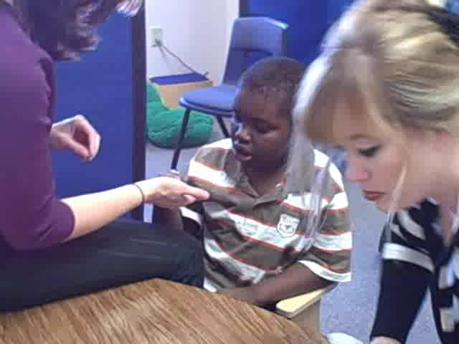
Video – With fade of item

Slide 49
Autoclitics
Many language programs frequently want to teach learners to produce sentences that contain increasing number of words
“I want”, “more”, “please”, “thank you” – only benefits the listener, not the speaker
A neuro-typical child may have up to 300-400 in words in one and two word form before utterances expand to include more complex language

Slide 50
Examples of Autoclitics
Skinner (1957) described 4 types of autoclitics
Descriptive: “I think”, “I see”, “I doubt”, “I heard”
Quantifying: a, this, that, few, many, all
Qualifying: no, not, yes
Relational: above, below, far, is, are

Slide 51
Mand Problems with Autoclitics
Child has only one word utterances as mands and teacher requires addition of “more” before saying the item desired
  More up, more go, more open, more stop, more home
  I want up, I want go, I want stop, I want home, I want no, I want yes
Adding articles
  I want a play, I would like some go, I want the

Slide 52
What causes these problems?
Skinner (1957) explained that autoclitic responses that enhance the meaning of their utterance don’t occur until there are an abundance of strong primary verbal operants
Taught too early – typical development of a child has about 300-400 one and two word utterances that include primary verbal operants (i.e. “daddy go”, “push me”) before most of the autoclitics are acquired

Slide 53
What is Intraverbal Behavior?
Words and phrases that evoke other words and phrases
When someone asks you a question and you answer – this makes up an “intraverbal” relation
A significant part of our day-to-day verbal behavior

Slide 54
What is Intraverbal Behavior?
Some intraverbal behavior is simple and often trivial (e.g. saying “blue” when someone says “red, white, and…”)
Other intraverbal interactions are more complex (e.g. “How do I change my tire?”)
Much of intellectual and academic behavior is intraverbal
Core element of conversations, social behavior, knowledge, thinking, creativity, memory, history, science, philosophy, literature, poetry, employment, international relations, and so on

Slide 55
Teaching Intraverbal Behavior to Children with Autism
Assess the child’s overall verbal repertoire (VB-MAPP)
BEGIN INTRAVERBAL TRAINING ONLY IF the child’s overall VB-MAPP scores are at least in Level 2 (past 18-months in terms of typical language development)

Slide 56
Intraverbal Subtest
Using the subtest 91 typical children and 262 students with Autism were tested.
Error Analysis was completed; concentrating on Verbal Condition Discrimination VCds
VCds – are statements that requiring more then one discrimination Ex. What grows outside… to What helps a flower grow.

Slide 57
Results
1 ½ years: 20-30 Mands and Tacts
IV score less then 5; generally no Intraverbals
2 years: 100-200 Mands and Tacts
IV score 10-30; Song fill-ins, comments, first name; some IV but no VCds.
2 1/2 years: 200-400 Mands and Tacts
IV score 20-40; min VCds, last word the prominent word to elicit response Ex. What do you smell with? Response – poopies ; What grows on your head? Response-shoulders

Slide 58
Results cont
3yrs : 500-1000 mands and tacts
IV 40-60; have basic IV still struggle with VCds
(Language burst between 21/2 and 3 years.
Errors: What grows on your head? R-plant
Where do you eat? R-Food
When do we set the table? R-so we don’t make a mess
Why do use a band aid? R-rainbows
Rote responses are very evident

Slide 59
Results cont.
3 years errors cont. : problems with use of prepositions and adjectives in VCds ex What is under a house? R- roof; Tell me something that is not a food; R- we don’t throw food
Causes of errors for VCds – Complexity of different parts of speech and meaning of individual words

Slide 60
Results cont.
3 ½ : 500-1200 mands and tacts, IV 50-70; still struggles with negation, prepositions, adverbs, time concepts
4 years: 800-1800 mands and tacts, IV 50-75; getting better with VCds
5 years:1000-2500 mands and tacts; IV 55-76 starting to get it; still struggle with time concepts. None of the five years answered What day is today correctly.

Slide 61
Results cont.
7-8 years – perfect score.
Other info
Kids with AU made same type of errors as typical kids who scored at their level. Rote responding more obvious and negative behavior was higher.

Slide 62
Insert video – error and autoclitics

Slide 63
Initial Presentation
Teach
1. Sd “What is this” picture card
2.“0” second prompt delay
Transfer
3. Repeat Sd
4. Fade Prompt “2-3” second delay
Test
5. 2-5 Easy skills
6. Represent Sd “2-3” second delay

Slide 64
Error Correction
Present
1. Sd “Whats this?” pic card
2. “2-3” second prompt delay/ block error
Teach
3. Sd “Do This?” model motor imitation
4. “0” second prompt delay
Transfer
3. Repeat Sd
4. Fade Prompt “2-3” second delay
Test
5. 2-5 Easy skills
6. Represent Sd “2-3” second delay

Slide 65
Practice Session
Practice with partner with error on the tact
Use blue note cards for mastered skills

Slide 66
Resources
www.asatonline.org
www.appliedbehavioranalysis.com
www.jacobslessons.com

