Slide 1
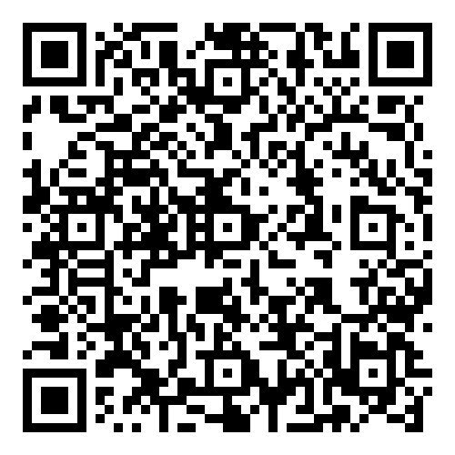
Goal 3: Engage
Advocacy and the
Texas School Funding Crisis
Scan the QR code for legislative contacts and advocacy resources.

