Slide 1


Empowering Families for a Safer Digital Future
Safer internet family night
Dr. Michael Waranowicz
Director of Technology, Sayreville Public Schools
February 11, 2025

Slide 2
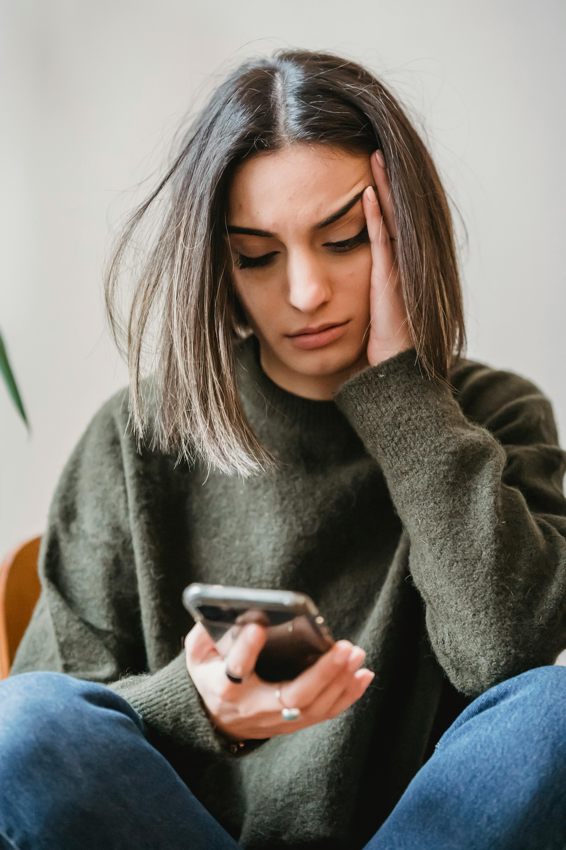
The Power and Pitfalls of the Internet
46% of teenagers in the U.S. have reported experiencing at least one form of cyberbullying
In 2023, the most common type of cyberbullying reported by 77.5% of teens was hurtful online comments
41% of adults reported experiencing similar types of online harassment
*Statistics from Cyberbullying Survey conducted by Pew Research Center

Slide 3
The Digital World: A Double-Edged Sword
Opportunities
Risks
🎓Learning new skills
👨‍👩‍👧‍👦Connecting with friends and family
🌐Participating in online communities
🎨Exploring creativity through social media and digital tools
🤬Cyberbullying
🥸Privacy risks
🤥Misinformation
📱Screen time

Slide 4
Staying Safe Online: Key Principles
Think before you share
Content posted online is permanent
Protect personal information
Utilize privacy settings
Use strong passwords
Limit sharing of personal information
Recognize and respond to risks
Cyberbullying
Scams and phishing
Screen time balance
Set healthy boundaries for internet usage

Slide 5

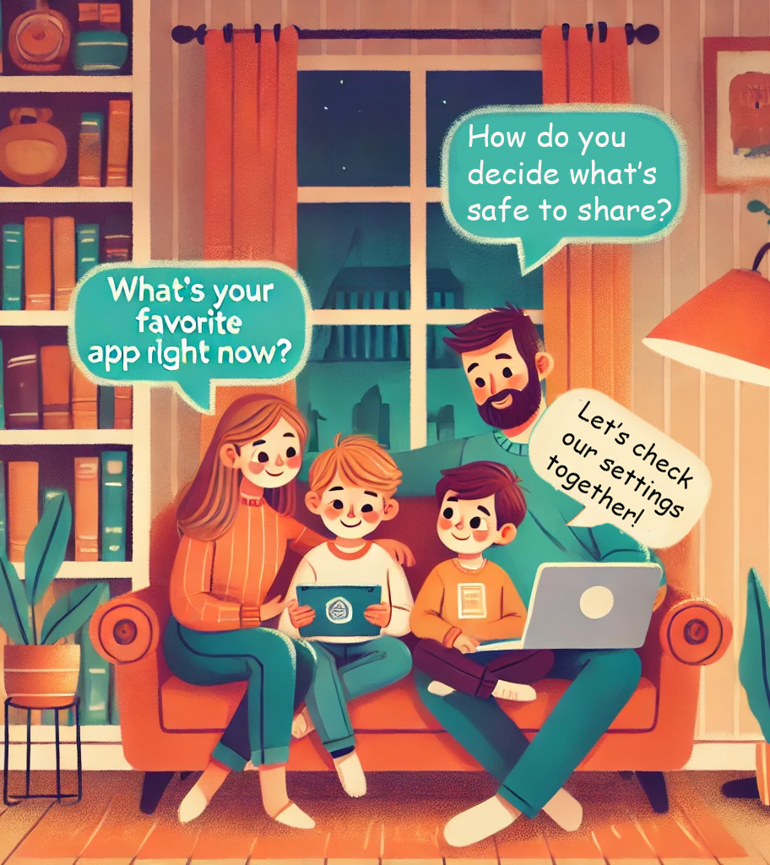
Being Digital Role Models
Communication is key
Set clear expectations
Model good behavior
Check privacy settings

Slide 6

Moving Forward: A Safer Digital Future
Together, we can help our children navigate the digital world safely

Slide 7
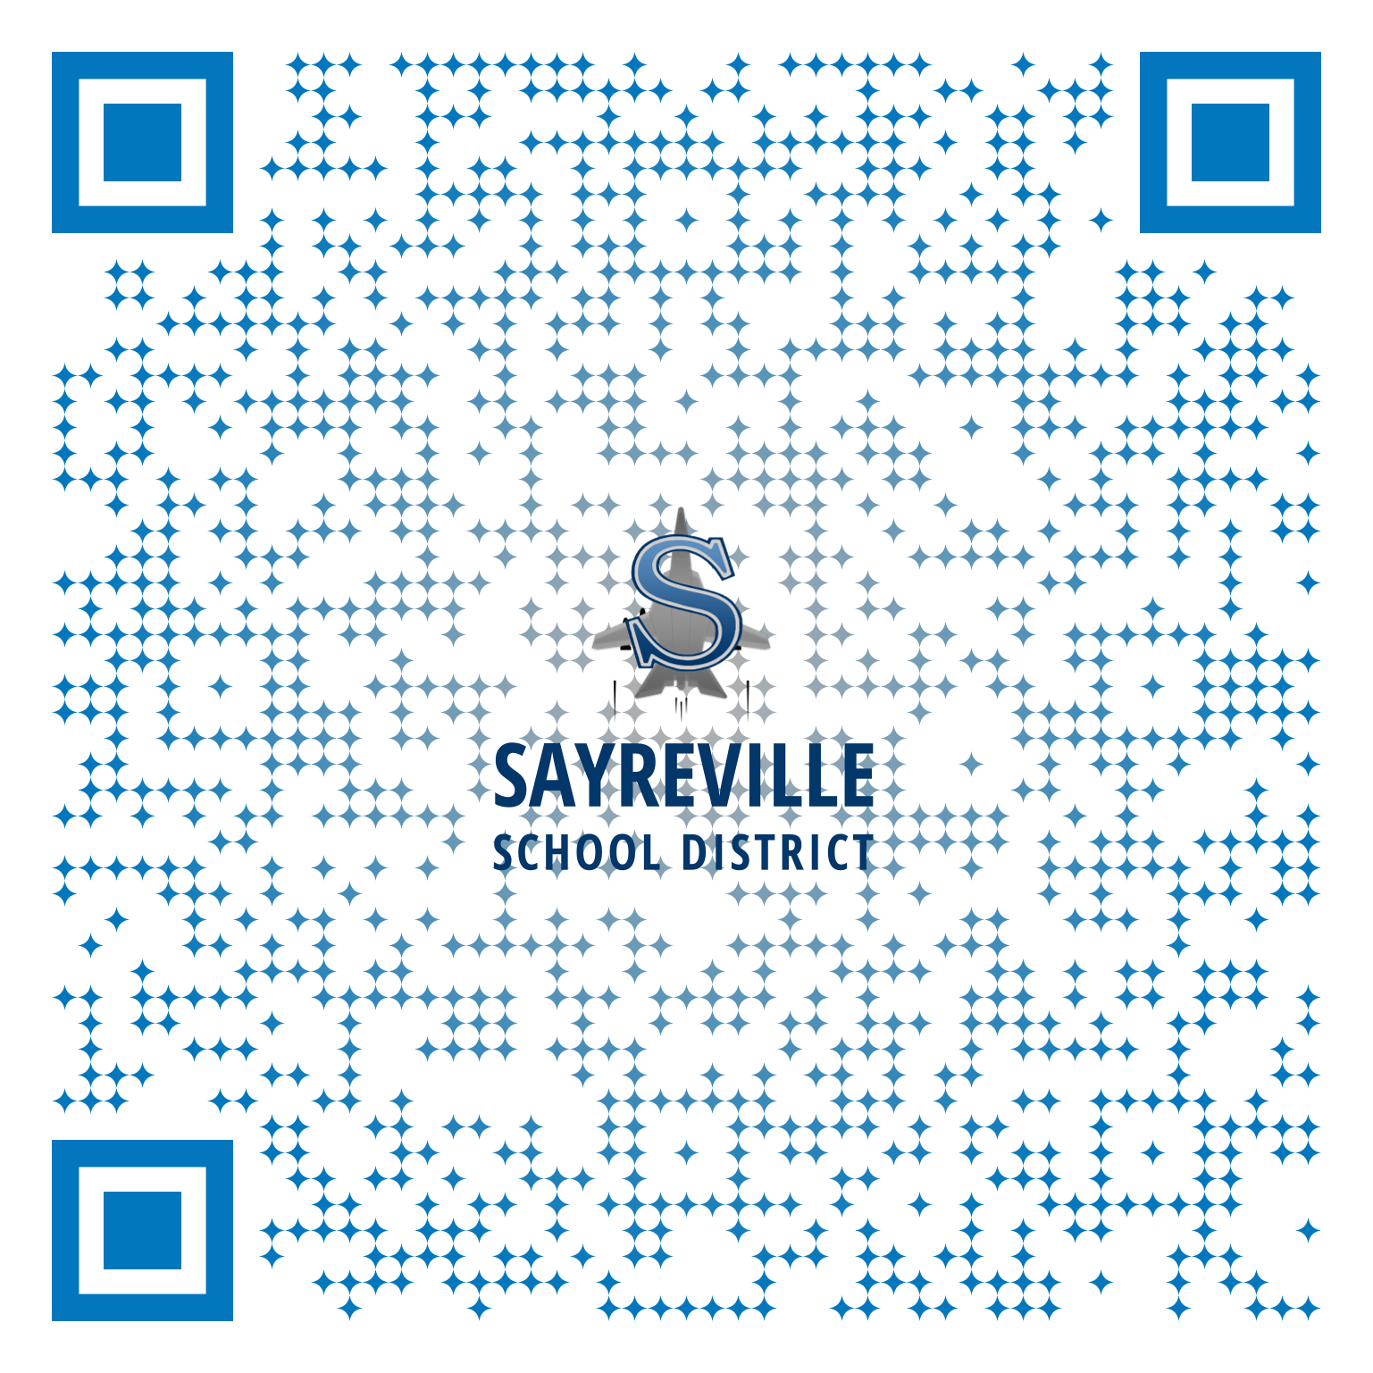
Thank you for Attending!
Internet Safety Resources:
Connect Safely
https://safer.connectsafely.org/
CISA Secure Our World
https://www.cisa.gov/secure-our-world
CISA Shields Up: Guidance for Families
https://www.cisa.gov/shields-guidance-families
CISA Raising Digital Citizens
https://www.cisa.gov/sites/default/files/2024-09/Secure-Our-World-Raising-Digital-Citizens-Tip-Sheet.pdf
CISA 4 Easy Ways to Stay Safe Online
https://www.cisa.gov/sites/default/files/2024-09/Secure-Our-World-4-Easy-Ways-Stay-Safe-Online-Tip-Sheet.pdf
Sayreville Public Schools Safer Internet Day Resources
https://www.sayrevillek12.net/district/departments/technology/safer-internet-day
Scan to view district website and full list of resources

