Slide 1

Spanish Opportunities for Growth
By World Language Department @ Milton High School

Slide 2

Spanish Classes You Can Take
Spanish 1
Spanish 2 and 2 Honors
Spanish 3 and 3 Honors
Spanish 4 and 4 Honors
AP Spanish Language and Culture
AP Spanish Language and Literature
All level 2 (or above) World Language courses are rigor courses that count towards the HOPE scholarship.

Slide 3
Curriculum Overview
Native Speaker Engagement
Cultural Language Input
Engage with a special curriculum tailored for Native and Heritage speakers, providing contextual lessons that respect and build upon their existing language skills.
Integrate cultural components into the curriculum, emphasizing the importance of understanding Spanish-speaking cultures alongside language acquisition.
LingCo Curriculum Focus
Explore the LingCo curriculum designed to enhance fluency through rich cultural language input. The framework fosters immersive learning in a supportive environment.

Slide 4

Language Competitions
Benefits of Competitions
National Spanish Exam
Participate in the Fulton Forum Language Competition, welcoming students at all levels to showcase their Spanish skills and compete for recognition.
Compete in the National Spanish Exam, specifically designed for students in Spanish 4 and above. This assessment evaluates language proficiency in a structured format.
Fulton Forum Language Competition
Engaging in language competitions enhances language skills, boosts confidence, and provides opportunities for scholarships and recognition.

Slide 5
Scholarship Options
Several scholarship options exist for language students. These programs support academic growth while encouraging immersion in various cultural contexts.
Scholarship | Eligibility | Details
Governor’s Honors Program | 10th-11th graders | Available for students in Spanish 4 and above.
LingCo Summer Study Abroad | All levels | Open for both French and Spanish students.

Slide 6

Advanced Placement Classes
College Credit Possibility
AP Spanish Literature & Culture
Completing AP courses can lead to college credit, strengthening students' academic profiles while offering advanced standing in higher education.
Take AP Spanish Literature & Culture for a comprehensive exploration of Spanish literature, complemented by in-depth discussions on various genres and historical contexts.
AP Spanish Language & Culture
Enroll in AP Spanish Language & Culture, a full-year course that deepens understanding of the language and culture and prepares students for college-level coursework.

Slide 7
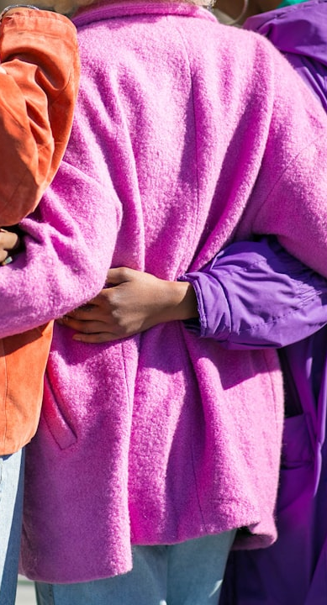
Clubs and Associations
Networking and Community Engagement
Clubs provide invaluable networking opportunities, allowing students to connect with peers and faculty while enriching their cultural experience.
Spanish Club
Participate in the Hispanic-Latino Student Association, open to all students. Engage in cultural events, activities, and celebrations throughout the year.
Spanish National Honor Society
Latino Culture Club
Join the Spanish National Honor Society, a year-round commitment that acknowledges outstanding achievement in Spanish language studies and service.
Sharing of culture from Hispanic/Latino students and their countries, open to all students. Learn about the traditions, foods, crafts, and heritage of different countries and cultures.

Slide 8

Next Steps
Assess Your Interests
Take Action
Consider which opportunities align with your personal goals and interests. Reflect on your language learning aspirations for the coming year.
Don’t wait! Sign up for classes, join clubs, or enter competitions. Seize all chances to enhance your Spanish language experience.
Engage with Peers and Teachers
Actively seek guidance from peers and educators on how best to utilize available resources and programs to support your journey.

