Slide 1


On-Level Elective Courses
Social Studies

Slide 2

Sociology (On-Level)
11th - 12th Grade - Semester
Special Note
This course emphasizes short readings and class discussion

Slide 3
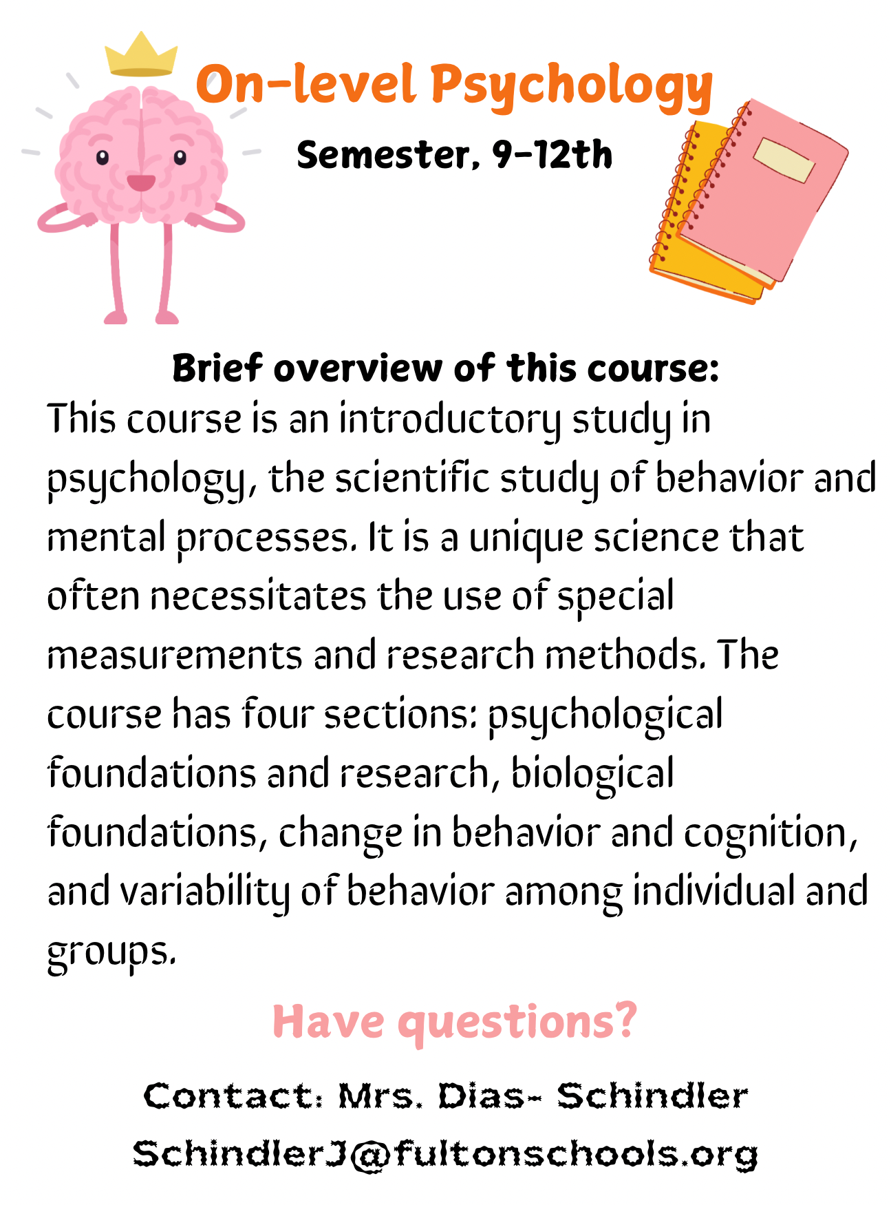
NEW!! Psychology (On-Level)
9-12th Grade - Semester
Special Note
Students who take OL Psych can still take AP Psychology in future years!

Slide 4

NEW!! U.S. History thru Film (On-Level)
11-12th Grade - Semester
Special Note
This is an elective and does NOT fulfill the U.S. History credit requirement

