Slide 1
Birth Control Methods

Slide 2
Categories Of Birth Control
Hormonal
Behavioral
Barrier
Surgical
  Vasectomy
  Tubal Ligation

Slide 3
Behavioral Methods
ABSTINENCE: ONLY 100% proven method to avoid an unintended pregnancy
Withdrawal: pulling the penis out of your partners body before ejaculation
Fertility Awareness/”Rhythm” Method: tracking your period & avoiding unprotected sex during ovulation

Slide 4
Abstinence
What is “abstinence” anyway?
100% effective in preventing pregnancy, but is it always effective in preventing STD’s?
More than ½ of sexually active teens wish they had waited longer to have sex. Why do you think this number is so high?
Advantages and disadvantages…you tell me…

Slide 5
Withdrawl/Pulling Out
If 100 couples used withdrawal in 1year, 19 of them would get pregnant
Not recommended for teens
  Pre-ejaculate, difficult to predict when you will ejaculate, etc.
No prescription needed
No protection from STD’s

Slide 6
Barrier Methods
Male Condom: barrier that fits over the penis
Female (Insertive) Condom: barrier that is inserted into the vagina or rectum up to 8 hours before intercourse
Dental Dam: barrier used between vulva &/or anus & mouth for safe oral sex

Slide 7

Barrier Methods
Condoms
98% effective with perfect use, 85% with user error
No age requirement to purchase & no prescription needed
Advantages:
  Inexpensive; protect from most STD’s; can be used for oral, anal & vaginal sex; easy to get; many non-latex options available
Possible disadvantages:
  Latex sensitivity, lose erection, don’t know how to use them, not as sensitive as skin-on-skin

Slide 8

Female/Insertive Condoms
95% effective with perfect use, 79% with user error
No age requirement to purchase & no prescription
Advantages:
  Can be inserted up to 8 hrs before sex, made of hypoallergenic polyurethane, inexpensive, can be used for anal & vaginal sex, protection from most STD’s, transmits body heat, feels more like a 2nd skin
Possible disadvantages:
  Noisy, don’t know how to use them, not as sensitive as skin-on-skin

Slide 9
Hormonal Methods
The Pill
The Patch (Ortho Evra)
Nuva Ring
The Shot (Depo)
The Implant (Implanon)
Emergency Contraception (Plan B, The Morning After Pill, Next Choice, “E.C.,” etc.)
Intra-Uterine Contraceptive (IUC/IUD)
  Mirena: hormonal
  Paragard: non-hormonal

Slide 10
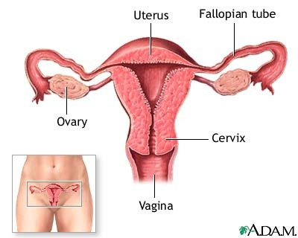
What is Hormonal Birth Control Doing to the Body?
Stops
ovulation
Thins the
uterine lining
Creates a thick mucus plug at the cervix

Slide 11
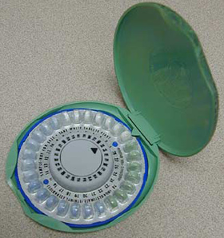
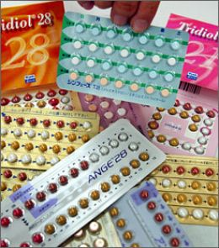
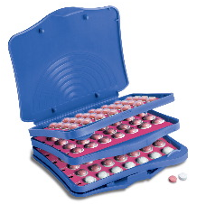
The Pill
Must be taken at the same time every day in order to work
Comes in a variety of hormone levels
Must have a prescription
99.7% effective with perfect use, 92% effective with user error
Advantages:
  Help with acne, bone thinning, cancer of the ovaries & uterus, cysts in breasts & ovaries, bad cramps, heavy periods, irregular periods, anemia & PMS
Possible disadvantages:
  Nausea, sore breasts, & spotting between periods. No protection from STD’s

Slide 12
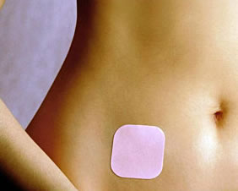
The Patch (Ortho Evra)
Put 1 patch on every week for 3 weeks in a row. Then there is a patch-free week.
Must have a prescription
99.7%-perfect use, 92%-user error
Advantages:
  Same as pill plus Nothing to change every day or right before sex
Possible disadvantages:
  Same as pill but can only be used by women who weigh no more than 200 lbs. No protection from STD’s

Slide 13
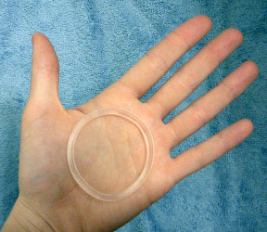
Nuva Ring
Inserted into vagina for 3-4 weeks at a time
Must have a prescription
Can be removed for up to 3 hrs if partner can feel it during sex
99.7%-perfect use, 92%-user error
Advantages:
  Same as the pill plus Lowest level of hormones of any hormonal birth control method. Nothing to change every day or do right before sex.
Possible disadvantages:
  Same as pill, No protection from STD’s

Slide 14
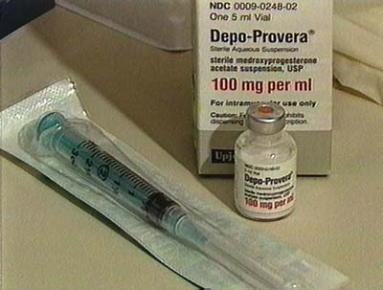
The Shot (Depo)
Doctor gives you the shot about every 12 weeks
Must have a prescription
99%-perfect use, 92%-user error
Advantages:
  Protection from cancer of the uterus, pregnancy in the tubes, & lighter periods
Possible disadvantages:
  Nausea, sore breasts, headaches, weight change, depression, temporary bone thinning, no protection from STD’s, & hair loss or hair gain on face or body

Slide 15
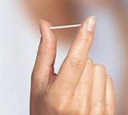
The Implant (Implanon)
Inserted into arm by doctor & works for 3 years
Must have a prescription
Greater than 99% effective
Advantages include:
  Prevents pregnancy well, lasts for 3 yrs, no medicine to take every day, nothing to do right before sex to make it work, & lighter periods
Possible disadvantages include:
  Acne, weight gain, cysts on ovaries, mood changes, depression, headache, nausea, sore breasts, & no protection from STD’s

Slide 16
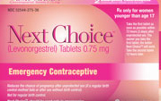
Emergency Contraception
Taken up to 5 days after unprotected sex, but most effective if taken ASAP after unprotected sex.
75% - 89% effective, depending on when you take it.
Advantages:
  Will not harm an already developing pregnancy, helps prevent pregnancy if a condom breaks or you were forced to have unprotected sex
Possible disadvantages:
  Dizziness, headaches, breast tenderness, nausea, no protection from STD’s, & it can throw off your period

Slide 17
Intra-Uterine Contraceptive (IUC)
Inserted into uterus by doctor & works for 5-12 yrs
Greater than 99% effective
Must have a prescription
Paragard (non-hormonal/copper)
  Advantages: no hormones, works for 10-12 years
  Possible disadvantages: heavier periods, worse menstrual cramps, no protection from STD’s
Mirena (hormonal)
  Advantages: fewer menstrual cramps, lighter periods, often periods stop after a few months, less anemia, works for 5 years.
  Possible disadvantages: irregular periods as body adjusts the first 3-6 months, no protection from STD’s

Slide 18
Pregnancy Myths:
http://pub.etr.org/sexmyths.html

Slide 19
What Did you Learn??
What method of birth control is 100% effective?
What helps prevent both pregnancy & STI’s?
Whose responsibility is it to think about birth control?
What are three things you can do to prevent an unintended pregnancy?

