Slide 1
the menominee theoretical model of sustainability:
An Overview
&
How it can be applied
22 November 2024
CMN Student Government Meeting
Jennifer K. Gauthier, Director
Sustainable Development Institute

Slide 2
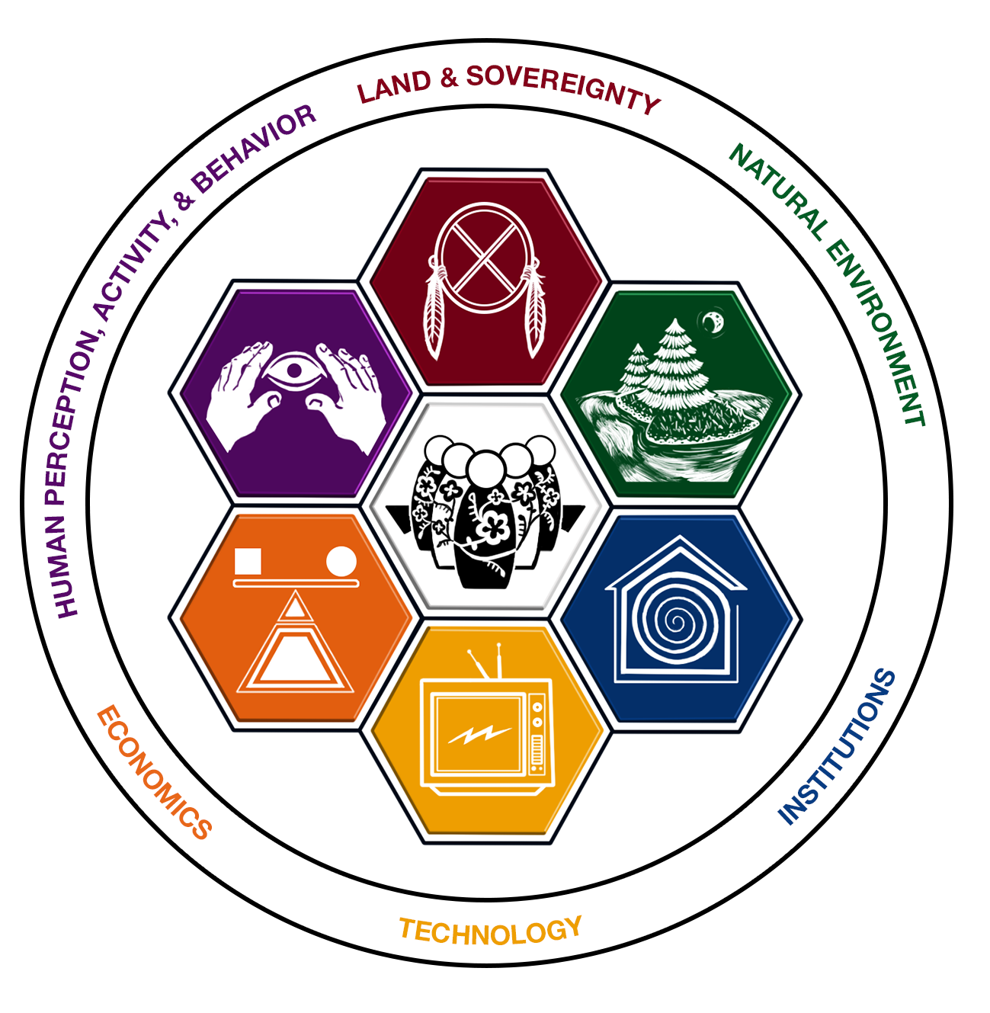

Menominee theoretical model of sustainability
Land and Sovereignty: This Dimension is concerned with how decisions are made for the land and the community
Natural Environment: This Dimension includes Menominee understanding that everything is connected and related. It includes people, human communities, plants, animals, rocks, water, and air.
Institutions: This Dimension refers to structures that develop and enforce rules of behavior and social interactions. Including the dynamic between humans, plants and animals, and the environment.
Technology: This Dimension had focused on rural community access to modern advances in telecommunication, expanded to include cultural tools and practices- today understood as "how humans do things...or how humans get things done.“
Economics: This Dimension incorporates multiple scales ranging from the individual household, to the tribe, to the region, to the nation, to the globe.
Human Perception, Activity, and Behavior: This Dimension includes individual perceptions, activities, and behaviors to community understandings, values, and collective pursuits.
Autochthony: This Dimension implies a cultural value and belief that the health of the land and people are one. A profound connection and relationship with the land.
Notes:
All of these systems, or ways of knowing, helped to create what we call the Menominee Theoretical Model of Sustainability.
It’s a newer model, only 30 years young, and contains many of the things that were shared with you throughout the day.
The model was created by our community including foresters, leadership, and community members and represents a way to think about and frame issues, to make decisions, and think about sustainability in many different contexts.
Each image represents a dimension and focuses on a specific area…much like clans.
Collectively, if all dimensions are discussed and represented, we have sustainability…when they are out of balance, are absent, or this one singular focus we can be out of balance, or have tensions arise.
Briefly, I’ll go through each dimension and as I do, think about the land where you live…what stories, ideas, issues, or hopes rise to the top for you. I encourage you to write those down and take them home with you.

Slide 3
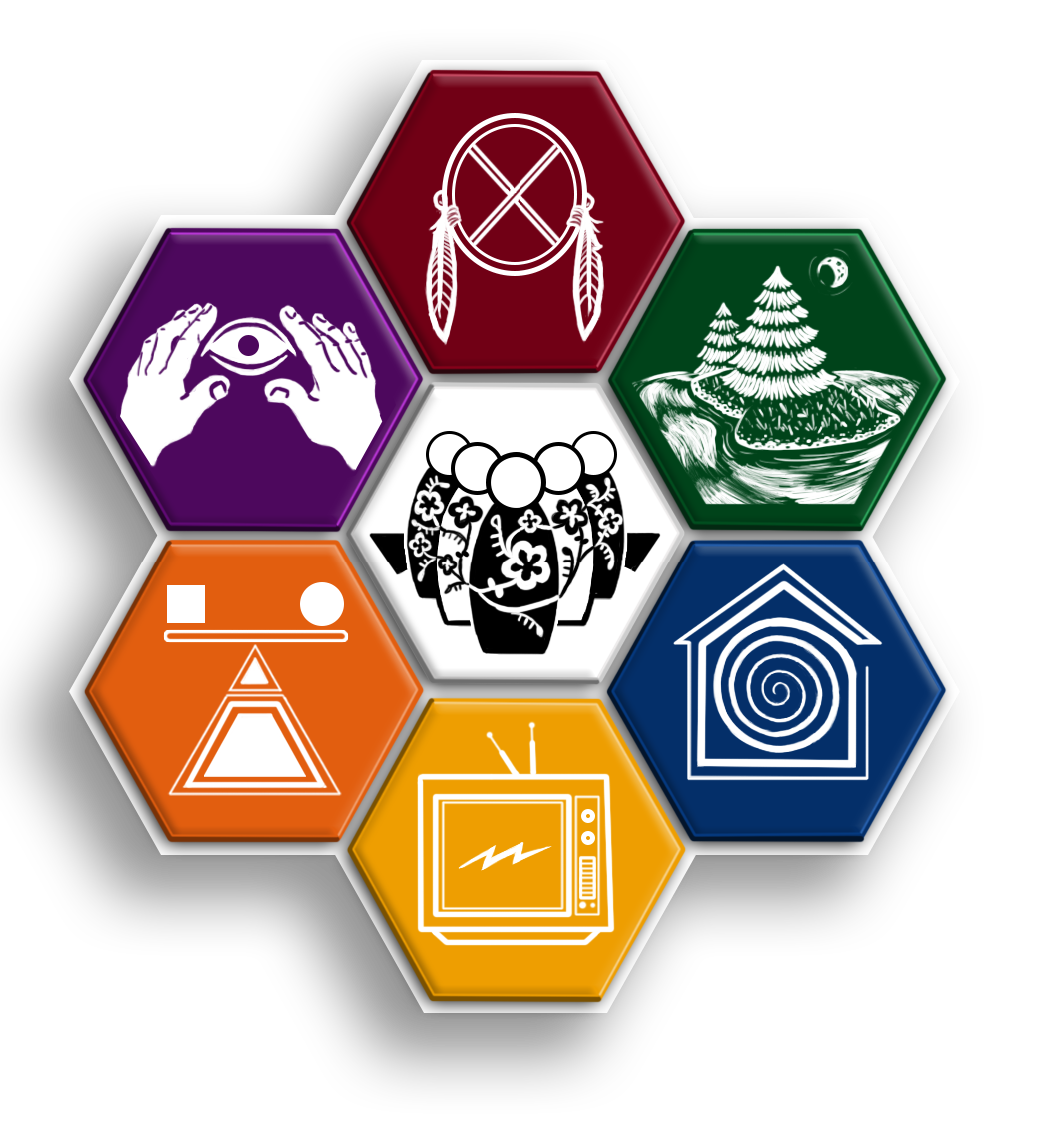
Land and Sovereignty:
Human Perception, Activity, and Behavior:
Natural Environment:
Autochthony:
Economics:
Institutions:
Technology:
Notes:
All of these systems, or ways of knowing, helped to create what we call the Menominee Theoretical Model of Sustainability.
It’s a newer model, only 30 years young, and contains many of the things that were shared with you throughout the day.
The model was created by our community including foresters, leadership, and community members and represents a way to think about and frame issues, to make decisions, and think about sustainability in many different contexts.
Each image represents a dimension and focuses on a specific area…much like clans.
Collectively, if all dimensions are discussed and represented, we have sustainability…when they are out of balance, are absent, or this one singular focus we can be out of balance, or have tensions arise.
Briefly, I’ll go through each dimension and as I do, think about the land where you live…what stories, ideas, issues, or hopes rise to the top for you. I encourage you to write those down and take them home with you.

