Slide 1
Session 2:
Keeping It Positive!

Slide 2


What’s Happening Today?
Apply It and Try It Reflections
Affirmations
Fun in Everyday Moments
Understanding your Child’s Behavior
Keeping it Positive

Slide 3




Apply It and Try It Reflection
Connections
Positive Comments
and Encouragement
How did it make you feel?
How did your child react?

Slide 4
Affirmations
Statements that are encouraging and motivating
Help us
feel strong
Help us feel optimistic about change
Make a note!
Reflect on the changes you have made or your efforts with your child.

Slide 5
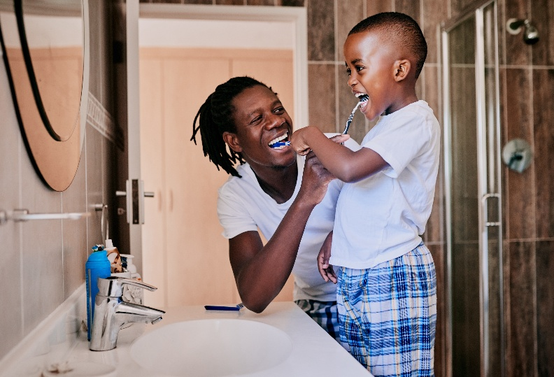
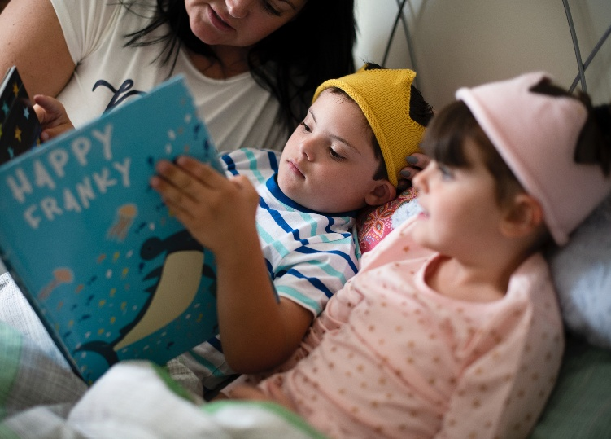


Fun in Everyday Moments

Slide 6
Powerful Practice: Tips for Playful Interactions with Your Child
Follow your child’s lead
Talk, talk, talk about what your child is doing
Encourage your child’s creativity and imagination
Avoid power struggles
Have fun together in everyday moments!

Slide 7

Role Play#1: Reflections
What happened?
How do you think Kenny felt?
How do you think his mother felt?
What could Kenny’s mother do differently?

Slide 8
Role Play #2 Reflections
What happened?
How is this scene different from the first one?
How did Kenny respond?
How did they both feel?

Slide 9
Social and Emotional Skills
Feel confident
Develop strong relationships
Make friends
Persist when tasks are hard
Follow directions
Identify and express feelings
Cope with strong emotions

Slide 10



When Skills are Absent?

Slide 11

Challenging Behavior:
What We Know
Happens when children lack language or social skills
Happens when children are stressed (tired, hungry, ill, different expectations)
Challenging behavior works

Slide 12





Why Do Children Do
What They Do?
“I want you to pay attention to me.”
“I want that (toy, food, paint, etc.).”
“I want to
play with you.”
“I don’t want to stop what I am doing.”
“I don’t want
to clean up!”

Slide 13
Challenging Behavior Works!
It sends a powerful message:
“I Want”
Get or Obtain
Toy
Activity
“I Don’t Want”
Avoid or Escape
Adult
Demand
Food
Attention or Comfort
Activity
Sibling

Slide 14

Apply It and Try It
Think about behaviors you want to see less of.
Think about behaviors you want to see more of.
Ignoring me
Hitting siblings
Screaming
Making messes
Whining at mealtime
More of
Less of
Listening
Playing with sister
Using kind words
Cleaning up
Eating at mealtime
Activity 2

Slide 15



Keeping it Positive
DRIVE
SAFELY
STOP!
Don’t do that!
Tell children what to do
Use positive words
No!

Slide 16


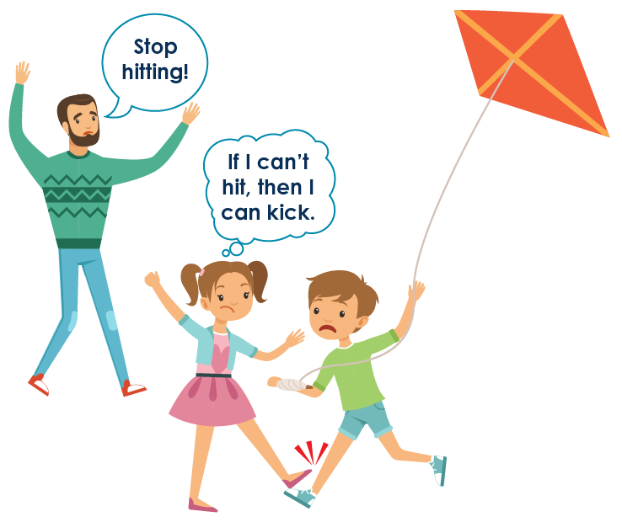
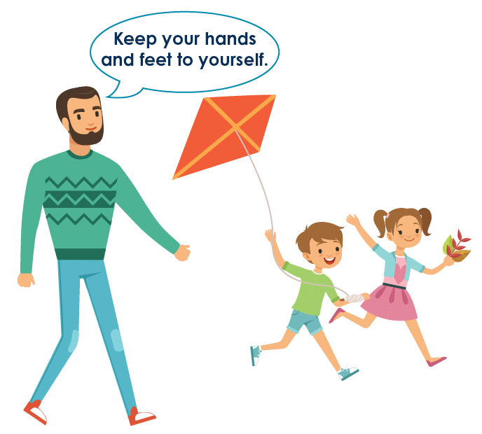
Make it Clear

Slide 17
What’s a Better Way to Say?
Avoid | Try This…
Stop yelling! | Use an indoor voice.
Don’t throw toys. | Toys stay on the floor.
Stop bothering your sister! | You can ask for a turn.
Avoid | Try This…
Be nice. | Use gentle touches.
Watch out. | Look both ways when we cross the street.
Be good. | Sit on the chair.

Slide 18
Apply It and Try It
Find times you normally say, “Stop, No, Don’t!”
Switch your language to the positive.
Keep track and reflect:
    How did your child respond?
    How did your child feel?
    How did you feel?
Activity 3

Slide 19
The Power of Encouragement with Positive Comments
Behavior | Desired Behavior | Positive Encouragement and Feedback
Not listening | Follow directions | “Thank you for listening, Asha, and for putting your books away.” (gives a hug)
Yelling | Use inside voice | “Wow, Jayden! You are using an inside voice. You are such a big kid.” (gives a high five)

Slide 20
Apply It and Try It Review
Things to Try at Home:
List behaviors you want to see more of
and less of at home (Handbook Activity 2)
Try to keep it positive with your child and use positive words (Handbook Activity 3)

Slide 21
Thank You

