Slide 1
Session 1:
Making the Connection!

Slide 2

Overview of Sessions
Making the Connection
Keeping It Positive
Behavior Has Meaning
The Power of Routines
Teach Me What to Do!
Responding With Purpose
Bringing It All Together With a Plan

Slide 3


What’s Happening Today?
Introductions
Purpose of the group
Group ground rules
Connecting with children
Encouragement

Slide 4

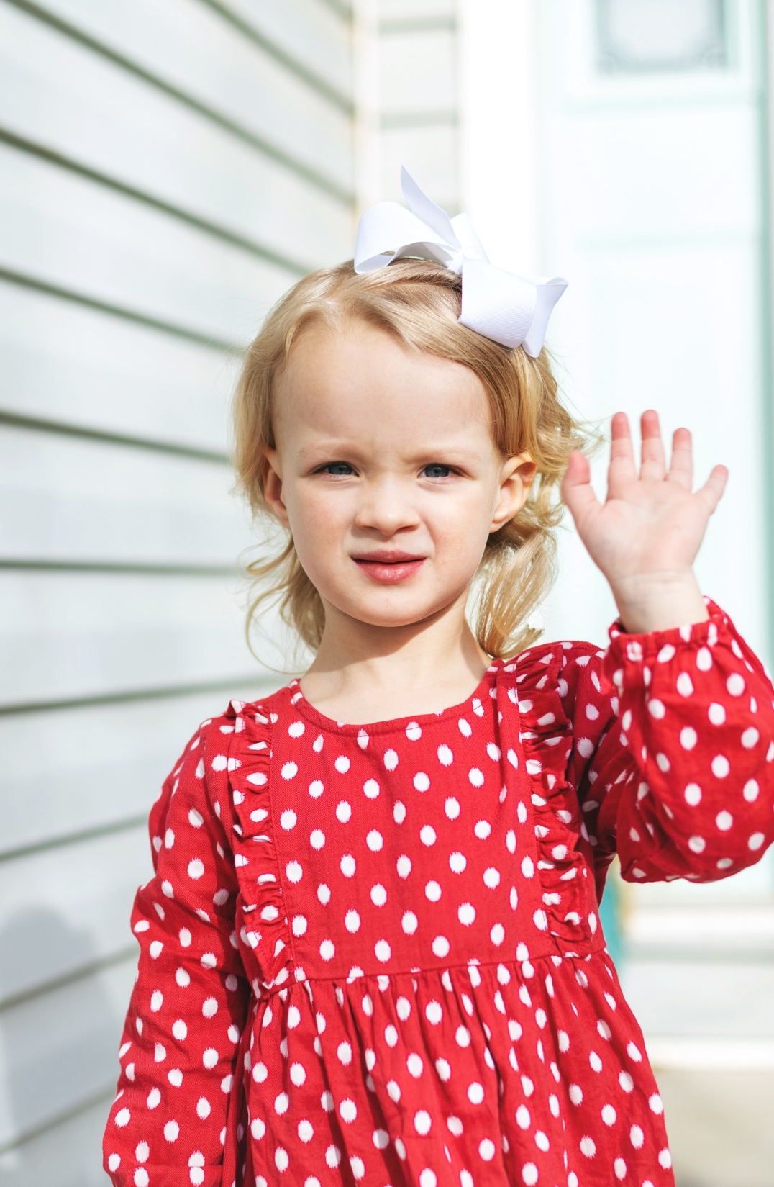
Getting to
Know You!
Please Share:
Your name
Name and age(s) of child/children
First positive thing that comes to mind about your child/children
What brought you to this group? What goal do you want to accomplish?

Slide 5
Examples of Ground Rules
Start on time
Put cell phones on vibrate
Allow everyone the opportunity to share
Ask questions
What is shared in group, stays in group
Be respectful of each other and acknowledge that each family is different

Slide 6

Relationship Activity
Think about someone who was very important to you when you were growing up.
What did this person do that made them so important and special to you?
How did this person make you feel?
Activity 1

Slide 7

A Quote
“Every child deserves a champion; an adult who will never give up on them, who understands the power of connection and insists that become the best they can possibly be.”
-Rita F. Pierson

Slide 8

Connecting with Your Children
Benefits
Pros
Barriers
Challenges
Obstacles
Advantages
Likes
Chart
Paper

Slide 9

Small Moments
Building connections is about positive time
and attention.
When life gets busy, remember you can do small things often.
Make everyday moments playful and interactive!

Slide 10

Apply It and Try It
Name 5 things that you will try to do in the next week to increase connections with your child.
Try to think of things that include playful interactions that make your child feel special!
Activity 2

Slide 11
Powerful Practice: Encouragement
Tips for Encouraging Your Child!
Get your child’s attention.
Be specific-say what you see.
Keep it simple-avoid combining positive feedback with criticism.
Be sincere and genuine.
Double the impact with physical warmth.
Use positive comments and encouragement with your child in front of others.

Slide 12
Apply It and Try It
Find at least 5 times in the next week when
you give your child positive comments and encouragement.
Write down what you said and did.
Reflect on:
  How did your child respond?
  How did your child feel?
  How did you feel?
Activity 3

Slide 13

Encouraging Statements
“You put everything in the toy box! Wow! You did such a great job picking up your toys tonight.”
“You shared your toys with me!
It’s so much fun to play with you!”
“You were being such a great helper when you helped me bring the groceries inside.”
“Thank you for using your inside voice when your sister was sleeping.”

Slide 14
Apply It and Try It Review
Try to find ways to connect with your child (Handbook Activity 2)
Try to use positive comments and encouragement with your child
(Handbook Activity 3)

Slide 15
Thank You

