Slide 1
BUDGETING BASICS

Slide 2


BUGETING BASICS

Slide 3


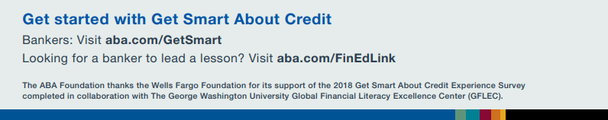



Becca Maxwell
Community Development Officer
Domingo Ortiz
Retail Regional Manager
This presentation contains general information only. Sunflower Bank | First National 1870 is not, by means of this presentation, rendering accounting, financial, investment, legal, tax, or other professional advice or services.
This presentation is not a substitute for such professional advice or services, before making any decisions related to these matters, you should consult a qualified professional advisor.
The FDIC Money Smart financial education program can help people of all ages enhance their financial skills and create positive banking relationships. First released in 2001 and regularly updated since then, Money Smart has a long track record of success.

Slide 4
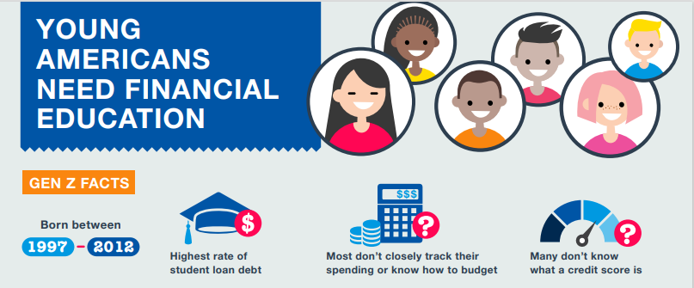
Financial Education

Slide 5
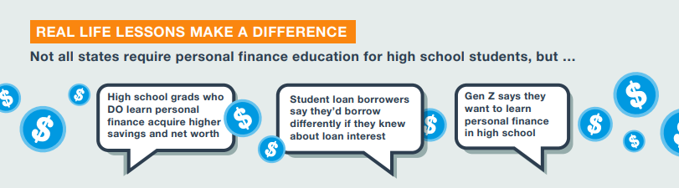
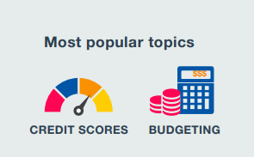
Financial Education
When it comes to avoiding fraud, is it better to be young and savvy or old and wise?
44% of people aged 20-29 reported losing money to fraud – Compared to 25% of people 70-79.

Slide 6
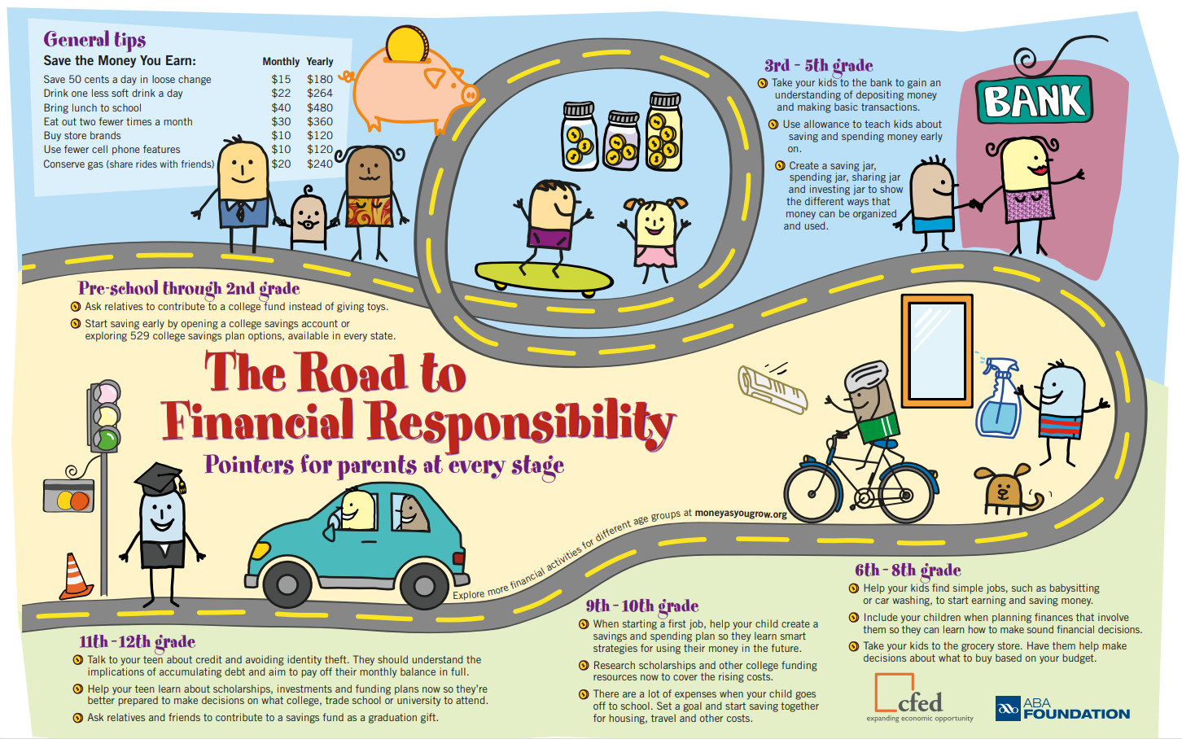

Slide 7
BUDGETING BASICS

Slide 8
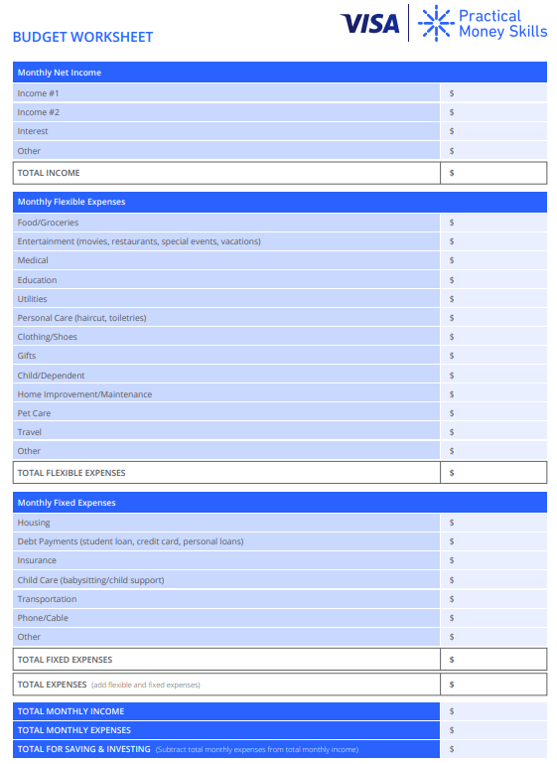
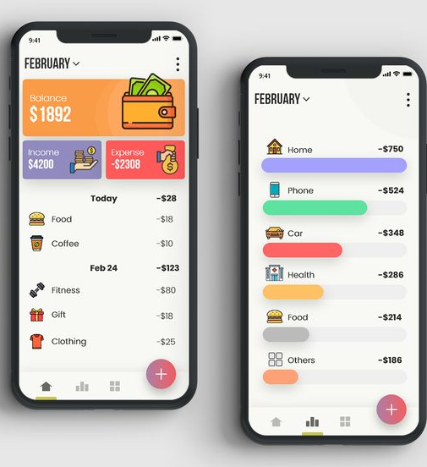
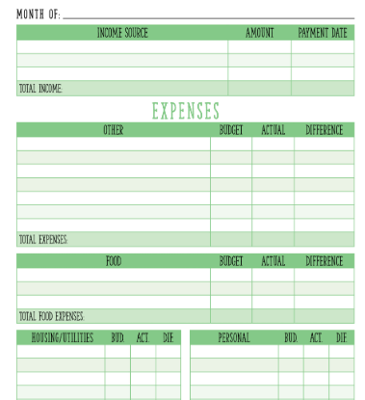
BEGIN WITH A BUDGET!!

Slide 9



BUDGETING

Slide 10
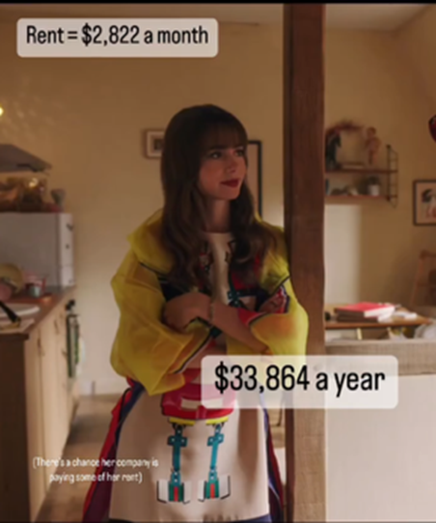


BUDGETING

Slide 11



BUDGETING

Slide 12

BUDGETING BASICS
If you’re new to budgeting, it’s important to understand what a budget is and how it helps you examine what you earn and how you are spending that income.
A budget is a financial plan that takes income and expenses into account and provides estimates for how much you make and spend over a given period of time.
Budgeting Basics

Slide 13
BUDGETING BASICS
Addressing your financial situation and distinguishing between needs and wants is an important first step before creating your annual budget.
Acknowledging areas where you are overspending can be an eye-opening experience. Creating a budget and sticking to it can help you save and reach your short- and long-term financial goals.
This is not a one-time exercise. Revisit and rework your budget if you have a financial windfall or setback so it reflects your current situation.

Slide 14
BUDGETING BASICS
Understanding the following key components will help you as you begin to build a monthly or annual budget:
Fixed expenses are expenses that stay the same from month to month, such as rent payments.
Flexible expenses are expenses that change from month to month, such as how much you spend on utilities.
Total expenses are the combined amount of your fixed and flexible expenses.
Total monthly income is the income from your job or other resources including investment dividends, pensions, Social Security benefits, rental income and more.
Disposable income is the money you have left over after you subtract your income taxes from your income.

Slide 15
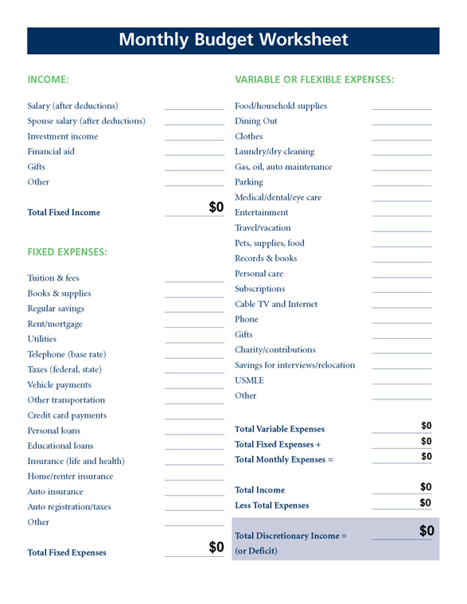
The next step is to create your monthly budget using the basic Budget Worksheet.
If you find you are not able to stick to your budget, it may mean you are spending beyond your means or that your budget is not flexible enough.
Take the time to review and readjust your budget monthly until you find a plan that works for you.

Slide 16
BUDGETING BASICS
If you’re looking to budget for specific goals, check out these budgeting calculators — they’re powerful tools for exploring ways to manage your finances:
Building an Education Fund
Emergency Fund
Retirement Fund
Rework Your Budget
Saving for a Goal
Travel Budgeting
BUDGET WORKSHEET PDF ADOBE

Slide 17
Creating a Budget

Slide 18

Budgeting Basics VIDEO
https://www.bing.com/videos/riverview/relatedvideo?q=Youtube+Two+Cents+PBS+Budgeting+Basics&&view=riverview&mmscn=mtsc&mid=57552E11A9CF9BA1308357552E11A9CF9BA13083&&aps=8&FORM=VMSOVR
Budgeting Basics
Next Gen Personal Finance
04:34 YouTube
Publisher: Two Cents PBS
A guide to managing your finances effectively, likening budgeting to commanding an army. The video provides a practical approach to budgeting, focusing on present dollars and assigning them jobs

Slide 19

BUDGETING BASICS
If you are like many Americans, you may find that you are spending more than you're saving and steadily going deeper into debt as a result.
This is an easy and common pattern to fall into, and you’ll need some careful planning and discipline to reverse it.

Slide 20
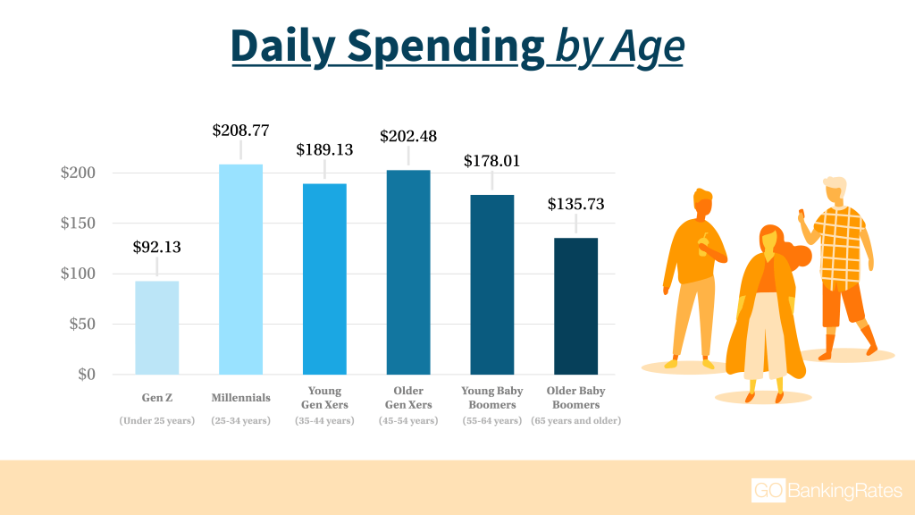
BUDGETING BASICS
The Average American:
Has a salary of $59,384
Has a mortgage of $244,498
Has $6,864 of credit card debt
Has $23,792 in car loans
Has $42,139 in HELOCS
Purchased 1st home at 37 years old
Has less than $1000 in savings
Has $38,290 in student loans

Slide 21
BUDGETING BASICS
Question your Needs and Wants
What do you want? What do you really need? Evaluate your current financial situation and make two lists — one for needs and one for wants. As you make the list, ask yourself the following:
Why do I want it?
How would things be different if I had it?
Which things are important and essential to me?
When your list is complete, reevaluate what qualifies as a need before making any purchases that will impact your budget.
Set Guidelines
Keep your budget balanced with wants and needs by setting clear guidelines. If you splurge on a vacation, consider cutting other costs that month to offset that large expense.
Take a look at this Budget Worksheet to get a sense of how to allocate your money for different expenses.
Track, Trim and Target
Once you start tracking, you may be surprised to find that you spend hundreds of dollars a month on eating out, entertainment or other discretionary expenses. To lower these costs, target areas where you can cut back on spending. Remember that reducing expenses is often a more realistic approach than cutting costs entirely.

Slide 22

BUDGETING BASICS
Once you've got a clear understanding of your current budget, the challenge is to find places where you can spend less (or earn more) in order to achieve your financial goals.

Slide 23

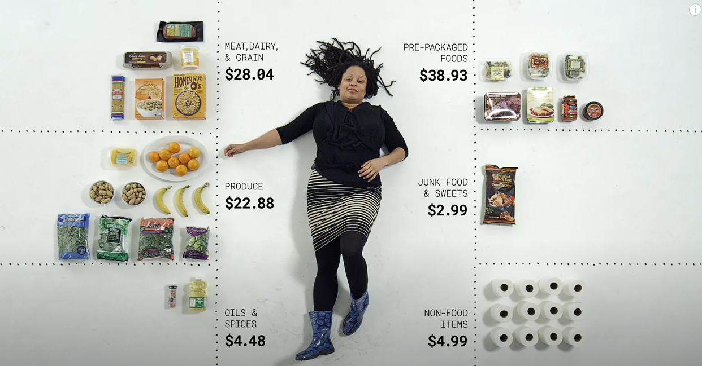

BUDGETING BASICS
How Different People Spend $100 | Cut
03:00

Slide 24
Budgeting Benchmarks

Slide 25

BUDETING BENCHMARKS
Creating and sticking to a budget is key to building a strong financial foundation. It’s a smart habit that will help you throughout life — after all, many of your financial responsibilities will change over your lifetime.
Whether you’re a student or a parent, check out these tips for how to set and achieve financial goals at any stage of life.

Slide 26

BUDETING BENCHMARKS
TIPS FOR STUDENTS
Establishing strong budgeting habits is essential for students and recent graduates. Whether you’re paying off student loans, saving for a car, or getting ready to rent your first apartment, creating monthly goals can help you track progress and achieve milestones.
As a student, it’s important to understand your unique set of financial priorities. For example, your parents may cover your housing costs, or you might have to pay monthly rent.
Similarly, your arrangement may offer a meal plan, or perhaps it’s your first time having to cook for yourself. Either way, budgeting can help prepare you to take on these new responsibilities.
Learn more about budgeting as a student

Slide 27
BUDETING BENCHMARKS
CHALLENGES FOR PARENTS
Parenthood adds a lot of joy to life — and a lot of new expenses. The U.S. Department of Agriculture estimates that to raise a child born in 2013 to age 18, it costs an average of $245,000.
Becoming a parent increases financial responsibility and can present personal finance challenges that did not exist before the addition of a new child. Create specific and realistic goals for a balanced and manageable budget for your family.
Make sure to plan for a range of spending categories including emergency funds, education funds, housing payments and family vacations. As your family grows, there are bound to be new financial challenges at every stage of your children's lives, from day care to college.
Learn how to adapt and readjust your budget throughout the year — with a bit of effort, it’ll more than pay off in the long run.
Rework Your Budget

Slide 28
BUDETING BENCHMARKS
BUILD AN EMERGENCY FUND
After creating your budget, it’s important to protect the money you are saving for the future. Do you have funds set aside in case of a major unplanned expense?
Building a substantial emergency fund that covers between three- and six-months’ worth of living expenses is key to a secure financial foundation.
When reevaluating your finances, make sure to account for emergency fund savings so that you’re prepared to handle any unexpected costs.
Check out the Emergency Fund calculator to get started.

Slide 29

BUDETING BENCHMARKS
MANAGING DEBT LOAD
Whether you’re working on paying off a mortgage or student debt, take time to evaluate how to most effectively pay down your loans.
Managing your debt load — the sum total of all of your loans — will help you get a better handle on your financial health.
Reducing these payments is an important step toward improving your financial well-being.

Slide 30
Q & A Session

Slide 31
Financial Literacy
First National 1870 is committed to providing our customers the opportunity to gain knowledge through our Financial Literacy program. We want to do our part to help those we serve through financial education so they can achieve their goals both today and in the future.
We believe that the path to achieving one’s financial goals is grounded in education. In addition, the ability to utilize financial tools and information is critical to learning sound money management skills.
Our dedicated team of professionals regularly holds a wide variety of Financial Literacy courses throughout the areas we serve. We hold classes in diverse locations such as schools, colleges, senior centers, Head Start programs, and community centers.
Whether it be courses on basic banking information, budgeting skills, credit card management, buying a car, purchasing a home, or a variety of other topics, our Financial Literacy program reaches people of all ages and stages of life.

Slide 32
COMMUNITY CONTACT INFORMATION
Domingo Ortiz
  VP, Retail Regional Manager
  Direct: 303-962-0177
  Domingo.ortiz@firstnational1870.com
Dolores Overton Direct: (505) 200-2111 |
  Market President – Santa Fe
  Direct: 1-505-992-2325
  Dolores.f.overton@FirstNational1870.com
Becca Maxwell
  VP, Community Development Officer NM
  Direct: 620-564-2010
  Becca.maxwell@sunflowerbank.com
Address:
62 Lincoln Ave | Santa Fe, NM

Slide 33
First National 1870 Customer-First Banking
We have the financial solutions and the right tools you need to achieve your finance goals while accommodating your lifestyle. Customer-First Personal Banking, a better banking experience provided by friendly bankers you know and trust.
For Additional Resources:
https://www.firstnational1870.com/

