Slide 1
USA Response to the Uyghurs Genocide

Slide 2
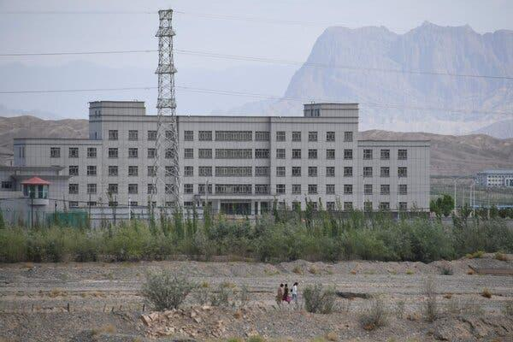
U.S Says China’s Repression of Uighers is Genocide
https://www.nytimes.com/2021/01/19/us/politics/trump-china-xinjiang.html?searchResultPosition=2

Slide 3
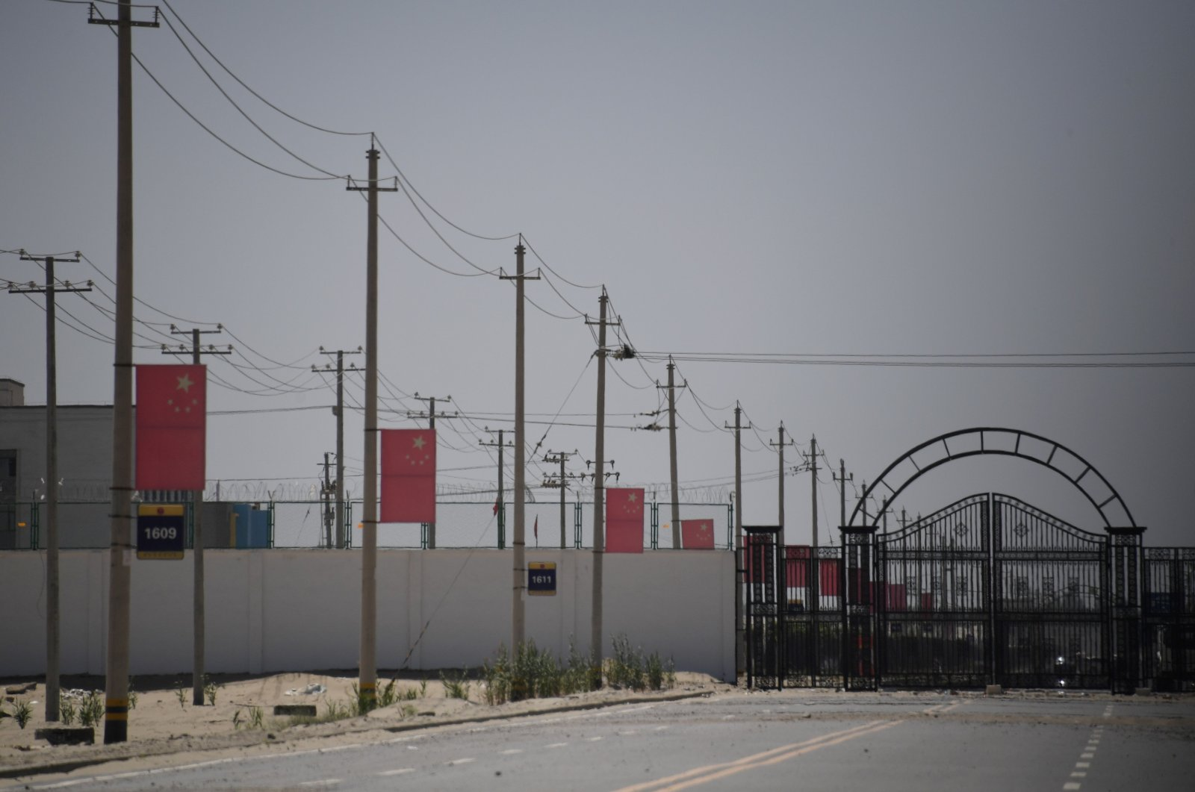
U.S to Ban Goods From China’s Xinjiang Over Uigher Forced Labor
https://www.dailysabah.com/business/us-to-ban-goods-from-chinas-xinjiang-over-uighur-forced-labor/news

Slide 4
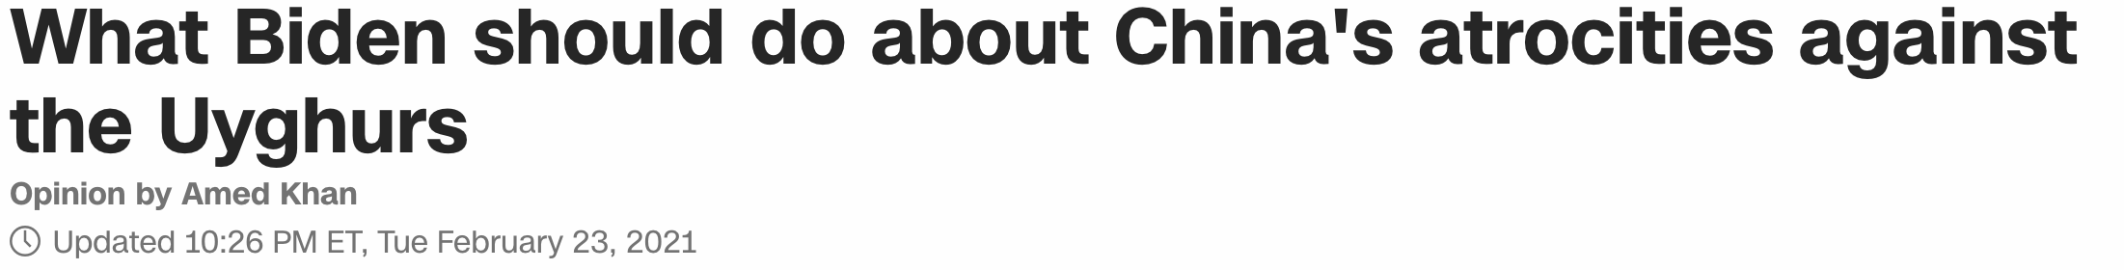
What Biden Should Do About China’s Atrocities Against the Uyghurs
https://www.cnn.com/2021/02/23/opinions/uyghurs-china-biden-atrocities-khan/index.html

