Slide 1


Batalla de los Libros Flyer
May 6th, 2025
9:30-11:30
OMS Registration Now Open
Notes:
Link:https://drive.google.com/file/d/14P9er2LytEA3SNg4DoOkqwAuI1tucjyj/view?usp=sharing

Slide 2
ELPAC Testing Reminders and Highlights

Slide 3
Highlights: 24-25 What’s New
Combined CAASPP & ELPAC Website
Combined ELPAC Online Test Administration Manual (information for both the Initial ELPAC and Summative ELPAC can be found)
  How to Start an ELPAC Session is no longer in the manual (now a separate document in “Test Administrator Interface Instructions and Resources” section)
Minor Test Administration (TA) Interface Changes. See What’s New Video for more details
Many Forms in TOMS and with Field Test Questions (longer testing time)
Summative ELPAC Testing Window:
  February 1, 2025, through May 31, 2025
Notes:
two forms:
Requires teachers have
TOMS accounts
CERS accounts
Districts should work closely with sites to ensure educators have the access and training necessary to use the interim assessments to their fullest potential.

Slide 4
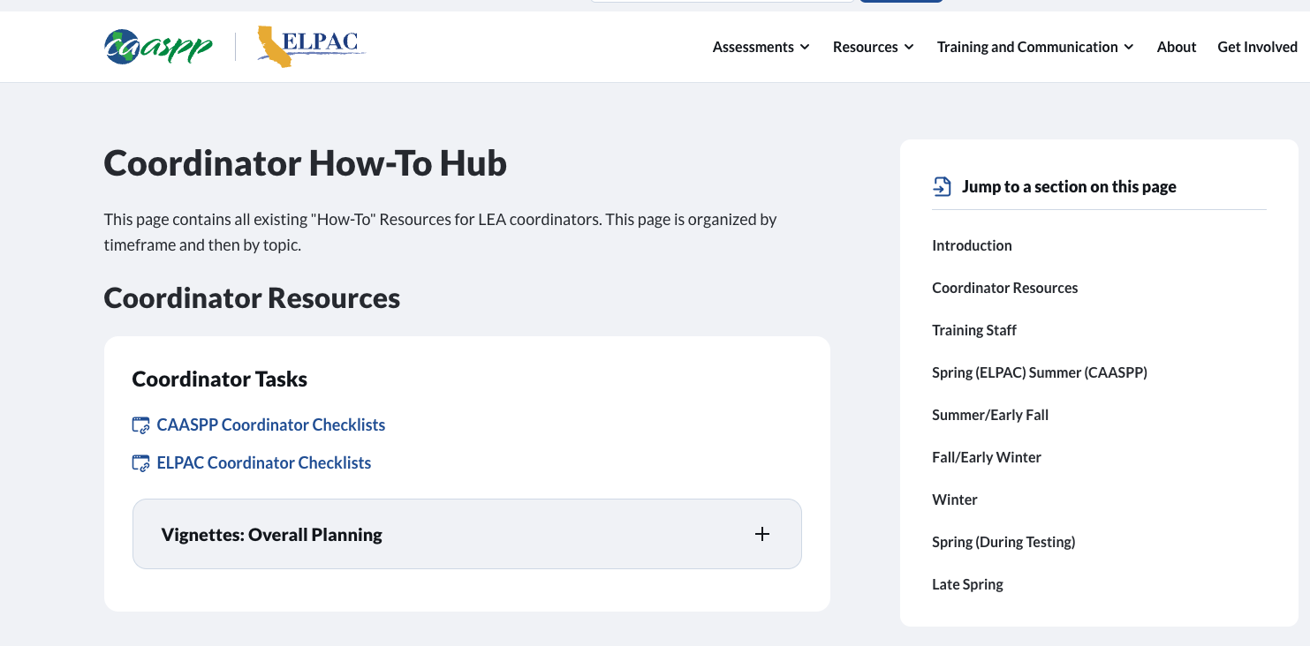
Coordinator How-To Hub
NEW!
https://www.caaspp-elpac.org/training-and-communication/training/coordinator-how-to-hub

Slide 5
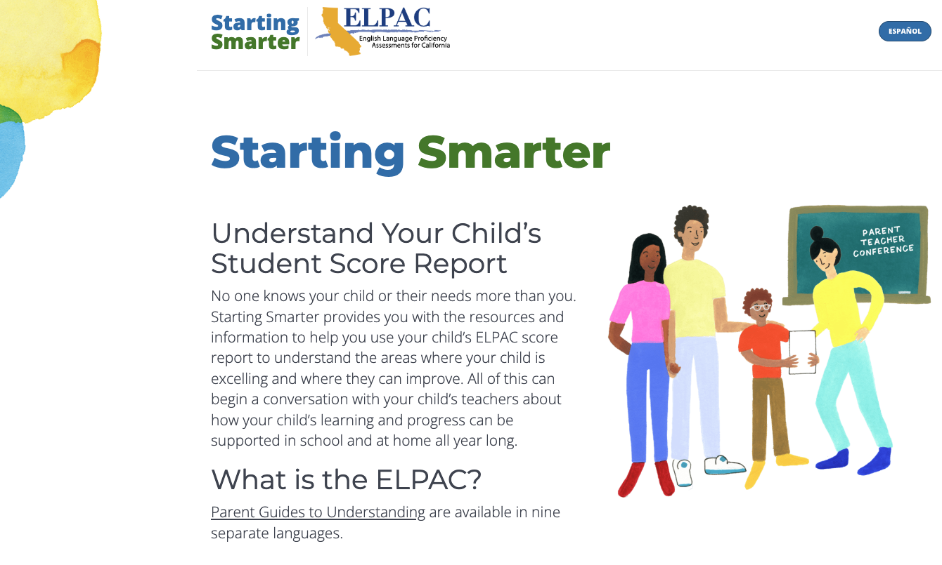
Videos Explaining Students’ Score Reports
UPDATE
https://elpac.startingsmarter.org/

Slide 6
Professional Development Resources

Slide 7
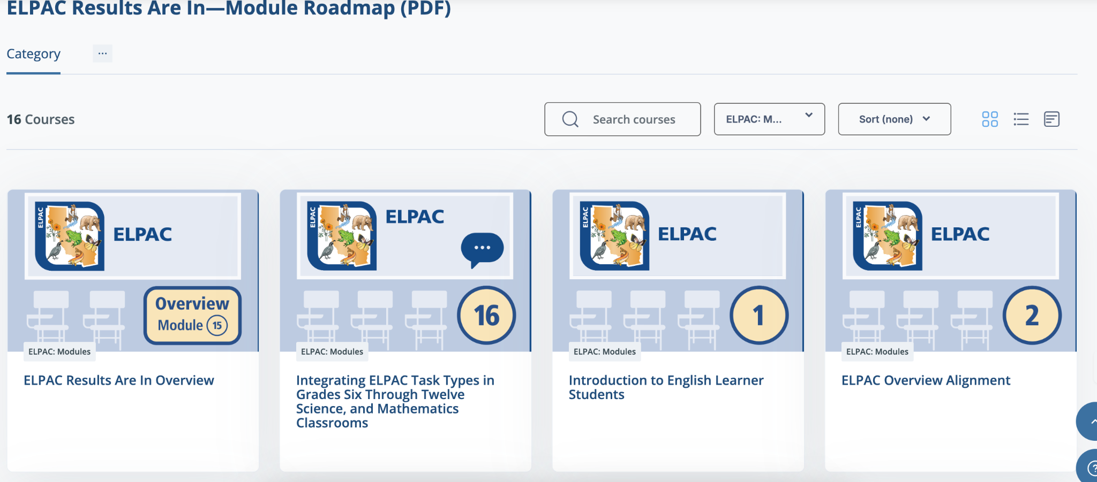
Moodle: ELPAC Results Are In, Now What?
NEW!
https://moodle.caaspp-elpac.org/course/index.php?categoryid=12

Slide 8
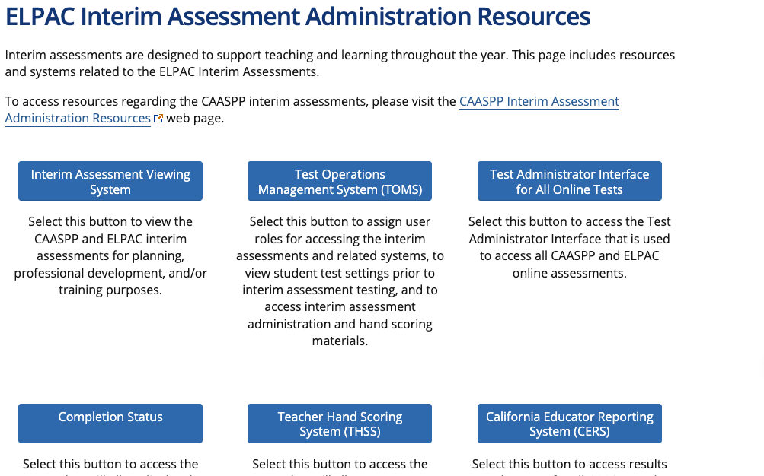
ELPAC Interim Assessments Update
See student progress
Standardized or non-standardized
Requires teachers have:
  TOMS accounts
  CERS accounts
Two forms now available
https://www.elpac.org/resources/elpac-interim-resources/
Notes:
two forms:
Requires teachers have
TOMS accounts
CERS accounts
Districts should work closely with sites to ensure educators have the access and training necessary to use the interim assessments to their fullest potential.

Slide 9

Professional Learning Resources for
ELPAC Task Types
The CDE is collaborating with California educators to develop a collection of professional learning resources focused on familiarizing educators with ELPAC task types and how to provide support for students who are English learners (ELs). Each resource is designed to be implemented by a training facilitator with a group of classroom educators. Three of the ELPAC Speaking and Writing task type professional learning resources are now available in Tools for Teachers, and several more will be available soon! Here are the links to the available resources:
ELPAC Speaking Domain—Summarize an Academic Presentation (SAP) Task Type
ELPAC Writing Domain—Justify an Opinion (WJO) Task Type
ELPAC Speaking Domain—Support an Opinion (SSO) Task Type
*account required
NEW!
Notes:
To view these new professional learning resources, staff need to log in using their Tools for Teachers account, which they can obtain either through self-registration, described in the flyer How to Self-Register for Tools for Teachers, or through their LEA ELPAC or CAASPP coordinator.

Slide 10
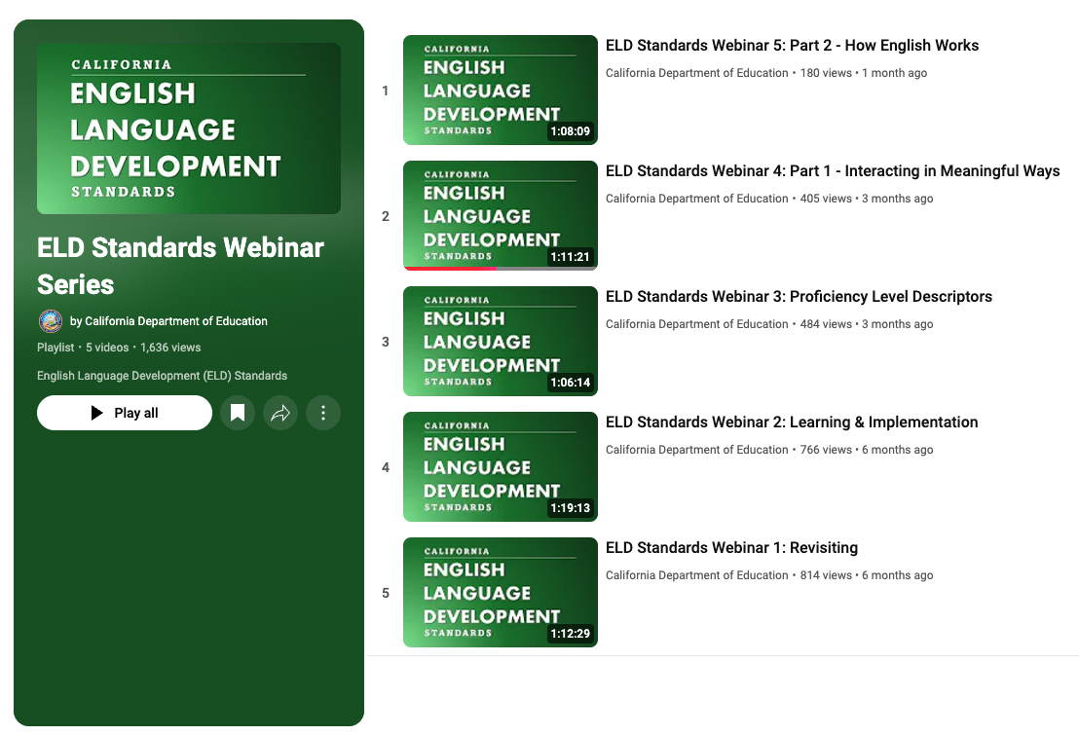
California English Language Development Standards Webinar Series
NEW!
CA ELD Standards Webinar Series
Notes:
California English Language Development Standards Webinar Series
The CDE MSD, in collaboration with the Region 15 Comprehensive Center, hosted a monthly webinar series to revisit the California English Language Development Standards (CA ELD Standards). The webinars included detailed presentations on the Proficiency Level Descriptors, Part I, Part II, and Part III of the standards, and how the standards can be used to provide high-quality integrated and designated ELD instruction for EL students. The webinar recordings playlist is available at CA ELD Standards Webinar Series as well as in the ELD Standards tab on the CDE ELD Standards web page.

Slide 11
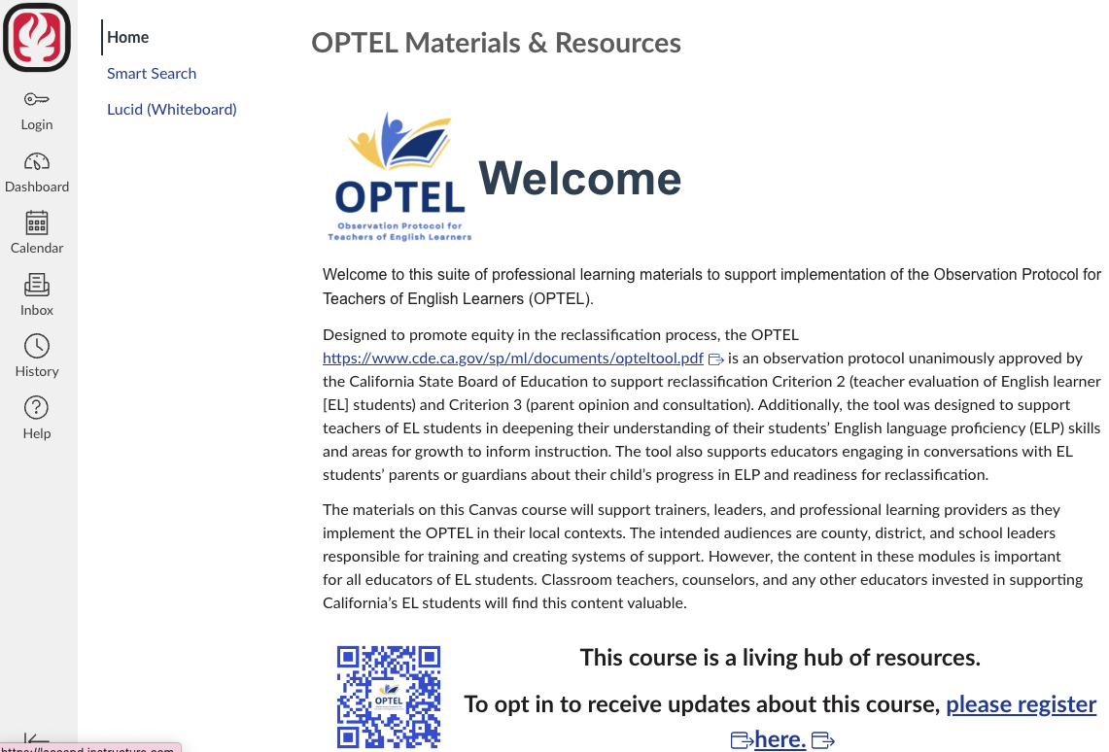
NEW!
OPTEL
https://lacoepd.instructure.com/courses/1088
Notes:
Observation Protocol for Teachers of English Learners Professional Learning Modules
The CDE MSD, in collaboration with the RELS and the Los Angeles County Office of Education (LACOE), and with support from the Region 15 Comprehensive Center, has developed a series of Observation Protocol for Teachers of English Learners (OPTEL) Professional Learning Modules. The Professional Learning Modules are a suite of resource materials to support the implementation of the OPTEL. The OPTEL Professional Learning Modules materials will help trainers, leaders, professional learning providers, and educators of EL students as they implement the OPTEL in their local contexts. Modules 1–3 are currently available on the LACOE Canvas Course at https://lacoepd.instructure.com/courses/1088. For information contact Emily Ingram, EPC, LPLO, by email at eingram@cde.ca.gov.

