Slide 1
Budget Advisory Committee
January 30, 2025 Meeting
Tumwater School District

Slide 2
Agenda Topics
1. Update – Where Are We At Financially
      Cash balance update
      Enrollment Update
    2. Fiscal Recovery Plan Implementation
      January 9th Work session – Review Reduction Options (Options A, B, C)
      Discussing Different Reduction Options
3. Legislative Update

Slide 4
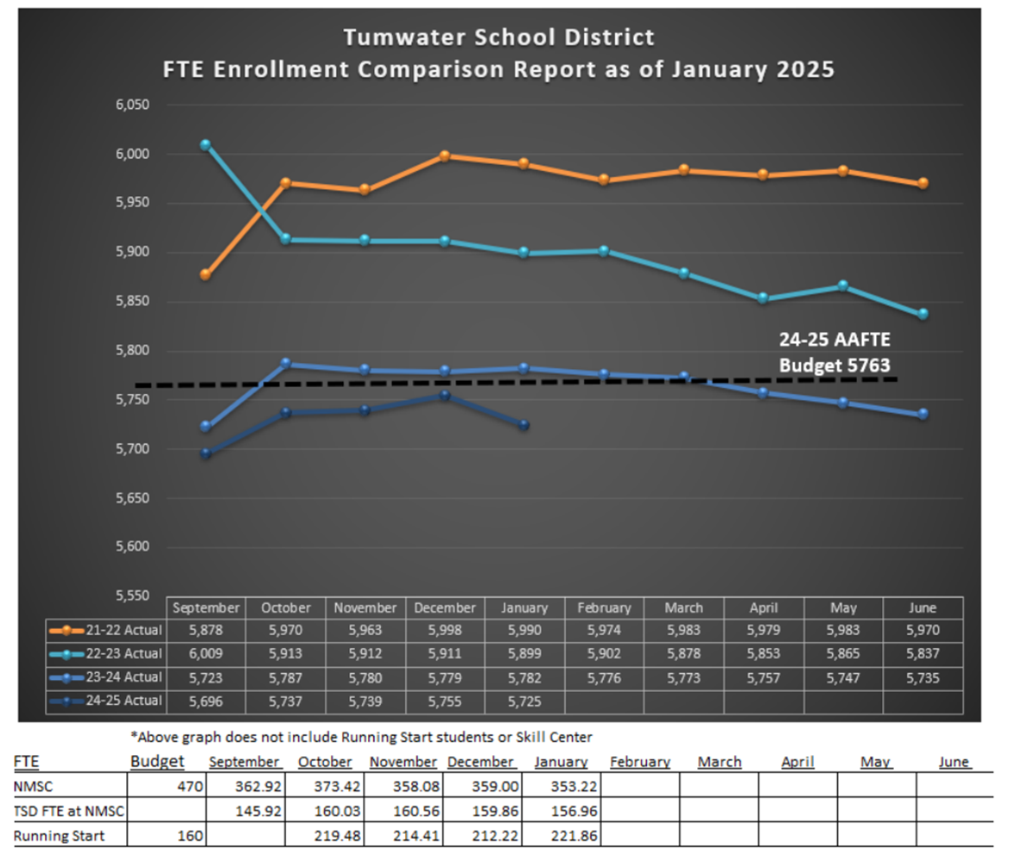


Slide 5
Budget Options – Board Input
Option A – “Stop Digging”
  Eliminate the budget deficit, but unlikely to make up any ground toward building back the fund balance.
Option B – “Avoid the Interfund Loan”
  Eliminate the budget deficit, and, in theory, build a modest operating surplus to avoid needing monthly cash loans to meet payroll.
  Option C – “Compliance with Board Policy in 1 Year”
  Eliminate the budget deficit, and, in theory build a larger operating surplus to get to a 6% unassigned fund balance.

Slide 6
Budget Recovery Plan - Timelines
January 23rd Meeting
    Reduced Educational Program Resolution #1
    Total Savings: Approximately $2.3 million
    23.1 FTE (27 Positions)
    Review the Full List Here
February 13th Meeting
    Reduced Educational Program Resolution #2
    School-level costs.

Slide 7
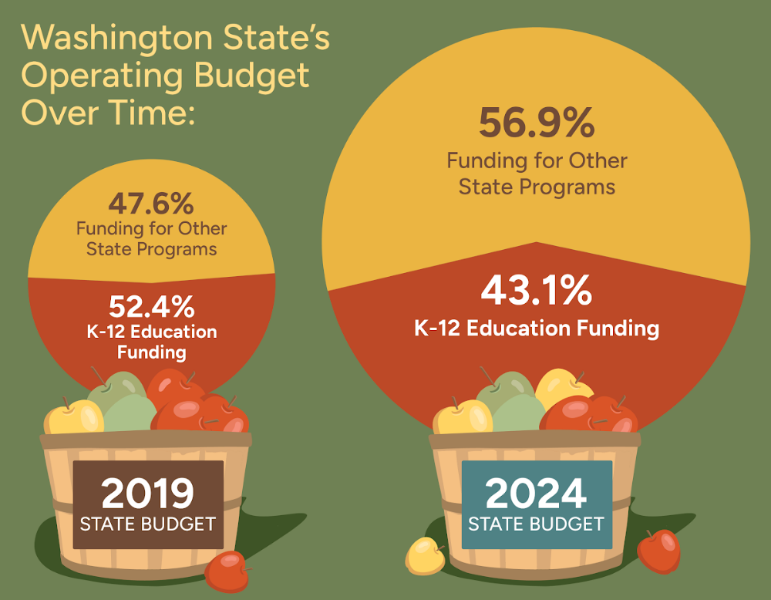
Status of Education Funding in Washington

Slide 8
Legislative Update – “Big Three” Proposals
Special Education
      Funding multiplier
      Funded enrollment cap
      Safety net eligibility threshold
Pupil Transportation
    Develop new formula more in line with current labor costs.
Non-Salary Costs
    MSOC – Materials, Supplies, & Operating Costs
    Covers energy, insurance, fuel, and other spiking supply costs.

Slide 9
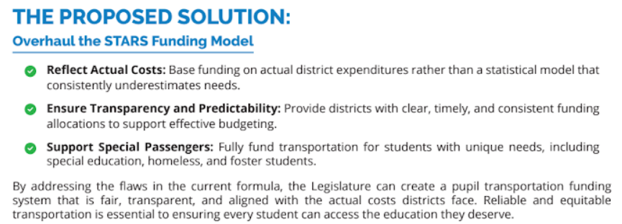
Pupil Transportation – What is the Issue?

Slide 10
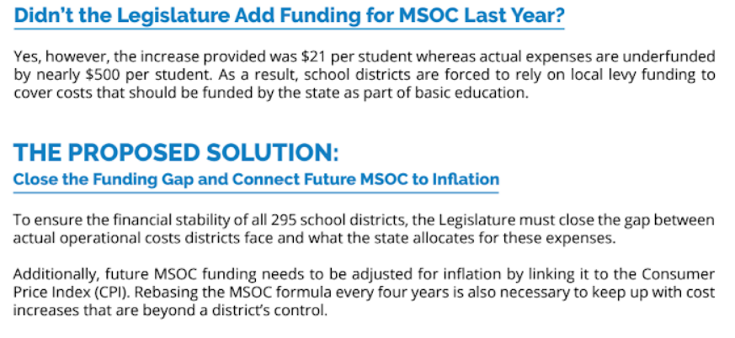
Non-Salary Costs – What is the Issue?

Slide 11
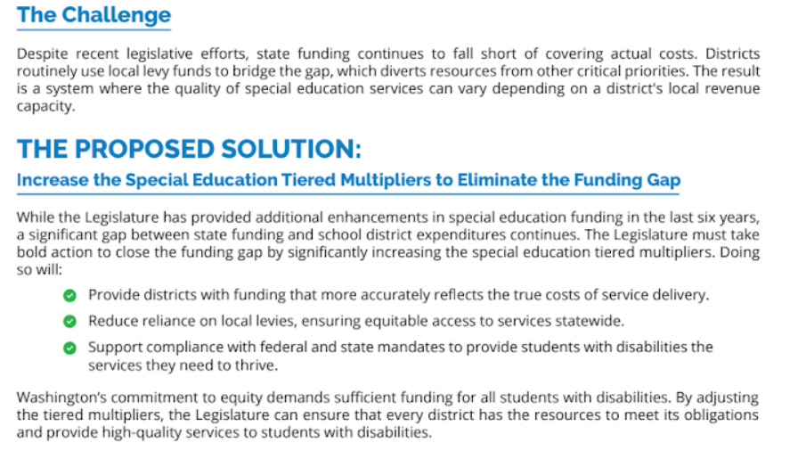
Special Education – What is the Issue?

Slide 12
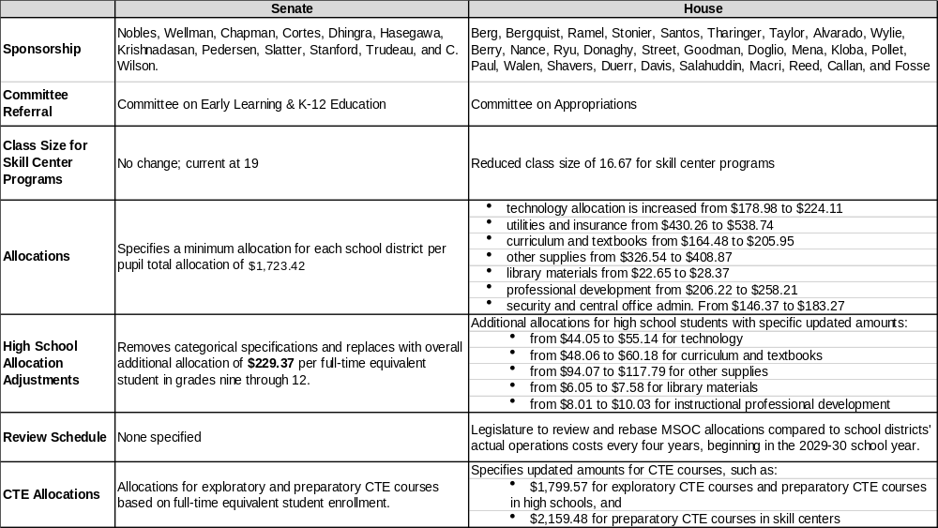

Slide 13
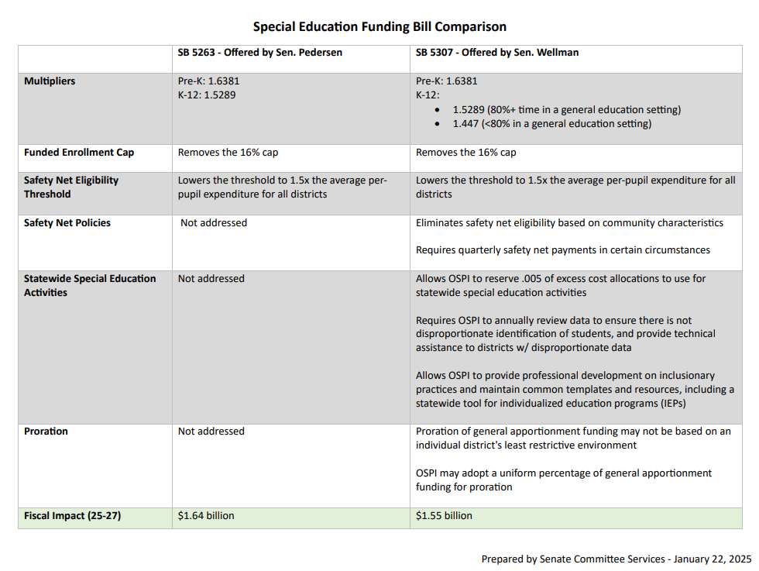

Slide 14
Contact Your Legislative Representatives!
District 22 Reps | District 35 Reps | District 2 Reps
Representative Travis Couture Republican Representative Dan Griffey Republican Senator Drew MacEwen Republican | Senator Jessica Bateman Democrat Representative Beth Doglio Democrat Representative Lisa Parshley Democrat | Representative Andrew Barkis Republican Representative Matt Marshall Republican Senator Jim McCune Republican
Source: Washington State Legislature Homepage

Slide 15
Use the “Big Three” Toolkit!
Policy Briefs for each major issue area here:
NEW Big 3 Policy Briefs - Google Drive

Slide 16
Questions?

