Slide 1

  The Financial Aid Office Presents…
  Financial Aid

Slide 2

What Is Financial Aid?
Financial aid consists of funds provided to students and families to help pay for postsecondary educational expenses.

Slide 3
How is Eligibility Determined?
Eligibility for federal financial aid is determined by a number of factors established by Congress, such as:
  Be a U.S. Citizen or Eligible non-citizen
  Be enrolled as a regular student in an eligible program
  Have a high school diploma or GED (or alternative)
  Maintain satisfactory academic progress
  Not owe money back to the Department of Education
  Certify that you will only use federal aid for educational purposes

Slide 4
How is Eligibility Determined?
The types of aid the student is eligible for is determined by several formulas, also decided by Congress.
  The first formula is the one that determines a student’s SAI or Student Aid Index and is used by the FAFSA Processing System (FPS) after the student fills out the FAFSA
  The second formula is the one that determines if the student qualifies for need-based aid (e.g., most grants) and is used by the school once they receive the student’s FAFSA

Slide 5
What Is the Student Aid Index
An index number used to determine a student’s eligibility for certain types of federal student aid.
Based on answers on the FAFSA
Student contribution
Parent contribution
(for dependent students)

Slide 6




What is Cost of Attendance (COA)?
Estimation of expected costs
Direct Costs
Indirect Costs
Tuition and fees
Transportation
Miscellaneous
personal expenses
Housing & Food
Books and supplies

Slide 7
How Do Schools Determine
Financial Need?
Cost of attendance (COA) – Student Aid Index (SAI) = Financial need

Slide 8
Types of Financial Aid
Loans
Scholarships
Self-Help Aid
Gift Aid
Work-Study Employment
Grants

Slide 9
Sources of Financial Aid
Federal Government
Employers
States
Private Sources
College and Universities

Slide 10


Free Application for federal
Student Aid (FAFSA®)
FAFSA on the Web (FOTW)
WWW.FAFSA.GOV
For the 2025-26 academic year, the FAFSA may be filed beginning December 1, 2024*
Uses tax/income information from 2 years prior (2023)
FSA ID Required– one for the student and one for 1 parent**
* Typically opens October 1 each year.
**In most cases. Would need both parents to obtain an FSA ID if
parents filed taxes as “Married Filing Separately.”

Slide 11
Who Is the Parent of Record?
If the student’s biological parents are married, student uses information for both parents
If parents are separated or divorced, student uses the parent who contributed the most financial support for the 12 months immediately preceding the filing of the FAFSA (regardless of who they live(d) with.
  If the parent above has remarried, the student will use the information for that parent and the parent’s spouse/partner
If parents state that both contributed equally, student uses the information for the parent with the greater amount of income and assets.

Slide 12
Filling Out the Sections
New last year, a dependent student will fill out their section of the FAFSA, then invite the parent or parents to sign in and fill out their section.
If parents are married (or remarried) and file their taxes separately, BOTH parents will have to obtain an FSA ID
and sign in and consent.
Third party preparers, including high school counselors, will also have to get an FSA ID.
Additionally, these preparers cannot fill out the student or parent’s sections. They will have to coordinate with both parties to complete their own sections.

Slide 13

Gathering Information
  Social Security Number & DOB
  Citizenship status
  Marital status
  Earned Income/tax information*
  Asset information
  College information
*Depends on filing status. For most tax filers, FAFSA will automatically bring in IRS tax information via a process called the FA Direct Data Exchange or FA-DDX. Only students or parents who have separated, divorced, and/or remarried since the 2023 taxes were filed, non-filers, and people who filed a foreign tax return will have to provide manual tax/income information.

Slide 14

Frequent FAFSA Errors
  Numbers & Dates
  Parent of Record
  Divorced/Married/Widowed/Remarried
  Assets
  Who must get an FSA ID*
*Rules governing who is required get an FSA ID have changed.
If the parents of a dependent student, or an independent student and spouse filed taxes as “Married Filing Separately,” then both tax filers
must obtain an FSA ID.

Slide 15



FAFSA Processing Results
FAFSA
College
Student*
*FAFSA Submission
Summary (FSS)

Slide 16
Special & Unusual Circumstances
Conditions exist that cannot be documented with the
FAFSA
Submit written explanation and documentation to your
college’s financial aid office
College will review and may request additional
information if necessary
Decisions are final and cannot be appealed to the
U.S. Department of Education

Slide 17

Examples
Secondary school tuition
Unusual uncovered medical/dental expenses
Extraordinary dependent care
Student cannot obtain parental information
Parent or spouse death
Loss of employment
Divorce

Slide 18
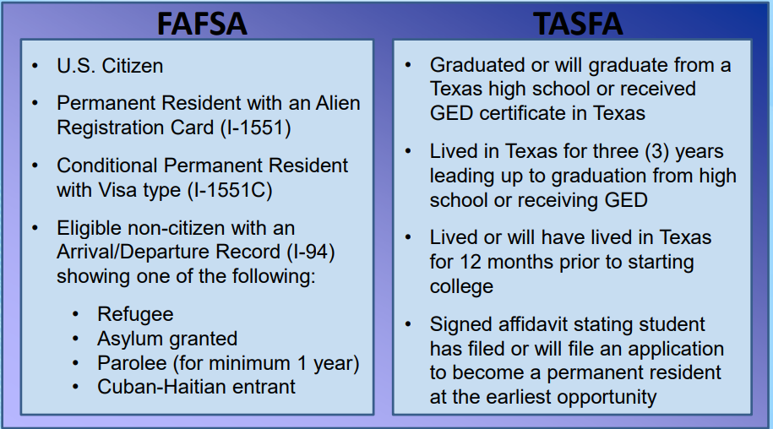
FAFSA or TASFA

Slide 19

Texas Application for State Financial Aid (TASFA)
Students that are classified as Texas Residents but are not eligible to apply for federal financial aid using the FAFSA, may be eligible to complete the TASFA application. Generally speaking, these students do not meet the definition of citizen or eligible non-citizen.
The following are the state financial aid programs that TASFA students may be eligible for. Please check with the institution to determine the exact rules at that particular school:
  Texas Public Education Grant (TPEG)
  Texas Equalization Grant (TEG)
  TEXAS Grant (4-year universities only)
  Texas College Work-Study
  State Exemption Programs
  College Access Loan (CAL)
The electronic application (preferred) can be found here: TASFA - Texas Higher Education Coordinating Board

Slide 20

Scholarships
A scholarship is money given by individuals, companies or organizations based either on need, merit, or some other qualification.
Considered “gift aid”, which means
free money
Does not usually require you to file
a FAFSA (check with donor)

Slide 21
Suggested Sequence
To maximize your scholarship odds, apply in the following order:
  The college(s) you are attending
      Don’t forget to speak to the department of your major. These scholarships are often not advertised.
  Local companies, organizations, houses of
  worship, etc.
  National scholarships/big search engines
1
2
3

Slide 22

Scholarship Scams
Be alert for the following red flags:
A scholarship is guaranteed or your money
back
Credit card or bank information to “hold” scholarship
Vague or no contact information
“You’ve been selected” or “You’re a finalist” in a
contest you didn’t enter
“You can’t get this information anywhere else”
Masquerading as a government agency

Slide 23
Scam Alert cont.
Scholarship scams are against the law!
If you encounter any of these situations, report them to
the:
  Federal Trade Commission @ www.ftc.gov
  National Fraud Information Center @ www.fraud.org
  Also visit:
  www.finaid.org/scholarships/scams.phtml

Slide 24
CSS Profile
The PROFILE is an online application that collects information used by certain colleges and scholarship programs to award institutional funds (NON-federal funds).
For the 2025-2026 year, the PROFILE can be filed as early as October 1, 2024, but no later than 2 weeks before the EARLIEST priority deadline of the schools you’re applying to.
Check your college’s/program’s information to determine if they require the PROFILE (can find a list on collegeboard.org).

Slide 25
CSS Profile cont.
You can print the Pre-Application Worksheet and instructions to review with parents and fill out at home before applying online.
The fee for the initial application and one college or program is $25. Additional reports are $16.
Fee waivers* are granted automatically – based on the information entered on the PROFILE application – to students who are first-time college applicants and are from families with low incomes and assets. (Int’l students are not eligible for fee waivers).
*pays for up to 8 colleges/scholarship programs

Slide 26

Any Questions?
Collin College
Financial Aid and Veterans Services Office
Contact Us:
972-881-5760
FinancialAid@collin.edu
https://www.collin.edu/financialaid/index.html

Slide 27
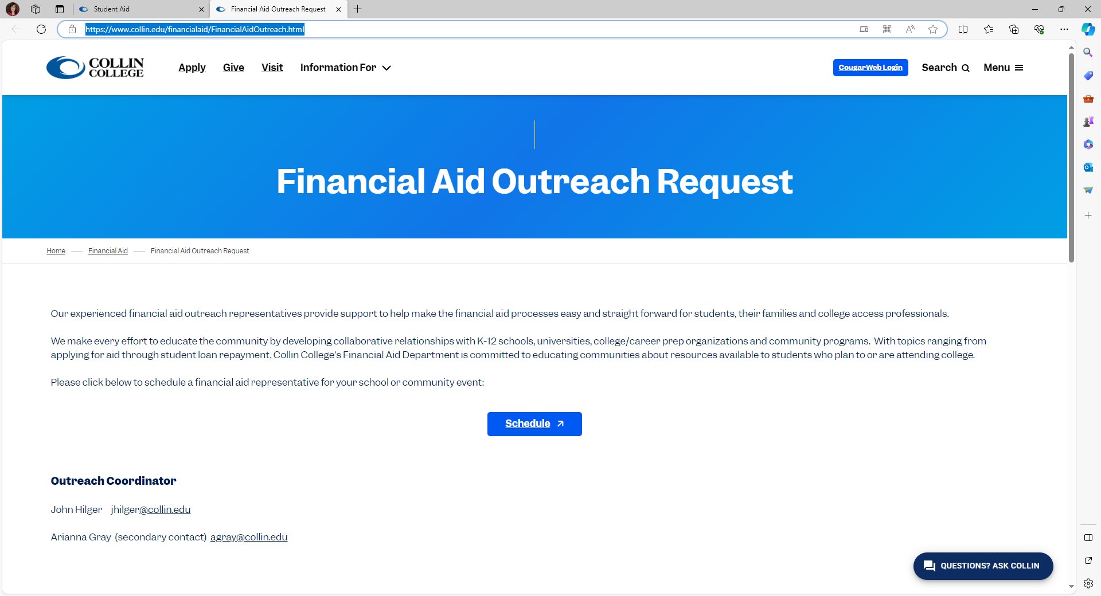
Requesting Presentations/Workshops
On the website at: Financial Aid Outreach Request (collin.edu)

Slide 28

Good Luck!
Find Your Future at Collin College!

