Slide 1
MCSD Construction Update
January 13, 2025
Ward Odom
Executive Director of Facilities and Capital Planning

Slide 2
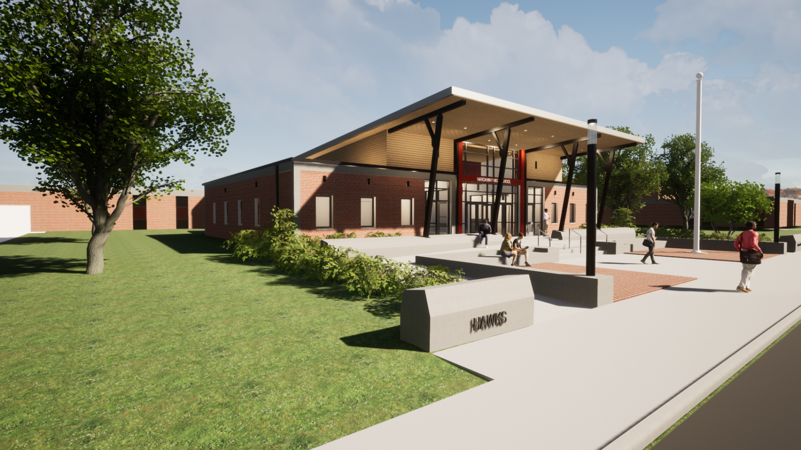
Hardaway Addition/Upgrade
Estimated Completion: Winter 2024/2025
Rendering

Slide 3
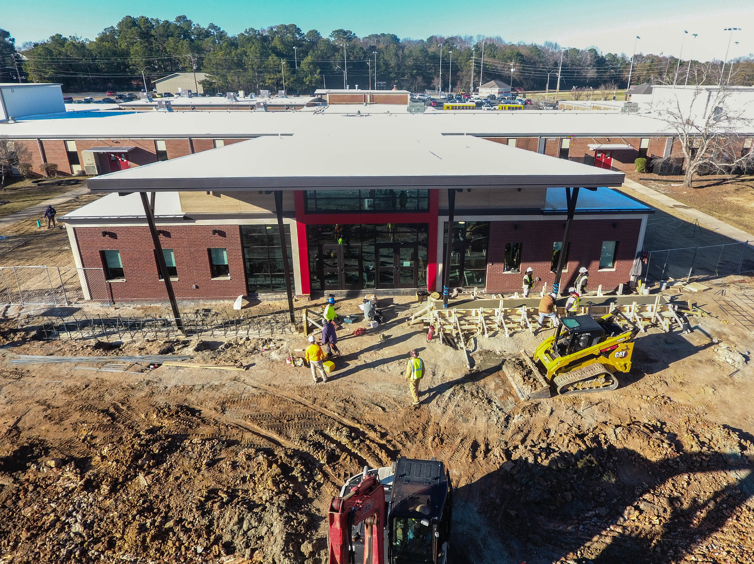
Hardaway Addition/Upgrade
Estimated Completion: Winter 2024/2025

Slide 4
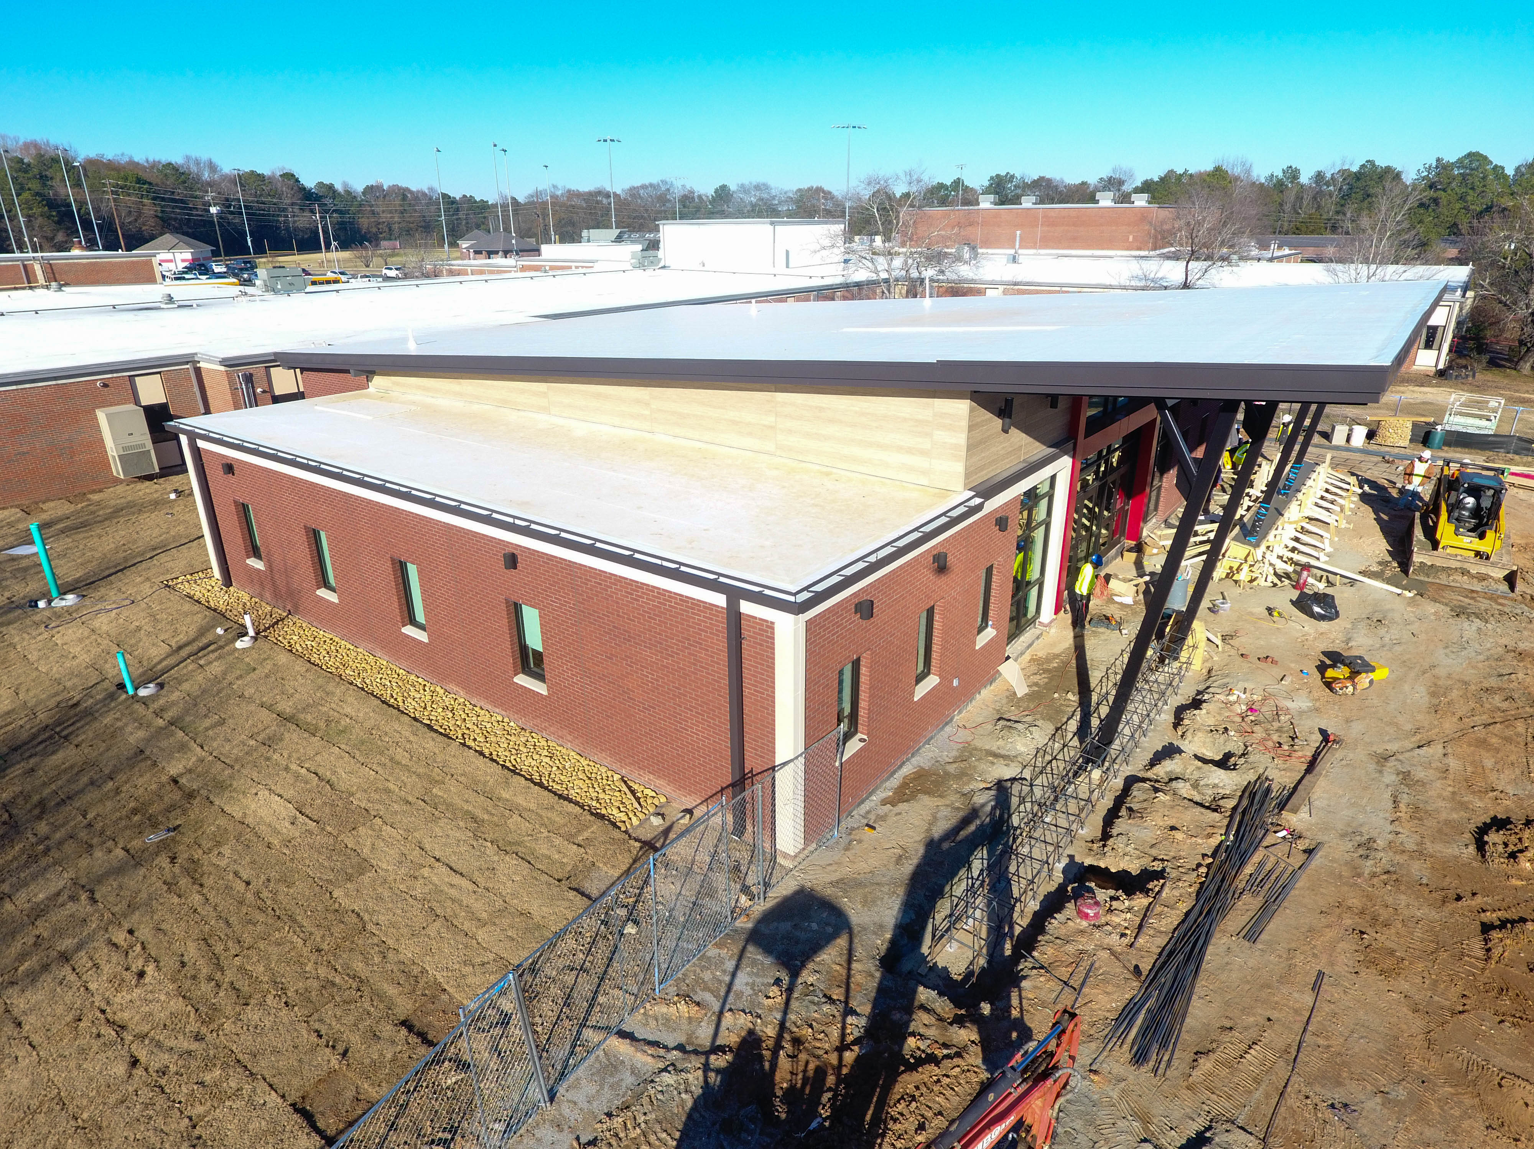
Hardaway Addition/Upgrade
Estimated Completion: Winter 2024/2025

Slide 5
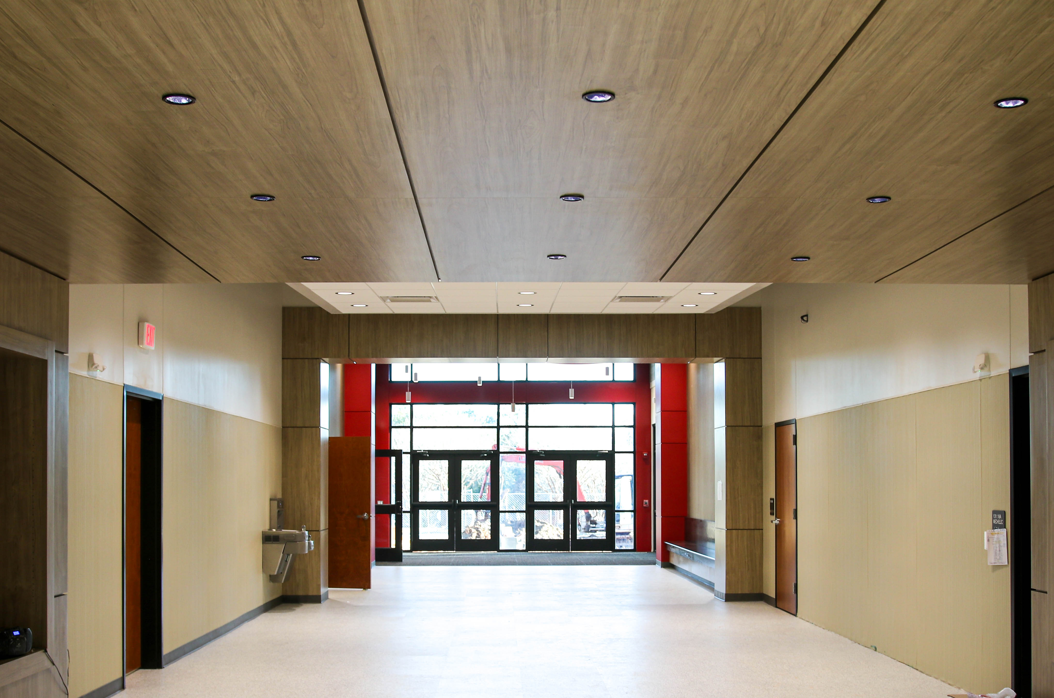
Hardaway Addition/Upgrade
Estimated Completion: Winter 2024/2025

Slide 6
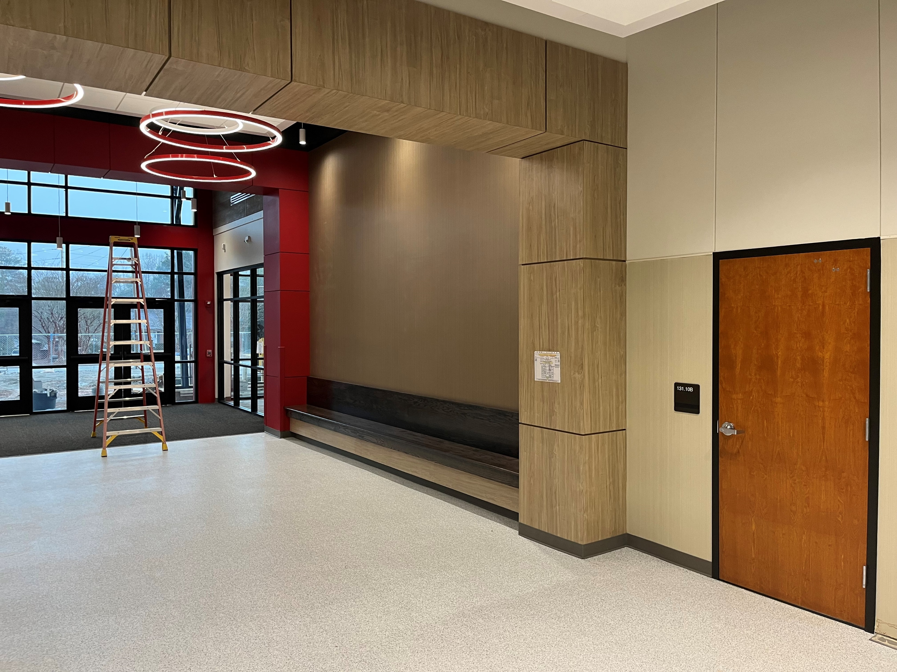
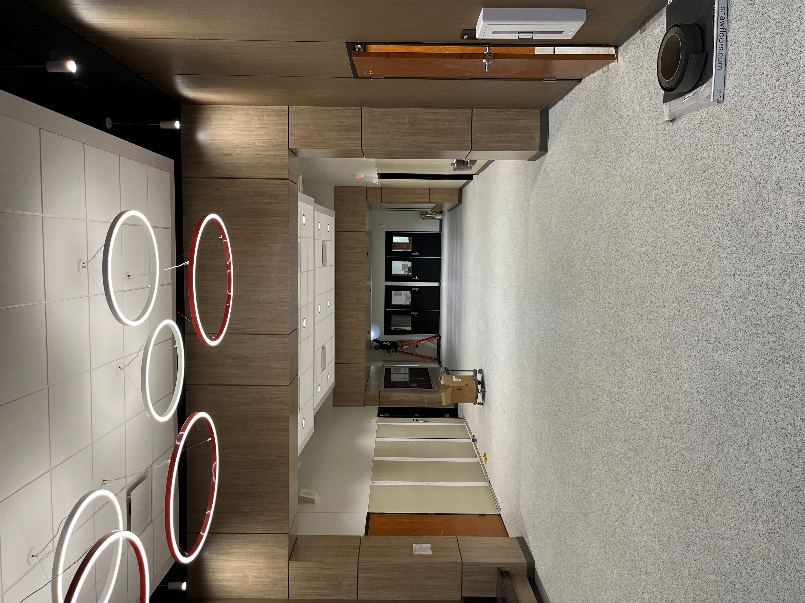
Hardaway Addition/Upgrade
Estimated Completion: Winter 2024/2025

Slide 7
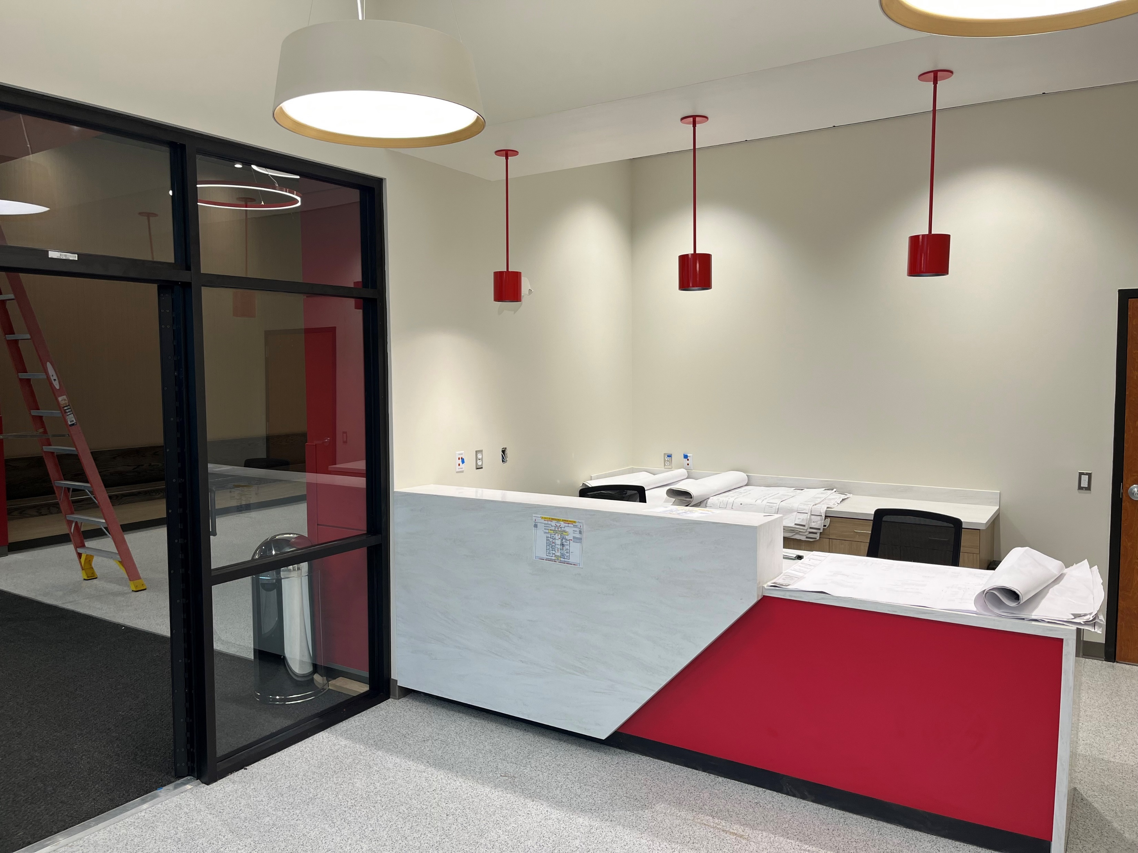
Hardaway Addition/Upgrade
Estimated Completion: Winter 2024/2025

Slide 8
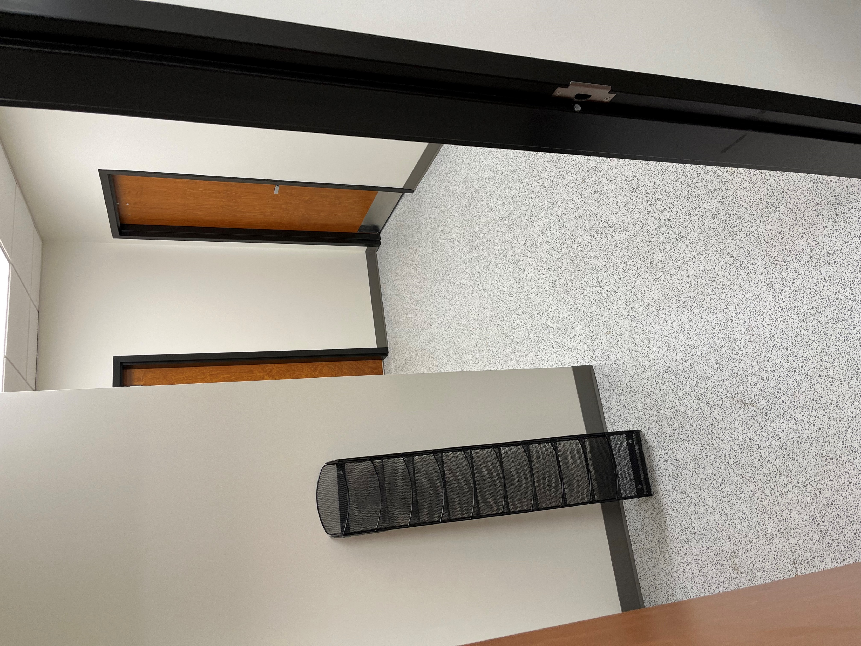
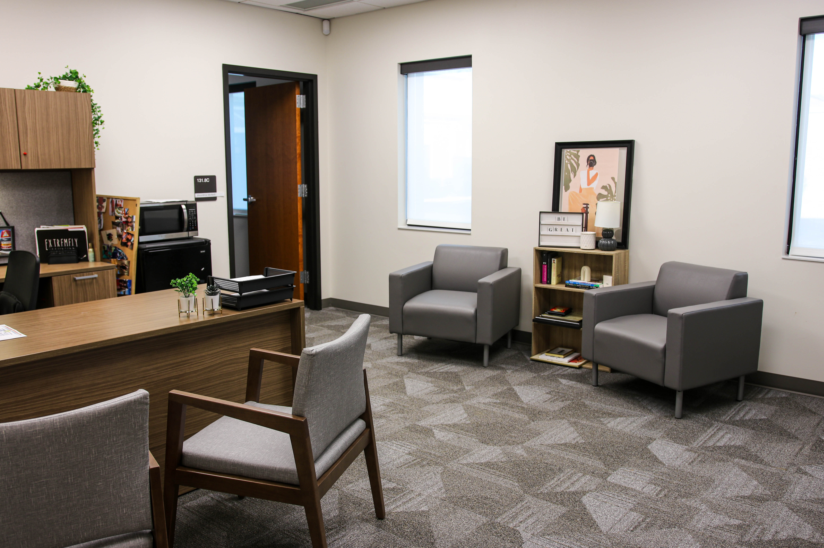
Hardaway Addition/Upgrade
Estimated Completion: Winter 2024/2025

Slide 9
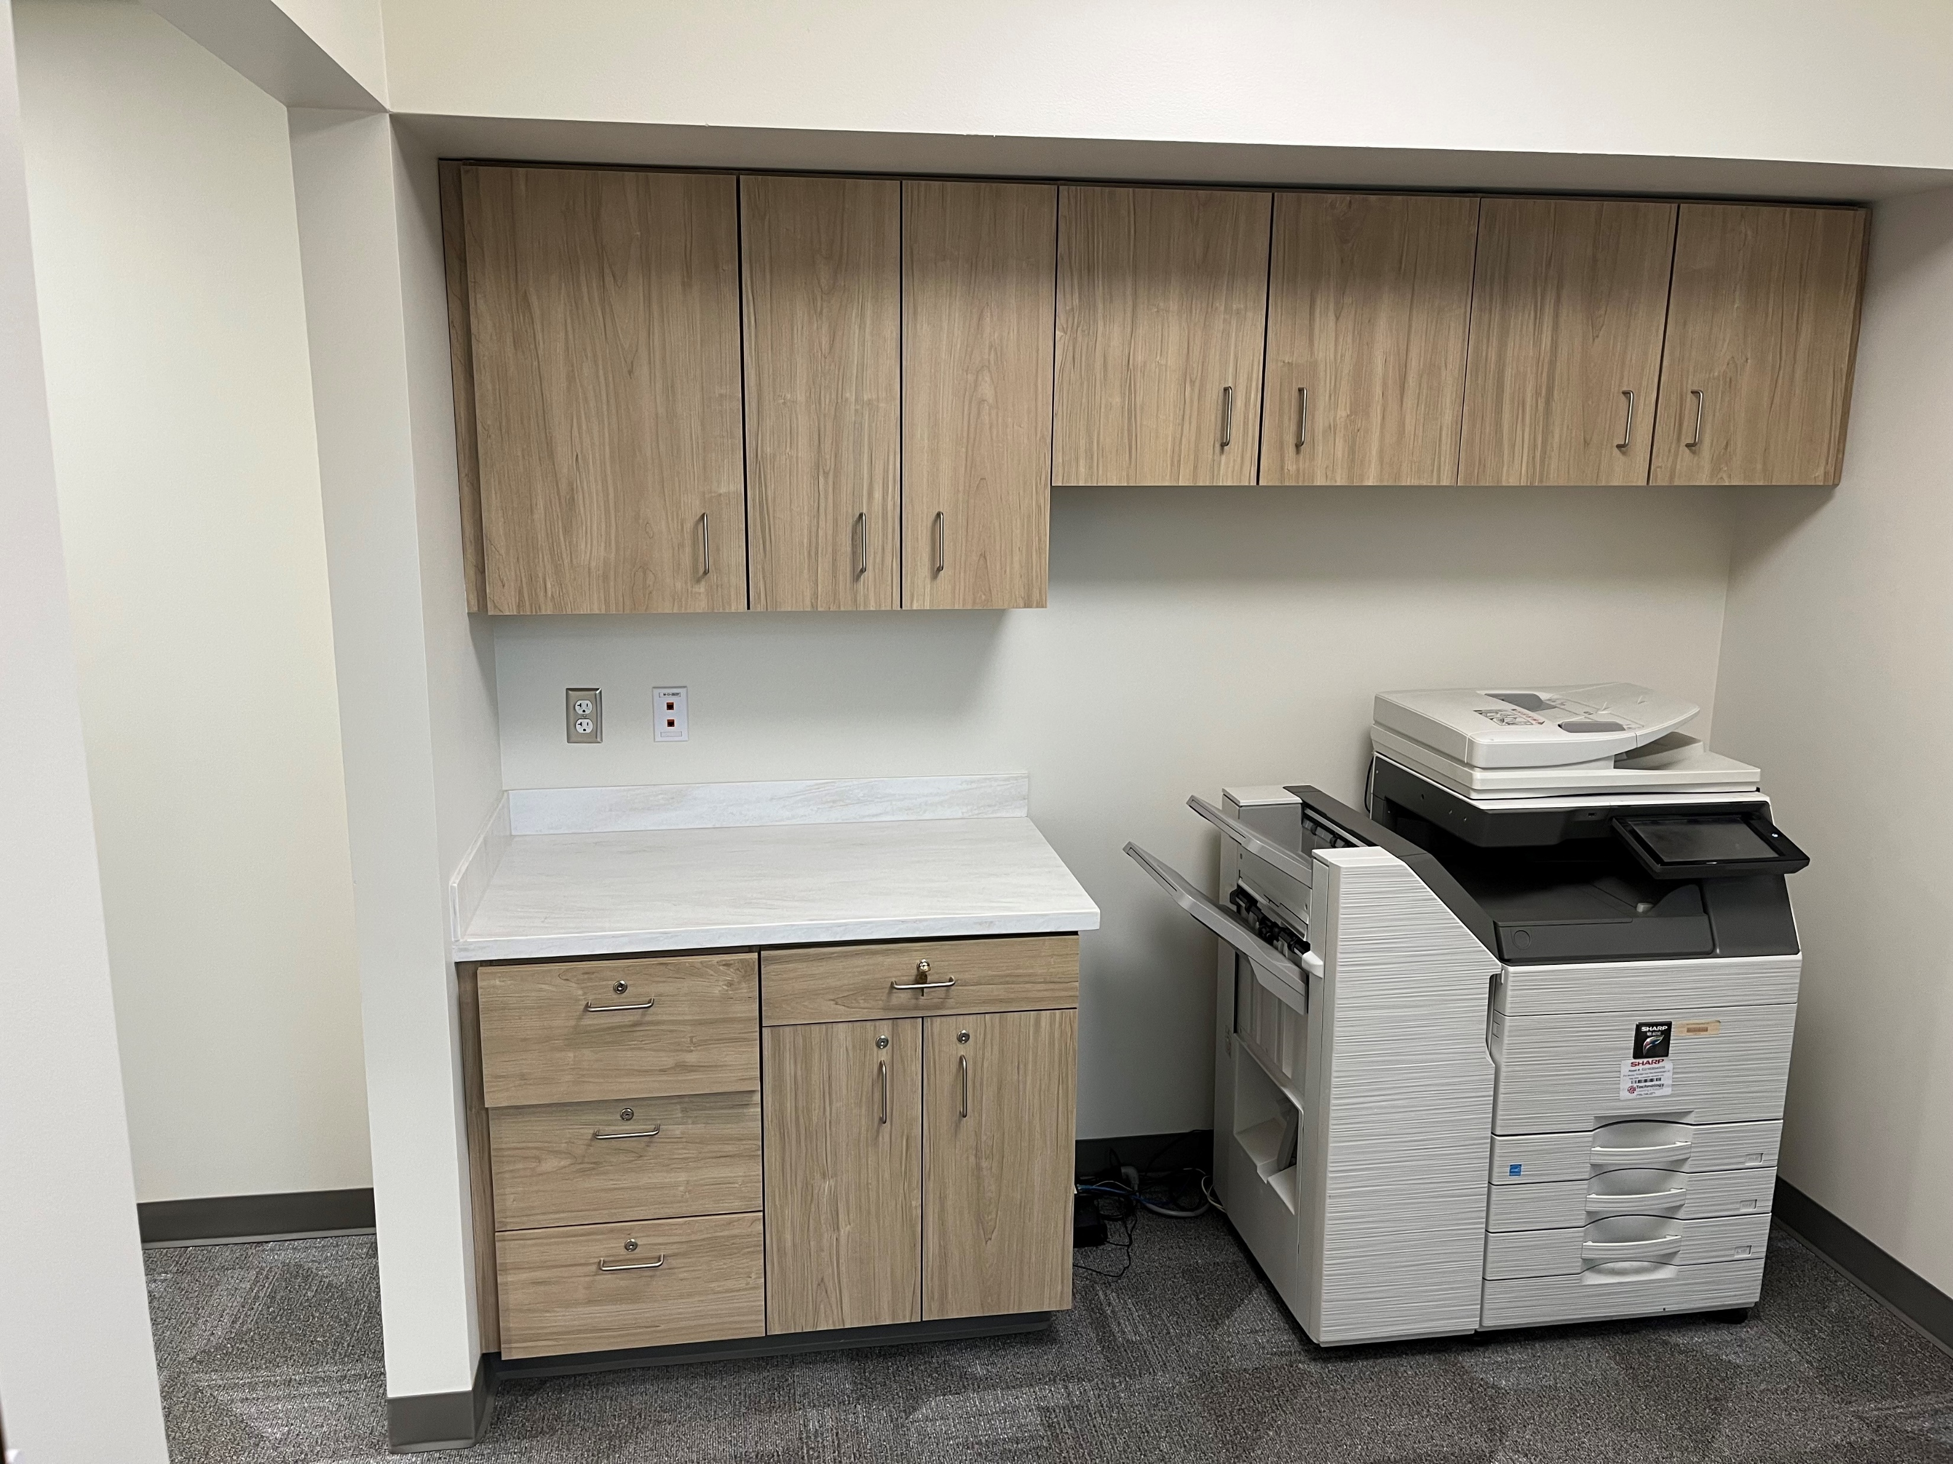
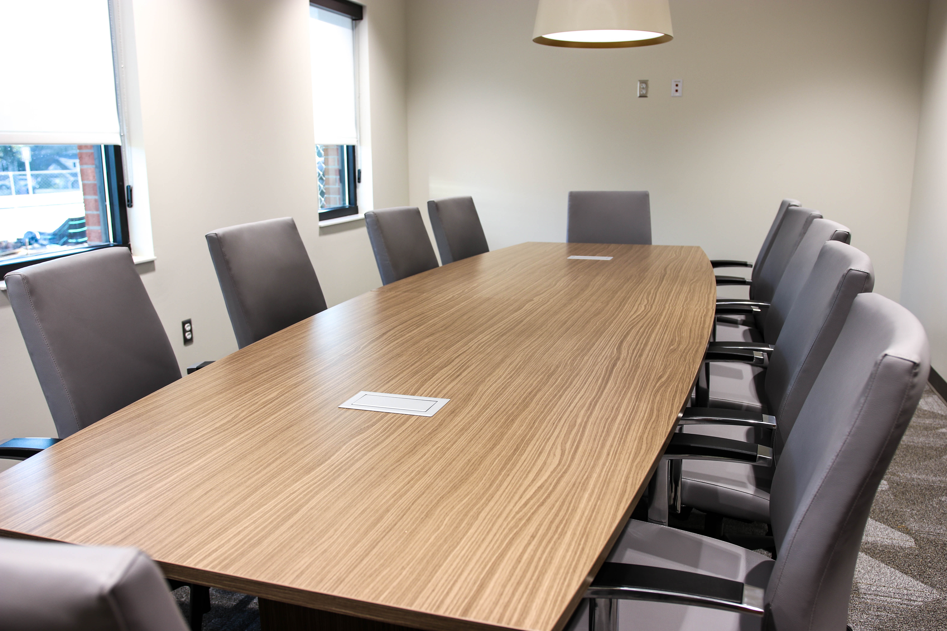
Hardaway Addition/Upgrade
Estimated Completion: Winter 2024/2025

Slide 10

Additional Projects
  Blackmon Road Middle HVAC Cooling Tower
    Estimated Completion (Phase 1): TBD
  COP 2026 Dimon, Fox, Richards and Rothschild HVAC
    Estimated Completion: TBD
  Double Churches Elementary Upgrade
    Estimated Completion: TBD
  Downtown Elementary HVAC Cooling Tower
    Estimated Completion: TBD
  Georgetown Elementary HVAC
    Estimated Completion: Fall 2025
  Kinnett Stadium Upgrade
    Estimated Completion: TBD
  Secure Vestibules
    Estimated Completion (Phase I): Winter 2025/2026

Slide 11
Available 2015 E-SPLOST Funds
As of 11/30/2024
Maximum cost from proceeds of
the tax as specified in the referendum $192,185,000
Less collection shortfall ($15,141,218)
Total E-SPLOST proceeds $177,043,782
Other funds $17,512,323
Total estimated revenue $194,556,105
Total Expended $193,100,826
Funds Available for Future Expenditures $1,455,279
Open Encumbrances:
HVAC-BRW GRG $1,290,521
BRW Intercom $58,778
ECM Roof $105,980
Total Encumbrances $1,455,279

Slide 12
Available 2020 E-SPLOST Funds
As of 11/30/2024
Maximum cost from proceeds of
the tax as specified in the referendum $189,000,000
Estimated additional proceeds in final
quarters allowed by law
Add'l Received thru November 30, 2024 $14,391,506
Add'l Estimated Dec and Jan $8,008,494
Total E-SPLOST proceeds $211,400,000
Other funds Received $25,373,800
Estimated additional $5,003,105
Total estimated revenue $241,776,905
Total expended and encumbered $173,800,145
Estimated funds available
for future expenditures $67,976,760

Slide 13
Available 2020 E-SPLOST Funds
Remaining Adjusted Allocation:
Stephen T. Butler STEAM Center Upgrades $2,000,000
New North Columbus Library $3,000,000
Technology $13,668,368
Athletic Improvements $6,500,000
Renovations and Modifications $30,255,651
Playgrounds $459,311
Campus Safety and Security $5,800,000
Furniture, Fixtures, and Equipment $116,039
Buses and Other Vehicles $3,286,391
Financing of Bond Issue & Other Debt Repayment $2,891,000
Total Remaining Adjusted Allocation $67,976,760

Slide 14
E-SPLOST

