Slide 1

Holland Central
School District
2025-2026 BUDGET PRESENTATION
#1
January 27, 2025

Slide 2
Presentation Overview
PRESENTATION OVERVIEW
January State Aid Run
Initial Property Tax Calculation
Draft 25-26 Revenues
Vehicle Proposition
Next Steps

Slide 3
10 Year Enrollment Data
PRESENTATION OVERVIEW
 | 14-15 | 15-16 | 16-17 | 17-18 | 18-19 | 19-20 | 20-21 | 21-22 | 22-23 | 23-24
Enrollment | 893 | 885 | 870 | 881 | 864 | 829 | 758 | 727 | 732 | 684
 |  | -8 | -15 | 11 | -17 | -35 | -71 | -31 | 5 | -48
data.nysed.com

Slide 4
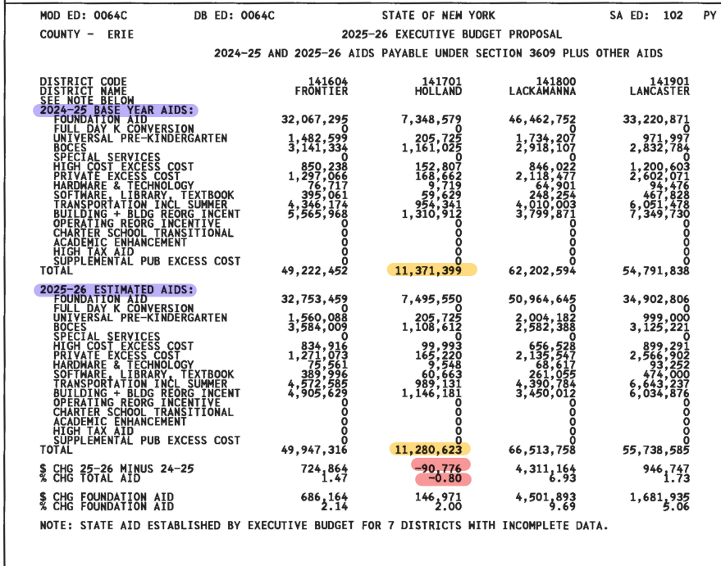
State Aid – January 15, 2025 Run
PRESENTATION OVERVIEW

Slide 5
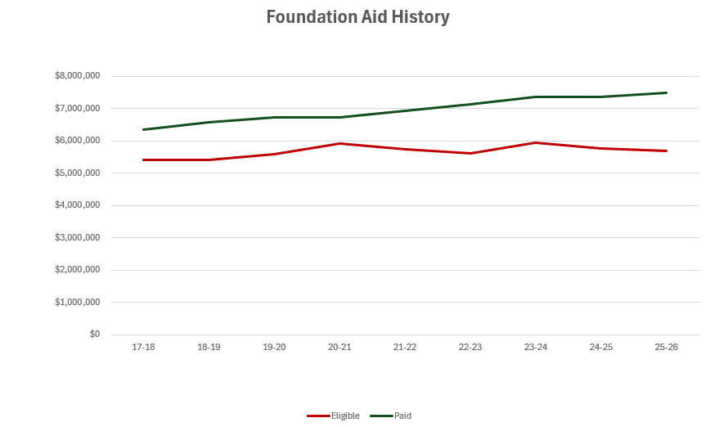

Slide 6
Foundation Aid
PRESENTATION OVERVIEW
Foundation Aid from 25-26 Aid Runs: $7,495,550
24-25: $7,348,579
Change Year to Year: $146,971 (+2%)
Foundation Aid Allocation by Formula SHOULD be: $5,756,650
What does this mean?
While suggested otherwise by the Rockefeller Study, Governor Hochul announced that all districts would receive at least a 2% year-over-year increase in Foundation Aid. Holland will receive an additional $146,971 rather than the expected decrease, which will result in a net increase of $1,738,900 above what the aid formula calculates that it should receive.
Good news for 25-26 but should not be counted on indefinitely.

Slide 7
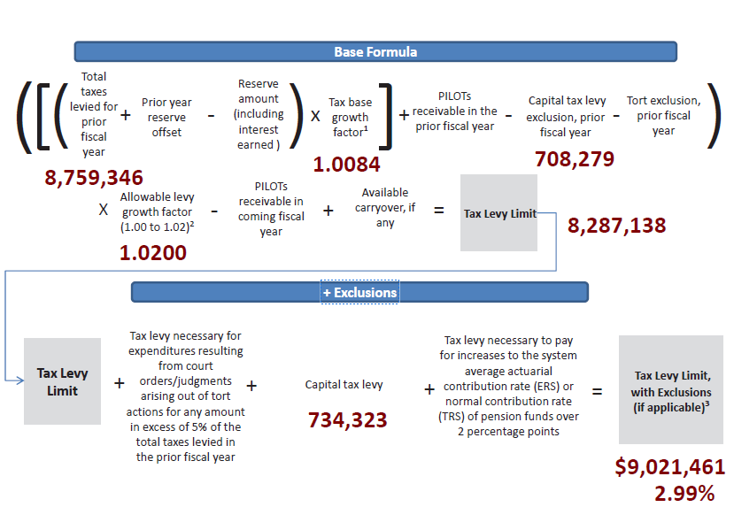
Draft Tax Levy 2025-26
PRESENTATION OVERVIEW
Tax Levy: $9,021,461
Increase % from 24-25: 2.99
Increase $ from 24-25: $262,115
Does NOT require supermajority vote

Slide 8
Draft 25-26 Revenues
PRESENTATION OVERVIEW
 | 2024-2025 | 2025-2026 | $ Change
Interfund Transfers & Appropriated Fund Balance | $663,296 | $100,000 | ($563,296)
Misc. Revenues | $465,240 | $339,978 | ($125,262)
Property Tax Levy | $8,759,346 | $9,021,461 | $262,115
Sales Tax | $1,150,000 | $1,040,000 | ($110,000)
State Aid | ($11,614,565) $11,371,399 | $11,280,623 | ($90,776)
Total | $22,652,447 | $21,782,062 | ($870,385)

Slide 9
Vehicle Proposition - $363,043
PRESENTATION OVERVIEW
Diesel Type C, 64 Pupil Front-Engine Bus $181,521.27
Diesel Type C, 64 Pupil Front-Engine Bus $181,521.27
Total Vehicle Proposition $363,043

Slide 10
Next Steps
PRESENTATION OVERVIEW
Finalize tax cap calculation
Review budget projections with departments and administrators
Review reserves/unassigned fund balance
Review BOCES projected contracts for 2025-26 (end of February)
First Draft of 25-26 Budget – March 2025 (Audit Committee)
Second Draft of 25-26 – March 2025
Adoption of 25-26 Budget – April 2025

Slide 11
Budget Vote
PRESENTATION OVERVIEW
Budget Hearing
6:00pm May 6, 2025 HS Library
Budget Vote
7:00am – 8:00pm May 20, 2025 Community Center
Board of Education Seat
One member for the BOE for 5-year term to end in 2030

Slide 12
Questions
PRESENTATION OVERVIEW

