Slide 1
PNNL Office of STEM Education
High School Program
Juan Lopez
HS Program Manager
Notes:
If you don’t already have a slide background image, consider using one from the approved PNNL Slide Backgrounds collection at https://pnnlcreative.getbynder.com/web/7f0fe9123b42683f/slide-backgrounds/.

Slide 2



HS | High School Internship Program
About the Program
HS students work alongside STEM professionals on research- or business-based projects
36-week academic year, or 10-week summer intern programs
Networking, career awareness, leadership & professional development opportunities
Eligibility
be enrolled in a public or private school and interested in pursuing a career in STEM or a related field
be in contact with your high school’s WBL coordinator and enrolled in WBL-required classes
be 16 years of age at the time the internship begins
be a sophomore, junior or senior at the time of application
have a cumulative GPA of 3.0 or higher (from 9th grade to current standing)
Application
Applications open in February and close mid-March
Interested applicants work with your Work-Based Learning Coordinator at your High School to verify job openings.
To apply, visit careers.pnnl.gov
YOUR CONTACT
Juan Lopez
HS Program Manager
juan.lopez@pnnl.gov
Notes:
PNNL is committed to providing students opportunities to engage with STEM professionals and learn about the world of science. Career-focused internships foster immersive experiences designed to expand students’ technical and communication skills and inspire students to pursue STEM career pathways.
PNNL partners with local high schools and beyond to offer student internships in a wide range of science, technology, engineering, and mathematics (STEM) and business fields. High School students have the unique opportunity to participate in internships, either during the summer or academic year.
As a PNNL intern, students can work in a laboratory alongside experienced researchers or in a PNNL office to expand their knowledge in a scientific field, develop their research abilities and business skills, and form relationships with PNNL’s scientists, engineers, and business leaders.
PNNL offers elective credits for these internships through work-based learning programs at students’ schools. In addition to direct research or business experiences, these programs include leadership development activities, field trips, networking opportunities and career awareness and development workshops.
Students must be at least 18 years of age to be eligible to work in PNNL laboratory spaces and in some field work settings.

Slide 3

HIGH SCHOOL INTERNSHIP PROGRAM
Career Awareness
Mentorship
Professional Development
Networking
“Participating in the internship allowed me to get my foot in the door and have a career that I love, establish lifelong friends and have a successful future.”
Laurie True, Former HS Intern
Notes:
I’m excited to be here today & share a bit about our HS program. I know many if not most of you have been engaged and collaborated with Nicole over the years and are likely fairly familiar with the process, programs, etc. but as I step into this role, I wanted to take the opportunity to share this information to ensure we are all have the same foundational understanding & there have likely been some changes due to COVID impact.
On the right-hand side, you can see some of the core elements of our intern program. I wanted to start off by sharing this quote because I think it really captures the essence of an internship and what we strive for at PNNL.
HS students are impressionable & it’s paramount that we meet the growing need for well-prepared STEM professionals. There is a national growing gap of those entering the workforce prepared to take on the tasks they are assuming.
Having the opportunity to inspire, engage and train students is critical. Providing HS students with the opportunity to expose them to career pathways & disciplines they may want to pursue or maybe have no idea about is a unique opportunity.
With that being said,

Slide 4

Office of STEM Education
IMPROVING STEM LITERACY & DIVERSITY
DEVELOPING OUR FUTURE WORKFORCE
COLLABORATING WITH EDUCATORS
Notes:
Now, you’ll hear about our work that aligns with the U.S. Department of Energy’s efforts to support and sustain a national pipeline of highly skilled and diverse science, technology, engineering, and mathematics (STEM) workers.

Slide 5

STEM Education Key Efforts
STEM Equity and Inclusion
Computing Science Education
STEM
Outreach
Professional Development for Educators
STEM Workforce Development
Notes:
PNNL is focused on building strong foundations for STEM literacy; increasing diversity, equity and inclusion in STEM; and preparing the STEM workforce for the future, particularly for DOE. We do that by developing strategic partnerships, engaging students and educators, and building computational literacy and STEM capabilities. Additionally, PNNL is a key stakeholder in the STEM Nexus, a multi-pronged community-based approach to engaging historically underserved, underrepresented student populations in STEM subjects to build out the STEM workforce of tomorrow.
STEM Outreach
STEM Equity and Inclusion
Professional Development for Educators
Computing Science Education
STEM Workforce Development
I want to step back for a moment & give you all some context about our OSE as a whole & the work that we do – and how internships come into play.
The colorful banners you see on my screen represent our core pillars, and our 5 signature efforts of the key work we do.
PNNL is committed to providing students opportunities to engage with STEM professionals and learn about the world of science. Career-focused internships foster immersive experiences designed to expand students’ technical and communication skills and inspire students to pursue STEM career pathways.
PNNL partners with local high schools and beyond to offer student internships in a wide range of science, technology, engineering, and mathematics (STEM) and business fields. High School students have the unique opportunity to participate in internships, either during the summer or academic year.
As a PNNL intern, students can work in a laboratory alongside experienced researchers or in a PNNL office to expand their knowledge in a scientific field, develop their research abilities and business skills, and form relationships with PNNL’s scientists, engineers, and business leaders.
The internships programs are placed under the OSE under the DOE workforce development pillar. Where you guys come in is the DOE workforce development. We want to continue that student; We want to bring them in. Why HS? They are most impressionable. They are looking for this experience & hopefully it will shape their career.
Things we are trying to continue is to work with our groups that are underrepresented and underserved. We know that females in science are underrepresented. We also know that our minority students are as well. We are pushing and reach those areas.

Slide 6
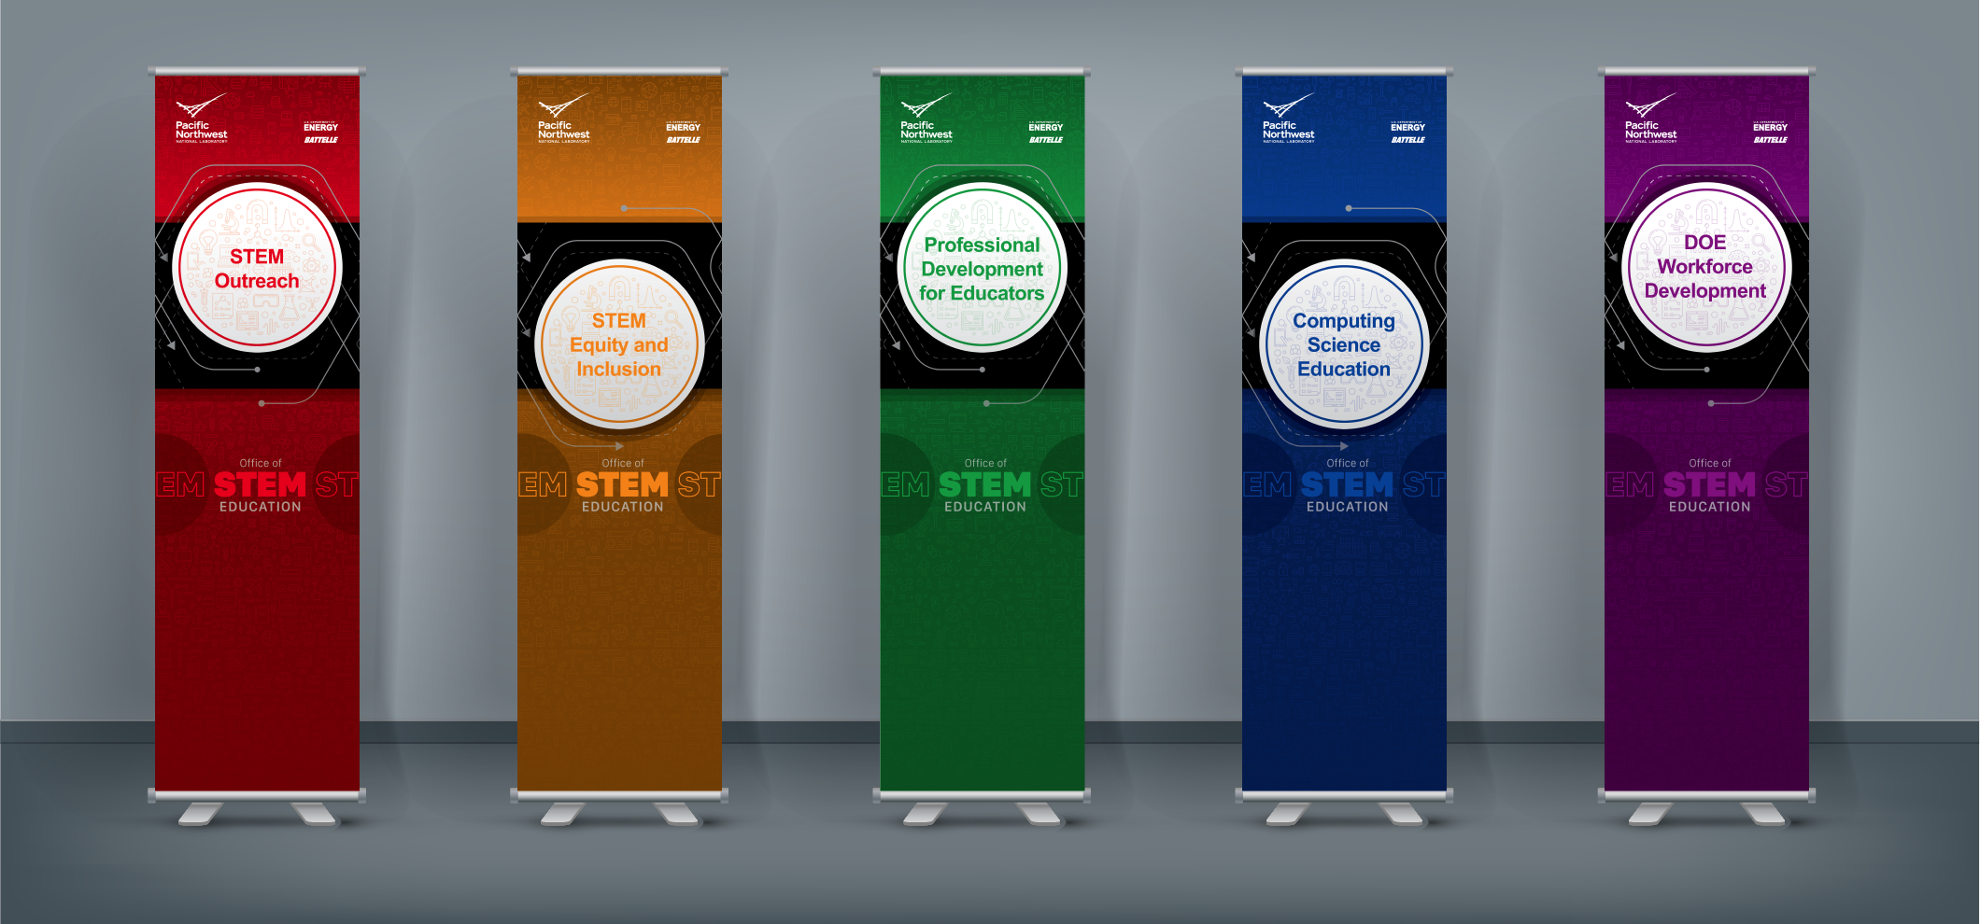

OFFICE OF STEM EDUCATION | Signature Programs

Slide 7

WORKFORCE DEVELOPMENT
Increase the number of students pursuing an advanced degree and STEM career pathways; particular emphasis on underrepresented groups and females
  Experiential and career-connected learning
    MESA
    Teacher & Scientist Partnerships
    STEM Ambassadors
    VR for High Impact Learning
    Competitions
  Internships and Research Appointments
    High School Programs and Internships
    DOE WDTS
    Sponsor
    Project-funded
  Gold Experience @ PNNL
    Professional Development
    Enrichment Activities
    Networking Events
Notes:
Workforce development is really the continuation of the student throughout their career pathway or pipeline & training the future, diverse STEM workforce. So as part of our PNNL workforce development efforts, we aim to INCREASE…. Focusing on underrepresented, aligned with our STEM Equity & Inclusion pillar. And we execute these efforts through….
We focus on internships & research appointments and how we entice them to continue to be interested and exposing them to National Labs.
This is what we do, that’s just a bit about us. Now you are part of our team, part of those impactful, workforce development efforts. So we WELCOME you.

Slide 8


#
HS Students
# Million
Budget
135
Districts
HS Program ​
Highlights
Capturing data to highlight the past three years of program success.
#
Converted to FTE Staff
55
Converted to LTE
#
Institutions
2019 – 2021 Data
Notes:
Discuss the numbers. Mention the converted to FTE and TECH are still active

Slide 9
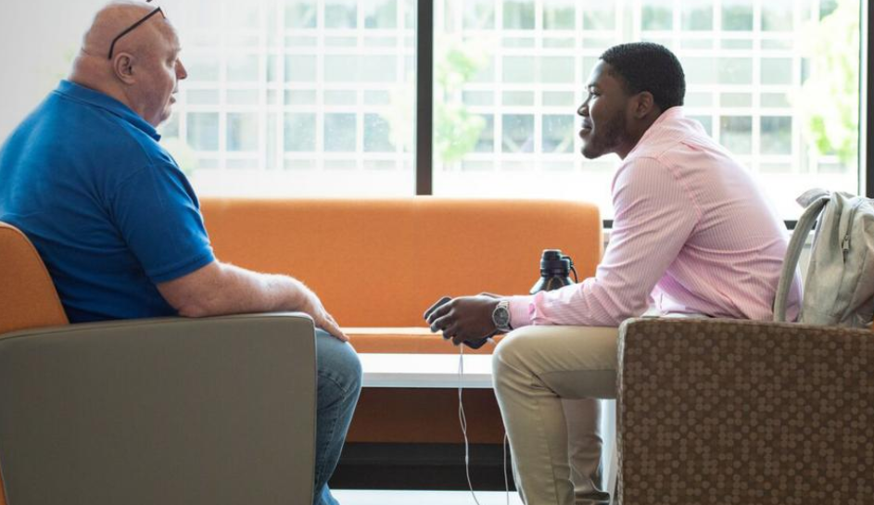

HS Program Opportunities
Age 16 required, limited tasks until age 18
Summer:
  Young Women in Science (YWiS)
  10 weeks, female juniors/seniors
  Student Research Apprenticeship Program (SRAP)
  10 weeks, juniors/seniors
  Summer Business Internship; (SBI)
  10 weeks, juniors/seniors
Academic Year:
  HS Student Research Intern (HS SRI)
  4 hours/day, ~36 weeks August-May
  HS Student Business Intern (HS SBI)
  4 hours/day, ~36 weeks August-May
Notes:
PNNL partners with local High schools & beyond to offer elective credits for these internships through work-based learning programs at students’ schools. In addition to direct research or business experiences, these programs include like I mentioned with the Gold experience leadership development activities, field trips, networking opportunities and career awareness and development workshops.
During the academic year, PNNL offers internships to high school students interested in either business or research, with work available up to four hours per day, five days per week. The High School Business Intern program allows students to work closely with experienced PNNL business professionals, while students in the High School Research Intern program receive mentorship in a laboratory setting from PNNL scientists and engineers. PNNL offers elective credits for these internships through work-based learning programs at students’ schools.
Students must be at least 18 years of age to be eligible to work in PNNL laboratory spaces and in some field work settings.
The Summer Research Apprenticeship, Young Women in Science and Summer Business Internship programs last about 10 weeks and provide students interested in STEM and business fields opportunities to engage and contribute to research and business-based projects while working in collaboration with a PNNL mentor
In addition to direct research experience, these programs include leadership development activities, field trips, and communications and career awareness workshops. Students must be at least 18 years of age to be eligible to work in PNNL laboratory spaces and in some field work settings.

Slide 10



HS: Special Programs
Bridging Opportunities for Leadership & Training in STEM (BOLTS)
  Specific Program for Computing & Analytics Division (NSD)
  Mission & Focus to increase number of student with computing skills and interest in STEM from historically underserved groups and females.
Minority Serving Institution Partnership Program - National Nuclear Security Administration (MSIPP-NNSA)
  is a research-based experience for students who are traditionally underrepresented in science and engineering, specifically African Americans, Hispanics, and Native Americans.
Notes:
BOLTS
Bridging Opportunities for Leadership and Training in STEM (BOLTS) is a mentorship program between PNNL researchers and students from local underserved high schools. The program is tailored to increase students’ confidence and expose them to multiple careers and opportunities in science, technology, engineering, and math (STEM)-related fields, with an initial focus on careers in computing analytics.
The mentorship program follows a cohort model. Each cohort participates in a formal capacity for three years. Students in each cohort have opportunities to participate in as many as three computing related STEM internship experiences at a national laboratory. They publish and present their research, network with scientists and staff, learn about scholarship and research opportunities, and build the confidence to pursue STEM through college and career.
WHAT TO EXPECT
As part of the BOLTS program students will receive:
» Support and guidance to explore and develop computing skills in STEM areas.
» Mentorship support within the STEM-related area they have chosen.
» Guidance on how to apply for scholarships, PNNL internships, and other opportunities.
Participating scientists receive training on how to be successful mentors to high school students from diverse backgrounds.
AUDIENCE
The BOLTS program is designed for students who demonstrate potential for success in STEM but may have real or perceived barriers to fulfilling that potential. Participants are recommended either by their teachers or by coordinators from the nonprofit Communities in Schools. Each cohort has a duration of at least three years, beginning during the students’ junior year in high school and continuing through their first year of college.
MSIPP-NNSA
The Minority-Serving Institution Partnership Program - National Nuclear Security Administration (MSIPP-NNSA) is a research-based experience for students who are traditionally underrepresented in STEM.
MSIPP-NNSA is designed to build a sustainable pipeline between the U.S. Department of Energy facilities and national laboratories and minority-serving institutions in STEM disciplines, and bring a heightened awareness of NNSA plants and laboratories to institutions with a common interest in STEM research fields. To learn more, visit the NNSA’s MSIPP website
**AS you can see, both programs emphasize serving & cultivating opportunities for historically & traditionally underrepresented populations. Again, these programs are under the HS program umbrella but are considered special programs due to key difference in deliverables, funding, approach, etc.
ABOUT OUR INTERNS: This program seeks students who have a passion for solving complex problems in national security, energy, and science. MSIPP-NNSA interns work side-by-side with a scientist in a specific research area that aligns with NNSA’s mission by applying cutting-edge research to make our nation safer and stronger. Such research areas include:
Biology
Computational science
Cybersecurity
High-energy physics
Mass spectrometry
Radiation detection
Radiochemistry
MSIPP-NNSA interns are assigned a PNNL project advisor who guides their work on projects supporting a wide range of NNSA mission areas and capabilities. Interns will deliver a poster presentation on their work and internship experience as part of the end-of-summer internship symposium sponsored by the Office of STEM Education.
TIMELINE
MSIPP-NNSA internship opportunities are posted on the PNNL Careers website. Opportunities are typically posted in September/October for interns that will begin assignments in June. MSIPP interns come to PNNL fully funded by NNSA for a period of 8-12 weeks. Depending on the work scope and mentor, the internship can be extended.

Slide 11




AT A GLANCE | Academic Year Cohort & Summer Cohort
Participants
  47 Male
  43 Female
  = 90 HS AY Interns
Minors @ the Lab
  Safety Guidance
Directorates
  Earth & Biological Sciences
  National Security
  Energy and Environment
  Physical and Computational Sciences
  Business Services
Onsite versus Remote
  Depends on project
Notes:
Really quick, at a glance what does the summer cohort look like.
We have about 14 students continuing their academic year internships into the summer.
16 SRAP new students coming in, 2 Yong Women in Science… Total of 37 and we haven’t finished hiring yet.. The HS program increases dramatically in the summer.
Everyone is remote, the lab is still not allowing HS onsite.
Minors at the lab, we have a few & we need to make sure we are following up with them. Still 10 in hiring. Hoping we hit 50 #. That would be the highest we have for a summer program.
That is a lot of you HS students taking part, who are from all over. I don’t know our demographics just yet, but we have interns participating from all over the nation. We are excited to have you all here!

Slide 12
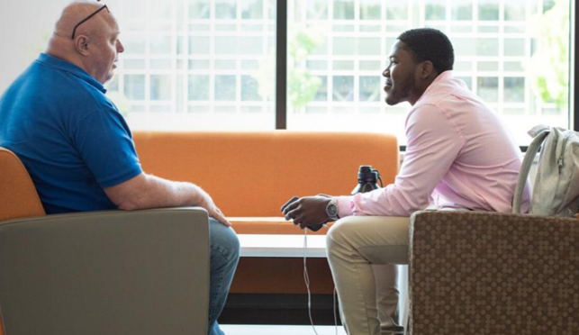
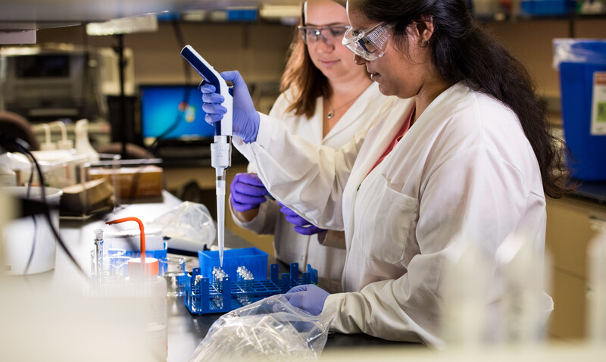

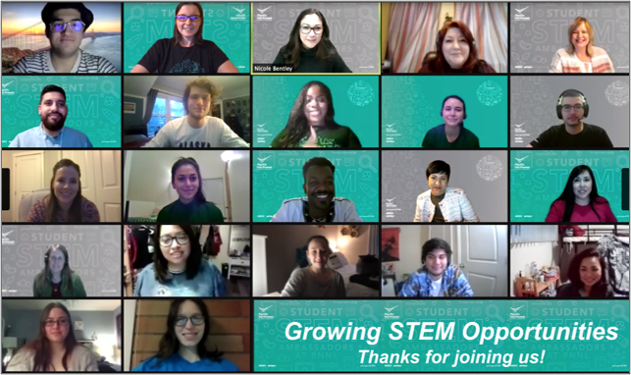
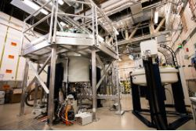

HS Program Highlights
PNNL internship programs are committed to providing a positive experience for students and mentors
Deliverables
Project Work
Resources
Mentorship
Enrichments
Networking
Notes:
What does the HS program entail?
Mentor – students are paried with High caliber scientists and business professionals provided with specific mentor training & resources to mentoring students
Collaborate - Work alongside a STEM or Business Professional
Grow - Enhance technical, communication and cultural skills
Engage - Receive guidance on career development and resources
Project Work
Business or researched based; work with stem professionals in work that creates impact designed to solve real-world, complex challenges
Deliverables
Attend presentation & abstract workshop
Symposium – 10 min PPT; 2 min Q & A.
Abstract – 200 words about their project. Mentor support, PM support, workshops to prepare & clear deadlines
Enrichments
Professional Development: Participate in opportunities to enhance your technical & soft skills
Social Activities: Meet, engage and connect with other interns across the lab!
Career Resources: Be in the know about key resources to continue your career pathway
Networking – have the chance to network with those in their group & beyond! Linked in workshops, etc.
Resources – Intern newsletter, Yammer STEM interns page, HUB/Scout, Mentor, PM, etc.

Slide 13
FORMAT | Obligations & Deliverables
Check-In’s
To discuss current project(s) + challenges, barriers, successes
  1-on-1 PM Check In’s
  Monthly Group Check In’s
Gold Experience
Attend enrichments & professional development
  Remote - LaunchPad
Deliverables
  Symposium PPT Presentation
    10 min + 2-min Q&A
  Abstract for Symposium Brochure
    200 words
Mentored by PNNL STEM professional
Monthly 1:1 & Group HS Program Check In’s
Networking + PD Opportunities
Symposium & Abstract Deliverables
Resources for a Remote Experience
Notes:
Mentor - High caliber scientists mentoring students
Collaborate: Work alongside a STEM or Business Professional
Grow: Enhance technical, communication and cultural skills
Engage: Receive guidance on career development and resources
Project Work: Science based or business based; Impact – engage in work solving real world problems
Check in’s (student and mentor) – to discuss project, well being, challenges/barriers/successes, etc.
Another chance to network and engage with other interns
Networking/PD Opp’s – via LaunchPad – including PD, career awareness & development, enrichments, social events (see ex’s off to right)
Mentors have access to view opportunities available to students; students are encouraged to share with their mentor what they are attending & come to a mutual decision on how many events to attend
ENRICHMENTS
Abstract & Presentation Skills Workshop
Power of Active Listening
Presenting a Professional LinkedIn Profile
VIRTUAL TOURS
EMSL
PNNL Sequim Marine Sciences Lab
Glass Lab at APEL
NETWORKING EVENTS
Tuesday with
Coffee Break
Trivia
Deliverables
Symposium – 10 min PPT; 2 min Q & A. Abstract – 200 words about their project. Share their project work, demonstrate communication and presentation skills and highlight impact and awareness about the unique and crucial work PNNL is conducting across several mission areas.
Mentor support, PM support, workshops to prepare & clear deadlines
Resources for a Remote Experience– Intern newsletter, Yammer STEM interns page, HUB/Scout, Mentor, PM, etc.
Personal
Professional
Educational

Slide 14
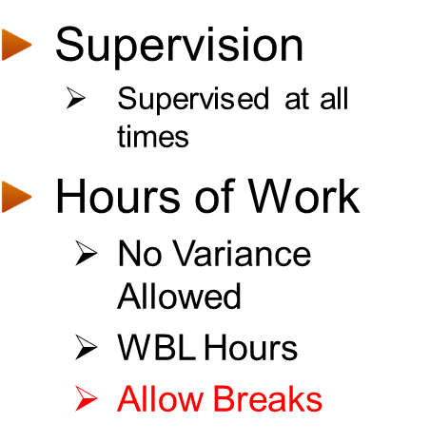
REMOTE WORK = ONSITE WORK
Hours and Schedules Minors are Permitted to Work in Non-Agricultural Jobs
 | Hours a Day | Hours a Week |  | Days a Week | Begin | Quit
14-15 year-olds
School weeks | 3 hours (8 hours Sat.-Sun.) | 16 hours |  | 6 days | 7 a.m. | 7 p.m.
Non-school weeks | 8 hours | 40 hours |  | 6 days | 7 a.m. | 7 p.m. (9 p.m. June 1 to Labor Day)
16-17 year-olds
School weeks | 4 hours (8 hours Fri.-Sun.) | 20 hours | 6 days |  | 7 a.m. | 10 p.m. (Midnight Fri.-Sat.)
School weeks with a special variance | 6 hours (8 hours Fri.-Sun.) | 28 hours | 6 days |  | 7 a.m. | 10 p.m. (Midnight Fri.-Sat.)
Non-school weeks | 8 hours | 48 hours | 6 days |  | 5 a.m. | Midnight
WAC Guidance (Academic Year)
Holidays: Thanksgiving, Christmas, Spring Break
Minors cannot work during school hours (special variance: running start)
Max of 4 hrs/day on any school day preceding another school day (Friday’s and/or if no school following a workday can work a longer day; cannot exceed 20 hours)
Notes:
*14-year-olds and 15-year-olds can work up to 3 hours on a school day preceding a school day. All other days, 8 hours per day.
**16-year-olds and 17-year-olds can work up to 4 hours on a school day preceding a school day. All other days, 8 hours per day.
***Up to 28 hours available through special variances.
WASHINGTON ADMINISTRATIVE CODE (WAC)
*Minors cannot work during school hours, unless the minor has been excused from school attendance by the minor's school district superintendent or her or his authorized agent. SO – students as part of a WBL approved course can be excused as that is what the course entails; however, they cannot just be logging on whenever during other classes.
*Running start is a special variance per PNNL policy and in line with the WAC. Since they have a different schedule for classes they can work more than 4 hours.
Ultimately it is up to their mentor, as they hired them on, and have a certain amount of direct project funding. I encourage the mentor & student to have these conversations.
Per WAC - the work week for minors is Sunday through Saturday and the school week is Monday through Friday. Any week with any amount of school time is considered a school week.
With summer = non-school meaning you have a lot of flexibility. You are hourly interns, so you are a LTE. Uou can work up to 40 hours if you want, except if you work in any of the states on the following slide.
You do not get vacation or holiday pay. (So coming up July 4th we are closed July 5th you don’t work that day and you don’t get any pay. If you are wanting to work & you need your hours, you need to talk to your mentor about working extra hours during the week or that Saturday. As long as you are not from these states you can do that.)
Training is considered work hours. So are enrichments and professional development workshops and events.
Confirm appropriate charge codes with your mentors – they establish that since they are paying for your time through their funding. If they haven’t given you a charge code yet, follow up with them.

Slide 15


Academic Year Work Hours
HS Interns are considered hourly LTE’s
  Hourly pay
  No Vacation or Holiday Pay
  Sick leave (1 hour for every 40 hours worked)
Hourly LTE located in states listed below are NOT permitted to work more than 8 hours a day or weekends.
  Alaska, California, Colorado, Kentucky, Nevada, Rhode Island & Puerto Rico
Minors working more than four hours must take at least 30-minute break
Minors working more than four hours are entitled to a 10-minute paid break
Hour's violation report ran weekly to ensure compliance of minors
2 violations of hours worked will result in internship exit
Notes:
Hours violations communicated to student & mentor. Big policy, we must ensure we are in compliance

Slide 16
Student Documentation Requirements
HR Requirements
Parent Authorization Form for Minors
Minor Workplace Evaluation Form
  *(if onsite)
Medical Release Form
Emergency Contact Information
OSE Requirements
LaunchPad Registration
1 Page Write-Up
Work Schedule
School Schedule
WBL Enrollment Confirmation
Worksite Learning Agreement
Notes:
Very briefly, I wanted to share what is required of hS interns from a documentation standpoint. I think this may be valuable for context about what our program requires from our office as well as HR and provide a better understanding about our policies.
HR REQUIRED FORMS
L& I (Parent Authorization Form): (Portia sends during onboarding & will copy or file for PM access) now we don’t get cc’d on any offer letters. L& I is the school authorization form, it is to employ a minor. It is a pre-employment form. * will remain somewhere in HR, maybe p file
Medical Release Form – coordinator to send/file to send out. Student fills it out & the Parents has to sign it. It talks about emergency medical treatment for minors. Anova requested we should think about that. When they were HR. Talked to lawyer David, he said we should do it. He approved the form & to let parents know that that’s what we need to do – for a MINOR. When she sends out forms, she will put it in a folder that PM can access.
Minor Workplace Evaluation Form (if onsite) – if student were onsite, it would have to be completed before the student is onboarded. Document is owned by safety & health; we make sure it is signed & everyone sees it. The mentor, the GL, the safety & health and COO and the student. In case of a causal analysis, those at fault, they would go back to the mentor/manager but come looking for PM & HR because we also have it. *will remain in the HR, maybe p file. **HS PM that it is completed before a minor steps foot on campus!! PM gives it to Joanna & puts it in the p file.
Emergency Contact Information: Student must designate an emergency contact in their myHR portfolio so we have that information on hand
OSE PROGRAM ACTIONS
1 page write up: includes a brief summary of the project work they are doing. We ask for this in case there is a change in work scope, we must document that in the case of an audit to ensure we know – especially for minors – the roles & responsibilities of the job duties they are performing
Work/school schedule – HS PM needs to have these for documentation purposes to ensure supervision of students by the mentor and myself, especially given we are remote AND ensure compliance of hours and make sure no violations are taking place! Need to know when they are in class.
WBL enrollment confirmation – they have to be enrolled in WBL program to take part in the internship. We don’t just hire cheap labor – HS students must be part of a program & we want to ensure it is in accordance with school & district policies. So they get a grade/credits for their course and are able to have a wbl experience through an external internship.
Worksite Learning Agreement - for them to take part in a HS program at PNNL, they have to be enrolled at a WBL course. The School OSPI owns that, we need a copy of it. Mentor signs it. It tells you what is required for school, what is required for the employer. That is what the WBL coordinator gets involved in. PM has a copy of that & the school is accountable for that. PM responsibility; for local only; the WBL Coordinator is the one who initiates the Worksite Learning Agreement, we just need a copy of it. WBL coordinators give to students to have mentor sign as the agreement.

Slide 17
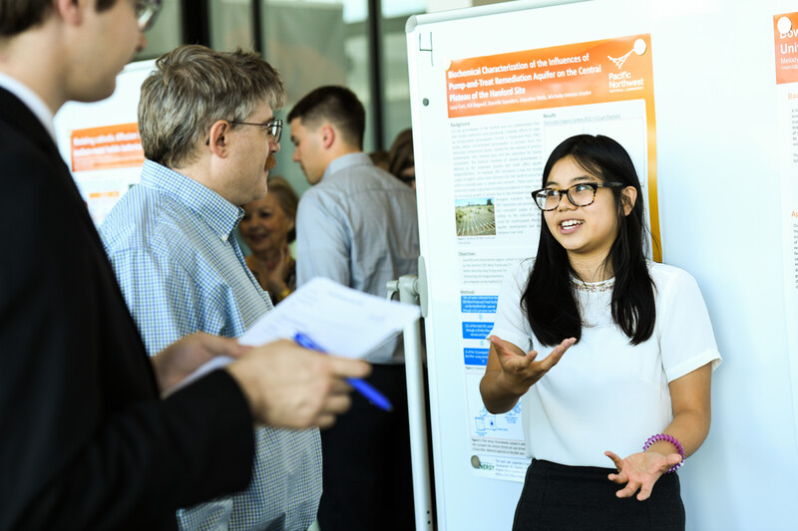
PNNL VIRTUAL RESEARCH SYMPOSIUM
May, 2025
  Zoom Platform
Notes:
This is our tentative date for Symposium. Again this is the final culmination of the student’s project where they get to share their work with colleagues and guests.
I know none of you have current students & Brenda you have a bolts intern with different deliverables but if anyone is interested in attending to view and about the work of our student research interns, I am happy to include you on the invite.
Symposium is scheduled…. We do recommend students stay the whole time. Sometimes they elect to to hear other students but again that’s up to you.
Mentors & guests and we let the students know for any family & friends, they need to register. There is a spot to register if you want to attend. It will be put on your calendar so you can plan. Same thing with students, they will save it as a calendar invite.
Just be aware we have lots of stuff going on & we will encourage them to attend.

Slide 18





HS Recruitment Timeline
1
2
3
4
5
Nov / Dec / Jan
February
March
April / May
June / August
Mentor Recruitment;
Student Outreach
Postings Live;
Connect with WBL Coordinators
Job Postings Close;
Process Student Applications
Conduct Interviews; Selections Made; Notify WBL Coordinators of Selections
Hiring Process Initiated; Students Onboarded
Notes:
This visual provides a nice snapshot of our recruitment timeline for HS students.
Postings open ~ 4 weeks. Live Mid-Feb; Close Mid-March.
April/May – Notify schools / WBL coordinators of selections. (WBL coordinators want to know for academic year students in May to put them in cohorts for next year classes)
*ideal timeframe for AY & Summer (AY we have had late postings in Aug/Sept) – want them to start 2 weeks before school to get training done*

Slide 19

HS Career Opportunities
ELGIBILITY
APPLICATION
be enrolled in a public or private school and interested in pursuing a career in STEM or a related field
be in contact with your high school’s WBL coordinator and enrolled in WBL-required classes
be 16 years of age at the time the internship begins
be a sophomore or junior at the time of application
have a cumulative GPA of 3.0 or higher (from 9th grade to current standing)
be willing to work 3–4 hours every weekday, except PNNL holidays
Applications open in February and close mid-March of every year
Interested applicants work with your Work-Based Learning Coordinator at your High School to verify job openings.
To apply, visit careers.pnnl.gov
  Click browse opportunities, find Undergraduate/High School, and browse openings for high school students. *Application deadlines vary, so please visit the application website for details.
Application Components: Cover Letter (Statement of interests) & Resume
Notes:
**Exceptions are granted for students who do not have a WBL course available at their school or district. I know that largely applies to non-local, out of state candidates*. We do have one current AY student who does not have a formal WBL course at her school.
High school students— are you interested in preparing for careers in STEM? Why not consider an internship at PNNL? During the academic year, students attend regular classes at their school for half a day and work up to 4 hours a day, 5 days a week at PNNL, working with a mentor in a specific research area. The internship includes educational and leadership development activities involving laboratory demonstrations, field trips, and communications and career awareness workshops.
For an academic year internship, PNNL works in collaboration with your high school’s work-based learning (WBL) program to provide elective credits that apply to graduation.
Restrictions May Apply: Due to PNNL policy, students under 18 years of age are not eligible to work in laboratory spaces and may be restricted from certain kinds of field work.
Key Dates: Internship applications open in early February. Positions are posted on the PNNL careers page as they become available. Be sure to check the job site often and read individual job postings carefully for specific closing dates. Internships take place during the school year between August and May.
Eligibility: If you meet the criteria below, please apply! To be considered for an internship, students must:
be enrolled in a public or private school and interested in pursuing a career in STEM or a related field
be in contact with your high school’s WBL coordinator and enrolled in WBL-required classes
be 16 years of age at the time the internship begins
be a sophomore or junior at the time of application
have a cumulative GPA of 3.0 or higher (from 9th grade to current standing)
be willing to work 3–4 hours every weekday, except PNNL holidays.
Students involved in other activities that require a significant time commitment should consider whether they will be able to fulfill the time requirements of a PNNL high school student research internship appointment.

Slide 20
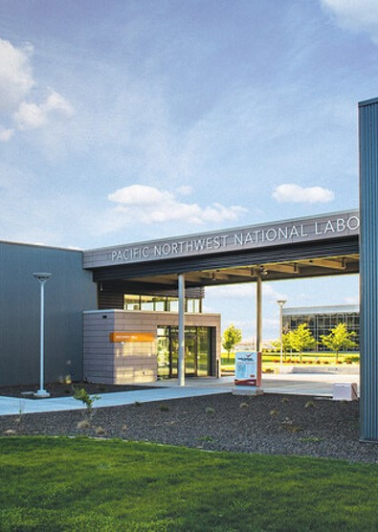


PNNL | A Place to Build Your Career
Average length of employment
for all jobs combined is 12 years
Retention rates have historically ranked in the top 25th percentile of industry benchmarks
Staff and Lab leadership agree that what attracts and retains people is:
Innovative Work, Job Interest Alignment, National Lab Mission, Work-Life Balance

Slide 21





WHERE TO APPLY
Careers.pnnl.gov
Notes:
Demographics of our workforce – more than 1,000 PhDs – scientists, engineers, other professionals
25,000 people are applying at any one time
Especially looking for people with advanced degrees, esp PhDs, in certain S&T areas: cyber security, data analytics, computer science, nuclear engineering, radiochemistry, power engineering, high-performance computing, atmospheric science
For fundamental science – hiring managers often choose from existing post-docs
Spectrum of basic science > applied technology
Others commercialize and deploy our IP
You work in collaborative teams across disciplines
Work with some of the nation’s top experts in data analytics, climate science, nonproliferation
Startups (roots) and Tech Trek

Slide 22



At a Glance – Summer HS Cohort
Participants
  14 Academic Yr.
  16 SRAP
  2 YWiS
  1 BOLTS
  4 MSIPP
  = 37 HS Interns
Onsite versus Remote
  100% Remote
Minors @ the Lab
  1 Academic Year
  8 SRAP
  2 MSIPP
Still In Hiring Process
  10 more participants
Notes:
I wanted to show you really quick what our HS summer cohort will look like. (** add where students are coming from – from all over, which is a good thing!)
Those academic year continuing on… they will go through summer & then off to college!
SRAP – student research focused
YWIS – women focused
Everybody is remote. No one is onsite! All HS kids are remote & it will continue that way until we probably are released back to work. If you are thinking you would like an academic year it will still be remote until further notice.
We still have minors at the lab. So, we need to be aware of that. even if your student is 18, they are still part of the HS program & they still need to be treated as such.
Next slide

Slide 23
Worksite Learning Agreement
The Training Supervisor/Employer agrees to comply with all requirements of a school work-experience program and:
Recognize the educational value of the training site and guide the student trainee in performing the job tasks.
Provide varied work experiences.
Consult with the coordinator on any problems that arise and/or prior to releasing the student trainee from the training site.
Inform other employees of their important role in assisting with the training of the student trainee.
Provide the student trainee with sufficient work hours to earn school credit.
Assure compliance with state and federal guidelines and regulations regarding non-discrimination against any employee/student trainee on the basis of race, religion, sexual orientation, including gender identity, national origin, gender, age or disability. Harassment of any employee/student trainee with regard to race, color, national origin, gender, genetic information or disability is strictly prohibited.
Provide a new employee orientation

