Slide 1

NHS Counseling Department
Northview High School
Class of 2029

Slide 2
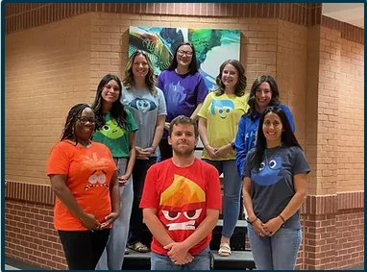
Counseling Dept Staff
Cara Dunn (Dept Chair): A-Ci
Cindy Choung: Cl-Ji
Andrew Alhadeff: Jo-M
Tiffany Heller: N-Si
Savannah Wilkerson: Sk-Z
Jasmine Jones: Social Worker
Taryn Woolstenhulme: Registrar
Amanda Richards: Intern

Slide 3

Graduation Requirements
Students must earn a total of 23 credits:
4 English
4 Mathematics
4 Science
3 Social Studies
1 Health/Physical Education
3 CTAE and/or World Language and/or Fine Arts
4 additional elective units
Counselors will conduct classroom guidance lessons and supplementary parent nights to support students in meeting these requirements.
Students planning to enter/transfer into a 4-year college/university must take a minimum of two units of the same world language.

Slide 4

Earning Credits
Students earn credit for a course by earning a passing grade (70 or higher) in the course.
Grading Scale:
A = 90 or higher
Grade Level Placement:
Freshmen = Less than 5 credits
Sophomore = 5 – 10.5 credits
Junior = 11 – 16.5 credits
Senior = 17 or more credits
F = 69 or below
C = 70-79
B = 80-89

Slide 5
General Grading Policies
Interim progress reports will be issued to students every 4.5 weeks.
Transcripts are issued at the end of S1 and S2; final semester grades are reflected on the high school transcript.
Each course semester is independent of the other; S1 and S2 course grades are NOT averaged.
Honors and AP courses receive an additional 7 points added to the final passing grade.
Parents can use Infinite Campus (IC) to track assignments, grades, attendance, discipline, etc. during the semester.

Slide 6
Typical 9th Grade Schedule
Teachers make recommendations based on the prerequisites listed in the academic catalog-online at www.northviewhigh.com.
Individual departments determine the prerequisites (not the counselors).
Research classes carefully.
Be aware of the scheduling policy. We do not change schedules unless there is an error on our part.
Semester One | Semester Two
9th/10th Grade English/Honors | 9th/10th Grade English/Honors
Math/Accelerated | Math/Accelerated
American Gov’t or Health AP Gov’t (Yearlong) | American Gov’t or Health AP Gov’t (Yearlong)
World Language/Honors or another elective | World Language/Honors or another elective
Biology/Honors | Biology/Honors
Elective | Elective

Slide 7

Final Exams and End-of-Course Tests
Georgia Milestones:
Biology*
11th Lit/Comp
GSE Algebra 1*
US History
9th grade courses are marked with an *
Final exams are given in all other courses – see teacher syllabi for details

Slide 8
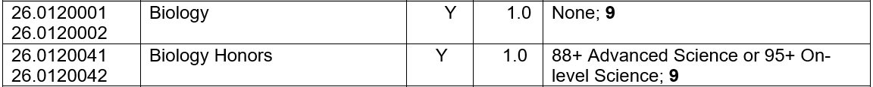
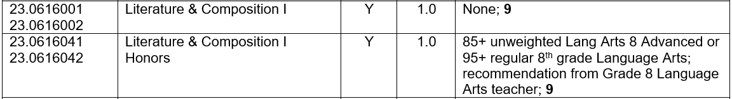
Course Placement
Teachers make recommendations based on prerequisites posted in the Course Catalog.
SCIENCE
LANGUAGE ARTS

Slide 9
Course Placement
Teachers make recommendations based on prerequisites posted in the Course Catalog.
SOCIAL STUDIES
NO WAIVERS permitted for 9th grade AP courses. Students must meet specified criteria.
AP Government Requirements for rising 9th graders: 88+ in 8th Grade History, 88+ in Language Arts Advanced.
Students may need to remove General Health and/or American Government from their schedule to make room for an AP course. Summer school and online options are available to rising 9th graders at the parent’s expense. Approximate cost for two classes taken during the summer is $500.
AP Gov’t is a yearlong course. AP Gov’t fulfills the American Gov’t graduation requirement.
Students must have the ability to learn independently, though they will have support in class.
Students should be strong with social studies skills including political cartoons and reading comprehension.
Students will be required to read material regularly on their own. When reading, students should read for detail; application and background of the concepts will be given in class.
The course is heavy on memorization of vocabulary and key concepts since tests/quizzes will be formatted to AP style multiple choice questions and free response questions. These questions will require students to use critical thinking skills to apply their knowledge of concepts/vocabulary to real world examples.
AP Human Geography requirements for rising 9th graders: 88+ in 8th Grade History, 88+ in Language Arts Advanced (same skill set as listed above). AP Human Geography is a yearlong course.
See note above regarding General Health and/or American Gov’t.

Slide 10
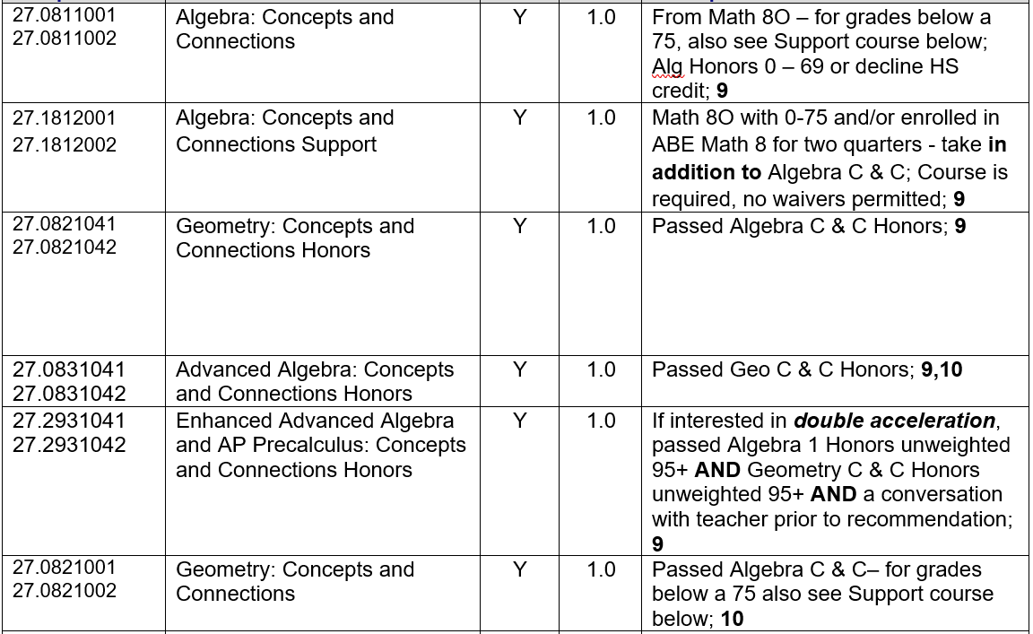
Course Placement
Teachers make recommendations based on prerequisites posted in the Course Catalog.
MATHEMATICS

Slide 11
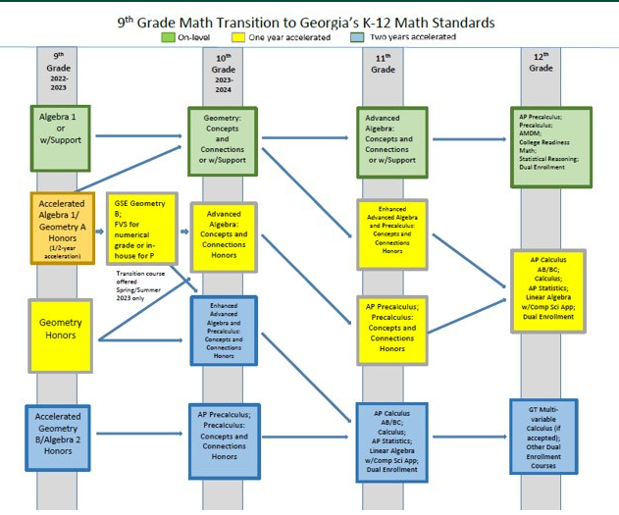
A Word On Math….

Slide 12
Course Placement
Teachers make recommendations based on prerequisites posted in the Course Catalog.
WORLD LANGUAGES
Computer # | World Languages | Term | Credit | Prerequisite and Grade Level
62.0110001 62.0110002 | Chinese I | Y | 1.0 | None; 9-12
62.0120001 62.0120002 | Chinese II | Y | 1.0 | Chinese I; 9-12
62.0120041 62.0120042 | Chinese II Honors | Y | 1.0 | 93+ in Chinese 8; 97+ Chinese I (HS) and teacher recommendation; 9-12
60.0110001 60.0110002 | French I | Y | 1.0 | None; 9-12
60.0120001 62.0120002 | French II | Y | 1.0 | French I; 9-12
60.0120041 60.0120042 | French II Honors | Y | 1.0 | 93+ in French 8; 97+ French I (HS) and teacher recommendation; 9-12
61.0110001 61.0110002 | German I | Y | 1.0 | None; 9-12
61.0120001 61.0120002 | German II | Y | 1.0 | German I; 9-12
61.0410001 61.0410002 | Latin I | Y | 1.0 | None; 9-12
61.0420001 61.0420002 | Latin II | Y | 1.0 | Latin I; 9-12
61.0420041 61.0420042 | Latin II Honors | Y | 1.0 | 90+ Latin I (HS) and teacher recommendation; 9-12
60.0710001 60.0710002 | Spanish I | Y | 1.0 | None; 9-12
60.9710001 60.9710002 | Spanish 1B | Y | 1.0 | Completed Middle School Spanish but not accepting high school credit
60.0720001 60.0720002 | Spanish II | Y | 1.0 | Spanish I; 9-12
60.0720041 60.0720042 | Spanish II Honors | Y | 1.0 | 93+ in Spanish 8 or 97+ Spanish I (HS) and teacher recommendation; 9-12

Slide 13
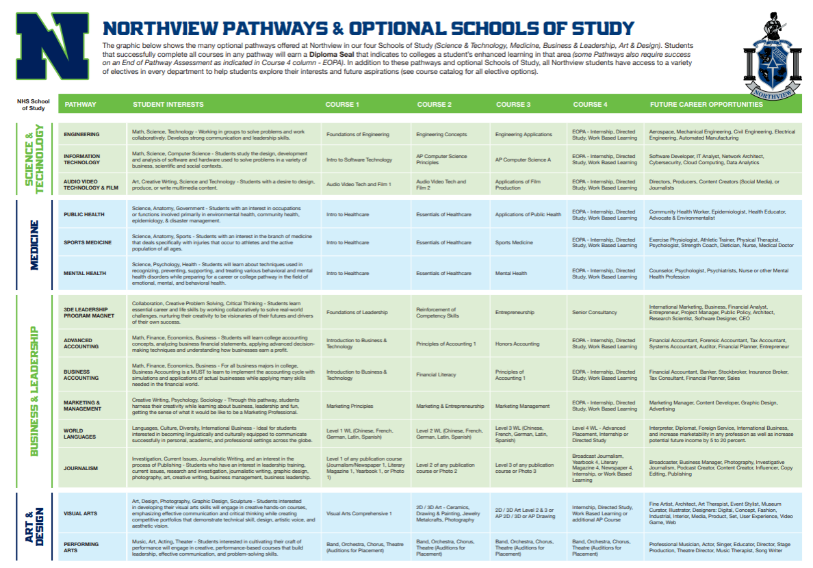
Link to Pathways and Optional Schools of Study

Slide 14
High School Academic Placement
All Academic course placements are subject to change. Students are currently placed based on first semester grades in pre-requisite courses.
If final second semester grades in pre-requisite courses or 8th Milestones scores drop below the Distinguished Learner level to be placed in Honors level courses, students will be removed before the beginning of the 2025/2026 School Year.

Slide 15
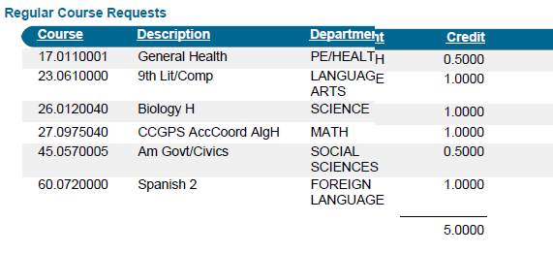
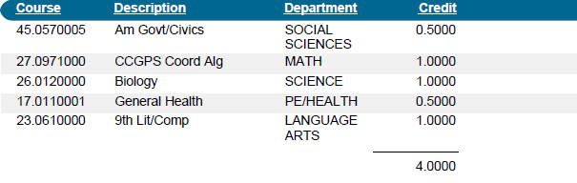
Typical 9th grade course request - two examples
5 units of credit- student is taking World Language *Student will select 1.0 units of electives
4 units of credit- student is not taking World Language *Student will select 2.0 units of electives

Slide 16
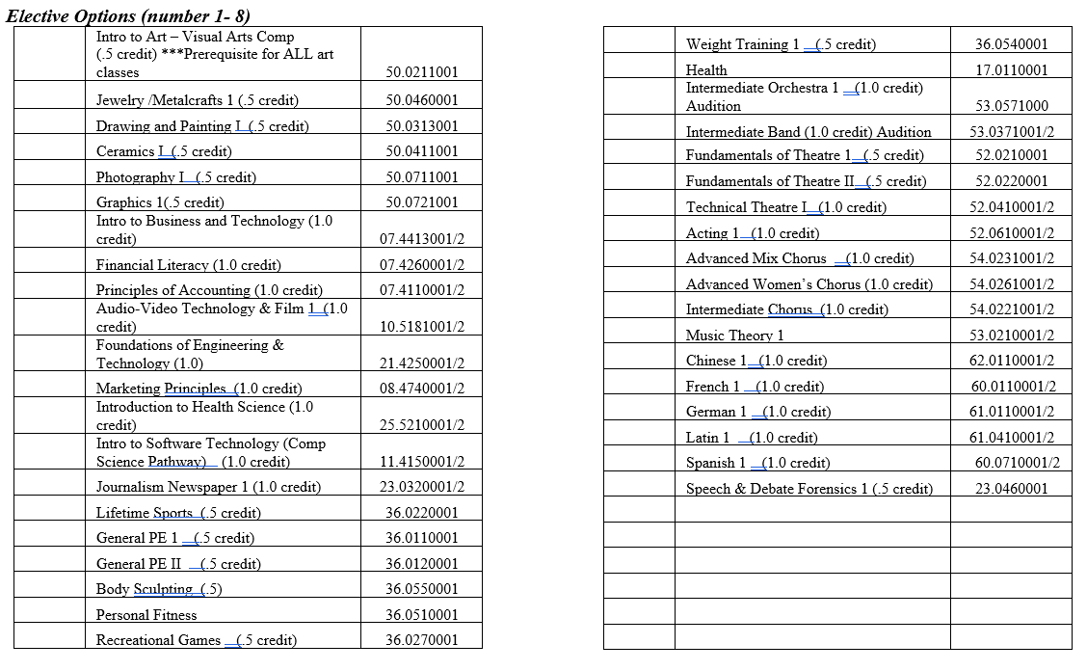
Course Selection
ELECTIVE CHOICES:
List your elective choices in order of priority from 1 – 8. You will find the course descriptions in your Northview Course Catalog. The Course Catalog can be accessed at www.northviewhigh.com. Enrollment in each course is limited, and we will honor as many requests as possible. If you do not list four choices and we cannot honor your other requests, we will select the elective for you. Any course listed on this form may be used to complete the student schedule.
Health and Personal Fitness are graduation requirements*

Slide 17
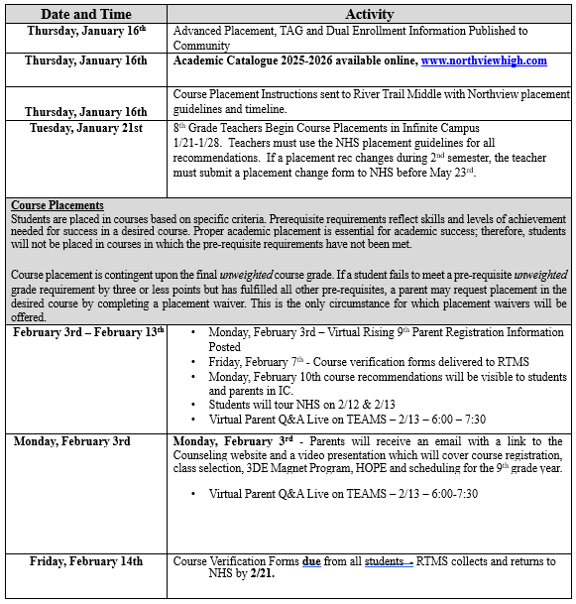
What Happens Next?

Slide 18
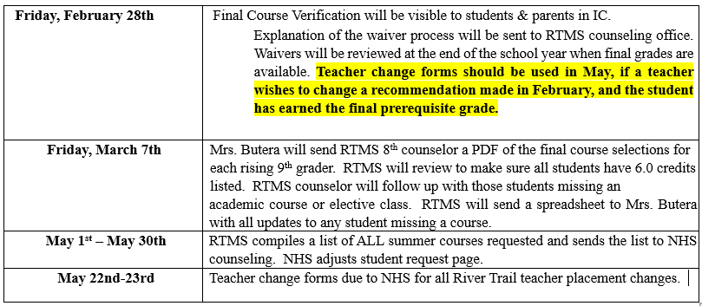
What Happens Next? (cont)

Slide 19
HOPE Scholarship
Partial in-state tuition covered – varies by year
Payment amount for private & public colleges and universities can be located on www.gafutures.org/hope-state-aid-programs/
Requirements:
  Graduate from an eligible high school
  GPA of at least a 3.0 (calculated by GSFC) in core classes and world language
  Academic Rigor: 4 classes that are academically rigorous
https://www.gafutures.org/media/187520/rigor-course-list-september-2017.pdf
For more information, visit www.gafutures.org.

Slide 20
Zell Miller Scholarship
100% of in-state tuition covered
Must meet all the requirements to be eligible for the HOPE Scholarship, plus:
  Graduate from an eligible high school
  GPA of at least a 3.7 (calculated by GSFC)
  SAT: min. 1200 combined critical reading score and math score (single administration)
  ACT: min. composite score of 26
    SAT/ACT scores MUST be submitted to GSFC to be considered
  OR, Valedictorian or Salutatorian
In college must maintain 3.3 GPA
For more information, visit www.gafutures.org

Slide 21
HOPE GPA
A 3.0 GPA is acquired by averaging core coursework, including failing grades, on a 4.0 scale.
Core Courses Conversion
English
Math
Science
Social Science
World Language
Honors points are removed and a 0.50 weighting is added back in for AP and Dual Enrollment courses only, not to exceed 4.0.
Course credit completed in middle school is not calculated in the HOPE GPA.
All calculations are done by the Georgia Student Finance Commission.
A | 90 to 100 | 4.0 Points
B | 80 to 89 | 3.0 Points
C | 70 to 79 | 2.0 Points
F | 0 to 69 | 0 Points
Counselors are not responsible for calculating the HOPE GPA
A 2.99 GPA does NOT qualify you for HOPE

Slide 22
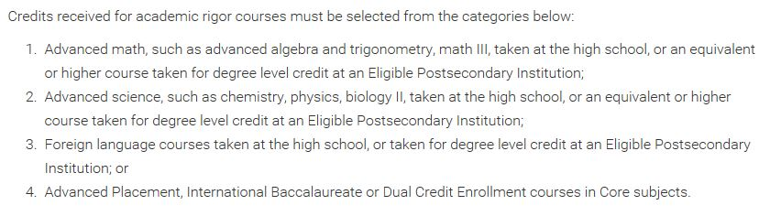
Students graduating in 2017 and beyond must earn a minimum of four (4) credits from the academic rigor course categories outlined on the www.gafutures.org website.
https://www.gafutures.org/hope-state-aid-programs/hope-zell-miller-scholarships/hope-scholarship/eligibility/academic-rigor-requirements/

Slide 23
Counseling Programs 9th Grade
9th grade-
  9th Advisement in Fall
  Individual 4 year planning in Spring
  9th Grade Parent Night in the Fall
  PSAT in the Fall
  AP Night
  College Week

Slide 24
Counseling Programs 10th Grade
10th grade-
  10th Advisement in Fall
  Individual 4 year planning in Spring
  Practice SAT/ACT Test options
  PSAT in the Fall
  10th Grade Parent Night
  AP Night
  College Week

Slide 25
Counseling Programs 11th Grade
11th grade-
  11th Advisement in Fall and Spring
  Junior Status Conferences in Spring
  SAT/ACT Prep courses
  PSAT in the Fall to qualify for National Merit Scholarship
  Junior Parent Night
  AP Night
  College Admission Rep Visits
  College Week

Slide 26
Counseling Programs 12th Grade
12th grade-
  12th Advisement in Fall
  Financial Aid Night
  NHS College Application Day
  Transcript and College Application Process
  College Admission Rep Visits
  College Week
  Letter of recommendation
  College admission guidance

Slide 27

Utilize our website at http://www.northviewcounseling.com.

Slide 28
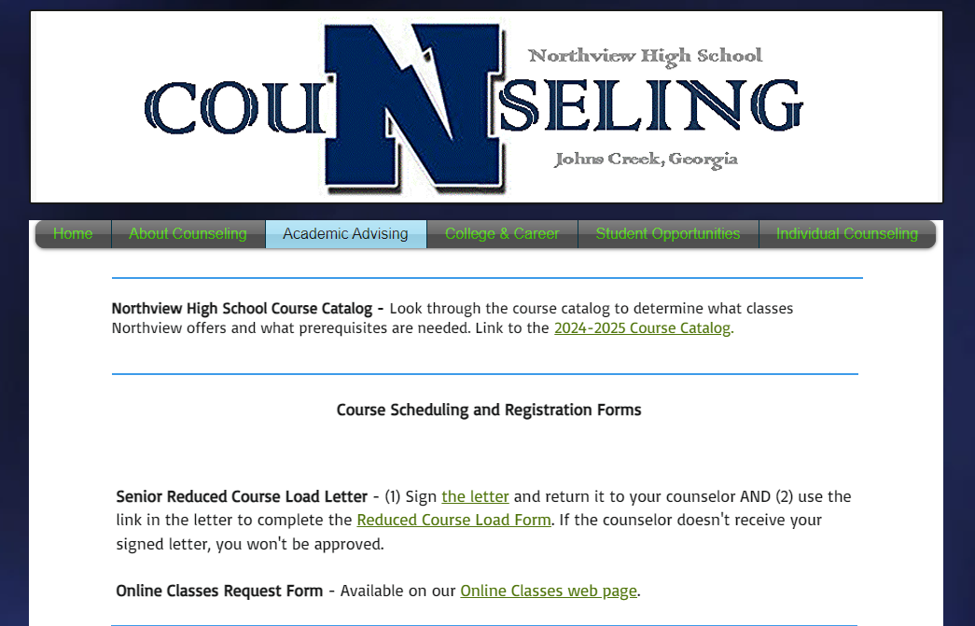
Access the Course Catalog on www.northviewcounseling.com under the Academic Advising tab.

Slide 29

THANK YOU for Attending!!
This power point presentation will be posted on our website at: http://northviewcounseling.com.
We have our virtual Q&A session (a link will be sent through the 8th grade counselor):
  February 13th: 6:00PM-7:30PM
  An FAQ will be posted on February 21st
  We look forward to working with you during the 2025-2026 school year!

