Slide 1


Slide 2
Southam Primary School has voted and chosen - Cancer Research UK for Children & Young People as our Charity of the Year 2024-2025.
This means we will be raising money for this charity throughout this school year.

Slide 3
Who are they?
Cancer Research for Children and Young People is the part of Cancer Research UK dedicated to supporting research into cancers affecting 0-24-year-olds.

Slide 4
What do they do?
They support children and young people who have this serious illness and their families who may be very worried.
They also help the very best scientists across the UK and around the world to discover new ways to find and treat these cancers. And they work with other cancer charities to have the biggest possible impact.

Slide 5
Since the 1970s, our work has helped double children’s cancer survival in the UK. That means more than 32,000 children's and young people's lives have been saved, thanks in part to our work.
People like….

Slide 6
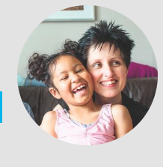
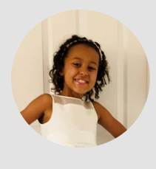
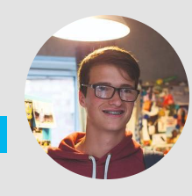
Zofeya diagnosed age 4 – now in remission, which means the cancer has gone away, for 10 years. Her Mum says “it’s amazing she’s still with us and doing so well and she’s a touch little cookie”
Pippa diagnosed age 5 – who finished her special treatment (chemotherapy) in 2019 and is now also doing well. Her Mum says “she was a superstar throughout”
Adam who is now in remission and whose success story like many others wouldn’t be possible without Cancer Research UK and everyone who raises funds for it.

Slide 7
So what happens now?
Southam Primary School is going to be fund raising in Spring and Summer 2025.
You need to tell your School Councillors your ideas for fund raising sales (no cakes please!) for Spring term by
Friday 9th December so they can share them at the next meeting and decide what our first fund raising venture will be.

