Slide 1
Head Lice
Allison Ormond, RN
Pamlico County Primary School

Slide 2
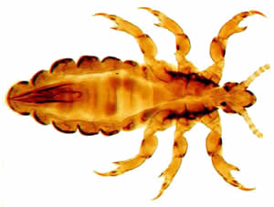
About: Head Lice
An ectoparasite that lives on the human head and neck
Feeds on human blood

Slide 3

About: Head Lice
Most common in preschool and elementary school-age children
  Less common among African Americans
Not associated to the cleanliness of the environment

Slide 4
Life Cycle
Nits (eggs)
  Oval, usually white or yellow
    Difficult to see and often confused with dandruff
  Cemented to the hair shaft, near the scalp
Nymphs
  Looks like an adult louse but they are the size of a pin head
  Becomes an adult in 7 days after hatching
Adults
  The size of a sesame seed; they each have 6 legs
    The female louse are larger than the males and they can lay up to 8 nits a day
  Can live up to 30 days

Slide 5
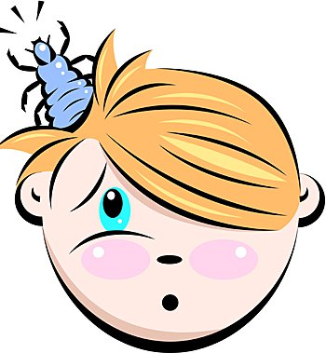
Signs and Symptoms
May be asymptomatic (no symptoms)
Itching
Tickling sensation
Sores from scratching

Slide 6

Potential Complications
Though lice do not carry or transmit any disease, frequent scratching can generate open sores that are prone to bacterial infections

Slide 7
Transmission
Direct contact with the hair of an infected person
Wearing infested clothing or accessories
Using infested brushes, combs, towels, or accessories
Lying on/with infested pillows, bedding, couches, or stuffed animals
They travel by crawling
  They cannot jump or fly
Dogs, cats, and other pets DO NOT play a role in the transmission of head lice

Slide 8
Treatment
There are several approved medications that treat head lice, which include over the counter and prescription medications
  Retreatment may be recommended or required
Wash and dry clothing, bedding, towels, etc. using hot water and a hot air cycle
Items that cannot be laundered, can be stored in plastic bags for 2 weeks
  Louse die within 1-2 days off of their host
Vacuum furniture and flooring

Slide 9
Prevent the Reoccurrence
Perform a head check on every member in the household and/or classroom of the infected person
Avoid head to head contact
Do not share clothing, accessories, brushes, or combs
Do not lie on/with pillows, bedding, couches, carpets, or stuffed animals that have been in recent contact with an infected person
Wash and dry clothing using hot water and a hot air cycle
Vacuum furniture and flooring
Pull your hair back, if you are in contact with an infected individual

Slide 10

References
CDC. (2013, September 24). Parasites - Lice - Head Lice. Retrieved January 25, 2018, from https://www.cdc.gov/parasites/lice/head/

