Slide 1
Diabetes
Allison Ormond, RN
Pamlico County Primary School

Slide 2
About: Diabetes
Chronic (long-term) disease
Affects how your body turns food into energy
  The majority of the food you eat is broken down into sugar (glucose), which is released into your bloodstream
Your pancreas makes a hormone called insulin, which acts as a key to let the blood sugar into your body’s cells for use as energy
If you have diabetes, your body either:
  Does not make enough insulin
  OR
  It cannot use the insulin it makes as well as it should

Slide 3
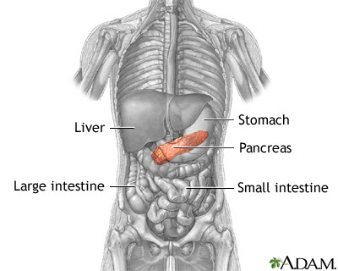
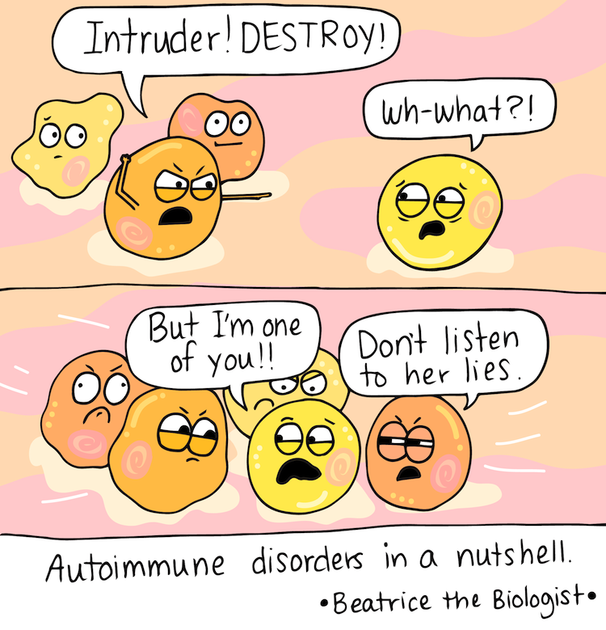
Type 1 Diabetes
Caused by an autoimmune reaction
  The body wrongly attacks insulin-producing cells in the pancreas
  The pancreas then cannot properly make insulin
    The pancreas either cannot produce enough insulin or any

Slide 4
Type 1 Diabetes
Risk Factors:
  Family history
  Age
    More likely to develop in children, teenagers, and young adults
  Race
    Caucasians are more likely to develop type 1 diabetes

Slide 5
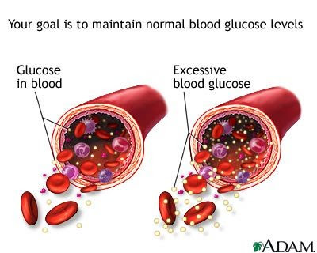
Type 2 Diabetes
The body does not properly use the insulin that it produces
  As a result, the body is unable to keep blood sugar levels within normal range

Slide 6
Type 2 Diabetes
Risk Factors:
  Being overweight
  Age
    Typically occurs in individuals who are older than 45 years old
  Being physically active less than 3 times a week
  Family history
  Race
    African Americans, Hispanic/Latino Americans, American Indians, or Alaska Natives are more likely to develop type 2 diabetes

Slide 7
Signs and Symptoms
Frequent urination
Excessive thirst
Extreme hunger
Blurry vision
Weight loss
Increase in infection
Lengthened time to heal wounds/sores
Neuropathy
  Numbness and tingling in the hands and/or feet

Slide 8
Hypoglycemia
When your blood sugar is TOO LOW
  Needs to be treated immediately
Signs and symptoms can include:
  Shakiness
  Anxiety
  Sweating/Clamminess
  Chills
  Irritability
  Dizziness
  Fatigue
  Blurred vision
  Nausea
  Hunger

Slide 9
Hyperglycemia
When your blood sugar is TOO HIGH
  Needs to be treated immediately
Signs and symptoms can include:
  Headache
  Difficulty concentrating
  Stomach pain
  Nausea
  Frequent urination
  Increased thirst
  Dry skin

Slide 10
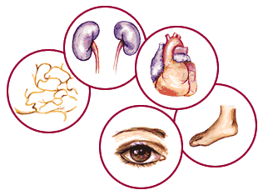
Complications
Many serious complications can arise as a result of diabetes, such as:
  Heart disease
  Kidney failure
  Limb amputation
  Stroke
  Vision loss

Slide 11
Diagnosis
A1C Test
  Measures your average blood sugar level over the past 2-3 months
Fasting blood sugar test
  Measures your blood sugar, after an overnight fast
Glucose tolerance test
  Measures your blood sugar before and after (at different time intervals) you drink a solution that contains glucose
Random blood sugar test
  Measures your blood sugar at the time you are tested

Slide 12
Management
As of yet, there is no cure for diabetes
Though this is so diabetes can be managed, by:
  Checking your blood sugar regularly
  Taking prescribed medication
    Oral medication(s)
    Insulin/insulin pump
  Eating healthy
  Participating in regular exercise
  Participating in regular check-ups
  Staying educated

Slide 13
Support
Diabetics typically need a large interdisciplinary healthcare team, in addition to their primary care physician, some of which include:
  Podiatrist
  Optometrist
  Diabetic educator
  Nutritionist/dietician
  Pharmacist
You will also need a large support system
  Family
  Friends
  Teachers/School faculty

Slide 14

References
CDC. (2017, July 20). Diabetes Home. Retrieved January 24, 2018, from https://www.cdc.gov/diabetes/basics/index.html

