Slide 1
Asthma
Allison Ormond, RN
Pamlico County Primary School

Slide 2
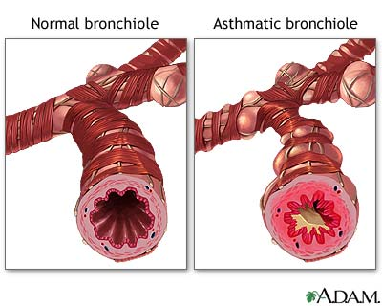
Asthma:
Is a chronic (long-term) lung disease
Makes it difficult to breathe by:
  Inflaming/narrowing the body’s airways
  Increasing mucous production

Slide 3
The Cause
The cause of asthma, is unknown
It is believed that there is a genetic and an environmental component of asthma
Risk factors, include:
  A family history of asthma
  Certain respiratory illnesses during childhood
  Exposure to irritants (i.e. cigarette smoke)

Slide 4
Signs and Symptoms
Wheezing
Cough
Shortness of breath
Chest tightness
These signs and symptoms can be very severe and they are potentially fatal

Slide 5



Triggers
Asthma can be triggered by:
  Allergens
  Irritants
  Medications
  Illness
  Weather
  Physical activity

Slide 6
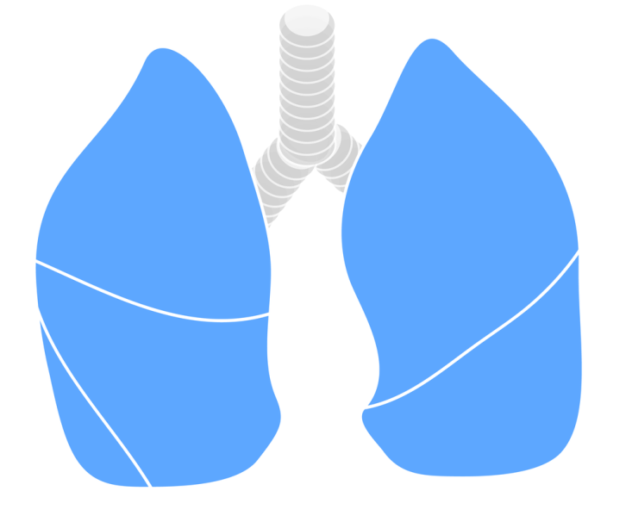
Diagnosis
Lung function test
  The best way to diagnose asthma (for certain)
  Spirometry
    Measures how much you inhale and exhale
    Can measure your breath speed
Physical exam
Medical history
  Analyzing the type and frequency
  of symptoms

Slide 7

Treatment
As of yet, there is no cure
Prevent asthma attacks
Follow your asthma action plan
Used prescribed medications, as directed
  Quick relief medications
  Long-term control medications
Identify and avoid any “triggers”
Track your asthma
  Peak flow meter
Participate in regular check-ups

Slide 8
Emergency Care
If the prescribed treatment and medications are not effective in relieving an asthma attack…
CALL YOUR DOCTOR
If you notice any:
  Discoloration in your skin and/or nail beds
  Difficulty talking
  Difficulty standing and/or walking
  Feelings of impending doom
  CALL 911

Slide 9

References
U.S. Department of Health & Human Services. (n.d.). Asthma. Retrieved January 23, 2018, from https://www.nhlbi.nih.gov/health-topics/asthma

