Slide 1
Strep Throat
Allison Ormond, RN
Pamlico County Primary School

Slide 2
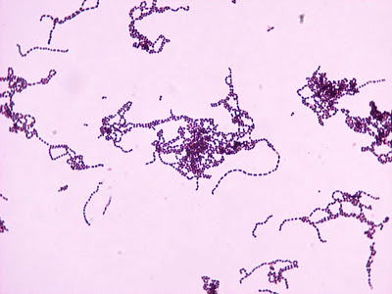
About
Caused by a bacteria
  A Streptococcus, also known as group A strep

Slide 3
Symptoms
Sore throat
Pain with swallowing
Fever ≥101°F
Red and/or swollen tonsils
Tiny red marks on the roof of the mouth
Swollen lymph nodes
Individuals may exhibit any or all of these symptoms

Slide 4
Transmission
Spread through contact with droplets
  Wash your hands frequently, with soap and water
  If you cough or sneeze, do it in your sleeve
  Do not share food or drinks
Diagnosis
Quick strep test
  A doctor swabs your throat to see if group A strep bacteria are present
Strep throat cannot be diagnosed by sight

Slide 5
Treatment
Antibiotic therapy
Individuals diagnosed with strep throat should stay home until:
  They no longer have a fever
  They have taken prescribed antibiotics for at least 24 hours
Often times, individuals feel better before completing their full course of antibiotics. Despite this, it is vital to complete the full course of prescribed antibiotics.

Slide 6


References
CDC. (2018, January 11). Strep Throat . Retrieved January 19, 2018, from https://www.cdc.gov/dotw/strepthroat/in dex.html

