Slide 1
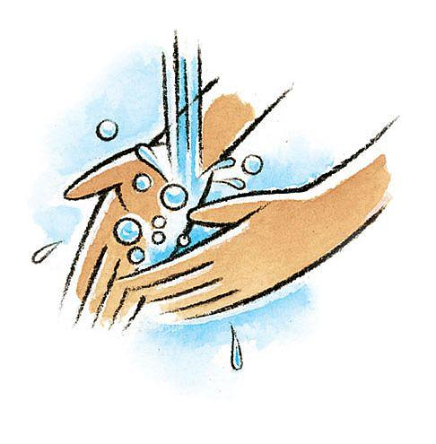
Hand Hygiene
A guide to keep your hands clean and healthy
Allison Ormond, RN
Pamlico County Primary School

Slide 2
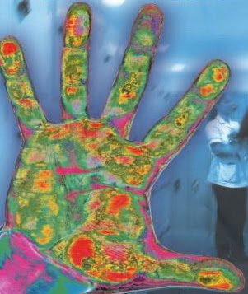
Why is hand washing so important?
It stops bad germs from spreading !

Slide 3

Who should wash their hands?
EVERYONE!

Slide 4
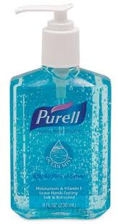

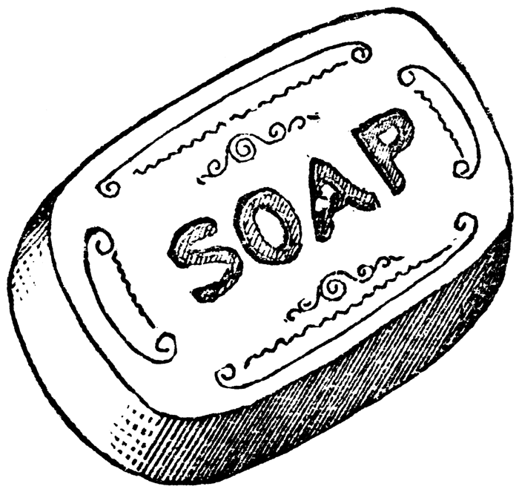
What do you need to wash your hands?
Warm water
Soap
OR an alcohol-based hand sanitizer
It is that simple!

Slide 5
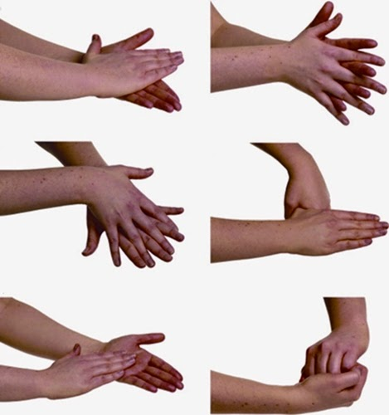
How do you wash your hands?
Wet your hands with warm water
Apply soap to your hands
Rub your hands all around
Rinse off your hands
Pat your hands dry
Turn off the water using your clean towel
Make sure to get EVERYWHERE like your hands, wrists, between your fingers, and your nails.

Slide 6


How long should you wash your hands for?
At least 15 -20 seconds
You can make things FUN by…
Singing a song like “Happy birthday” twice

Slide 7
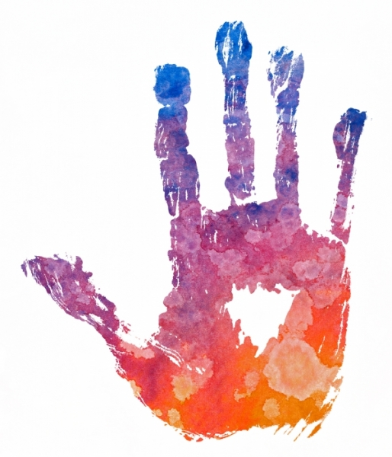
What are the Most Missed Areas?
Fingertips
Nails
Between the fingers
Thumbs
Palms
Wrists
Make sure that you wash EVERYWHERE!

Slide 8

FUN facts
Hand washing is the number one way to prevent the transmission of disease
Most sicknesses and disease is spread through touch
Water alone cannot remove germs
You must rub your hands together with soap AND water
Coughing or sneezing in your hand can spread sickness around
So…. “if you cough or sneeze, do it in your sleeve”

Slide 9
Test your Skills!
Who should wash their hands?
    Everyone!
What do you need to wash your hands?
    Soap and water
    OR an alcohol-based hand sanitizer
How long should you wash your hands for?
    At least 15 seconds
What song can you sing while washing your hands to make it more fun? How many times should you sing it?
    Happy Birthday, twice
WAY TO GO!!!!

Slide 10


References:
CDC. (2016, April 28). Hand Hygiene in Healthcare Settings. Retrieved January 10, 2018, from https://www.cdc.gov/handhygiene/science/index.html
Thank you for watching!
Please share this information with a friend!

